Slide 1
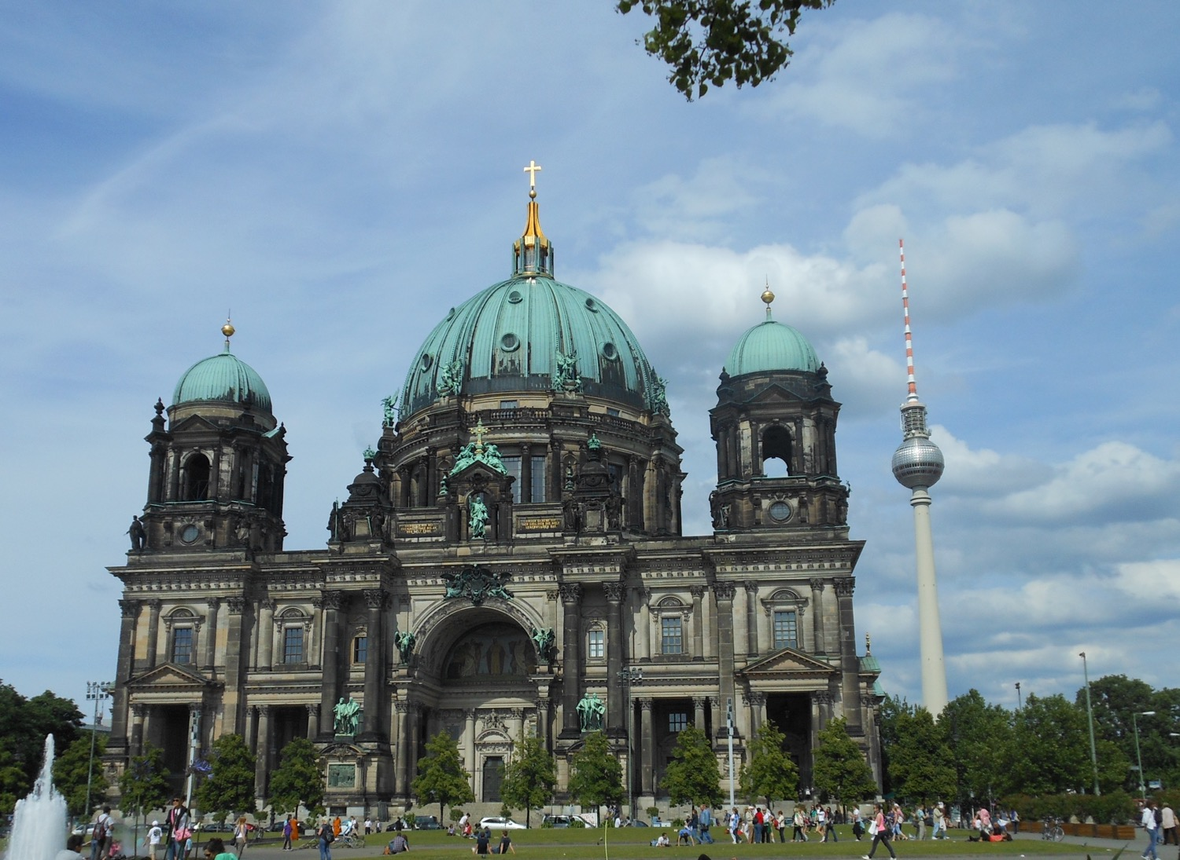

Chapter 6: Federal Republic of Germany
STUDY PRESENTATION
© 2025 Clairmont Press

Slide 2
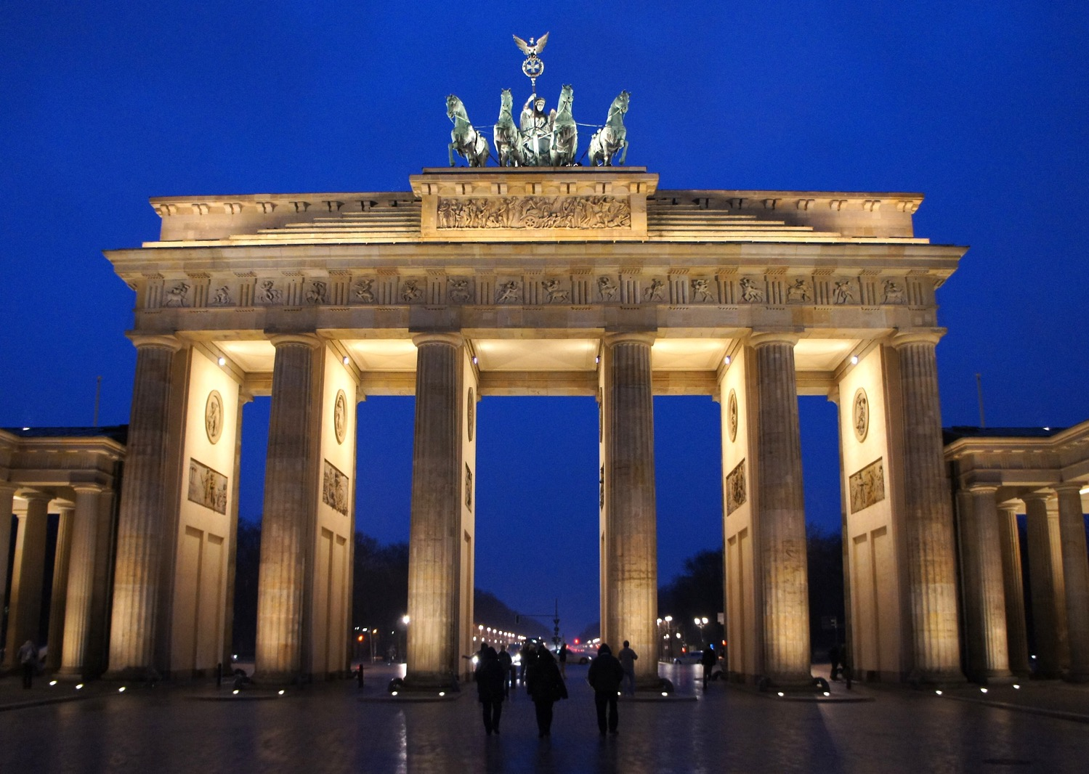
Section 4: Economy of Germany

Slide 3
SECTION 4: ECONOMY OF GERMANY
  Essential Question:
    What evidence is there of strong trading partnerships between Germany and other countries?

Slide 4
SECTION 4: ECONOMY OF GERMANY
  What terms do I need to know?:
  deficit
  surplus
  euro

Slide 5
ECONOMIC SYSTEM TODAY
Germany has a strong market economy that has remained strong even when other countries have experienced recessions.
    Germany is ranked in the top 20 freest economies in the world.
Germany’s economy is 3rd-largest in the world in terms of GDP and is the largest economy in Europe.
Stimulus efforts in 2008 and 2009 increased Germany’s total budget deficit (shortfall), but slower spending and high tax revenues let Germany reach a budget surplus (extra) in 2012.
    Recent years have varied between surplus and deficit.

Slide 6
TRADE
Germany is a global power in the manufacturing of steel, iron, coal, machinery, tools, electronics, and automobiles.
    German exports add up to more than $2 trillion annually.
Because Germany produces so many manufactured goods, they must import oil, gas, small machinery, food, and agricultural items that the people of Germany need.
    Germany’s imports from the Netherlands, China, Poland, Belgium, and Italy alone add up to more than $1.9 trillion.

Slide 7
STANDARD OF LIVING
Germany has a high standard of living, and most adults in Germany work outside of the home.
More than 95% of Germans work in manufacturing and service industries.
    These jobs require secondary education or continuing education after high school to stay informed of new technologies.
Germans tend to save more and borrow less than Americans.
    An average German saves about 10% of income and has little or no debt.

Slide 8
CURRENCY
Since the end of World War I, Germany has experienced many changes and difficulties in its economy and currency.
By the time of the reunification of Germany, the German mark was a very strong, stable, and safe currency.
Germany continued to use the mark until the introduction of the euro in 1999, the currency of the European Union.
    Currently, 19 countries use the euro as their currency.

Slide 9
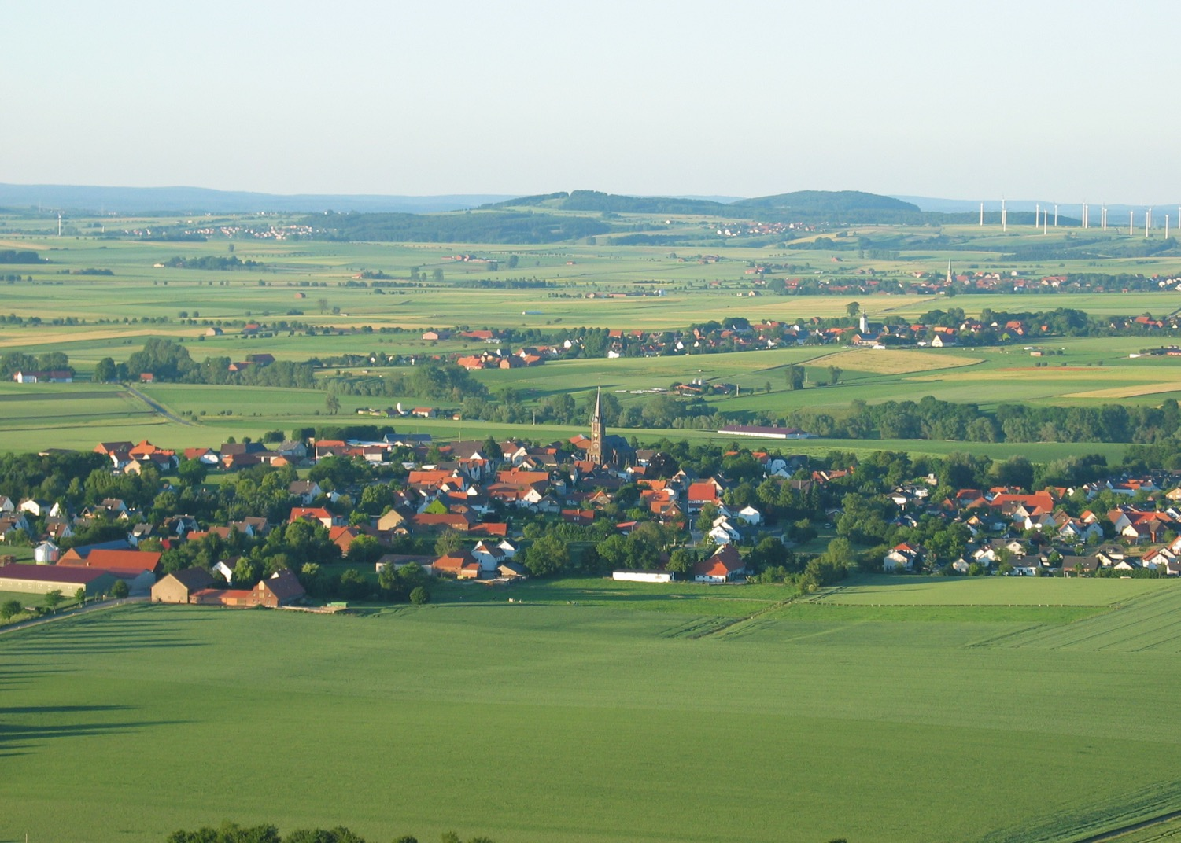
Image Credits: all Wikimedia Commons. Maps ©2025 Clairmont Press.
Return to Main Menu

