Slide 1


Chapter 6: Federal Republic of Germany
STUDY PRESENTATION
© 2025 Clairmont Press

Slide 2

Section 5: US-German Relations

Slide 3
SECTION 5: US-GERMAN RELATIONS
  Essential Question:
    What evidence exists that the United States and Germany have developed strong trade relations?

Slide 4
SECTION 5: US-GERMAN RELATIONS
  What terms do I need to know?:
  Transatlantic Economic Council (TEC)

Slide 5
WORKING TOGETHER FOR SECURITY
Since the end of WWII, Germany has helped the US in their common goal of preserving peace in Europe.
    US policy toward Germany is to maintain a close relationship as friends, trading partners, and allies.
    As NATO allies, the US and Germany work together to maintain peace and freedom.
Germany was a major part of the UN forces in Afghanistan in the 2000s and has remained a strong ally in fighting global terrorism since the September 11, 2001 attacks.

Slide 6
BILATERAL ECONOMIC RELATIONS
The US and Germany share a commitment to an open and expanding world economy.
In 2007, Germany pushed for the creation of the Transatlantic Economic Council (TEC), increasing cooperation between the US and the European Union to promote economic growth.
The United States is one of Germany’s leading export markets.
    The combined goods traded between the two countries show Germany as the United States’ 5th-largest trading partner.

Slide 7
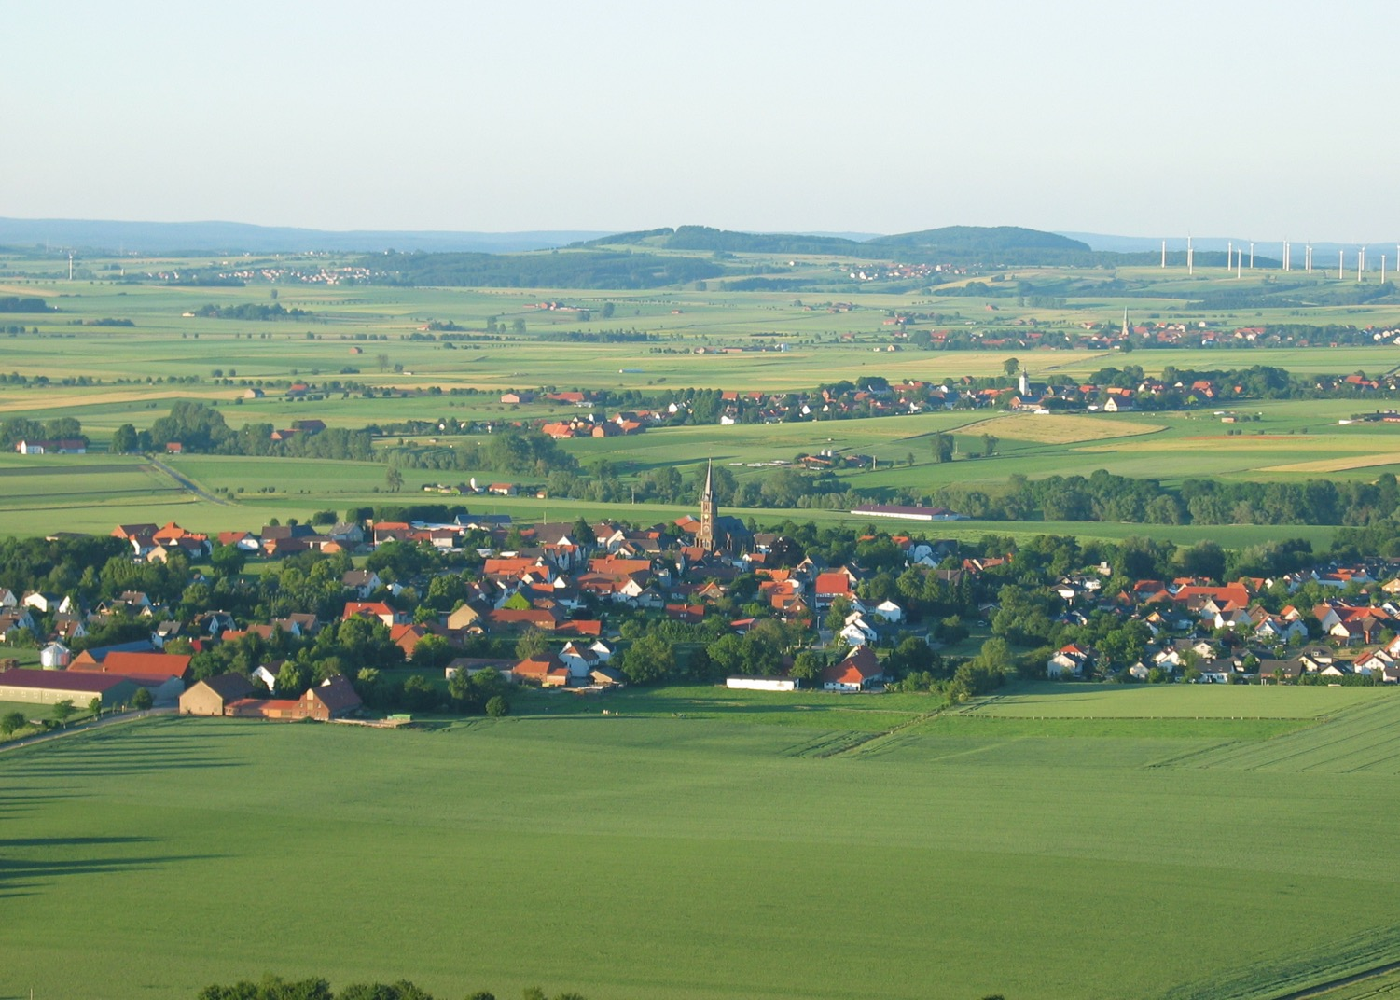
Image Credits: all Wikimedia Commons. Maps ©2025 Clairmont Press.
Return to Main Menu

