Slide 1
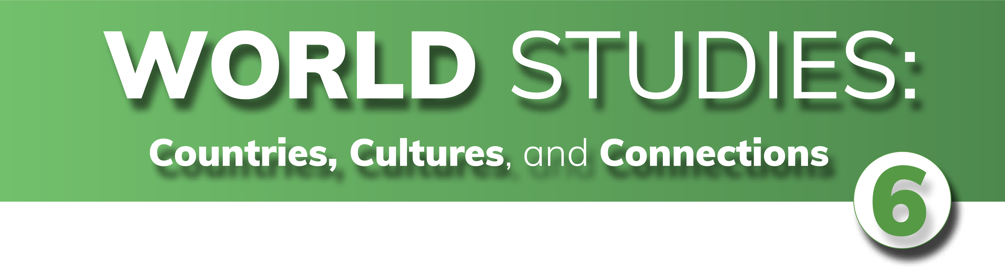

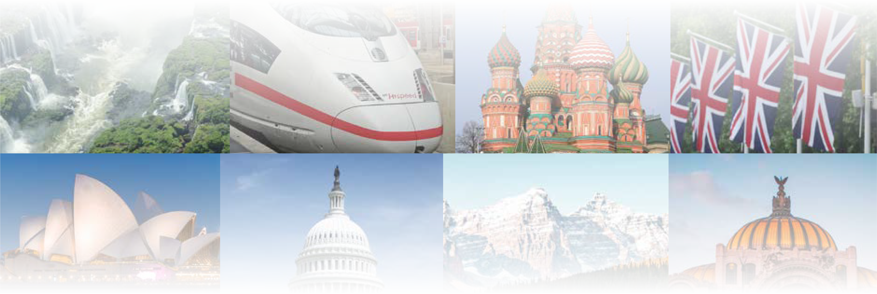
CHAPTER 2
Government and Civics
CHAPTER 2
Government and Civics
To play the game, go to the next slide and click on a point value to go to a question.
Click the Final Wrap-Up button on slide 3 to go to the final question.

Slide 2
Terms
Power Distribution
Citizen Participation
Democracies
Wild Card
100
100
100
100
100
200
200
200
200
200
300
300
300
300
300
400
400
400
400
400
500
500
500
500
500

Slide 3
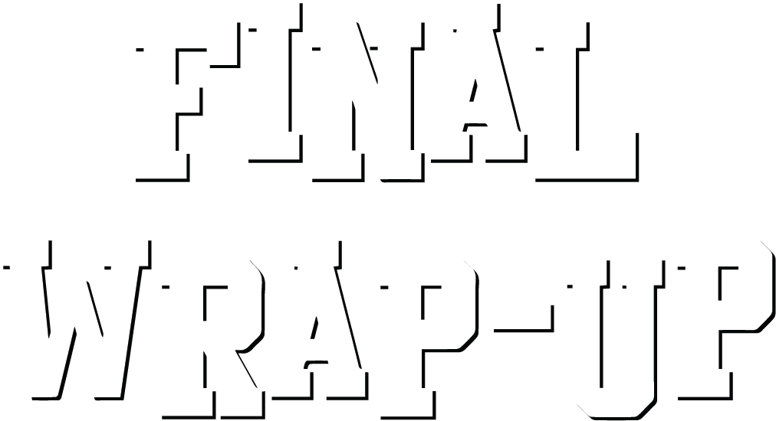
If you have completed all the other questions on the board, then click the button below!

Slide 4
Terms - 100
What term refers to the system by which a country is organized?

Slide 5
Terms - 100
Answer:
government
Board

Slide 6
Terms - 200
What term refers to the right of a group of people to be free of outside interference?

Slide 7
Terms - 200
Answer:
sovereignty
Board

Slide 8
Terms - 300
Which branch of government creates the laws of a country?

Slide 9
Terms - 300
Answer:
legislative branch
Board

Slide 10
Terms - 400
Which branch of government enforces the laws passed by the legislative branch?

Slide 11
Terms - 400
Answer:
executive branch
Board

Slide 12
Terms - 500
Which branch of government oversees a country's courts and settles disputes among citizens and between citizens and the government?

Slide 13
Terms - 500
Answer:
judicial branch
Board

Slide 14
Power Distribution - 100
In which form of government does the central government hold almost all the power?

Slide 15
Power Distribution - 100
Answer:
unitary government
Board

Slide 16
Power Distribution - 200
Which type of government has the weakest national government?

Slide 17
Power Distribution - 200
Answer:
confederation government
Board

Slide 18
Power Distribution - 300
Which form of government shares power among different levels of government?

Slide 19
Power Distribution - 300
Answer:
federal government
Board

Slide 20
Power Distribution - 400
Name a country other than the U.S. which has a federal government, as listed in the text.

Slide 21
Power Distribution - 400
Answer:
Australia or Canada
Board

Slide 22
Power Distribution - 500
Name one group listed in the text that is considered a confederation government.

Slide 23
Power Distribution - 500
Answer:
United Nations and/or OPEC
Board

Slide 24
Citizen Participation - 100
In what form of government does a ruler have absolute control, or total power?

Slide 25
Citizen Participation - 100
Answer:
autocracy
Board

Slide 26
Citizen Participation - 200
In which form of government does a person rule with total authority, often in a harsh way?

Slide 27
Citizen Participation - 200
Answer:
dictatorship
Board

Slide 28
Citizen Participation - 300
In what form of government does a sovereign have all the power?

Slide 29
Citizen Participation - 300
Answer:
absolute monarchy
Board

Slide 30
Citizen Participation - 400
What title is given to the person in charge of the day-to-day running of the country?

Slide 31
Citizen Participation - 400
Answer:
head of government
Board

Slide 32
Citizen Participation - 500
In which form of government does a political party or other small group make all the major decisions?

Slide 33
Citizen Participation - 500
Answer:
oligarchy
Board

Slide 34
Democracies - 100
In what form of government do citizens
have the power to choose their leaders?

Slide 35
Democracies - 100
Answer:
democracy
Board

Slide 36
Democracies - 200
In which form of government do citizens vote for a representative from a political party and they in turn select the head of state?

Slide 37
Democracies - 200
Answer:
parliamentary democracy
Board

Slide 38
Democracies - 300
What is the title of the chief public representative of a country, who may or may not serve as head of government?

Slide 39
Democracies - 300
Answer:
head of state
Board

Slide 40
Democracies - 400
Which form of government has a sovereign as its head of state, but with limited power?

Slide 41
Democracies - 400
Answer:
constitutional monarchy
Board

Slide 42
Democracies - 500
In which form of government do citizens elect the president as head of government separately from the legislature?

Slide 43
Democracies - 500
Answer:
presidential democracy
Board

Slide 44
Wild Card - 100
Name one example of an oligarchy as listed in the text.

Slide 45
Wild Card - 100
Answer:
Iran and/or China
Board

Slide 46
Wild Card - 200
North Korea is an example of a _____, because one person rules the country and is supported by the military.

Slide 47
Wild Card - 200
Answer:
dictatorship
Board

Slide 48
Wild Card - 300
In which type of government have the most power?

Slide 49
Wild Card - 300
Answer:
(direct) democracy
Board

Slide 50
Wild Card - 400
What kind of government does the United States have?

Slide 51
Wild Card - 400
Answer:
republic
Board

Slide 52
Wild Card - 500
Which government official is selected by members of parliament?

Slide 53
Wild Card - 500
Answer:
prime minister or premier
Board

Slide 54

Make your wager on the scoresheet and prepare for
the final question!
Final Question

Slide 55
Final Wrap-Up
According to the distribution of power in the U.S. government, laws relating to divorce or family matters, wills, and injuries from car wrecks are examples of laws of the _____ government.

Slide 56
Final Wrap-Up
Answer:
state
Board

