Slide 1


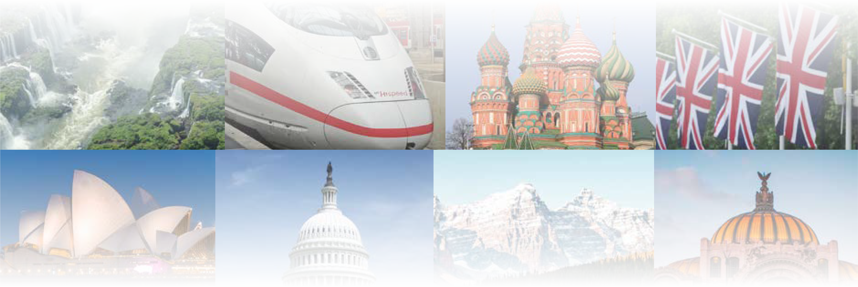
CHAPTER 6
Federal Republic of Germany
CHAPTER 6
Federal Republic of Germany
To play the game, go to the next slide and click on a point value to go to a question.
Click the Final Wrap-Up button on slide 3 to go to the final question.

Slide 2
People and
Titles
Places
Terms
History
Wild Card
100
100
100
100
100
200
200
200
200
200
300
300
300
300
300
400
400
400
400
400
500
500
500
500
500

Slide 3

If you have completed all the other questions on the board, then
click the button below!

Slide 4
People and Titles - 100
Who is Germany's first
female chancellor?

Slide 5
People and Titles - 100
Answer:
Angela Merkel
Board

Slide 6
People and Titles - 200
Under which emperor
was Germany unified from many smaller states into one kingdom?

Slide 7
People and Titles - 200
Answer:
Emperor (Kaiser)
Wilhelm I
Board

Slide 8
People and Titles - 300
Who became the leader of Germany in 1933 who encouraged prejudice and orchestrated the Holocaust?

Slide 9
People and Titles - 300
Answer:
Adolph Hitler
Board

Slide 10
People and Titles - 400
Who is the head of state
in Germany?

Slide 11
People and Titles - 400
Answer:
president
Board

Slide 12
People and Titles - 500
What is the title of the Head
of Government in Germany who takes care of the day-to-day business of the nation as well as the military?

Slide 13
People and Titles - 500
Answer:
chancellor
Board

Slide 14
Places - 100
Which mountain range is located on the southern border of Germany with Austria?

Slide 15
Places - 100
Answer:
Bavarian Alps
Board

Slide 16
Places - 200
Which German river is
most important for the transportation of both goods and people?

Slide 17
Places - 200
Answer:
Rhine River
Board

Slide 18
Places - 300
The area along the Rhine River near ____ and Frankfurt are the most densely populated.

Slide 19
Places - 300
Answer:
Cologne
Board

Slide 20
Places - 400
What is the capital of Germany?

Slide 21
Places - 400
Answer:
Berlin
Board

Slide 22
Places - 500
What is Europe’s second-longest river located in Germany?

Slide 23
Places - 500
Answer:
Danube River
Board

Slide 24
Terms - 100
What is the name for monies paid by the losing country to the winners to make up for damages
done in war?

Slide 25
Terms - 100
Answer:
reparations
Board

Slide 26
Terms - 200
What is the currency of the European Union?

Slide 27
Terms - 200
Answer:
euro (€)
Board

Slide 28
Terms - 300
What is the name for a shortfall (often in a budget)?

Slide 29
Terms - 300
Answer:
deficit
Board

Slide 30
Terms - 400
What is the name of a country where the government guarantees people certain benefits when they are unemployed, poor, disabled, elderly, or sick?

Slide 31
Terms - 400
Answer:
welfare state
Board

Slide 32
Terms - 500
What political body seeks to increase cooperation between the United States and the European Union by promoting economic growth through trade and job creation?

Slide 33
Terms - 500
Answer:
Transatlantic Economic Council
Board

Slide 34
History - 100
What was the name of the political party led by Adolph Hitler, which came to power in Germany in the 1930s?

Slide 35
History - 100
Answer:
National Socialist Party or Nazi Party
Board

Slide 36
History - 200
What was the systematic, state-sponsored persecution and murder of Jews and other groups the Nazis considered inferior in countries Germany controlled?

Slide 37
History - 200
Answer:
Holocaust
Board

Slide 38
History - 300
What was the name for the period after World War II when countries threatened to attack each other with nuclear weapons?

Slide 39
History - 300
Answer:
Cold War
Board

Slide 40
History - 400
What was the name of the wall built by East Germany to separate the communist part of the capital city from the free sections?

Slide 41
History - 400
Answer:
Berlin Wall
Board

Slide 42
History - 500
What alliance of Eastern European countries was formed in 1949 to counteract the North Atlantic Treaty Organization (NATO)?

Slide 43
History - 500
Answer:
Warsaw Pact
Board

Slide 44
Wild Card - 100
What is the name of a German freeway?

Slide 45
Wild Card - 100
Answer:
autobahn
Board

Slide 46
Wild Card - 200
What type of precipitation has increased acidity caused by air pollution and other environmental factors?

Slide 47
Wild Card - 200
Answer:
acid rain
Board

Slide 48
Wild Card - 300
What is the name of a
group of people who have agreed to work together
for a common goal?

Slide 49
Wild Card - 300
Answer:
alliances
Board

Slide 50
Wild Card - 400
What is the name of the
states of Germany?

Slide 51
Wild Card - 400
Answer:
Länder
Board

Slide 52
Wild Card - 500
What is the name of
the lower house of the German Parliament whose members are elected by citizens of the states?

Slide 53
Wild Card - 500
Answer:
Bundestag
Board

Slide 54

Make your wager on the scoresheet and prepare for
the final question!
Final Question

Slide 55
Final Wrap-Up
What is the name for
the upper house of the German Parliament whose members are appointed by individual states?

Slide 56
Final Wrap-Up
Answer:
Bundesrat
Board

