Slide 1
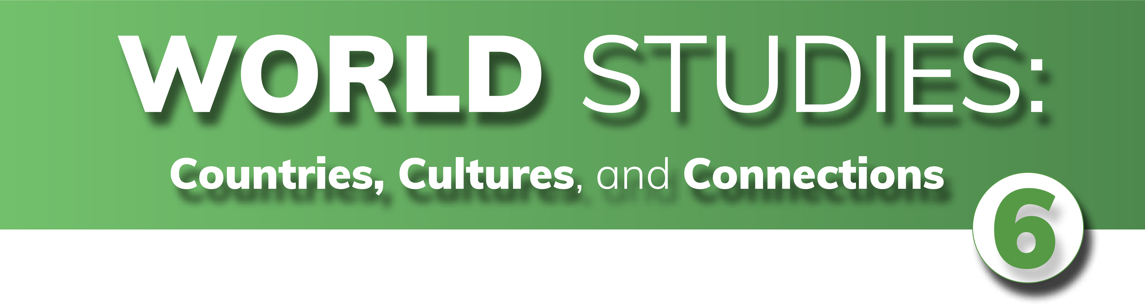

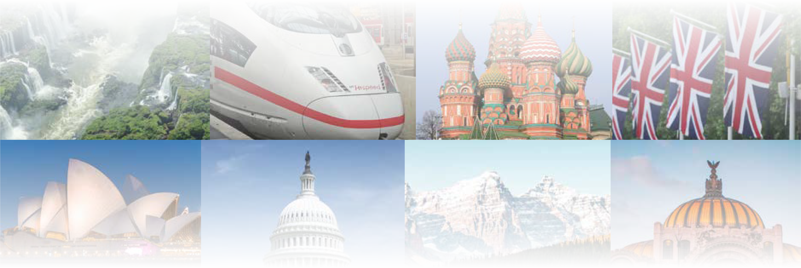
CHAPTER 12
The Geography and History of Latin America
CHAPTER 12
The Geography and History of Latin America
To play the game, go to the next slide and click on a point value to go to a question.
Click the Final Wrap-Up button on slide 3 to go to the final question.

Slide 2
Places
Terms
Government
Economics
Wild Card
100
100
100
100
100
200
200
200
200
200
300
300
300
300
300
400
400
400
400
400
500
500
500
500
500

Slide 3

If you have completed all the other questions on the board, then
click the button below!

Slide 4
Places - 100
What region is located on
two continents from Mexico
to the southern tip of Chile
as well as Cuba and several island nations?

Slide 5
Places - 100
Answer:
Latin America
Board

Slide 6
Places - 200
What region is located at
the tip of the North American continent?

Slide 7
Places - 200
Answer:
Central America
Board

Slide 8
Places - 300
What large mountain range
is located along the western coast of South America?

Slide 9
Places - 300
Answer:
Andes Mountains
Board

Slide 10
Places - 400
What desert is located along the western side of South America and is the second-driest place on Earth?

Slide 11
Places - 400
Answer:
Atacama Desert
Board

Slide 12
Places - 500
What is the world's second-longest river located in South America?

Slide 13
Places - 500
Answer:
Amazon River
Board

Slide 14
Terms - 100
What term refers to a narrow strip of land that connects two land masses?

Slide 15
Terms - 100
Answer:
isthmus
Board

Slide 16
Terms - 200
What title is given to
the Bishop of Rome, who
is the head of the Roman Catholic Church?

Slide 17
Terms - 200
Answer:
pope
Board

Slide 18
Terms - 300
What civilization developed
in Central America on the Yucatán Peninsula reached its peak around 2,000 years ago?

Slide 19
Terms - 300
Answer:
Maya
Board

Slide 20
Terms - 400
What empire was centered
in what is now Mexico,
whose capital city was built
on islands in a lake where Mexico City is today?

Slide 21
Terms - 400
Answer:
Aztec
Board

Slide 22
Terms - 500
What empire developed in the Andes Mountains of South America?

Slide 23
Terms - 500
Answer:
Inca
Board

Slide 24
Government - 100
What is the name for the exchange of goods, people, ideas, plants, animals, and diseases between Europe and the Americas?

Slide 25
Government - 100
Answer:
Columbian Exchange
Board

Slide 26
Government - 200
What is the name of
Spanish soldiers who conquered native people
in the "New World?"

Slide 27
Government - 200
Answer:
conquistadors
Board

Slide 28
Government - 300
What policy, declared by a U.S. President, states that rivalries and wars of countries in the Old World should not affect the freedom and independence of countries in the New World?

Slide 29
Government - 300
Answer:
Monroe Doctrine
Board

Slide 30
Government - 400
What term refers to a person who rules with
total authority, often in
a harsh way?

Slide 31
Government - 400
Answer:
dictator
Board

Slide 32
Government - 500
What term refers to a criminal drug-trafficking organization?

Slide 33
Government - 500
Answer:
drug cartel
Board

Slide 34
Economics - 100
What organization developed
a system to assist struggling countries to move out of
severe poverty?

Slide 35
Economics - 100
Answer:
Pathways to Prosperity in the Americas
Board

Slide 36
Economics - 200
What term refers to the movement from one
locality to another?

Slide 37
Economics - 200
Answer:
migration
Board

Slide 38
Economics - 300
In 2013, Jorge Mario
Bergoglio of Argentina
became the first Latin American to be given
what title?

Slide 39
Economics - 300
Answer:
Pope (Francis)
Board

Slide 40
Economics - 400
Which person does the old rhyme "in fourteen hundred and ninety-two, _____ sailed the ocean blue" refer to?

Slide 41
Economics - 400
Answer:
Christopher Columbus
Board

Slide 42
Economics - 500
Which dictator ruled Chile for nearly 20 years?

Slide 43
Economics - 500
Answer:
Augusto Pinochet
Board

Slide 44
Wild Card - 100
What canal serves as a shortcut for ships traveling between the Atlantic and Pacific Oceans?

Slide 45
Wild Card - 100
Answer:
Panama Canal
Board

Slide 46
Wild Card - 200
Which dictatorial family ruled Nicaragua for over
40 years?

Slide 47
Wild Card - 200
Answer:
Somoza Family
Board

Slide 48
Wild Card - 300
Which of Mexico's most powerful drug traffickers was arrested and sent for trial in the U.S. in 2017?

Slide 49
Wild Card - 300
Answer:
Joaquin "El Chapo”
Guzmán
Board

Slide 50
Wild Card - 400
What sea separates South America from Central America?

Slide 51
Wild Card - 400
Answer:
Caribbean Sea
Board

Slide 52
Wild Card - 500
What is the most
prominent religious sect
in Latin America?

Slide 53
Wild Card - 500
Answer:
Roman Catholic
Christianity
Board

Slide 54

Make your wager on the scoresheet and prepare for
the final question!
Final Question

Slide 55
Final Wrap-Up
Spanish, Portuguese, and French are called _____ languages because they grew out of Latin, spoken in the Roman Empire.

Slide 56
Final Wrap-Up
Answer:
Romance
Board

