Slide 1


SMART SKILLS
Week 2 – Charts/Graphs 1
© 2025 Clairmont Press

Slide 2
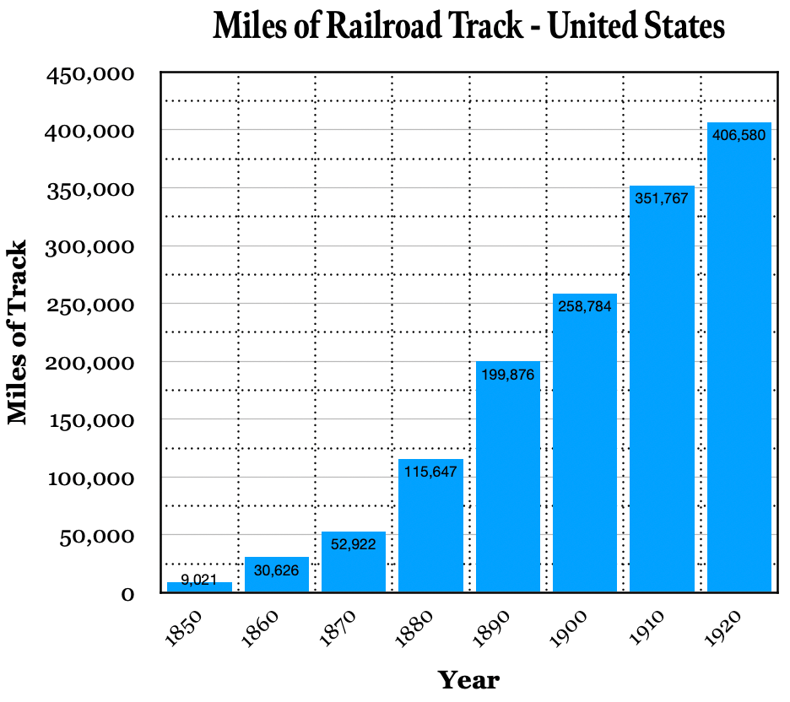
Monday
  Study the graph. What do you notice? What information is contained on the x-axis and y-axis?
Notes:
Answers will vary. The x-axis represents years; the y-axis shows miles of railroad track. Students may need a review lesson of what x-axis and y-axis refer to.

Slide 3
Tuesday
  Based on the graph, how many miles of railroad were in the United States in 1850?
  How much had it grown by the turn of the century?
Notes:
9,021
We’ll introduce “turn of the century” here and point students to observe data from 1900. The amount of track grew from 9,021 to 258,784, an increase of 249,763 miles of track.

Slide 4
Wednesday
Focus on the axes.
How many years are there between each entry on the x-axis?
What value is represented by the distance between the solid lines on the y-axis?
What value is represented by the first row of dotted lines on the y-axis?
Notes:
Ten years; 50,000 miles of track; 25,000 miles of track

Slide 5
Thursday
  What is the overall trend shown on the graph? What might a person predict as the number of miles of track in 1930? What about 1940? Explain your thinking.
Notes:
The overall trend was a large increase in miles of track each year. A person might predict that since this trend has gone on for 70 years, it might continue. Students might (correctly) predict that railroad mileage will decrease as other forms of transportation rise in importance.

Slide 6
Friday
  Write a question that can be answered using this chart. Have another student answer it and check their work. Explain any errors.
Notes:
Answers will vary. You may want to allow some students to share their questions and answers if time allows.

Slide 7

Image Credits
Title Slide: West Virginia State Capitol building, Charleston, WV. © Shutterstock, licensed.
End Slide: Appalachian Trail through Harper’s Ferry, WV. © Shutterstock, licensed.
Notes:
Images are licensed and may not be reused.

