Slide 1


SMART SKILLS
Week 1 – Map 1
© 2025 Clairmont Press

Slide 2
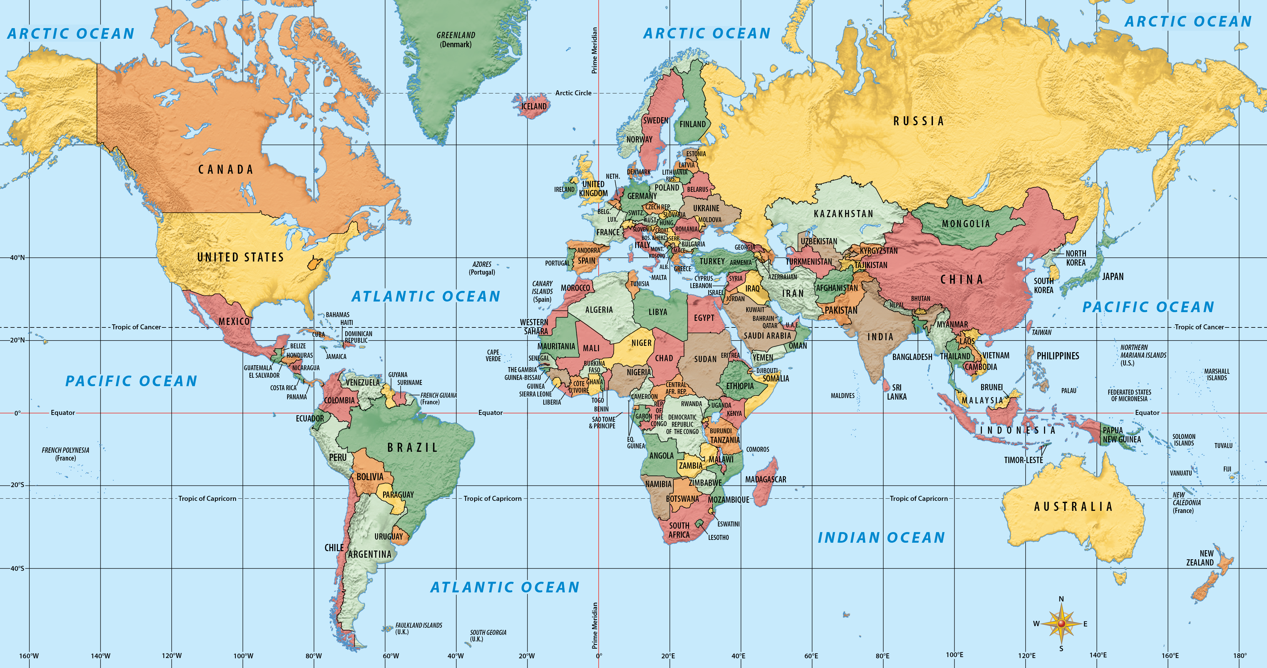
Monday
Study the map. What do you notice?
Notes:
Allow 1-2 minutes for students to record what they notice on the map. Examples: countries are in different colors. Features include grid lines, compass rose, labels for oceans, equator, prime meridian, oceans are blue, etc.

Slide 3
Tuesday
What country is at 30°N, 15°E?
What country is at 35°N, 135°E?
Notes:
Egypt; Japan
If you have time, try to have your students determine the latitude and longitude of West Virginia.

Slide 4
Wednesday
Traveling north from West Virginia, what countries would you cross before reaching the North Pole? What about traveling toward the South Pole?
Notes:
The United States and Canada would be crossed going north.
Going south, the countries would be the United States, Cuba, possibly Jamaica, Panama, Colombia. Ecuador, and Peru, depending on where you start from in West Virginia

Slide 5
Thursday
Begin in West Virginia and follow latitude 40°N eastward around the world. List the countries that you cross.
Notes:
United States, Portugal, Spain, Italy, Albania, Greece, Turkey, Armenia, Azerbaijan, Turkmenistan, Uzbekistan, Tajikistan, Kyrgyzstan, China, North Korea, Japan, United States. Some part of the Pacific Ocean are cropped out on this map, but there are no additional countries crossed.

Slide 6
Friday
Locate France on the map. Write a sentence to describe its relative location. Write a sentence to describe its absolute location.
Notes:
Answers will vary. Example: France is north of Spain and south of Belgium. It borders the Atlantic Ocean. One absolute location in France is 45°N, 0° (the Prime Meridian crosses France).

Slide 7

Image Credits
Title Slide: West Virginia State Capitol building, Charleston, WV. © Shutterstock, licensed.
End Slide: Appalachian Trail through Harper’s Ferry, WV. © Shutterstock, licensed.
Notes:
Images are licensed and may not be reused.

