Slide 1
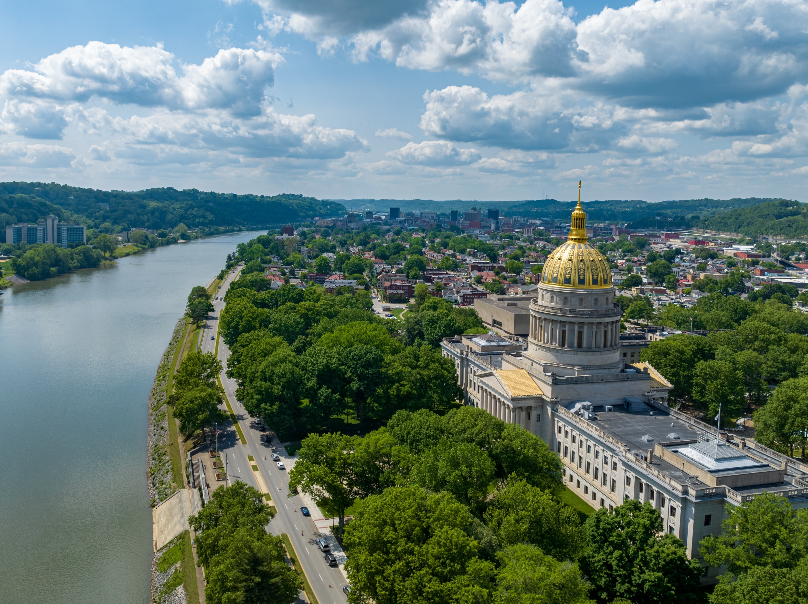

SMART SKILLS
Overview
© 2025 Clairmont Press

Slide 2
Overview
The goal of the Smart Skills presentations is to promote mastery of a skill and further support the standards.
The questions promote higher order thinking (interpreting, analyzing, formulating, determining, etc.).
By using these questions to begin a lesson, students will be guaranteed work in essential skills throughout the year. For example: 5 minutes a day, 5 days a week, for seven weeks each skill equals to 2 ½ class periods devoted to each skill per year.

Slide 3
How to Use the System
    Follow weeks 1-35 as shown in the chart on slide 4. For week one, use the presentation file Map1Week1(Week 1, Map 1). Maps will be the focus again in weeks 6, 11, 16, 21, 26, and 31.
The same presentation is used each day of the week. The slide days are marked, and the answers are in the Notes section of the slide. Answers and discussion should take no more than five minutes.
The questions become more rigorous and/or open-ended as the week progresses. By Friday, the students will be challenged with higher-level questions.
The chart on slide 4 shows the progression:
    Maps
    Charts and Graphs
    Analyzing Art and Artifacts
    Timelines
    Political Cartoons

Slide 4
Map/ Globe Skills | Charts/ Graphs | Analyzing Art & Artifacts | Timelines | Political Cartoons
Map 1 Week 1 | C/G 1 Week 2 | Artifact 1 Week 3 | Timeline 1 Week 4 | Cartoon 1 Week 5
Map 2 Week 6 | C/G 2 Week 7 | Artifact 2 Week 8 | Timeline 2 Week 9 | Cartoon 2 Week 10
Map 3 Week 11 | C/G 3 Week 12 | Artifact 3 Week 13 | Timeline 3 Week 14 | Cartoon 3 Week 15
Map 4 Week 16 | C/G 4 Week 17 | Artifact 4 Week 18 | Timeline 4 Week 19 | Cartoon 4 Week 20
Map 5 Week 21 | C/G 5 Week 22 | Artifact 5 Week 23 | Timeline 5 Week 24 | Cartoon 5 Week 25
Map 6 Week 26 | C/G 6 Week 27 | Artifact 6 Week 28 | Timeline 6 Week 29 | Cartoon 6 Week 30
Map 7 Week 31 | C/G 7 Week 32 | Artifact 7 Week 33 | Timeline 7 Week 34 | Cartoon 7 Week 35

Slide 5
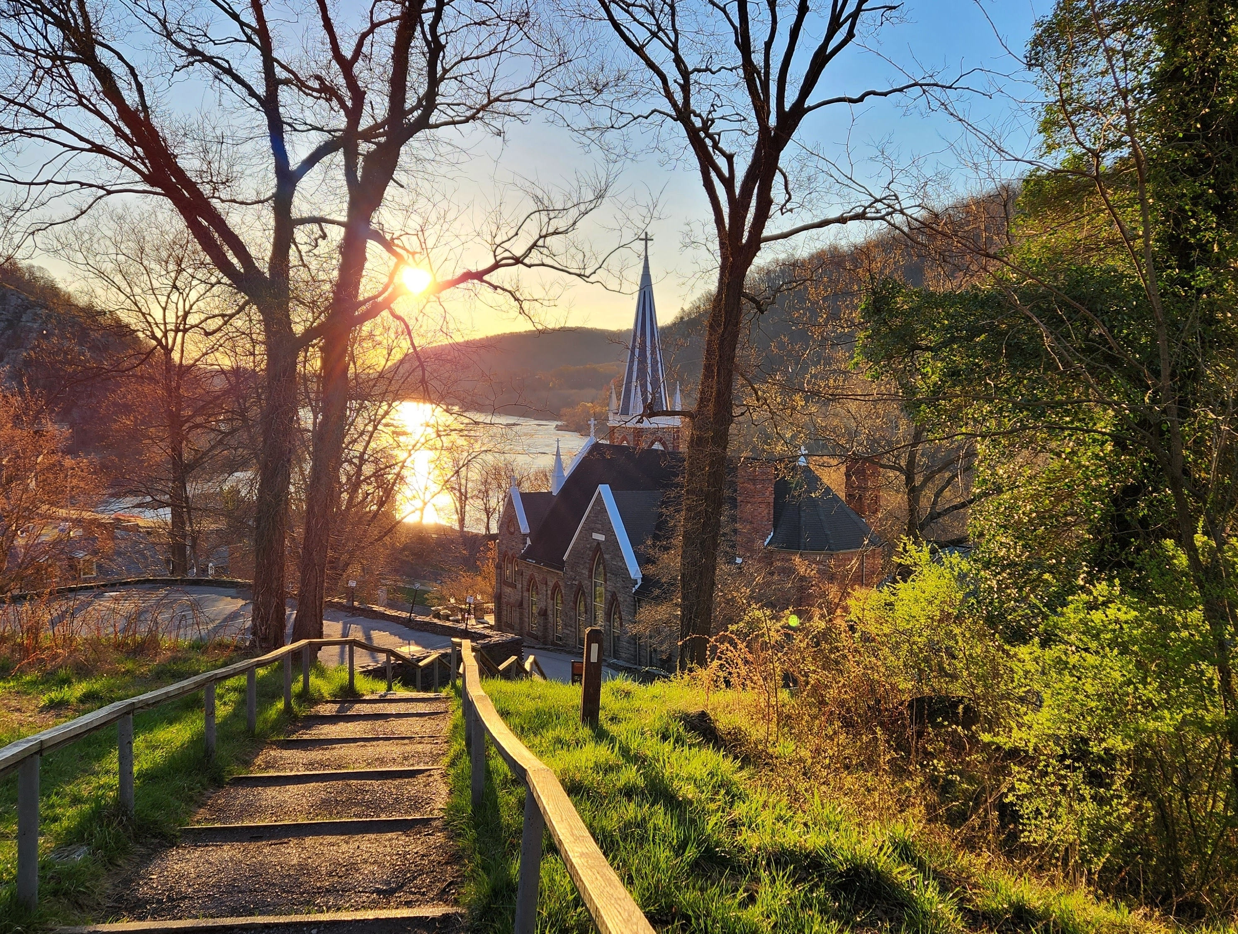
Image Credits
Title Slide: West Virginia State Capitol building, Charleston, WV. © Shutterstock, licensed.
End Slide: Appalachian Trail through Harper’s Ferry, WV. © Shutterstock, licensed.
Notes:
Images are licensed and may not be reused.

