Slide 1
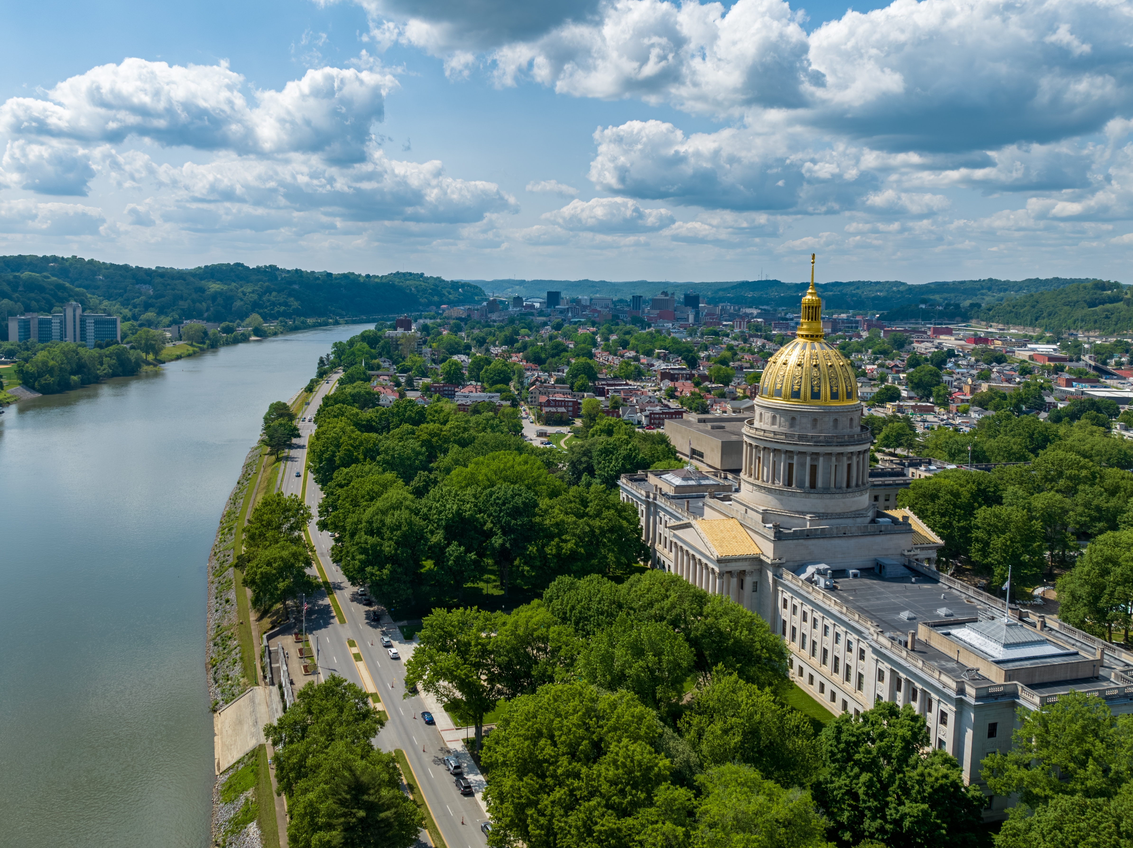

SMART SKILLS
Week 4 – Timeline 1
© 2025 Clairmont Press

Slide 2
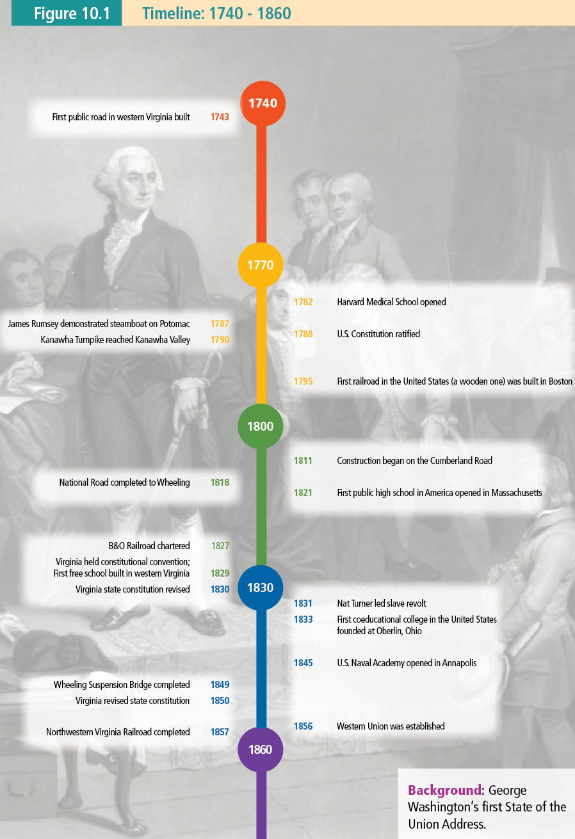
Monday
  Study the timeline from page 379 of your textbook.
  What years are included?
  What is the basic purpose of the timeline?
Notes:
The date range is 1790-1860. The timeline aims to show key U.S. and West Virginia historical events from this time.

Slide 3
Tuesday
  How many years passed between the ratification of the US Constitution and the construction of the first free school built in western Virginia?
  How many years passed between the ratification of the US Constitution and the construction of the first railroad in the United States?
Notes:
41 years; 33 years

Slide 4
Wednesday
  Write a question that could be answered using the timeline. Have another student answer the question, then check their answer. Correct any errors.
Notes:
Answers will vary. Use some students’ responses for class discussion.

Slide 5
Thursday
  What would need to be done to add the following entries to the timeline?
  Jane Austen published “Pride and Prejudice” (1813)
  Mark Twain published The Adventures of Tom Sawyer (1876)
Notes:
The Jane Austen entry would go after Construction began on the Cumberland Road. The Mark Twain entry is beyond this timeline, so the timeline would need to be expanded to include it.

Slide 6
Friday
How would you change this timeline to make it more effective or informative?
Notes:
Answers will vary. Students may suggest a longer timeline with the addition of key events. They may indicate that different colors would be more effective. A more descriptive title might help users, etc.

Slide 7
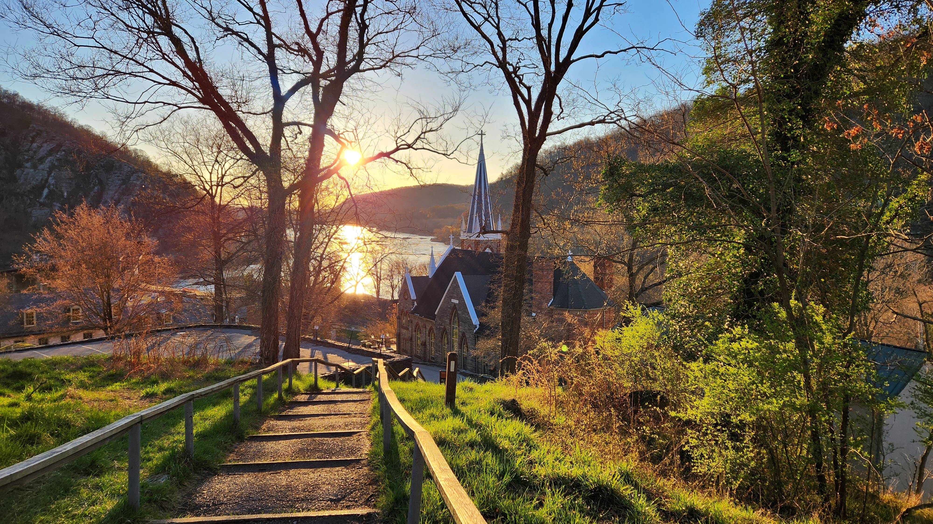
Image Credits
Title Slide: West Virginia State Capitol building, Charleston, WV. © Shutterstock, licensed.
End Slide: Appalachian Trail through Harper’s Ferry, WV. © Shutterstock, licensed.
Notes:
Images are licensed and may not be reused.

