Slide 1
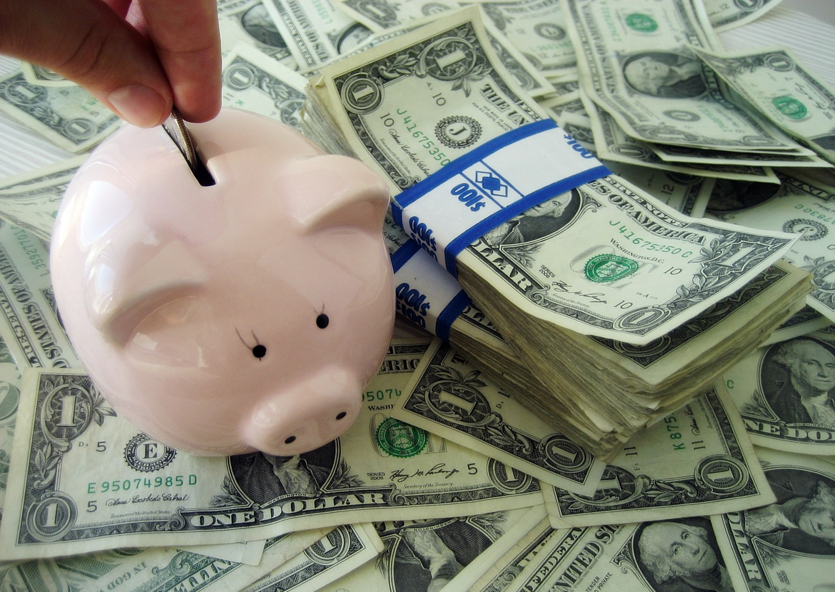

Chapter 3: Economic Understandings STUDY PRESENTATION
© 2025 Clairmont Press

Slide 2
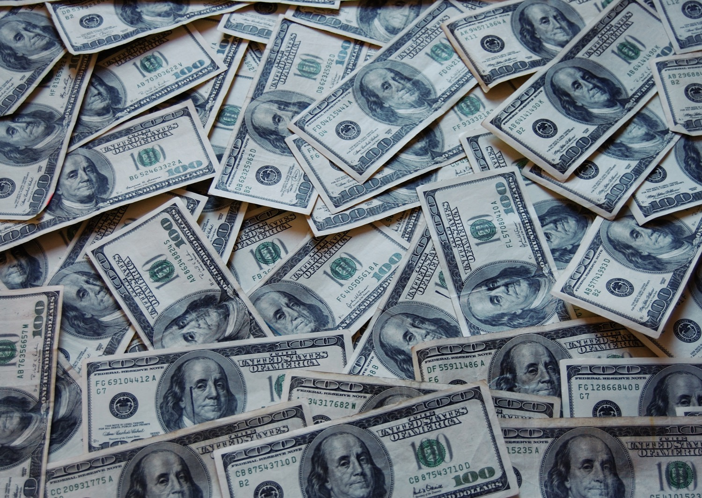
Section 1: Economic Fundamentals
Section 2: Trade
Section 3: Economic Systems and Growth

Slide 3
SECTION 1: ECONOMIC FUNDAMENTALS
Essential Question:
How are people both consumers and producers?

Slide 4
SECTION 1: ECONOMIC FUNDAMENTALS
What terms do I need to know?:
needs
wants
goods
services
consumer
producer
scarcity
choice
resource allocation
price
vote
sharing
contests
force
authority
lottery
first-come/first-served
personal characteristic
opportunity cost
trade-off

Slide 5
NEEDS AND WANTS
All humans have the same basic needs, like air, food, water, and shelter, but we all desire different things, called wants, which are almost unlimited.
Humans satisfy their needs and wants by buying goods and services.
Goods are tangible items like food, clothing, and so on, while services are the work or activities people perform for a fee, like a haircut or a doctor’s appointment.
The person who buys these things is a consumer, and the person or group providing these things is a producer.

Slide 6
SCARCITY REQUIRES CHOICE
Scarcity is when people and societies try to satisfy unlimited wants with limited resources, like when the newest phone is released and everyone tries to get one.
Scarcity requires both consumers and producers to make choices with their limited resources, such as deciding how to use the limited resources they have access to.

Slide 7
RESOURCE ALLOCATION STRATEGIES
Economists identify many ways in which the resource allocation decision could be made, including:
price- trade or barter for the resource
vote- majority decides who gets the resource
sharing- dividing the resource
contests- resource goes to the winner
force- the strongest gets the resource
authority- directed/ordered by another person
lottery- resource goes to the luckiest
first-come/first-served- first person gets the resource
personal characteristic- resource goes to the person who is oldest, is the most experienced, etc.
Some of these strategies may be used more than others, based on the economy one is looking at.

Slide 8
COST/BENEFIT ANALYSIS
Each choice individuals, families, businesses, and governments make, offer an opportunity that has a cost and a benefit.
The opportunity cost, in any decision, is the value of the next best alternative that the person does not choose.
Opportunity costs and benefits can affect how resources are used, like time.

Slide 9
TRADE-OFFS
Trade-offs are when an individual or group choose to have less of one thing for more of another.
This requires comparing the costs and benefits of all alternatives before making your decision.
If properly done, one could even have both, but in reduced amounts.
Return to Main Menu

Slide 10
SECTION 2: TRADE
Essential Question:
Why do producers sometimes turn out a low supply of their goods?

Slide 11
SECTION 2: TRADE
What terms do I need to know?:
supply
profit
demand
specialization
trade
exports
imports
tariff
quota
embargo
subsidy
standards
currency
exchange rate

Slide 12
SUPPLY AND DEMAND
Supply is the quantity of a good or service available for sale, which can affect both purchasing decisions and prices.
Typically, when the supply of something is high, the price is low.
A producer’s goal is to fell goods and services for more than it costs to produce them.
Profit is the difference between cost of production and selling price of a good or service.
Demand describes the quantity of a good or service consumers are willing to buy.
Demand is based on a buyer (1) wanting something, (2) having the ability to pay for it, and (3) be willing to pay attention to price.
While separate concepts, considering supply and demand together helps us understand when people are willing to buy certain items and why.

Slide 13
SPECIALIZATION AND TRADE
Specialization can help a country become economically successful.
By focusing on making only a few products based on their resources, they can maximize profit from trade.
Trade is the voluntary exchange of goods and services among people and countries.
When trade is voluntary and non-fraudulent, both parties benefit and are better off after trading than they were before.
Goods sent to other countries for trade are exports, and goods brought into a country for trade from other countries are called imports.

Slide 14
BARRIERS TO TRADE
Some say too much trade with other countries causes domestic workers to lose jobs, so countries sometimes will limit trade by creating trade barriers.
The most common are tariffs and quotas.
A tariff is a tax on imports coming into the country.
A quota is a specific limit placed on the number of imports that may enter a country.
Another trade barrier is an embargo, or a government order stopping trade with another country.
Sometimes, this is used to put pressure on another country.
A subsidy is another trade barrier, where the government of a country gives money to certain businesses so they can continue to compete with imported goods.
The final trade barrier is a standard, when the government sets limits and rules regarding imports and domestic goods.

Slide 15
TRADE AND EXCHANGING CURRENCIES
Currency is the money people use to make trade easier.
However, since different countries may have different currencies, trade between nations require exchanging currencies.
An exchange rate is the price of one nation’s currency in terms of another nation’s currency.
It helps to accurately exchange the value of one currency to another when trading.
For example, when this PowerPoint was written, one United States dollar was the equivalent to 18.44 Mexican pesos, meaning the USD has a higher value.
Return to Main Menu

Slide 16
SECTION 3: ECONOMIC SYSTEMS
Essential Question:
What are the three basic economic questions that every country must answer?

Slide 17
SECTION 3: ECONOMIC SYSTEMS
What terms do I need to know?:
economist
traditional economy
barter
command economy
market economy
mixed economy
economic continuum
Gross Domestic Product (GDP)
Consumer Price Index (CPI)
inflation
unemployment
factors of production
natural resources
renewable
nonrenewable
capital goods
infrastructure
human capital
entrepreneurship
income
expenses
literacy rate
life expectancy

Slide 18
ECONOMIC MODELS
A person who studies an economy is called an economist.
Economists study the ways people or countries address the issue of limited resources, since no country has everything its people want or need.
Countries must answer these questions:
What goods and services will be produced?
How will they be produced?
Who are the goods and services produced for?
These answers determine the economic system.

Slide 19
Traditional Economy
Traditional economies are defined as:
Heavily dependent on agriculture.
People tending to barter (trade items of value rather than money).
Economic decisions are often based on long-held customs.
In this system, each member of society at an early age knows what their role in the larger group will be since jobs are inherited.
People are dependent upon each other to fulfill their roles, because the alternative is the breaking-down of the system.

Slide 20
Command Economy
In command economies, government planning groups make the basic economic decisions, determining what to produce, the prices, and wage rates.
Businesses and farms are generally owned by the government, who give the workers production goals to reach in order to provide the proper amount of goods for the country.
One problem with this economy occurs when the government attempts to predict what people will need but ends up overlooking another portion of the economy.
A benefit of this economy is that prices are controlled and people know how much things will cost. Common needs, like food and shelter, have lower costs than luxuries, like televisions and computers, which are priced higher.

Slide 21
Market Economy
In market economies, economic decisions are made at an individual level, with producers answering economic questions based on their beliefs of how consumers will respond to goods.
Businesses and farms decide what they want to produce individually in order to make a profit.
A benefit of this economy is that consumers have an easy time finding what goods they want, and they are free to earn as much money as they’d like in order to buy the goods and services they want.
A problem is that, if a business doesn't manage its money well, it can go out of business and cause workers to lose their jobs and income.

Slide 22
All Economies are Mixed
No countries today have any pure market system, instead blending characteristics of the three.
These hybrids are called mixed economies.
That said, most economies tend to lean more towards one system than the others.
Most societies have rules protecting consumers, workers, and businesses.
To see where a country falls, between command and market economies, we use the economic continuum, where 0 represents a pure command economy and 100 represents a pure market economy.

Slide 23
MEASURING THE ECONOMY
A major economic indicator economists use is the Gross Domestic Product (GDP), which measures the total value of goods and services produced within a country in one year.
The GDP per capita, or per person, is best used when comparing two countries’ economies.
For example, India’s GDP was about $3.417 trillion while South Korea’s was about $1.674 trillion in 2022, but the GDP per capita of India was about $7,100 while South Korea’s was about $45,000.

Slide 24
MEASURING THE ECONOMY, Pt. 2
The Consumer Price Index (CPI) measures prices monthly in a country. When it shows prices are rising steadily, this indicates inflation (a continual increase in the price of goods and services).
If wages do not increase at a level to keep up with inflation, a consumer’s spending power decreases.
An unemployed person is someone without a job but has been actively looking for one, and the unemployment rate tracks the number of unemployed people in a country.
A low supply of jobs means workers are willing to accept lower wages for a job, but low unemployment means businesses have to offer higher wages to attract employees.

Slide 25
FACTORS OF PRODUCTION
Factors of production are the resources of a society needed to produce a good or service.
Factors of production are natural resources, capital goods, human resources, and entrepreneurship.
Natural resources are products of the Earth and its atmosphere that are useful to humans.
These resources can be renewable, or things that can replenish themselves over time like plants and animals, and nonrenewable, or or things that are not replenishable like mineral resources.
Capital goods are the tools used in the production of goods and services, like textile mills, furniture factories, and even infrastructure (basic structures and buildings a country needs to function).

Slide 26
FACTORS OF PRODUCTION, Pt. 2
Human resources describe the people who produce goods or services by transforming natural resources through effort and activity.
Entrepreneurship occurs when people start their own businesses, risking money and time in hopes for a successful business.
To be successful, a business must earn a profit, which is the expenses of resources subtracted from the income of selling their goods or services.

Slide 27
INCREASING THE GROSS DOMESTIC PRODUCT
To improve a country’s GDP, governments and people must invest in the factors of production.
Countries can invest in natural resources by developing ways to harness their power, like oil, solar, and wind energy.
Countries can invest in capital goods, including factories, technologies, and buildings needed for businesses to operate.
Countries can invest in education, training, health, and skills of workers, increasing both the literacy rate (percent of the population over 15 that can read and write) and life expectancy (average lifespan of people).
Countries can invest in entrepreneurship by providing financial assistance or reducing barriers to starting a business.

Slide 28
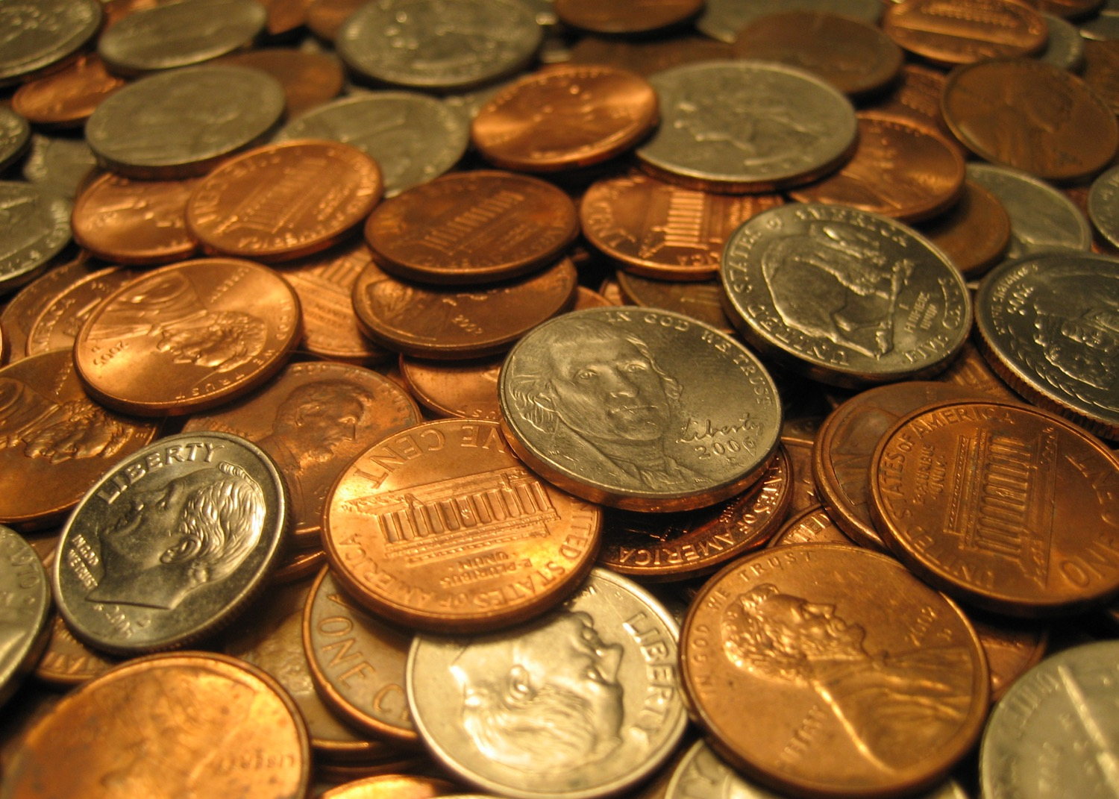
Image Credits: all Wikimedia Commons. Maps ©2025 Clairmont Press.
Return to Main Menu

