Slide 1
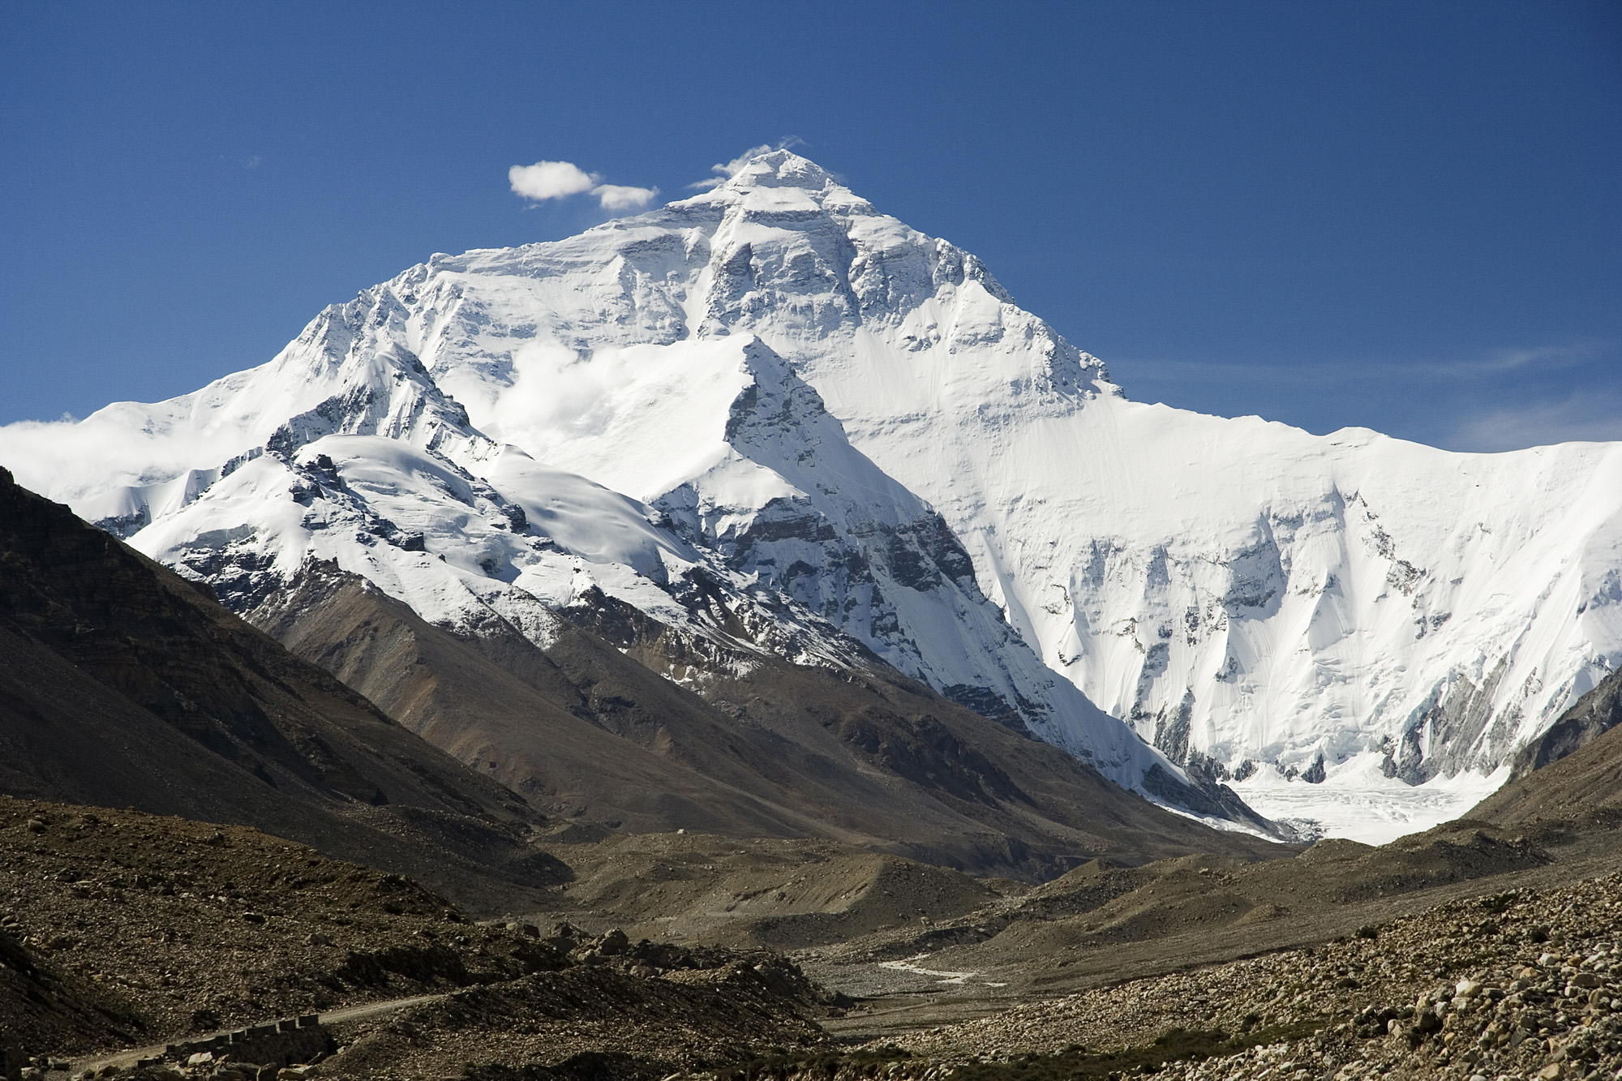

Chapter 12: Geography and History
of Southern and Eastern Asia
STUDY PRESENTATION
© 2025 Clairmont Press

Slide 2
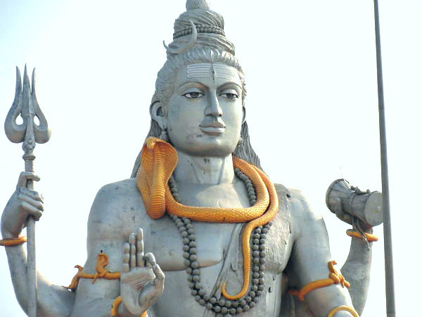
Section 1: The Geography of Southern and Eastern Asia
Section 2: The People of Asia
Section 3: A Brief History of Southern and Eastern Asia

Slide 3
SECTION 1: THE GEOGRAPHY OF SOUTHERN AND EASTERN ASIA
  Essential Question:
    How have the Himalayas influenced the history and culture of Asia?

Slide 4
SECTION 1: THE GEOGRAPHY OF SOUTHERN AND EASTERN ASIA
  What terms do I need to know?:
  subcontinent
  tectonic plate
  archipelago
  peninsula

Slide 5
LOCATION OF THE COUNTRIES OF SOUTHERN AND EASTERN ASIA
Twenty-nine countries make up the region separated by different geographic features.
    India is a subcontinent (a large land area mostly separate from the rest of a continent) and is also on a different tectonic plate (a separate part of Earth’s crust) than most of the rest of Asia.
    North over the Himalayas, China has one of the largest economies and second largest population in the world.
    To the east, North Korea is virtually cut off from the rest of the world, while South Korea has a growing, high-tech economy.
    The Sea of Japan separates the Korean Peninsula from Japan, which is an archipelago (a chain of islands).
    To the Southwest, Vietnam’s economy is beginning to grow thanks to trade with the US.

Slide 6
PHYSICAL FEATURES OF ASIA
Southern and Eastern Asia are home to many of the longest rivers in the world, like the Ganges River, the Chang Jiang (Yangtze) River, and the Huang He (Yellow) River.
The Himalayan Mountains are the tallest mountain range in the world, with Mount Everest as its highest peak.
The Taklamakan Desert in western China and the Gobi Desert in northern China are among the largest in the world.
Connected to China is the Korean Peninsula, which is a landform surrounded on three sides by water.
The Sea of Japan and the South China Sea are two of the larger bodies of water in Southern and Eastern Asia.

Slide 7
IMPACT OF GEOGRAPHY ON WHERE PEOPLE LIVE AND HOW THEY TRADE
India is separated from the rest of Asia by mountains. Most of India’s population lives in river valleys south of the Himalayas. The rivers provide water for irrigation, travel, trade routes, and drinking water.
China’s population is more concentrated around its rivers, opposed to its mountain and desert regions, because of the rivers’ resources.
In North Korea and South Korea, geography and politics influence the trade success (or failures) of the countries.
As an island nation with few natural resources, Japan relies on trade by sea and air to meet the needs and wants of its people.
Return to Main Menu

Slide 8
SECTION 2: THE PEOPLE OF
SOUTHERN AND EASTERN ASIA
  Essential Question:
    What are differences between ethnic groups and religious groups?

Slide 9
SECTION 2: THE PEOPLE OF
SOUTHERN AND EASTERN ASIA
  What terms do I need to know?:
  ethnic group
  religious group
  philosophy
  Hinduism
  Vedas
  Brahman
  reincarnation
  karma
  caste system
  Buddhism
  Four Noble Truths
  Nirvana
  Middle Way
  Tripitaka
  Mahayana Sutras
  Shintoism
  kami
  Confucianism
  Golden Rule of Behavior
  Analects

Slide 10
ETHNIC AND RELIGIOUS
GROUPS IN ASIA
An ethnic group refers to a group of people who share cultural ideas and beliefs that have been a part of their community for many years.
    These commonalities include language, religion, history, types of food, and a set of traditional stories, beliefs, or celebrations.
A religious group refers to a group of people who share a belief system in a god or gods with a specific set of rituals and literature.
The four main ethnic and religious groups in Asia include Hinduism, Buddhism, Shinto, and Confucianism.
    Hinduism, Buddhism, and Shinto are religions native to Southern and Eastern Asia.
    China is the birthplace of Confucianism, which is not a religion, but rather a philosophy, based on morality and good deeds.

Slide 11
Hinduism
Hinduism is one of the oldest religions in the world and was founded in India around 1500 BC. Aryan priests followed complicated rituals and hymns known as the Vedas.
    There is no specific founder for Hinduism, unlike other religions. Followers of Hinduism are called Hindus.
    Many gods and goddesses exist in Hinduism, but it is believed that they are all part of a supreme “universal spirit” named Brahman.
    The Ganges River is a holy river for Hindus, and several religious practices involve the river.

Slide 12
Hinduism, Pt. 2
    Reincarnation is the religious belief that when a person dies, their soul is reborn into a person or animal according. This is based on his or her good or bad deeds, or karma.
    The caste system, a system of social classes that are inherited and cannot be changed, acts an important religious and social influence for Hindus.
      The traditional castes include Brahmans, Kshatriyas, Vaishyas, and Sudras.
      Over time, the castes have been further divided, complicating the structure of India’s social structure.

Slide 13
Buddhism
Buddhism was founded by Siddhartha Gautama around 500 BC.
    Siddhartha sought answers as to why there is so much suffering in the world. After meditation, Siddhartha became known and “Buddha” or “The Enlightened One.” He believed the cause of human suffering to be greed and the desire for material things.
    The central teaching of Buddhism is called the Four Noble Truths, which include moral “truths” and instructions for conduct.
    Nirvana exists as a state of perfect peace for Buddhists. It can be reached by following the Middle Way, via rules outlined by the Eightfold Path.
    The Tripitaka and the Mahayana Sutras make up two Buddhist texts.

Slide 14
Shintoism
Shintoism is a religion unique to Japan, with no specific date of origin or founder. It is closely intertwined with Japanese culture.
    The main belief of Shintoism is reverence for the kami, which are spirits that Shinto followers believe live in nature, animals, and a person’s ancestors.
    Followers offer prayers and perform rituals to honor and please the kami.
    Shintoism has been a part of Japanese life for so long that it is thought of as part of Japanese culture.

Slide 15
Confucianism
Confucianism was founded by a Chinese scholar named Confucius around 550 BC.
    Confucius emphasized good character and virtue as a means to peace and social order.
    Confucius’s teachings were written down in the Analects.
      The Golden Rule of Behavior says, “What you do not like when done unto you, do not do to others.”
    Confucius believed his philosophy would bring order to China if leaders and the government followed Confucianism’s guiding principles.
      The Chinese and many other people throughout Southern and Eastern Asia continue to respect and practice Confucianism teachings.
Return to Main Menu

Slide 16
SECTION 3: A BRIEF HISTORY OF SOUTHERN AND EASTERN ASIA
  Essential Question:
    How did the events of World War II impact Asia politically and socially?

Slide 17
SECTION 3: A BRIEF HISTORY OF SOUTHERN AND EASTERN ASIA
  What terms do I need to know?:
  nationalism
  communism
  Cold War
  containment
  domino theory
  armistice
  demilitarized zone

Slide 18
COLONIALISM AND STRUGGLES
FOR INDEPENDENCE
Many regions of Southern and Eastern Asia were colonized by European powers.
    India was colonized by the British, and France colonized most of Southeast Asia.
    Although the Koreas, China, and Japan escaped European colonization, they were all affected by the independence movements and growth of communism.
    Many Asian countries gained independence after World War II.

Slide 19
WORLD WAR II AND ITS AFTERMATH
During World War II, Japan took over many parts of the Pacific and China, but they were pushed back by the US and its allies.
Nationalism (pride in one’s country) fueled independence movements across the region.
Communism, a type of government in which a single party controls the country and the government owns all property and controls the economy, took hold in Vietnam and China.
The Cold War, a war of words with no direct fighting, began after World War II as the United States sought containment to stop the spread of communism to other Asian countries.

Slide 20
KOREAN WAR
The US believed that if one country became communist, other neighboring countries would also fall to communism – a concept known as the domino theory.
After WW2, the Korean Peninsula was divided: the Soviet-controlled north and the Allied-controlled south.
North Korean forces invaded the south to reunify the peninsula in 1950, but UN forces fought them back, resulting in an armistice (pause in fighting) in 1953.
In the end, the peninsula was divided into two countries: the northern, communist half, and the southern, democratic half.
Tensions remain between North Korea and South Korea. The border between the two countries is a demilitarized zone, which means no military equipment or people are allowed within the border.

Slide 21
VIETNAM WAR
Many Vietnamese wanted to reorganize their country under the communist leadership of Ho Chi Minh, but the US feared the spread of communism.
War broke out in 1955 between the North Vietnamese, supported by the Soviet Union, and the South Vietnamese, supported by the US.
Many resources were contributed to the war, but it became increasingly unpopular in the US.
    The US withdrew their military by 1975, and Vietnam was soon united under a communist government.

Slide 22
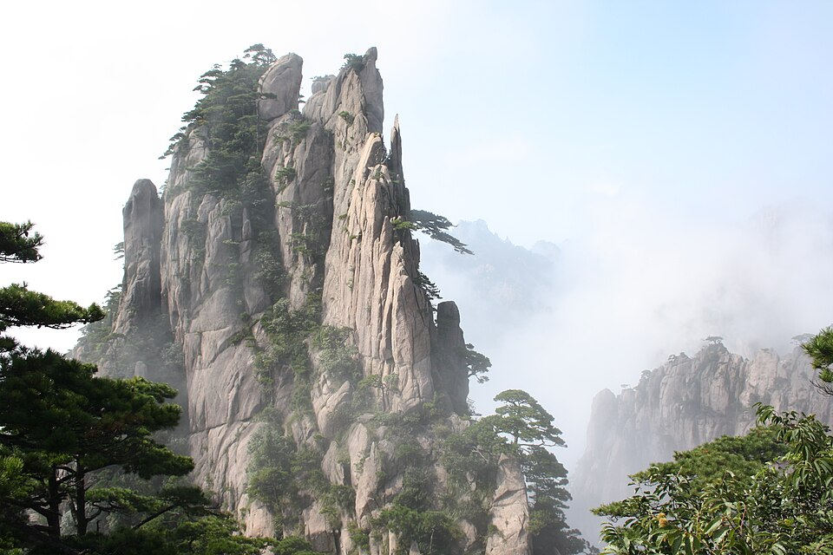
Image Credits: all Wikimedia Commons. Maps ©2025 Clairmont Press.
Return to Main Menu

