Slide 1
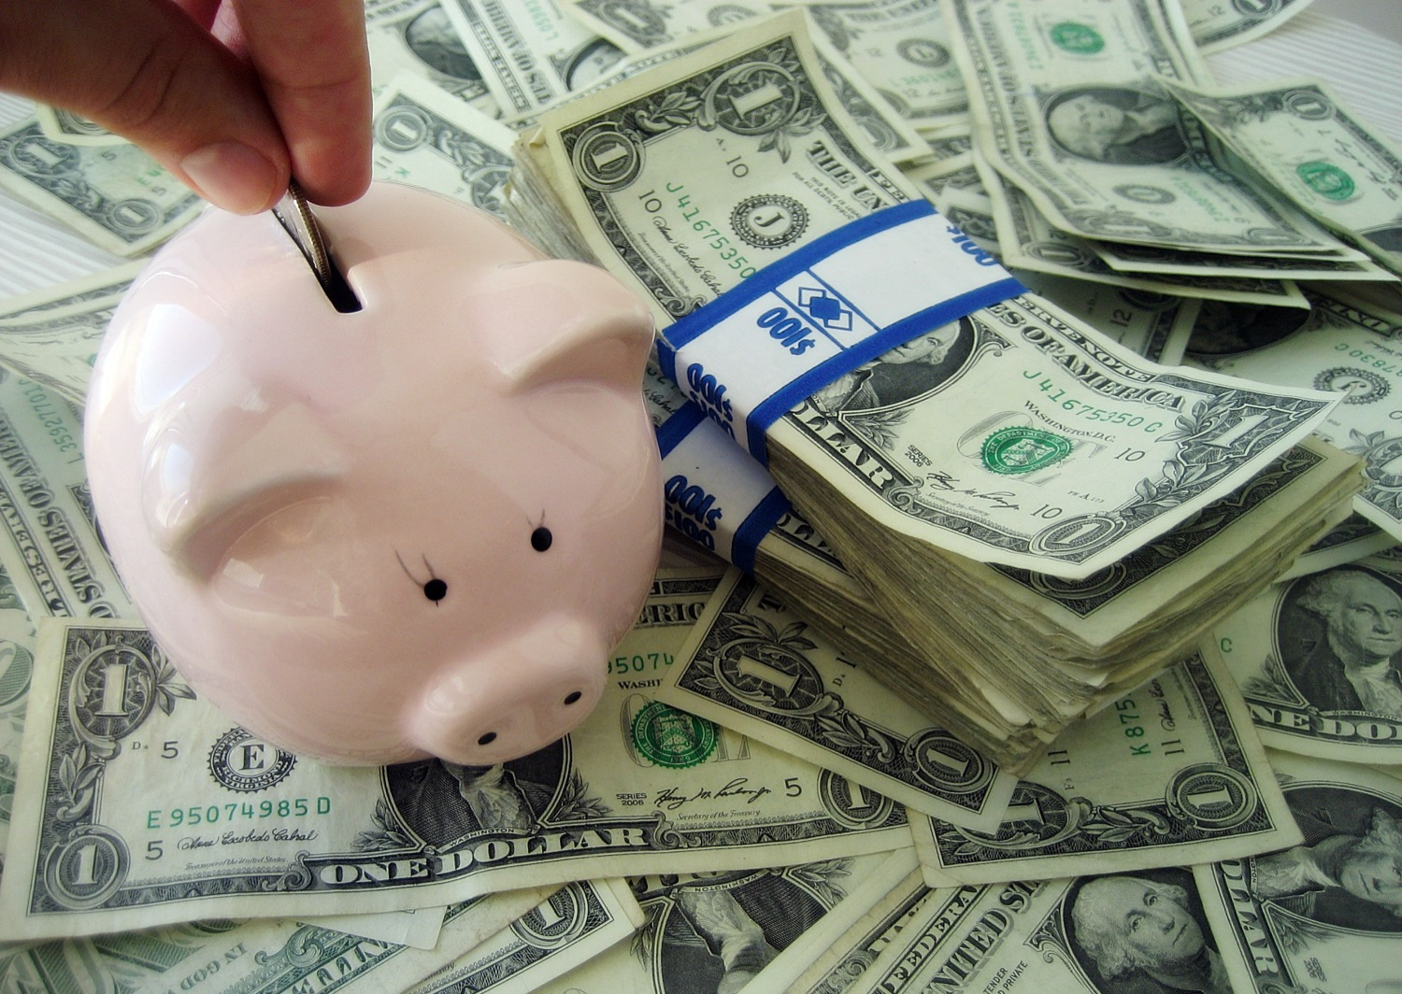

Chapter 3: Economic Understandings STUDY PRESENTATION
© 2025 Clairmont Press

Slide 2
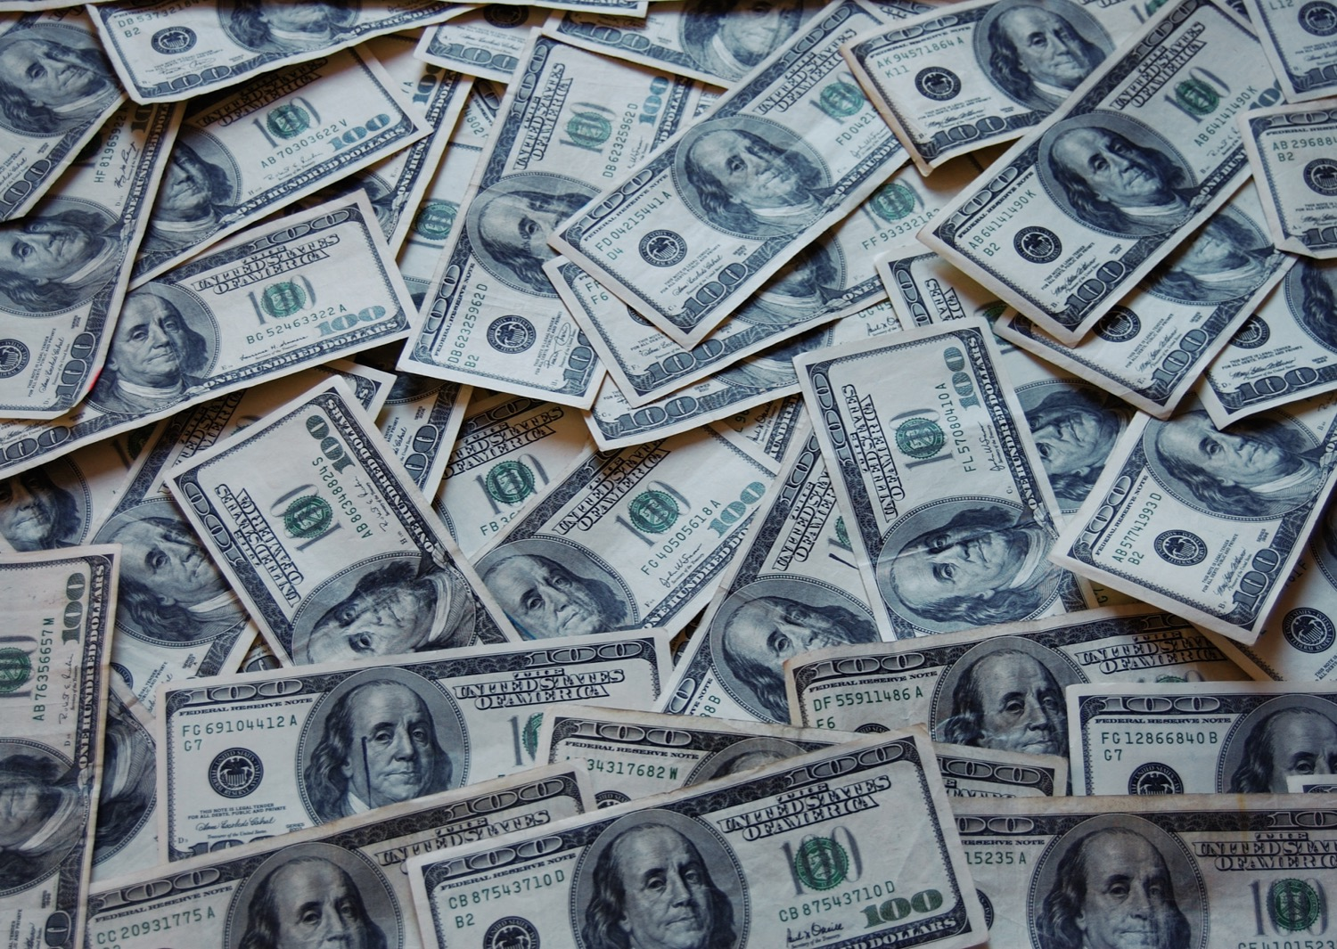
Section 1: Economic Fundamentals

Slide 3
SECTION 1: ECONOMIC FUNDAMENTALS
Essential Question:
How are people both consumers and producers?

Slide 4
SECTION 1: ECONOMIC FUNDAMENTALS
What terms do I need to know?:
needs
wants
goods
services
consumer
producer
scarcity
choice
resource allocation
price
vote
sharing
contests
force
authority
lottery
first-come/first-served
personal characteristic
opportunity cost
trade-off

Slide 5
NEEDS AND WANTS
All humans have the same basic needs, like air, food, water, and shelter, but we all desire different things, called wants, which are almost unlimited.
Humans satisfy their needs and wants by buying goods and services.
Goods are tangible items like food, clothing, and so on, while services are the work or activities people perform for a fee, like a haircut or a doctor’s appointment.
The person who buys these things is a consumer, and the person or group providing these things is a producer.

Slide 6
SCARCITY REQUIRES CHOICE
Scarcity is when people and societies try to satisfy unlimited wants with limited resources, like when the newest phone is released and everyone tries to get one.
Scarcity requires both consumers and producers to make choices with their limited resources, such as deciding how to use the limited resources they have access to.

Slide 7
RESOURCE ALLOCATION STRATEGIES
Economists identify many ways in which the resource allocation decision could be made, including:
price- trade or barter for the resource
vote- majority decides who gets the resource
sharing- dividing the resource
contests- resource goes to the winner
force- the strongest gets the resource
authority- directed/ordered by another person
lottery- resource goes to the luckiest
first-come/first-served- first person gets the resource
personal characteristic- resource goes to the person who is oldest, is the most experienced, etc.
Some of these strategies may be used more than others, based on the economy one is looking at.

Slide 8
COST/BENEFIT ANALYSIS
Each choice individuals, families, businesses, and governments make, offer an opportunity that has a cost and a benefit.
The opportunity cost, in any decision, is the value of the next best alternative that the person does not choose.
Opportunity costs and benefits can affect how resources are used, like time.

Slide 9
TRADE-OFFS
Trade-offs are when an individual or group choose to have less of one thing for more of another.
This requires comparing the costs and benefits of all alternatives before making your decision.
If properly done, one could even have both, but in reduced amounts.
Return to Main Menu

Slide 10
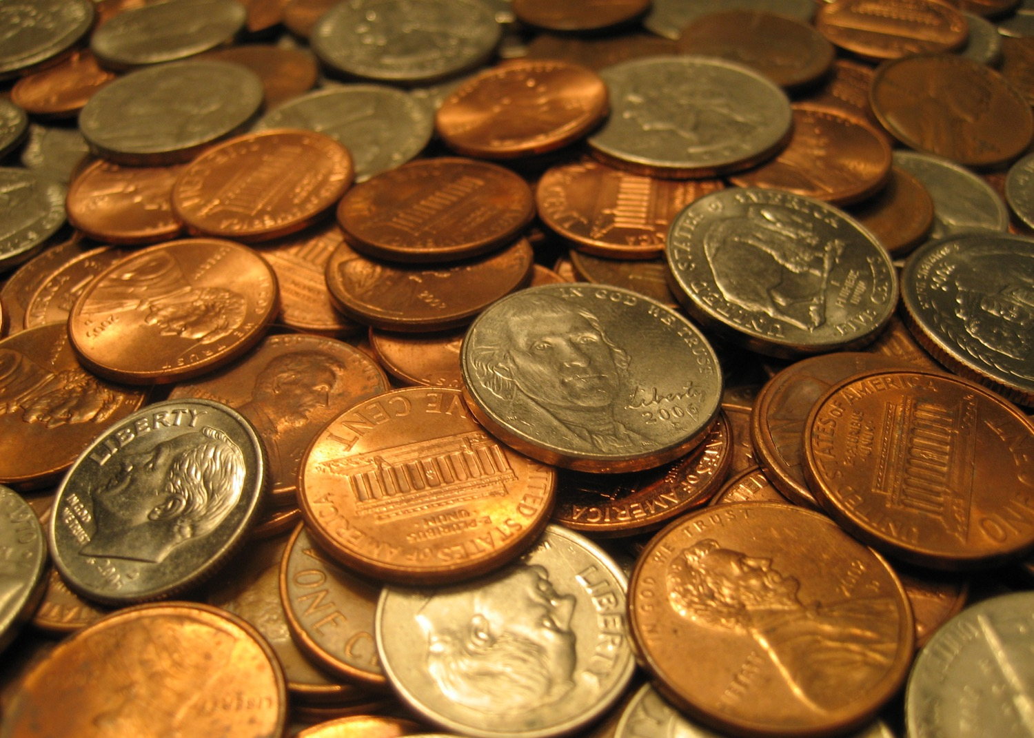
Image Credits: all Wikimedia Commons. Maps ©2025 Clairmont Press.
Return to Main Menu

