Slide 1
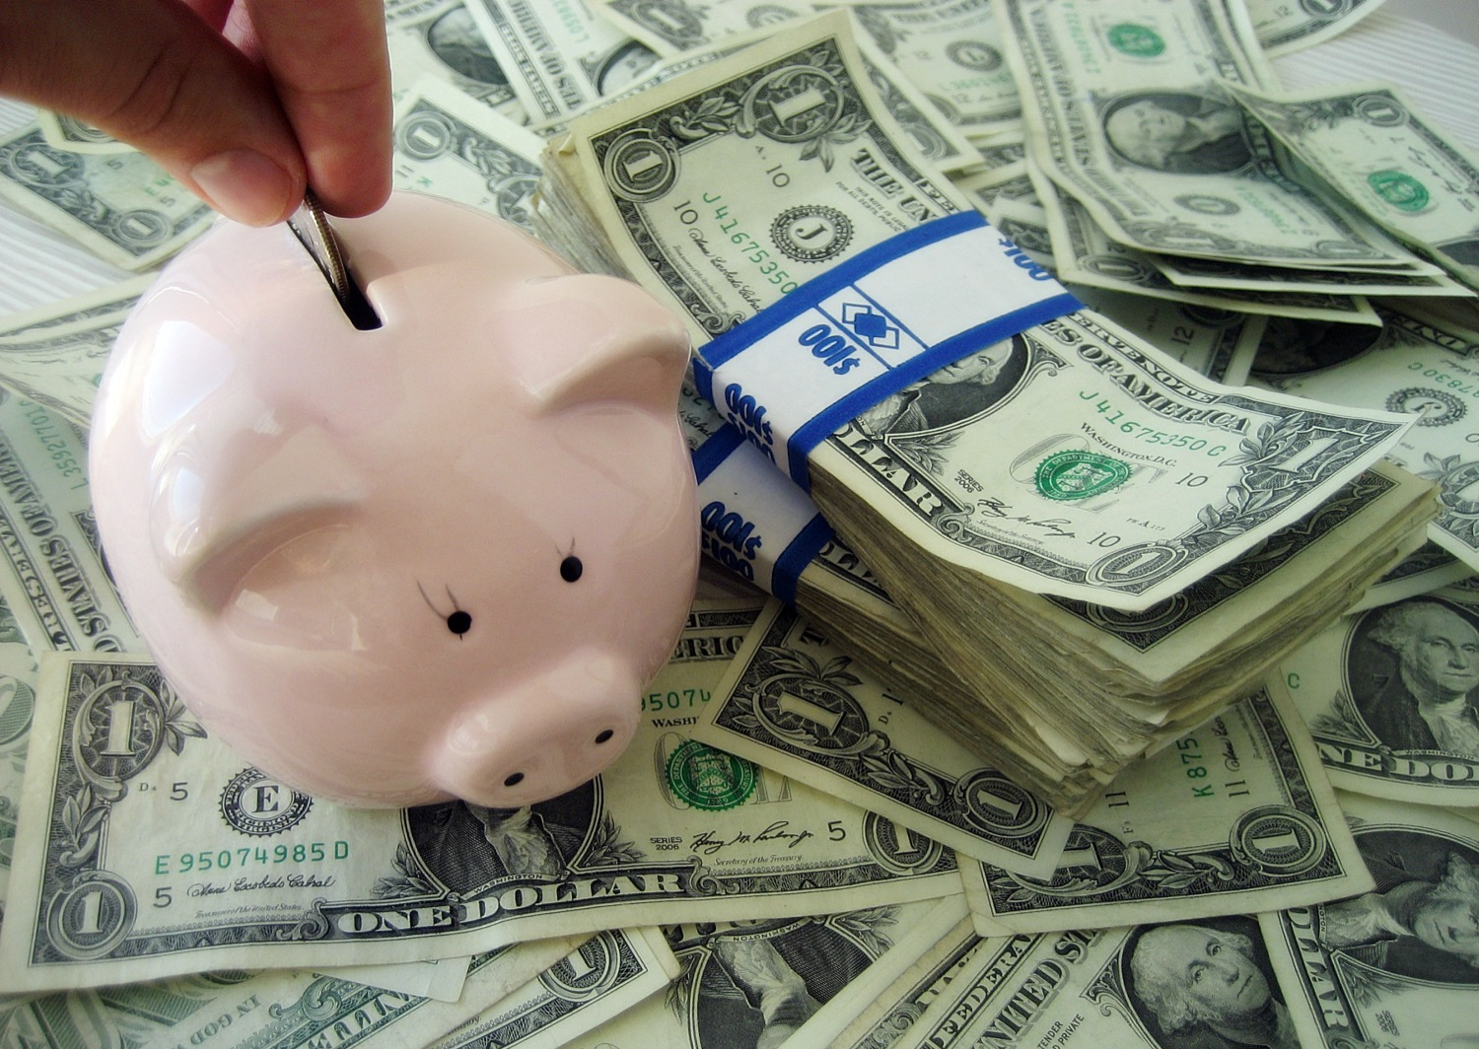

Chapter 3: Economic Understandings
STUDY PRESENTATION
© 2025 Clairmont Press

Slide 2
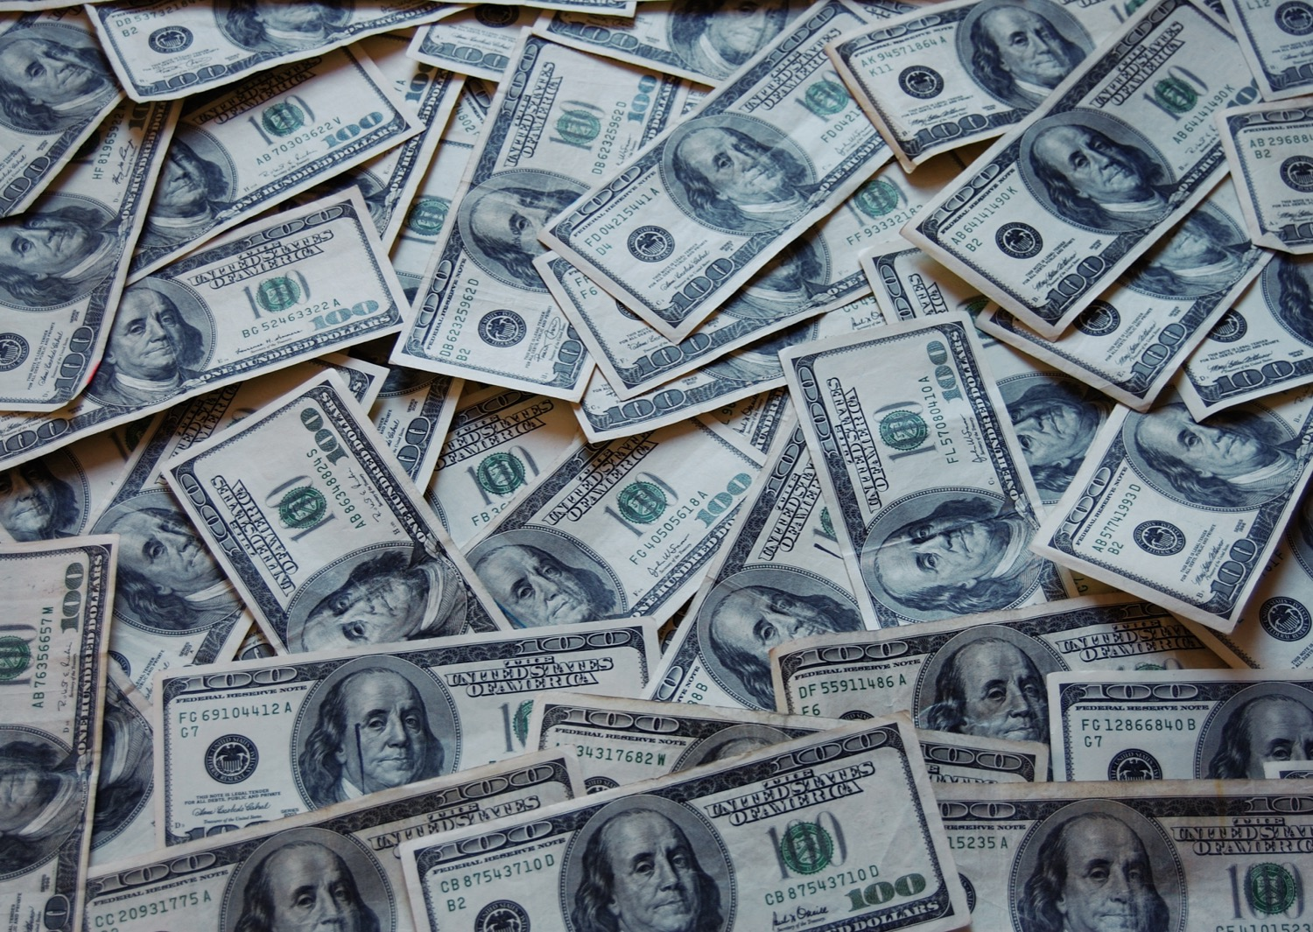
Section 2: Trade

Slide 3
SECTION 2: TRADE
  Essential Question:
    Why do producers sometimes turn out a low supply of their goods?

Slide 4
SECTION 2: TRADE
  What terms do I need to know?:
    supply
    profit
    demand
    specialization
    trade
    exports
    imports
    tariff
    quota
    embargo
    subsidy
    standards
    currency
    exchange rate

Slide 5
SUPPLY AND DEMAND
Supply is the quantity of a good or service available for sale, which can affect both purchasing decisions and prices.
    Typically, when the supply of something is high, the price is low.
A producer’s goal is to fell goods and services for more than it costs to produce them.
    Profit is the difference between cost of production and selling price of a good or service.
Demand describes the quantity of a good or service consumers are willing to buy.
    Demand is based on a buyer (1) wanting something, (2) having the ability to pay for it, and (3) be willing to pay attention to price.
While separate concepts, considering supply and demand together helps us understand when people are willing to buy certain items and why.

Slide 6
SPECIALIZATION AND TRADE
Specialization can help a country become economically successful.
    By focusing on making only a few products based on their resources, they can maximize profit from trade.
Trade is the voluntary exchange of goods and services among people and countries.
When trade is voluntary and non-fraudulent, both parties benefit and are better off after trading than they were before.
Goods sent to other countries for trade are exports, and goods brought into a country for trade from other countries are called imports.

Slide 7
BARRIERS TO TRADE
Some say too much trade with other countries causes domestic workers to lose jobs, so countries sometimes will limit trade by creating trade barriers.
The most common are tariffs and quotas.
    A tariff is a tax on imports coming into the country.
    A quota is a specific limit placed on the number of imports that may enter a country.
Another trade barrier is an embargo, or a government order stopping trade with another country.
    Sometimes, this is used to put pressure on another country.
A subsidy is another trade barrier, where the government of a country gives money to certain businesses so they can continue to compete with imported goods.
The final trade barrier is a standard, when the government sets limits and rules regarding imports and domestic goods.

Slide 8
TRADE AND EXCHANGING CURRENCIES
Currency is the money people use to make trade easier.
    However, since different countries may have different currencies, trade between nations require exchanging currencies.
An exchange rate is the price of one nation’s currency in terms of another nation’s currency.
    It helps to accurately exchange the value of one currency to another when trading.
    For example, when this PowerPoint was written, one United States dollar was the equivalent to 18.44 Mexican pesos, meaning the USD has a higher value.
Return to Main Menu

Slide 9
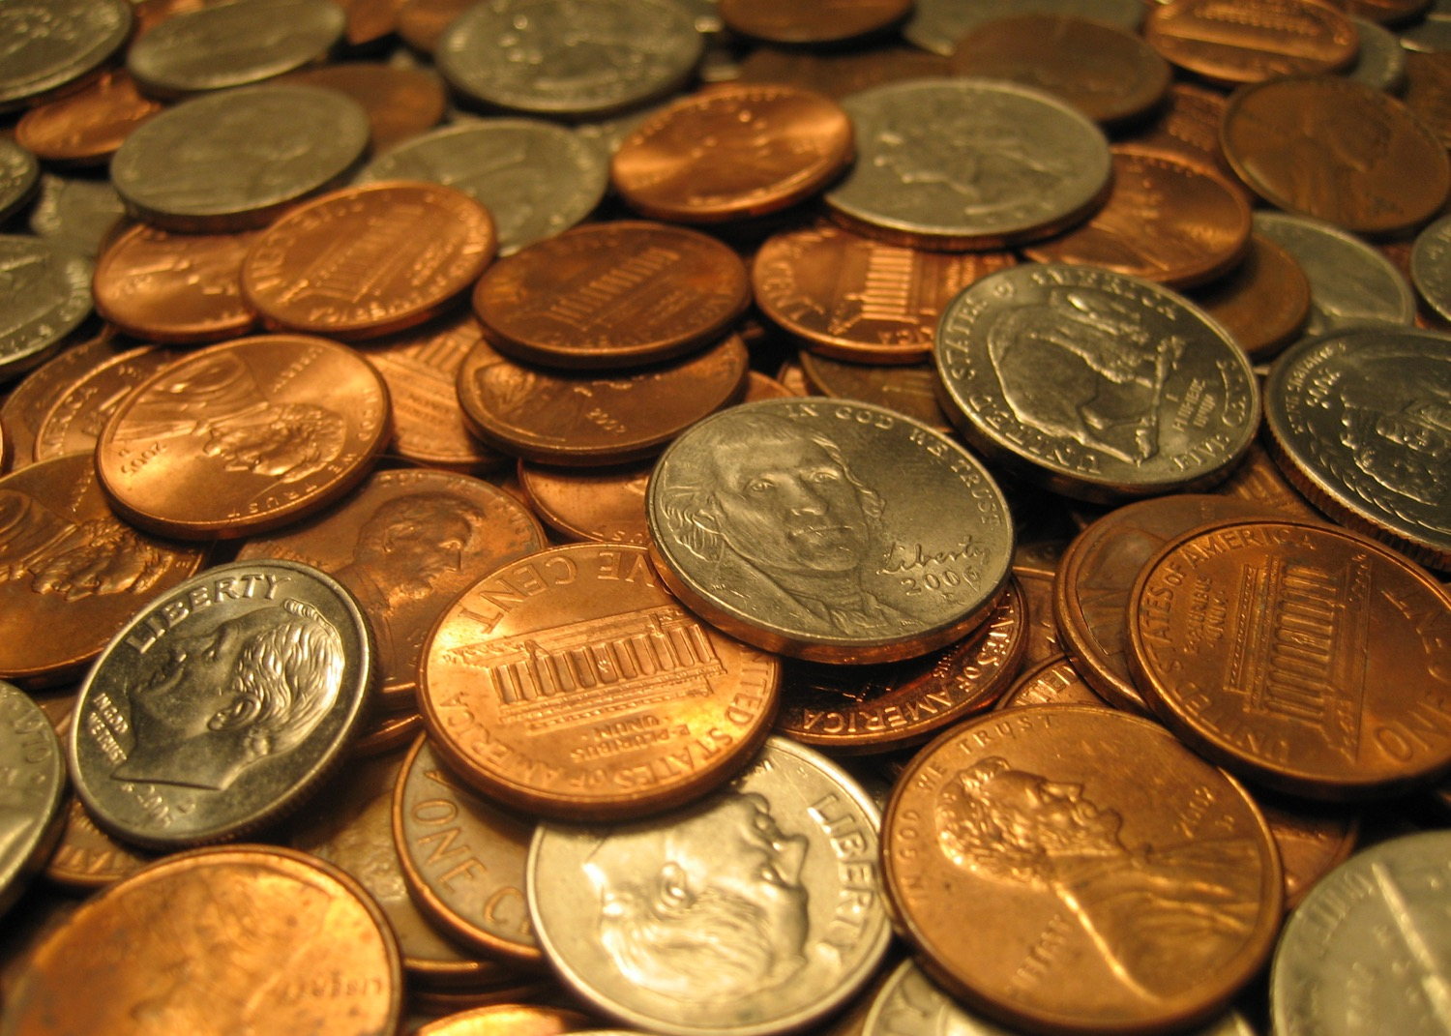
Image Credits: all Wikimedia Commons. Maps ©2025 Clairmont Press.
Return to Main Menu

