Slide 1
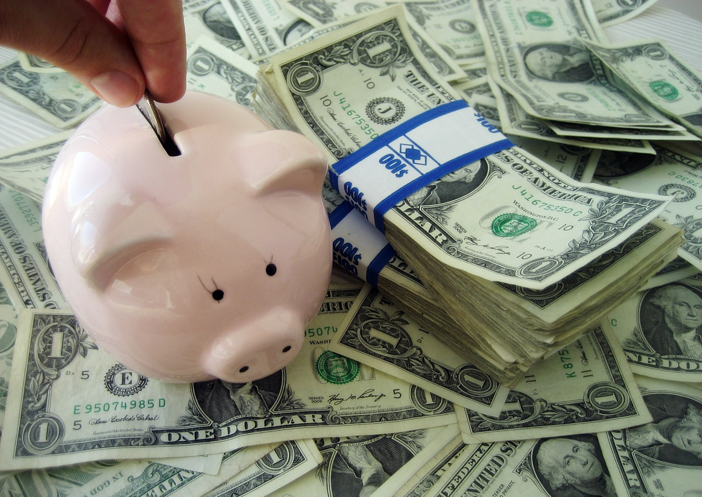
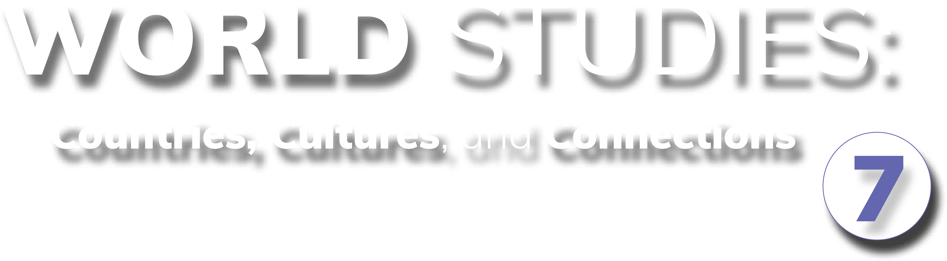
Chapter 3: Economic Understandings STUDY PRESENTATION
© 2025 Clairmont Press

Slide 2
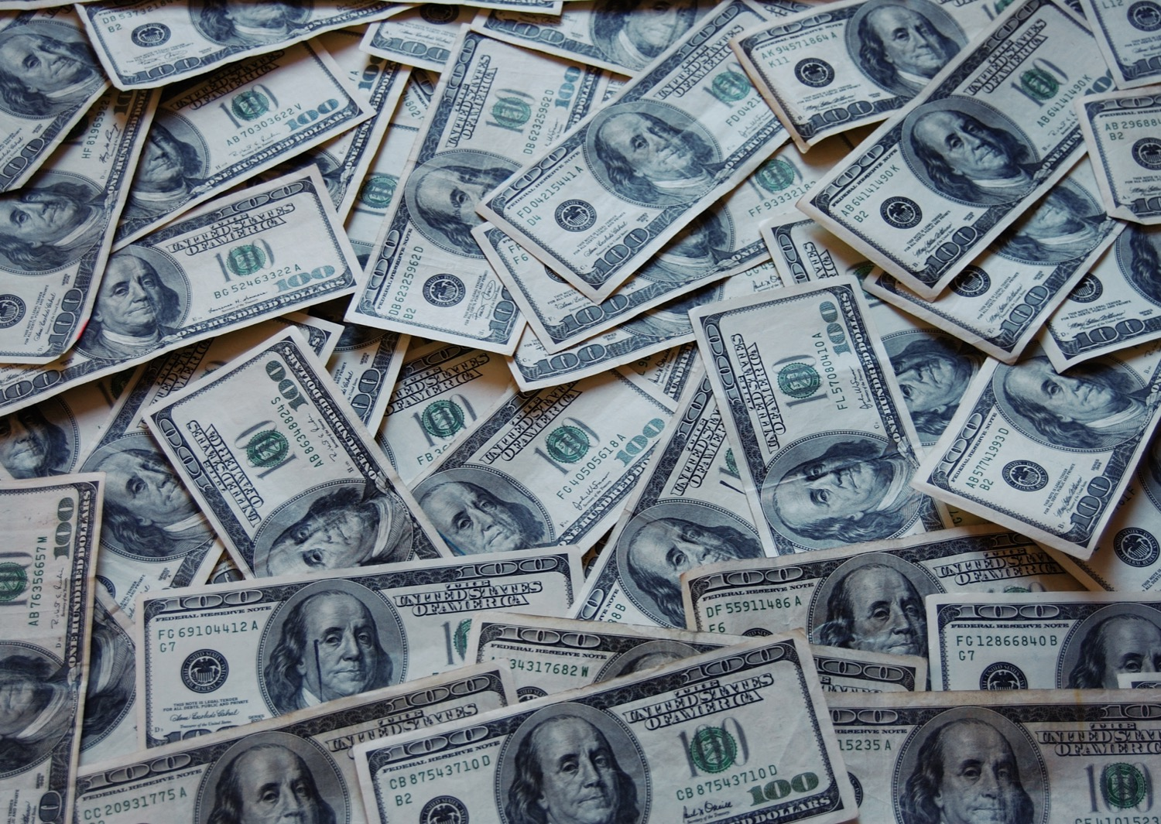
Section 3: Economic Systems and Growth

Slide 3
SECTION 3: ECONOMIC SYSTEMS
Essential Question:
What are the three basic economic questions that every country must answer?

Slide 4
SECTION 3: ECONOMIC SYSTEMS
What terms do I need to know?:
economist
traditional economy
barter
command economy
market economy
mixed economy
economic continuum
Gross Domestic Product (GDP)
Consumer Price Index (CPI)
inflation
unemployment
factors of production
natural resources
renewable
nonrenewable
capital goods
infrastructure
human capital
entrepreneurship
income
expenses
literacy rate
life expectancy

Slide 5
ECONOMIC MODELS
A person who studies an economy is called an economist.
Economists study the ways people or countries address the issue of limited resources, since no country has everything its people want or need.
Countries must answer these questions:
What goods and services will be produced?
How will they be produced?
Who are the goods and services produced for?
These answers determine the economic system.

Slide 6
Traditional Economy
Traditional economies are defined as:
Heavily dependent on agriculture.
People tending to barter (trade items of value rather than money).
Economic decisions are often based on long-held customs.
In this system, each member of society at an early age knows what their role in the larger group will be since jobs are inherited.
People are dependent upon each other to fulfill their roles, because the alternative is the breaking-down of the system.

Slide 7
Command Economy
In command economies, government planning groups make the basic economic decisions, determining what to produce, the prices, and wage rates.
Businesses and farms are generally owned by the government, who give the workers production goals to reach in order to provide the proper amount of goods for the country.
One problem with this economy occurs when the government attempts to predict what people will need but ends up overlooking another portion of the economy.
A benefit of this economy is that prices are controlled and people know how much things will cost. Common needs, like food and shelter, have lower costs than luxuries, like televisions and computers, which are priced higher.

Slide 8
Market Economy
In market economies, economic decisions are made at an individual level, with producers answering economic questions based on their beliefs of how consumers will respond to goods.
Businesses and farms decide what they want to produce individually in order to make a profit.
A benefit of this economy is that consumers have an easy time finding what goods they want, and they are free to earn as much money as they’d like in order to buy the goods and services they want.
A problem is that, if a business doesn't manage its money well, it can go out of business and cause workers to lose their jobs and income.

Slide 9
All Economies are Mixed
No countries today have any pure market system, instead blending characteristics of the three.
These hybrids are called mixed economies.
That said, most economies tend to lean more towards one system than the others.
Most societies have rules protecting consumers, workers, and businesses.
To see where a country falls, between command and market economies, we use the economic continuum, where 0 represents a pure command economy and 100 represents a pure market economy.

Slide 10
MEASURING THE ECONOMY
A major economic indicator economists use is the Gross Domestic Product (GDP), which measures the total value of goods and services produced within a country in one year.
The GDP per capita, or per person, is best used when comparing two countries’ economies.
For example, India’s GDP was about $3.417 trillion while South Korea’s was about $1.674 trillion in 2022, but the GDP per capita of India was about $7,100 while South Korea’s was about $45,000.

Slide 11
MEASURING THE ECONOMY, Pt. 2
The Consumer Price Index (CPI) measures prices monthly in a country. When it shows prices are rising steadily, this indicates inflation (a continual increase in the price of goods and services).
If wages do not increase at a level to keep up with inflation, a consumer’s spending power decreases.
An unemployed person is someone without a job but has been actively looking for one, and the unemployment rate tracks the number of unemployed people in a country.
A low supply of jobs means workers are willing to accept lower wages for a job, but low unemployment means businesses have to offer higher wages to attract employees.

Slide 12
FACTORS OF PRODUCTION
Factors of production are the resources of a society needed to produce a good or service.
Factors of production are natural resources, capital goods, human resources, and entrepreneurship.
Natural resources are products of the Earth and its atmosphere that are useful to humans.
These resources can be renewable, or things that can replenish themselves over time like plants and animals, and nonrenewable, or or things that are not replenishable like mineral resources.
Capital goods are the tools used in the production of goods and services, like textile mills, furniture factories, and even infrastructure (basic structures and buildings a country needs to function).

Slide 13
FACTORS OF PRODUCTION, Pt. 2
Human resources describe the people who produce goods or services by transforming natural resources through effort and activity.
Entrepreneurship occurs when people start their own businesses, risking money and time in hopes for a successful business.
To be successful, a business must earn a profit, which is the expenses of resources subtracted from the income of selling their goods or services.

Slide 14
INCREASING THE GROSS DOMESTIC PRODUCT
To improve a country’s GDP, governments and people must invest in the factors of production.
Countries can invest in natural resources by developing ways to harness their power, like oil, solar, and wind energy.
Countries can invest in capital goods, including factories, technologies, and buildings needed for businesses to operate.
Countries can invest in education, training, health, and skills of workers, increasing both the literacy rate (percent of the population over 15 that can read and write) and life expectancy (average lifespan of people).
Countries can invest in entrepreneurship by providing financial assistance or reducing barriers to starting a business.

Slide 15
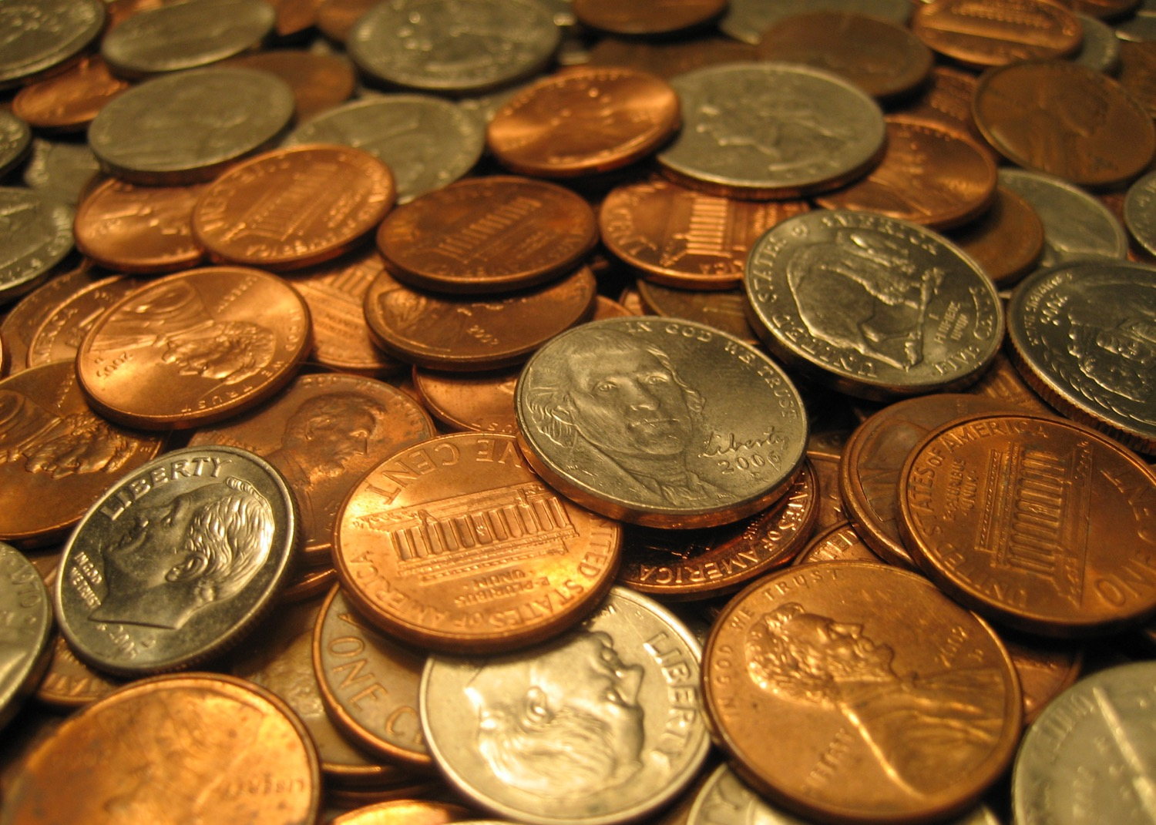
Image Credits: all Wikimedia Commons. Maps ©2025 Clairmont Press.
Return to Main Menu

