Slide 1
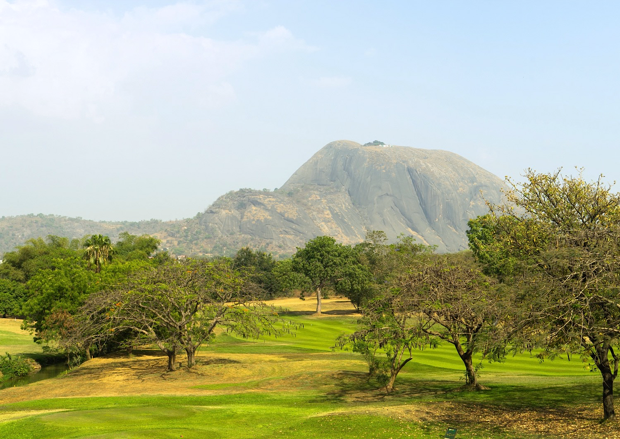

Chapter 11: Federal Republic of Nigeria
STUDY PRESENTATION
© 2025 Clairmont Press

Slide 2
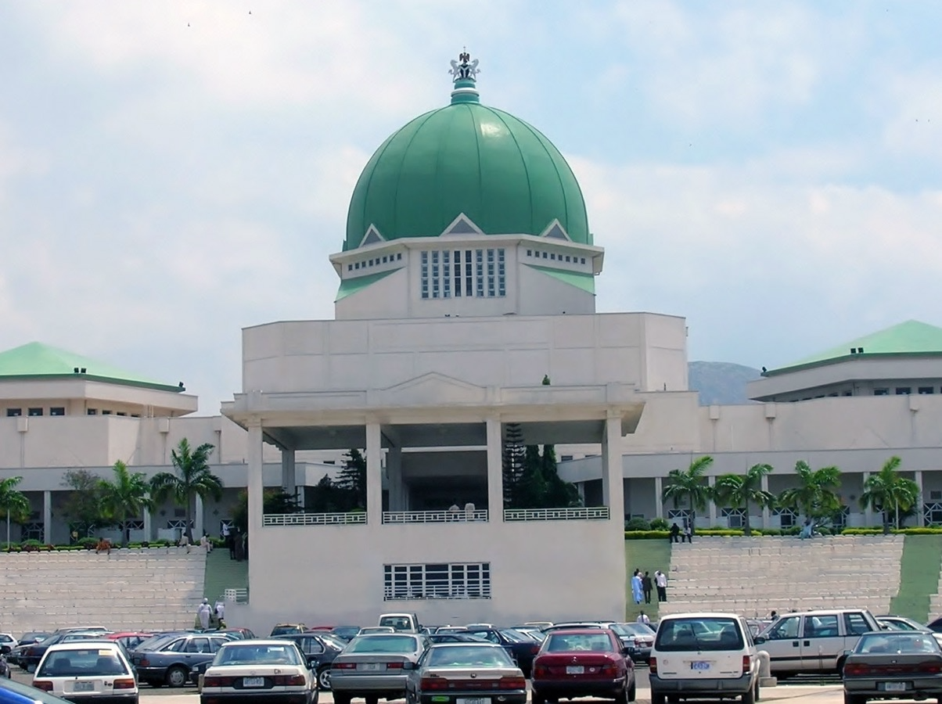
Section 1: The Geography of Nigeria

Slide 3
SECTION 1: THE GEOGRAPHY
OF NIGERIA
  Essential Question:
    What is the role of religion in Nigeria?

Slide 4
SECTION 1: THE GEOGRAPHY
OF NIGERIA
  What terms do I need to know?:
  delta
  navigable
  tropical savanna climate
  harmattan
  diverse
  Boko Haram

Slide 5
LOCATION AND SIZE OF NIGERIA
Nigeria is in the eastern and northern hemispheres and is located on Africa’s west coast.
Nigeria is bordered by Niger, Benin, Cameroon, Chad, and the Gulf of Guinea.
Nigeria’s land area is about 356,000 miles, which is roughly six times the size of Georgia.

Slide 6
PHYSICAL GEOGRAPHY OF NIGERIA
The Niger River is the source of the country’s name and is the largest river in West Africa.
    The river begins in Guinea and flows through Guinea, Mali, Niger, Benin, and Nigeria to the Gulf of Guinea.
The river flows through rain forests and swamps and has a delta, which is where a river divides into smaller bodies of water as it meets with a larger body of water.
Most of the river is navigable, or ships can operate on it, which is great for trade and shipping.

Slide 7
PHYSICAL GEOGRAPHY OF NIGERIA, Pt. 2
While the coastline is rich in oil, government corruption and other problems have prevented the country from enjoying these benefits.
The country has low plains in the south with some dense forests, highlands and extinct volcanoes in the central part of the country, and the north has rolling plains with plateaus.

Slide 8
CLIMATE OF NIGERIA
Nigeria is just north of the Equator, meaning temperatures are high, with the most common climate being the tropical savanna climate.
    That means monthly average temperatures are above 64° F year-round.
    A dry winter season is followed by a rainy season in May.
Along the coast is hot and wet most of the year, with tropical rain forests in this area.
The climate is hotter and drier in the north, with few plants being able to grow.
    During the winter, a dry wind called the harmattan blows from the northeast, carrying dust from the Sahara across the region.

Slide 9
NATURAL RESOURCES OF NIGERIA
Nigeria has large deposits of petroleum and natural gas along with other natural resources.
    Unfortunately, the money from selling the oil has not benefitted many, due to mismanagement and corruption.
Nigeria has other natural resources that the government has not invested in because of its investment in the oil trade.
Even though Nigeria has a large amount of arable land, it still has to import much of its food to meet the needs of the people.
Nigeria also has talc, gypsum, iron ore, lead, zinc, gold, coal, gemstones, rock salt, and kaolin.

Slide 10
IMPACT OF LOCATION IN NIGERIA
About half the people in the country still live in rural areas, practicing traditions.
The coast is heavily populated because it is easier to trade and is the center of the oil industry.
Areas along the Niger River and its delta are also heavily populated.
Cities like Lagos and Abuja are both large urban centers.

Slide 11
ENVIRONMENTAL
ISSUES IN NIGERIA
Deforestation is a problem, causing soil erosion as well as destroying habitats for plants and animals and disrupting the water cycle.
Urbanization brings with it pollution problems.
    Nigeria deals with oil spills quite a bit, which can contaminate the water, air, and land.
The government needs to balance earning money from oil with protecting the environment.

Slide 12
PEOPLE OF NIGERIA
Nigeria is a very diverse, or varied, country, with the Hausa, Igbo, and Yoruba ethnic groups making up a 5th of the population.
Nigeria is also divided by religion, with half being Muslim, 40% being Christian, and the remaining 10% practicing indigenous beliefs.
    Religious tensions are a constant problem, with the militant Muslim group Boko Haram trying to take over parts of the country.
Generally, religion is taken very seriously, and most people will make frequent references to their faith.

Slide 13
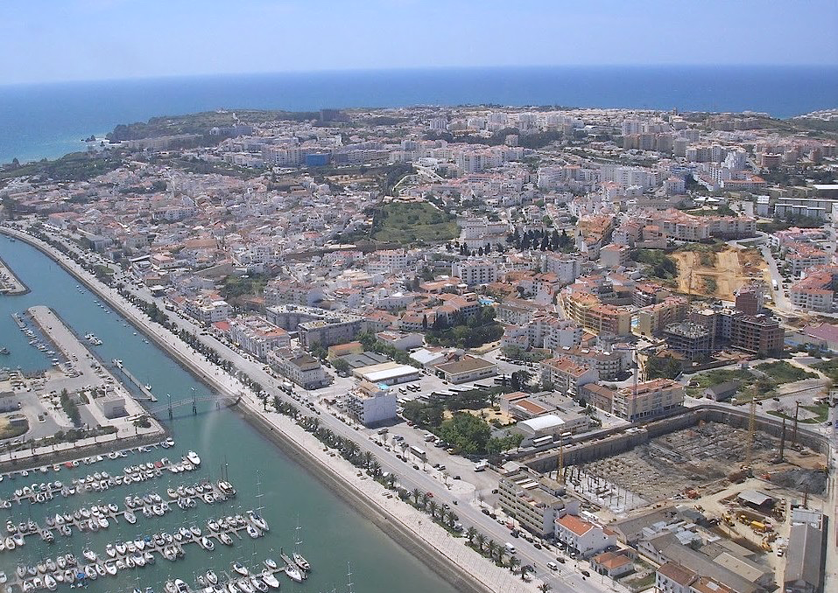
Image Credits: all Wikimedia Commons. Maps ©2025 Clairmont Press.
Return to Main Menu

