Slide 1


Chapter 11: Federal Republic of Nigeria
STUDY PRESENTATION
© 2025 Clairmont Press

Slide 2
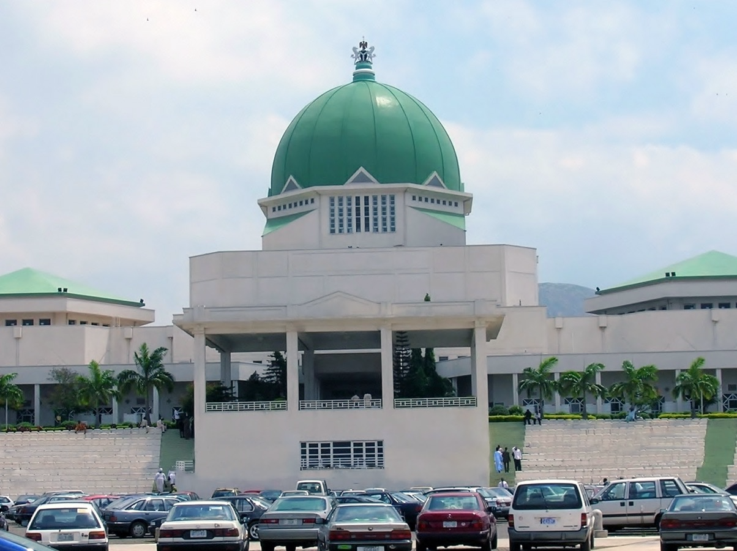
Section 2: A Brief History of Nigeria

Slide 3
SECTION 2: A BRIEF HISTORY OF NIGERIA
Essential Question:
What was the immediate aftermath of independence in Nigeria?

Slide 4
SECTION 2: A BRIEF HISTORY OF NIGERIA
What terms do I need to know?:
merchant
missionary
Pan-African Movement
nationalism
Independent State of Biafra
civil war
military coup
civilian rule

Slide 5
EARLY HISTORY
Throughout its history, Nigeria has had many different ruling systems and has come in frequent contact with foreign traders.
The first group of traders that came to Nigeria were merchants, or people involved in trade, from North Africa and the Arabian Peninsula.
These traders brought gold, ivory, iron, slaves, and gum, as well as the Quran and Islam.
Two of the four trans-Saharan trade routes went through Nigeria, which made it a crossroads of people, goods, and ideas from around the continent.
European traders arrived in the 15th century, looking for gold and slave labor.
For over 300 years, the human slave trade was conducted along Africa’s shores, with the center of the trade in Nigeria.

Slide 6
BRITISH COLONIAL HISTORY
The British stayed in Nigeria even after they abolished slavery in 1807.
They were interested in Nigeria’s cocoa, groundnuts, rubber, and palm oil, so they made permanent settlements in Nigeria.
The British used the Niger River to move inland.
Along with their takeover, they brought missionaries to promote Christianity in the country.
British influence and control over Nigeria grew over the 19th century.

Slide 7
PAN-AFRICAN MOVEMENT
This movement began as a reaction to colonial rule in Africa.
The goal of the Pan-African Movement was for all people of African decent to work together to improve Africa and to think of Africa as a homeland.
Another goal was to end European colonial rule, and as it spread through Nigeria and the rest of Africa, many Nigerians began pushing for independence.

Slide 8
INDEPENDENCE
After World War II, Nigeria was granted more freedoms through a series of constitutions, and nationalism (love for one’s country and a desire for independence) grew.
After gaining independence in 1960, war broke out between the Muslim north and Christian south, leaving thousands dead or injured.
When the country tried to reorganize itself into twelve regions, the Igbo people in the east declared themselves to be the Independent State of Biafra, resulting in a 30-month civil war (war between citizens of the same country).
By the end, Biafra was again part of Nigeria, but military coups (military takeovers of the government) and violence occurred in the years following.

Slide 9
INDEPENDENCE, Pt. 2
In 1999, a new constitution was adopted, and a civilian government was established.
Nigeria is currently experiencing its longest period of civilian rule (which means that the leaders have not been part of the military), despite some minor violence around elections.
There were accusations of voting irregularities and corruption in the 2023 election, leading to protesting in the streets.

Slide 10
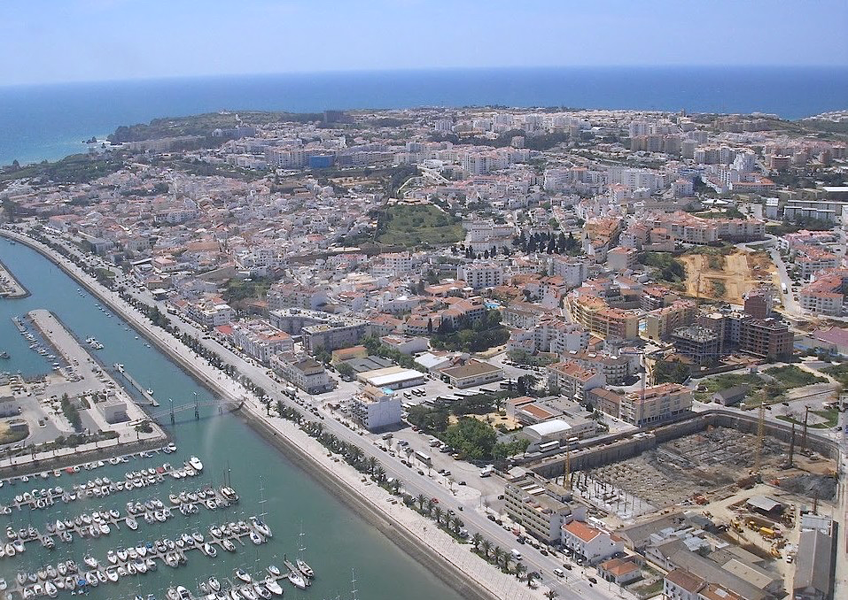
Image Credits: all Wikimedia Commons. Maps ©2025 Clairmont Press.
Return to Main Menu

