Slide 1


Chapter 11: Federal Republic of Nigeria
STUDY PRESENTATION
© 2025 Clairmont Press

Slide 2
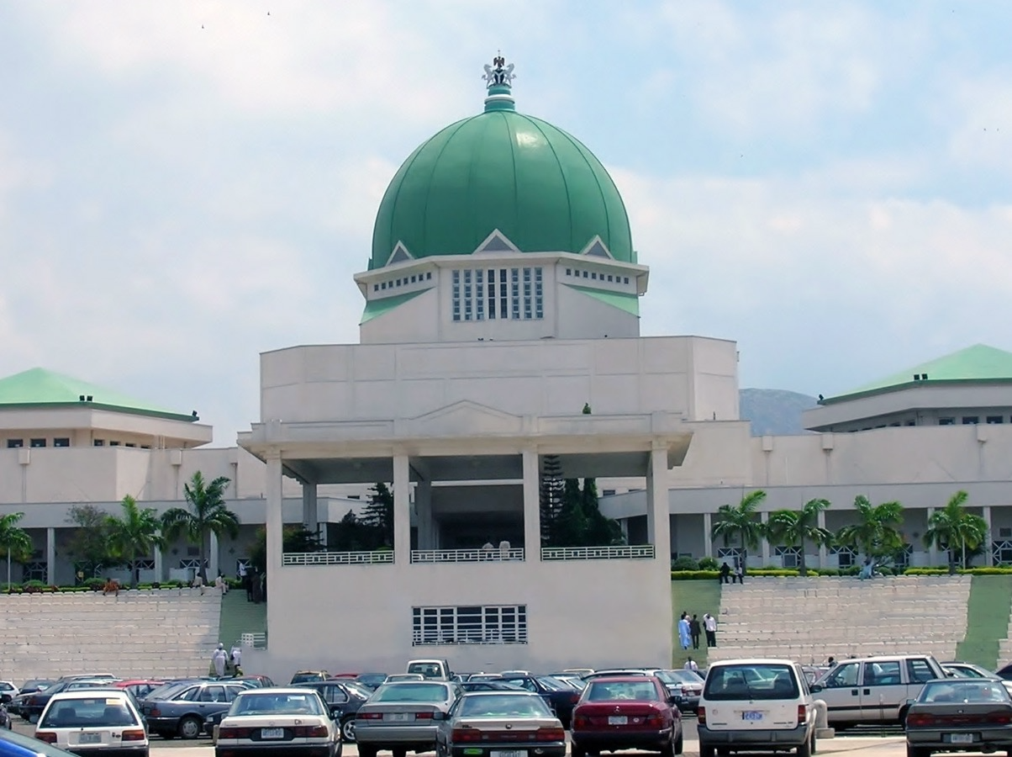
Section 3: Government of Nigeria

Slide 3
SECTION 3: GOVERNMENT OF NIGERIA
Essential Question:
How do citizens participate in the government?

Slide 4
SECTION 3: GOVERNMENT OF NIGERIA
What terms do I need to know?:
republic
federal government
presidential democracy
Federal Executive Council
National Assembly
Supreme Court

Slide 5
STRUCTURE OF GOVERNMENT
Nigeria is a republic, which means it has elected representatives.
Nigeria also has a federal government, which means power within the government is divided among the national, state, and local governments.
Nigeria is a presidential democracy, which means a president is both head of government and head of state.
The constitution, written in 1999, established a civilian government and has been amended several times.

Slide 6
CITIZEN PARTICIPATION
Citizens ages 18 and up vote directly for the president and legislature.
While the constitution guarantees freedom of speech, expression, press, and religion, these rights are not always protected.
Both the government and Boko Haram have been guilty of limiting people’s rights.

Slide 7
BRANCHES OF GOVERNMENT
The head of government (president) and cabinet make up the executive branch.
The cabinet, called the Federal Executive Council, is appointed by the president.
The legislative branch, called the National Assembly, is made up of two houses: the Senate and the House of Representatives.
The judicial branch has a Supreme Court, with a chief justice and 15 justices, appointed by the president and confirmed by the Senate.
Sharia Law is used in some states in the north, but most Nigerian laws are based on British law traditions.

Slide 8
CHALLENGES FACING THE GOVERNMENT
Government corruption and terrorism are common problems in the country.
The country also has had a long period of military dictators as rulers, so they are getting used to elected leaders.
The government is working to strengthen its democracy and diversify its economy.
The Nigerian government forces have a lack of understanding on how to respond to peaceful protests, like when they killed close to 500 people in 2015.
Boko Haram has been a looming threat to the government and citizens of Nigeria since 2009.

Slide 9
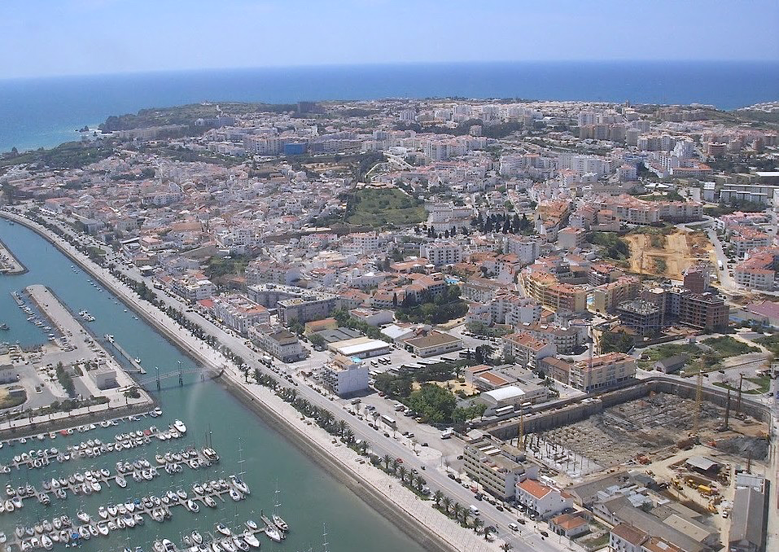
Image Credits: all Wikimedia Commons. Maps ©2025 Clairmont Press.
Return to Main Menu

