Slide 1


Chapter 11: Federal Republic of Nigeria
STUDY PRESENTATION
© 2025 Clairmont Press

Slide 2
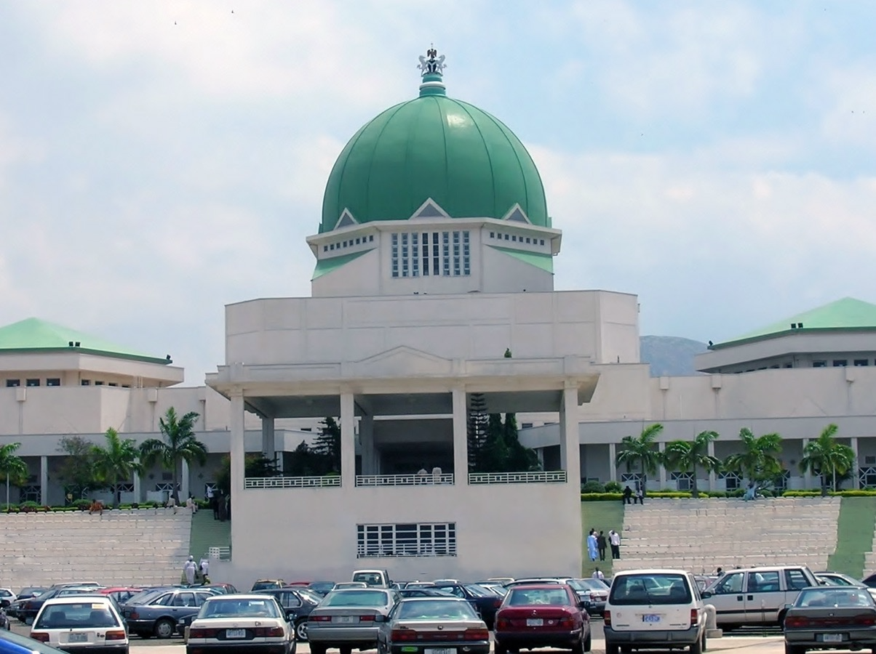
Section 4: Economy of Nigeria

Slide 3
SECTION 4: ECONOMY OF NIGERIA
Essential Question:
What factors are driving Nigeria’s economic growth?

Slide 4
SECTION 4: ECONOMY OF NIGERIA
What terms do I need to know?:
Nollywood
diversified economy
infrastructure
naira

Slide 5
TYPE OF ECONOMY
Nigeria has the largest economy in Africa, with a GDP of $362 billion as of 2023.
Nigeria’s economy is mixed, leaning toward a market economy.
Because of their oil reserves, Nigeria is a member of OPEC, and their reserves have been a dominant source of income since the 1970s.
Nigeria’s economic growth has recently been driven by agriculture, telecommunications, and services, but it has not been enough to decline poverty levels.
Nigeria’s entertainment industry includes a growing film industry that has been nicknamed Nollywood.

Slide 6
TYPE OF ECONOMY, Pt. 2
The most important challenge is developing a diversified economy, or one that is broadened to focus on other resources and industries instead of just one.
Nigeria is branching into telecommunications, financial services, and cement.
Nigeria is trying to improve its infrastructure, which includes roads, railways, and communication systems.
This would not only benefit Nigerians, but also businesses trading goods.

Slide 7
Natural Resources
Nigeria has a wide variety of natural resources.
It has roughly 37 billion barrels of petroleum and 209 trillion cubic meters of natural gas.
It also has talc, gypsum, iron ore, lead, zinc, gold, coal, rock salt, gemstones, and kaolin.
The government does not focus too much on these resources, though.

Slide 8
Human Capital
Nigeria should have a strong economy thanks to its rich oil deposits, but years of corruption, civil war, and military rule have left it poor.
Investment in human capital is a way to make the economy grow.
The literacy rate is currently about 62%, with 71% for men and 52% for women.
Investments in healthcare have improved the child mortality rate, and Nigeria also faces the second-highest rate of HIV/AIDS in the world.

Slide 9
Capital Goods
Nigeria has heavily invested in capital goods for the oil industry.
However, focus on this part of the economy has left many Nigerians without proper food or housing.
Nigeria does not have a large manufacturing sector, with most of their non-oil related capital goods having to be imported.
Infrastructure improvements have begun, making the transportation of goods and people easier.

Slide 10
Entrepreneurship
Currently, it is not easy to be an entrepreneur in Nigeria.
Nigeria’s government is working to help small businesses thrive.
It costs about four times the average annual income to get a business license.

Slide 11
TRADE
Trade is very important to Nigeria.
In 2023, the country’s exports totaled roughly $60 billion, and its imports totaled roughly $72 billion.
The country’s major exports are crude petroleum, natural gas, fertilizer, refined petroleum, and gold, while its imports were refined petroleum, wheat, garments, plastics, and automobiles.

Slide 12
CURRENCY
The currency of Nigeria is the naira, which can be exchanged at banks or electronically so trade can occur.
In 2024, one US dollar can be exchanged for about 1,591 Nigerian nairas.

Slide 13
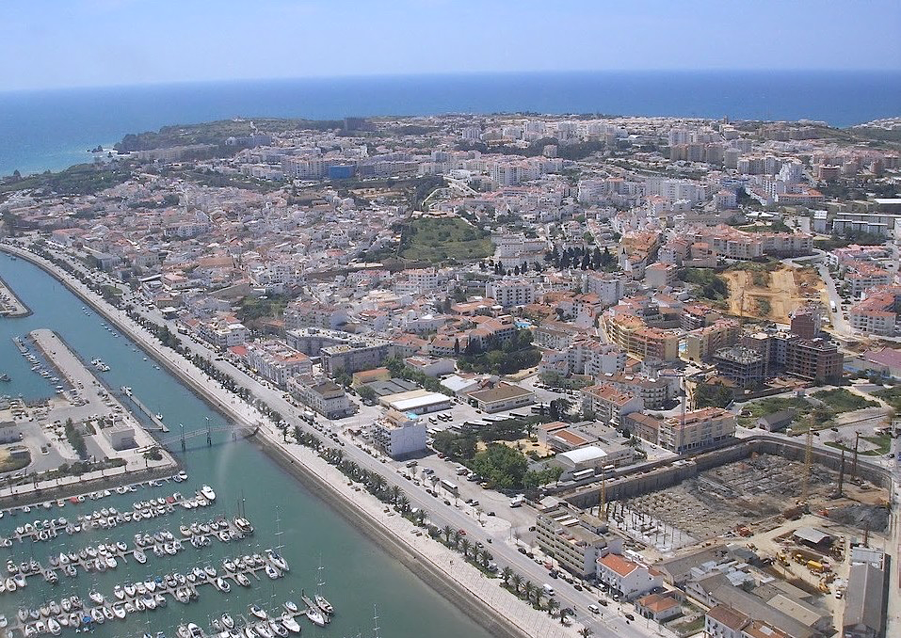
Image Credits: all Wikimedia Commons. Maps ©2025 Clairmont Press.
Return to Main Menu

