Slide 1


Chapter 11: Federal Republic of Nigeria
STUDY PRESENTATION
© 2025 Clairmont Press

Slide 2
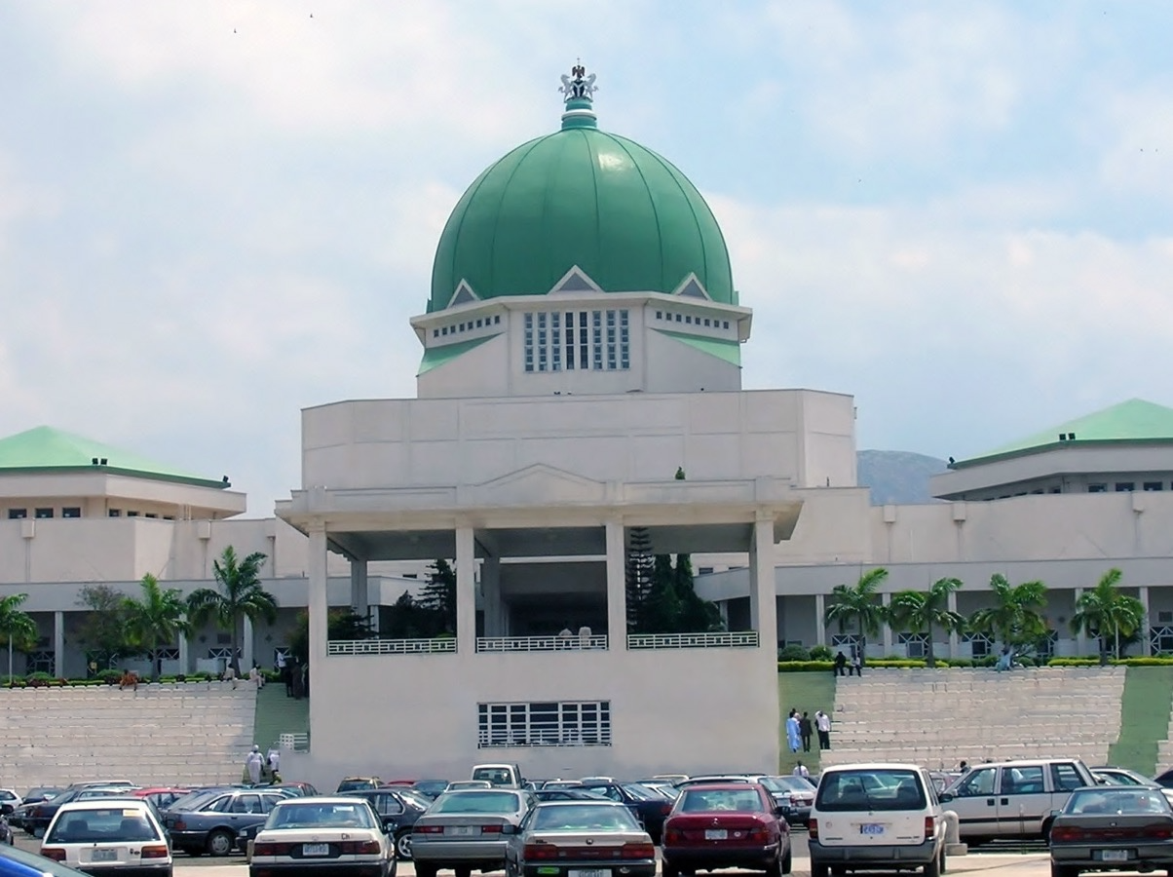
Section 5: U.S.-Nigeria Relations

Slide 3
SECTION 5: U.S.-NIGERIA RELATIONS
Essential Question:
What are some reasons the relationship between the two countries was strained?

Slide 4
SECTION 5: U.S.-NIGERIA RELATIONS
What terms do I need to know?:
diplomatic relations
African Growth and Opportunity Act (AGOA)

Slide 5
IMPROVING RELATIONS
The US established diplomatic relations, or an arrangement where two nations have representatives in each other’s country, with Nigeria in 1960, following its independence from the United Kingdom.
From 1966-1999, Nigeria experienced many civil wars and military coups.
Following the adoption of the new constitution in 1999, relations improved, along with cooperation on foreign policy goals like peacekeeping.
The two countries hold talks on key areas: good governance, anti-corruption, trade, investment, food security, security, and counterterrorism.

Slide 6
U.S. ASSISTANCE TO NIGERIA
The US wants to help improve economic stability, security, and sell-being for Nigerians by strengthening their democracy.
Nigeria is combatting corruption in their government, and improving transparency will help citizens trust the government again.
The US also wants to help with health, education, and agricultural production.

Slide 7
BILATERAL ECONOMIC RELATIONS
The US is Nigeria’s largest foreign investor in Nigeria, with most investments concentrated on petroleum, mining, and the trade sector.
Nigeria is eligible for preferential trade benefits under the African Growth and Opportunity Act (AGOA), which increases the market access to the US for qualifying countries in sub-Saharan Africa.
The US and Nigeria have signed a bilateral trade and investment framework agreement.

Slide 8
NIGERIA’S MEMBERSHIP IN INTERNATIONAL ORGANIZATIONS
Nigeria and the US belong to many of the same organizations, including the United Nations, International Monetary Fund, World Bank, and World Trade Organization.
Nigeria is also an observer to the Organization of American States.
Nigeria is a member of the Organization of Petroleum Exporting Countries (OPEC), who’s goal is to control the price of oil in the world by controlling the supply.

Slide 9
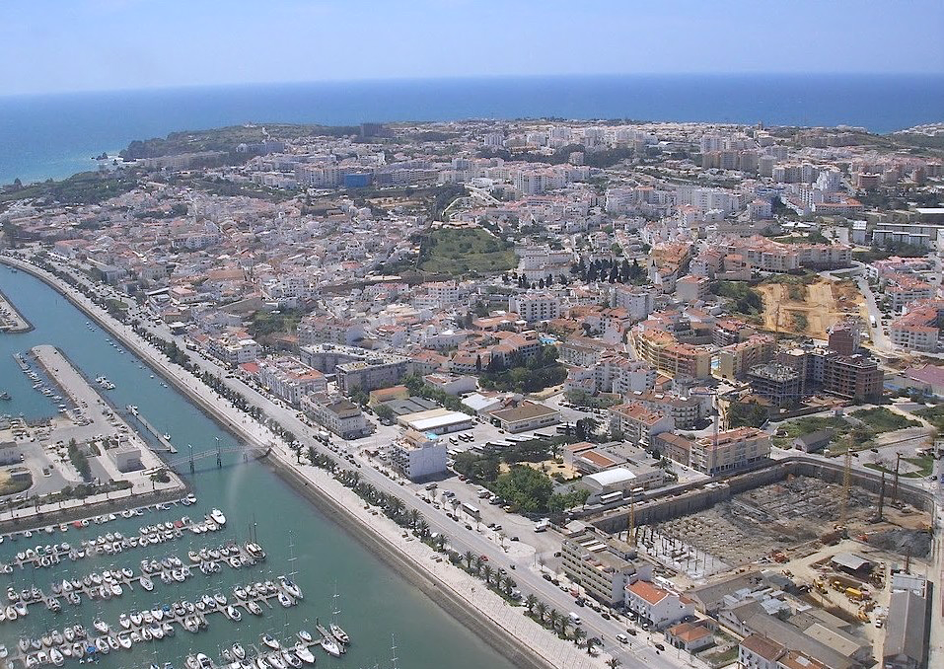
Image Credits: all Wikimedia Commons. Maps ©2025 Clairmont Press.
Return to Main Menu

