Slide 1
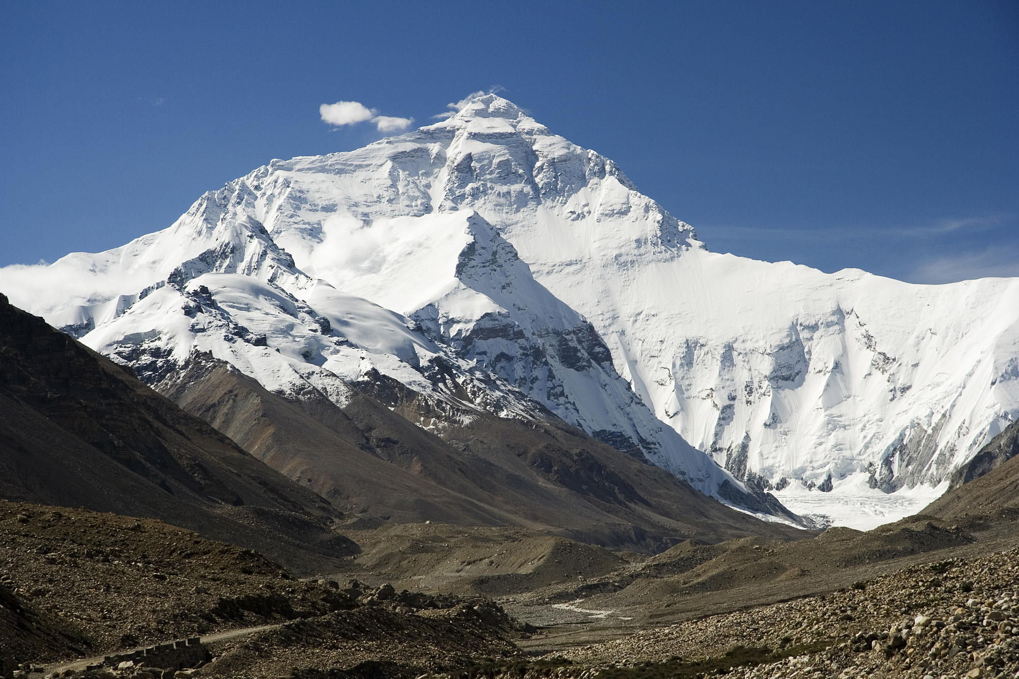

Chapter 12: Geography and History of Southern and Eastern Asia
STUDY PRESENTATION
© 2025 Clairmont Press

Slide 2
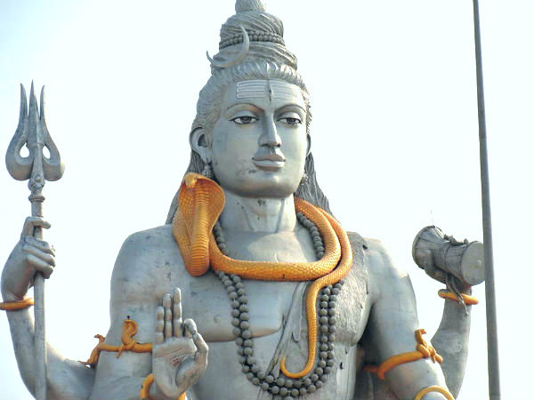
Section 1: The Geography of Southern and Eastern Asia

Slide 3
SECTION 1: THE GEOGRAPHY OF SOUTHERN AND EASTERN ASIA
Essential Question:
How have the Himalayas influenced the history and culture of Asia?

Slide 4
SECTION 1: THE GEOGRAPHY OF SOUTHERN AND EASTERN ASIA
What terms do I need to know?:
subcontinent
tectonic plate
archipelago
peninsula

Slide 5
LOCATION OF THE COUNTRIES OF SOUTHERN AND EASTERN ASIA
Twenty-nine countries make up the region separated by different geographic features.
India is a subcontinent (a large land area mostly separate from the rest of a continent) and is also on a different tectonic plate (a separate part of Earth’s crust) than most of the rest of Asia.
North over the Himalayas, China has one of the largest economies and second largest population in the world.
To the east, North Korea is virtually cut off from the rest of the world, while South Korea has a growing, high-tech economy.
The Sea of Japan separates the Korean Peninsula from Japan, which is an archipelago (a chain of islands).
To the Southwest, Vietnam’s economy is beginning to grow thanks to trade with the US.

Slide 6
PHYSICAL FEATURES OF ASIA
Southern and Eastern Asia are home to many of the longest rivers in the world, like the Ganges River, the Chang Jiang (Yangtze) River, and the Huang He (Yellow) River.
The Himalayan Mountains are the tallest mountain range in the world, with Mount Everest as its highest peak.
The Taklamakan Desert in western China and the Gobi Desert in northern China are among the largest in the world.
Connected to China is the Korean Peninsula, which is a landform surrounded on three sides by water.
The Sea of Japan and the South China Sea are two of the larger bodies of water in Southern and Eastern Asia.

Slide 7
IMPACT OF GEOGRAPHY ON WHERE PEOPLE LIVE AND HOW THEY TRADE
India is separated from the rest of Asia by mountains. Most of India’s population lives in river valleys south of the Himalayas. The rivers provide water for irrigation, travel, trade routes, and drinking water.
China’s population is more concentrated around its rivers, opposed to its mountain and desert regions, because of the rivers’ resources.
In North Korea and South Korea, geography and politics influence the trade success (or failures) of the countries.
As an island nation with few natural resources, Japan relies on trade by sea and air to meet the needs and wants of its people.

Slide 8
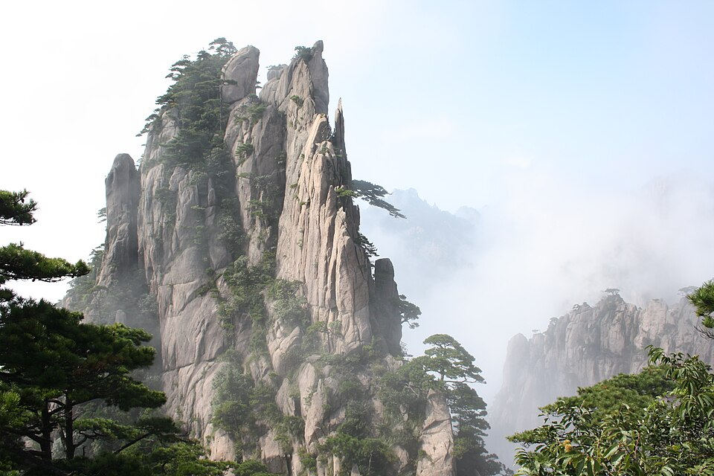
Image Credits: all Wikimedia Commons. Maps ©2025 Clairmont Press.
Return to Main Menu

