Slide 1
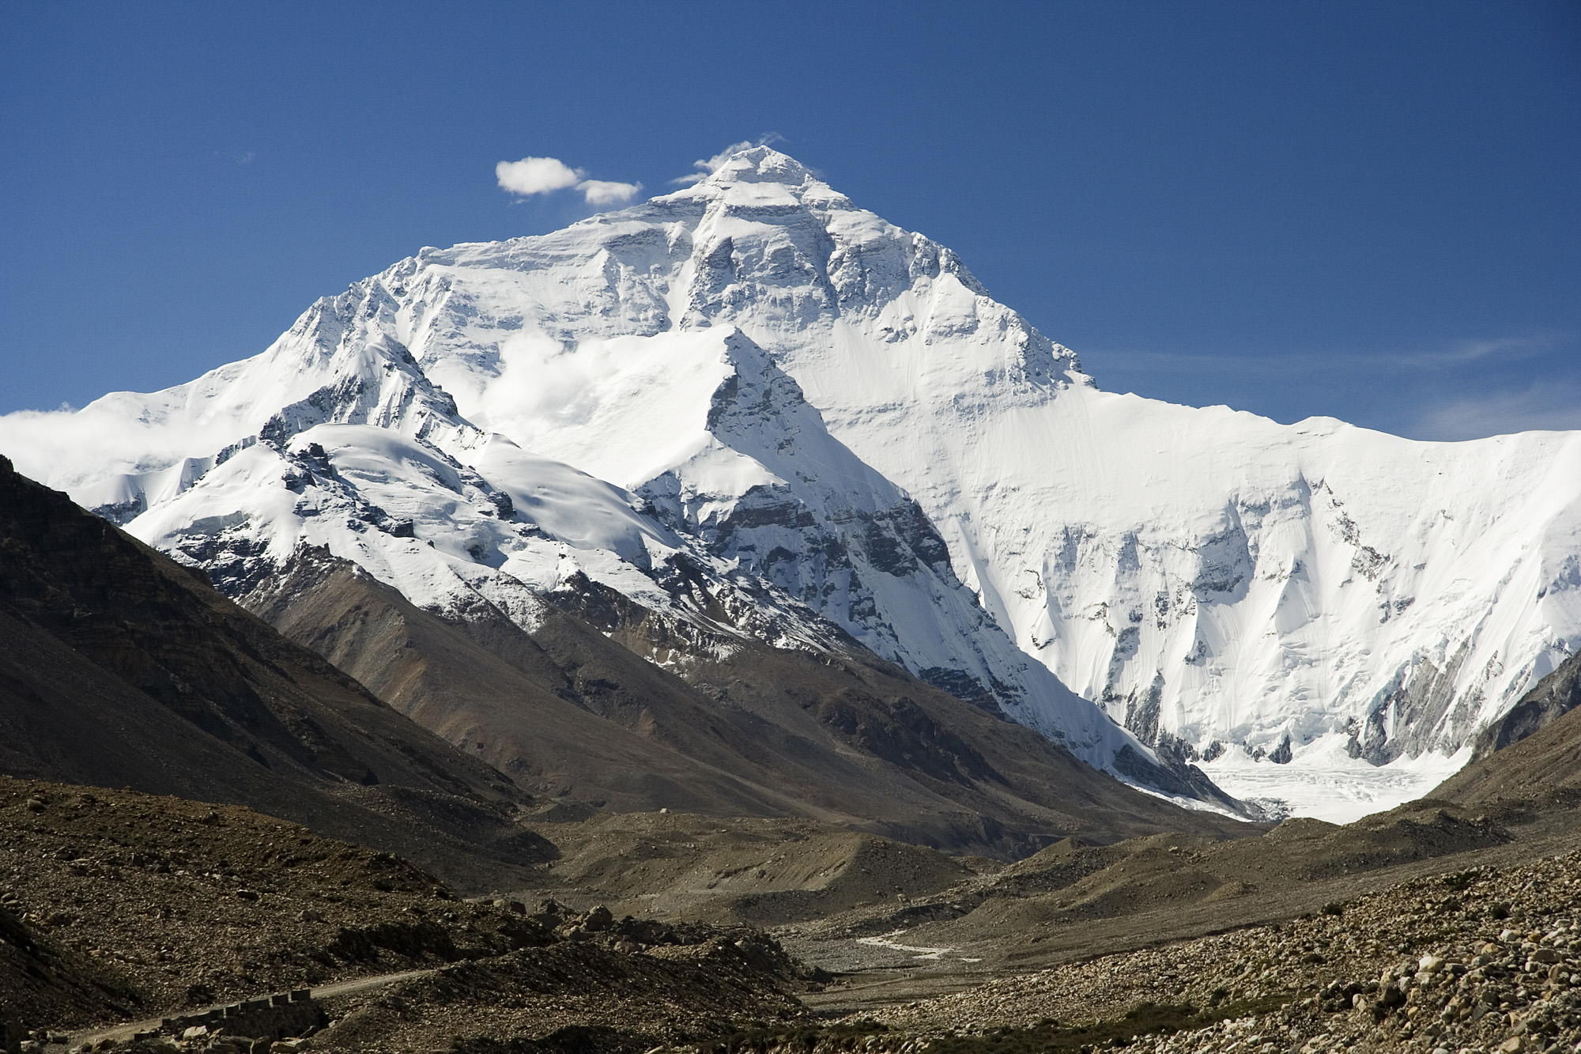

Chapter 12: Geography and History of Southern and Eastern Asia
STUDY PRESENTATION
© 2025 Clairmont Press

Slide 2
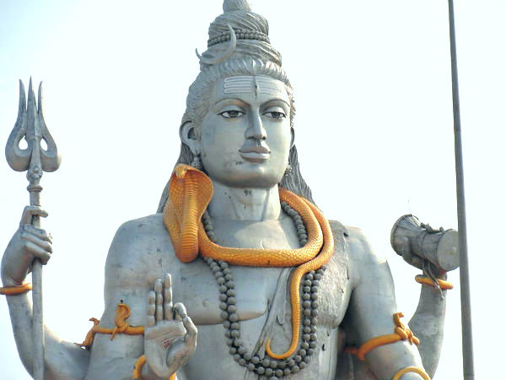
Section 2: The People of Asia

Slide 3
SECTION 2: THE PEOPLE OF SOUTHERN AND EASTERN ASIA
Essential Question:
What are differences between ethnic groups and religious groups?

Slide 4
SECTION 2: THE PEOPLE OF SOUTHERN AND EASTERN ASIA
What terms do I need to know?:
ethnic group
religious group
philosophy
Hinduism
Vedas
Brahman
reincarnation
karma
caste system
Buddhism
Four Noble Truths
Nirvana
Middle Way
Tripitaka
Mahayana Sutras
Shintoism
kami
Confucianism
Golden Rule of Behavior
Analects

Slide 5
ETHNIC AND RELIGIOUS GROUPS IN ASIA
An ethnic group refers to a group of people who share cultural ideas and beliefs that have been a part of their community for many years.
These commonalities include language, religion, history, types of food, and a set of traditional stories, beliefs, or celebrations.
A religious group refers to a group of people who share a belief system in a god or gods with a specific set of rituals and literature.
The four main ethnic and religious groups in Asia include Hinduism, Buddhism, Shinto, and Confucianism.
Hinduism, Buddhism, and Shinto are religions native to Southern and Eastern Asia.
China is the birthplace of Confucianism, which is not a religion, but rather a philosophy, based on morality and good deeds.

Slide 6
Hinduism
Hinduism is one of the oldest religions in the world and was founded in India around 1500 BC. Aryan priests followed complicated rituals and hymns known as the Vedas.
There is no specific founder for Hinduism, unlike other religions. Followers of Hinduism are called Hindus.
Many gods and goddesses exist in Hinduism, but it is believed that they are all part of a supreme “universal spirit” named Brahman.
The Ganges River is a holy river for Hindus, and several religious practices involve the river.

Slide 7
Hinduism, Pt. 2
Reincarnation is the religious belief that when a person dies, their soul is reborn into a person or animal according. This is based on his or her good or bad deeds, or karma.
The caste system, a system of social classes that are inherited and cannot be changed, acts an important religious and social influence for Hindus.
The traditional castes include Brahmans, Kshatriyas, Vaishyas, and Sudras.
Over time, the castes have been further divided, complicating the structure of India’s social structure.

Slide 8
Buddhism
Buddhism was founded by Siddhartha Gautama around 500 BC.
Siddhartha sought answers as to why there is so much suffering in the world. After meditation, Siddhartha became known and “Buddha” or “The Enlightened One.” He believed the cause of human suffering to be greed and the desire for material things.
The central teaching of Buddhism is called the Four Noble Truths, which include moral “truths” and instructions for conduct.
Nirvana exists as a state of perfect peace for Buddhists. It can be reached by following the Middle Way, via rules outlined by the Eightfold Path.
The Tripitaka and the Mahayana Sutras make up two Buddhist texts.

Slide 9
Shintoism
Shintoism is a religion unique to Japan, with no specific date of origin or founder. It is closely intertwined with Japanese culture.
The main belief of Shintoism is reverence for the kami, which are spirits that Shinto followers believe live in nature, animals, and a person’s ancestors.
Followers offer prayers and perform rituals to honor and please the kami.
Shintoism has been a part of Japanese life for so long that it is thought of as part of Japanese culture.

Slide 10
Confucianism
Confucianism was founded by a Chinese scholar named Confucius around 550 BC.
Confucius emphasized good character and virtue as a means to peace and social order.
Confucius’s teachings were written down in the Analects.
The Golden Rule of Behavior says, “What you do not like when done unto you, do not do to others.”
Confucius believed his philosophy would bring order to China if leaders and the government followed Confucianism’s guiding principles.
The Chinese and many other people throughout Southern and Eastern Asia continue to respect and practice Confucianism teachings.

Slide 11

Image Credits: all Wikimedia Commons. Maps ©2025 Clairmont Press.
Return to Main Menu

