Slide 1
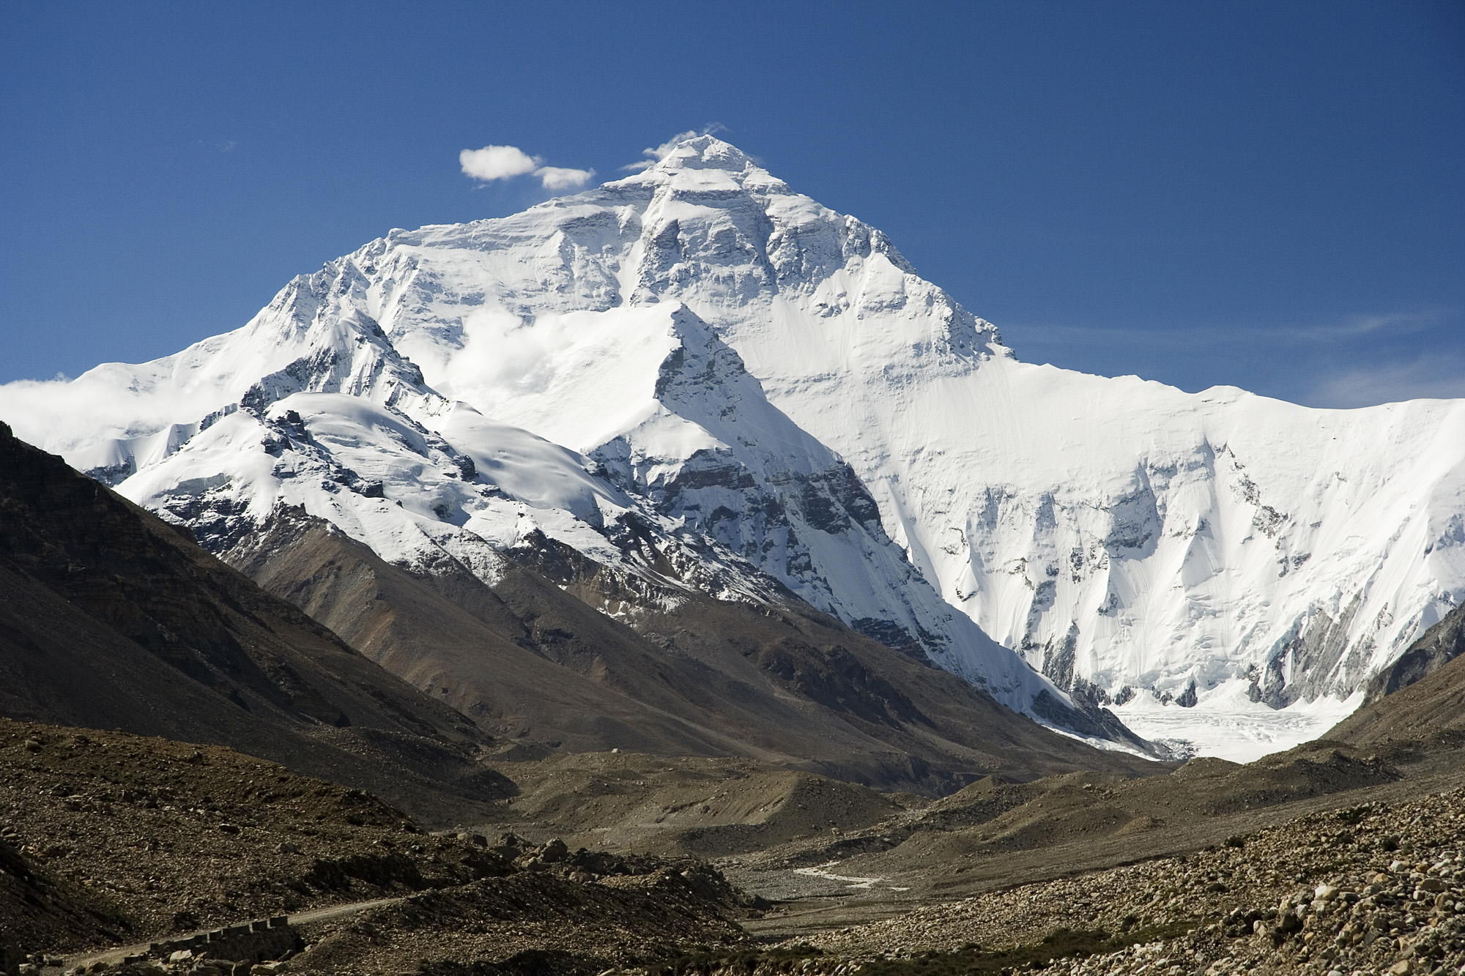
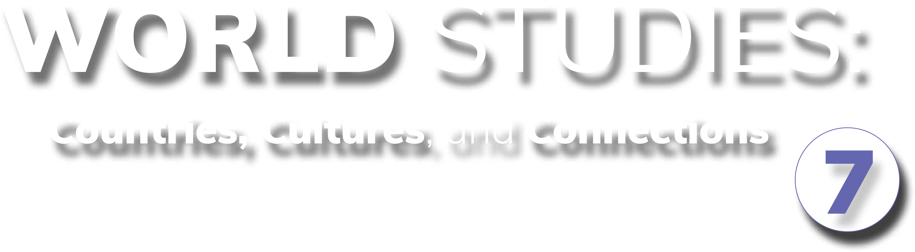
Chapter 12: Geography and History of Southern and Eastern Asia
STUDY PRESENTATION
© 2025 Clairmont Press

Slide 2
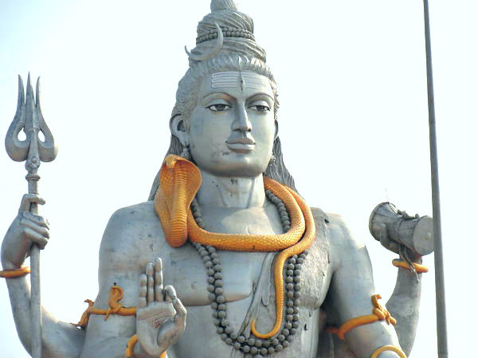
Section 3: A Brief History of Southern and Eastern Asia

Slide 3
SECTION 3: A BRIEF HISTORY OF SOUTHERN AND EASTERN ASIA
Essential Question:
How did the events of World War II impact Asia politically and socially?

Slide 4
SECTION 3: A BRIEF HISTORY OF SOUTHERN AND EASTERN ASIA
What terms do I need to know?:
nationalism
communism
Cold War
containment
domino theory
armistice
demilitarized zone

Slide 5
COLONIALISM AND STRUGGLES FOR INDEPENDENCE
Many regions of Southern and Eastern Asia were colonized by European powers.
India was colonized by the British, and France colonized most of Southeast Asia.
Although the Koreas, China, and Japan escaped European colonization, they were all affected by the independence movements and growth of communism.
Many Asian countries gained independence after World War II.

Slide 6
WORLD WAR II AND ITS AFTERMATH
During World War II, Japan took over many parts of the Pacific and China, but they were pushed back by the US and its allies.
Nationalism (pride in one’s country) fueled independence movements across the region.
Communism, a type of government in which a single party controls the country and the government owns all property and controls the economy, took hold in Vietnam and China.
The Cold War, a war of words with no direct fighting, began after World War II as the United States sought containment to stop the spread of communism to other Asian countries.

Slide 7
KOREAN WAR
The US believed that if one country became communist, other neighboring countries would also fall to communism – a concept known as the domino theory.
After WW2, the Korean Peninsula was divided: the Soviet-controlled north and the Allied-controlled south.
North Korean forces invaded the south to reunify the peninsula in 1950, but UN forces fought them back, resulting in an armistice (pause in fighting) in 1953.
In the end, the peninsula was divided into two countries: the northern, communist half, and the southern, democratic half.
Tensions remain between North Korea and South Korea. The border between the two countries is a demilitarized zone, which means no military equipment or people are allowed within the border.

Slide 8
VIETNAM WAR
Many Vietnamese wanted to reorganize their country under the communist leadership of Ho Chi Minh, but the US feared the spread of communism.
War broke out in 1955 between the North Vietnamese, supported by the Soviet Union, and the South Vietnamese, supported by the US.
Many resources were contributed to the war, but it became increasingly unpopular in the US.
The US withdrew their military by 1975, and Vietnam was soon united under a communist government.

Slide 9
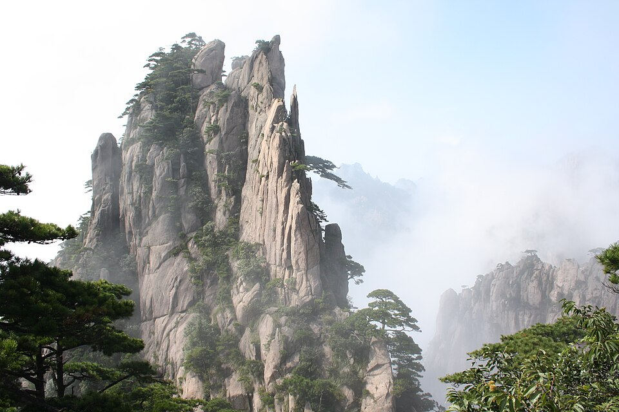
Image Credits: all Wikimedia Commons. Maps ©2025 Clairmont Press.
Return to Main Menu

