Slide 1

Smart Skills
Week 1 - Map 1
Notes:
See the Smart Skills directions on the Teacher Tech Website for World Studies 7th Grade for teaching suggestions.
Teacher notes and answers will display in this space.

Slide 2
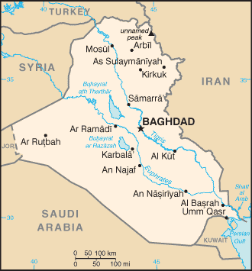
Monday
What is the country featured in the map?
What countries border the featured country?
Notes:
Iraq
Turkey, Syria, Jordan, Saudi Arabia, Kuwait, Iran

Slide 3
TUESDAY
What are the major rivers located in Iraq?
Into what body of water do the rivers empty?
Notes:
Tigris and Euphrates
the Persian Gulf

Slide 4
WEDNESDAY
What is roughly the distance from Baghdad to the Persian Gulf?
Notes:
About 300 miles.

Slide 5
THURSDAY
Why do you believe that Iraq strongly defends its Persian Gulf ports?
Notes:
Open answer (the Persian Gulf is its only direct access to the ocean, making it important for its Navy and shipping)

Slide 6
FRIDAY
What are some key components that would improve this map?
Notes:
Open answer

