Slide 1

Smart Skills
Week 1 – Chart/Graph 1
Notes:
See the Smart Skills directions on the Teacher Tech Website for World Studies 7th Grade for teaching suggestions.
Teacher notes and answers will display in this space.

Slide 2
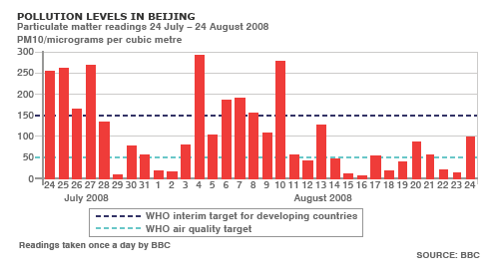
Monday
What type of graph is shown here?
What is the graph displaying?
Notes:
Bar graph
the pollution levels in Beijing, China

Slide 3
TUESDAY
What is the source of this graph?
What do the X axis and the Y axis each display?
Notes:
BBC
X axis: days of the month, Y axis: amount of particulate matter in the air

Slide 4
WEDNESDAY
What is the day that has the highest particulate matter reading?
What is the range in time that the study was conducted?
Notes:
August 4th, 2008
one month

Slide 5
THURSDAY
What do each of the dashed lines indicate on the graph?
According to this graph, in the opinion of the WHO (World Health Organization) does Beijing, China have an air pollution issue?
Notes:
WHO air quality targets for developed and developing countries
yes, it does, since it has an average above their target.

Slide 6
FRIDAY
Why is it important for people across the world to understand different graphs?
How can graphs be an international tool to help solve problems across borders?
Notes:
Open answer
open answer

