Slide 1

Smart Skills
Week 1 - Artifact 1
Notes:
See the Smart Skills directions on the Teacher Tech Website for World Studies 7th Grade for teaching suggestions.
Teacher notes and answers will display in this space.

Slide 2
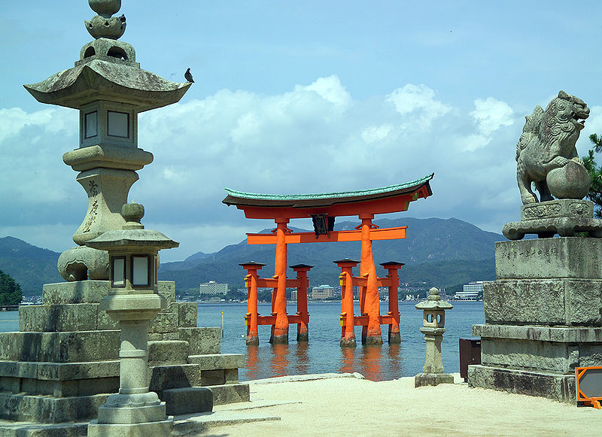
Monday
Analyze the image. Which continent do you believe the image is from?
What evidence in the picture led you to your choice?
Notes:
Open answer (Asia)
open answer

Slide 3
TUESDAY
What do you think the focal point of the image is?
Why do you believe that it is the most significant part of the image?
Notes:
Open answer
open answer

Slide 4
WEDNESDAY
What might be the purpose of the structures in the image?
Explain your answer.
Notes:
Open answer

Slide 5
THURSDAY
The picture is of the Japanese Itsukushima Shrine. It is a Shinto Shrine.
Compare and contrast this to religious buildings or shrines in your city or town.
Notes:
Open answer

Slide 6
FRIDAY
Why do you believe societies build monuments, shrines, and other ceremonial structures?
How can future archaeologists learn from structures such as this?
Notes:
Open answer
Open answer

