Slide 1

Smart Skills
Week 1 – Political Cartoon 1
Notes:
See the Smart Skills directions on the Teacher Tech Website for World Studies 7th Grade for teaching suggestions.
Teacher notes and answers will display in this space.

Slide 2
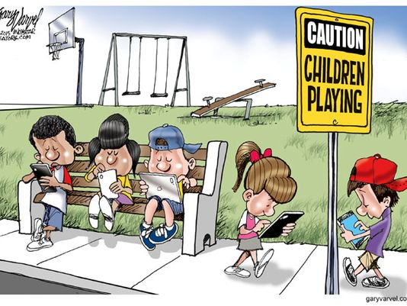
Monday
Who is the author of the political cartoon?
What is the date of the political cartoon?
Who or what is the subject of the cartoon?
Notes:
Gary Varvel
2015
Children’s use of electronic devices

Slide 3
TUESDAY
Describe what you are viewing in the political cartoon.
How is the artist trying to convey his message?

Slide 4
WEDNESDAY
What is the cartoon meant to signify: humor, anger, sarcasm, or disgust?
What emotions does the cartoon stir in you?

Slide 5
THURSDAY
Does the cartoonist choose a political side in this cartoon?
Do you feel like the cartoonist is making a fair statement? Explain.

Slide 6
FRIDAY
How can a cartoonist be an influential citizen in society?
Why is it important to analyze the political standpoint of the cartoonist?

