Slide 1
CHAPTER 10
WESTERN VIRGINIA IN THE NEW NATION – 1787-1850
Section 1 Virginia Revises Its Constitution
Section 2 Improving Transportation

Slide 2
SECTION 1
Virginia Revises Its Constitution
Main Menu

Slide 3
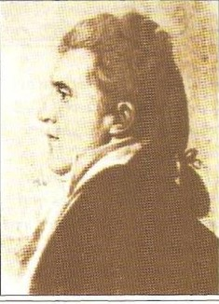
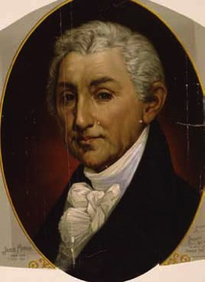
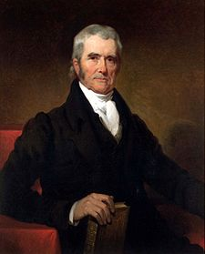
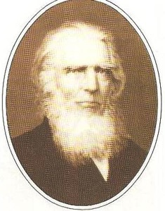
Virginia Constitutional Convention
1829
Delegates
Phillip Doddridge
James Monroe
John Marshall
Judge Lewis Summers
Alexander Campbell
James Madison

Slide 4
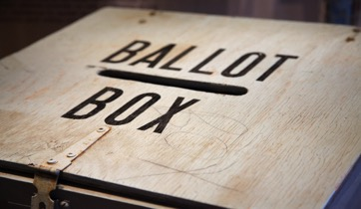
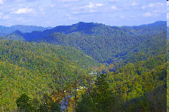
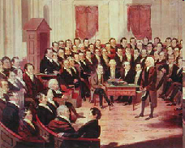
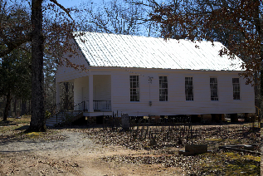
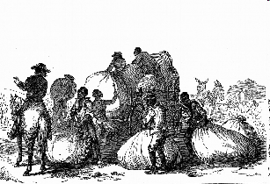
Western Virginia vs. Eastern Virginia
Western and Eastern Virginia drew farther apart because of a number of factors, including
suffrage
geography
representation in the state legislature
religion
slavery

Slide 5
Constitutional Issues
Suffrage/Representation
Eastern Virginians wanted to include slaves in the population count to determine representation in the state legislature.
Western Virginians wanted the vote for all white men.
They also wanted property qualifications for voting.
Virginia Constitution of 1830
Extended suffrage to people who rented property
Gave the Virginia General Assembly the right to reapportion voting districts after 1841

Slide 6
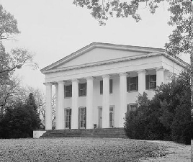
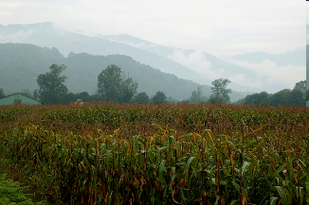
Geographic Differences
Eastern Virginia had large estates or plantations.
Berry Hill Plantation
Western Virginia, with its hilly terrain, could only support small farms.

Slide 7
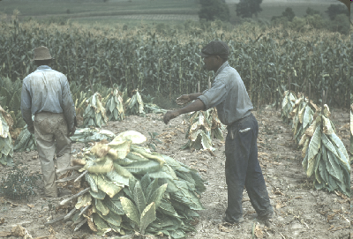
Slavery
Eastern Virginia supported slavery because the planters needed slave labor to maintain their plantations.
Arguments FOR slavery:
Arguments AGAINST slavery:
Slavery was not forbidden in the United States Constitution.
Slavery went against the Declaration of Independence.
The Bible showed the ills of slavery.
The Bible mentioned slaves.
Western Virginia pushed for the emancipation of slaves.

Slide 8
Religious groups took sides in the slavery issue, further dividing eastern and western Virginia.
In the West, religious denominations included Methodist, Baptist, Presbyterian, Quaker, Dunkard, Mennonite, Moravian, and Lutheran.
In the East, the most important church was the Episcopal Church, which supported slavery. Many wealthy, aristocratic slave owners were members of the Episcopal Church.
Some Methodist, Baptist, and Presbyterian churches also supported slavery.
The Methodist church actually split into two divisions because of the slavery issue.

Slide 9
Ruffner Pamphlet
Henry Ruffner made a speech at Washington College (now Washington and Lee University) in which he took a firm stand against slavery.
He suggested that slavery was responsible for limiting economic progress in western Virginia. He compared Wheeling and Pittsburgh and concluded that Pittsburgh had become larger and more industrialized than Wheeling because slavery was not allowed in Pennsylvania.
He further stated that western Virginia’s resources of forests, iron, coal, limestone, and salt were ideally suited to industrialization, but were not developed because of the emphasis of the eastern-dominated Virginia legislature on slavery.
Ruffner proposed that the Virginia legislature permit western Virginia to be free while the eastern tidewater could be slave.

Slide 10
The Reform Convention of 1850
Those attending from western Virginia
Gideon D. Camden (Harrison County)
John S. Carlile (Barbour County)
Charles J. Faulknier (Berkeley County)
Joseph Johnson (Harrison County)
Benjamin Smith (Kanawha County)
George W. Summers (Kanawha County)
Waitman T. Wiley (Monongalia County)

Slide 11
Accomplishments of the Constitutional Convention of 1850
Changes in Suffrage
Eliminated property tax as a voting requirement
Eliminated the inclusion of slaves in determining representation
Gave vote to all white men over 21 years of age
Required a capitation tax on all voters
RESULTS
Western Virginia gained control of the House of Delegates
Eastern Virginia maintained control of the Senate
The sphere of power began to shift to the West.

Slide 12
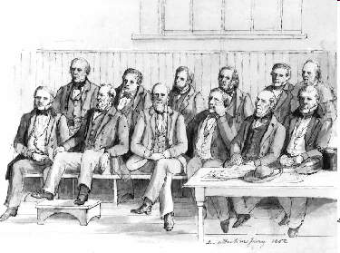
Other Political Changes
Local officials would be chosen by popular vote; they would no longer be appointed.
Other officials, including justices of the peace, sheriffs, county clerks, circuit clerks, judges, and the governor would be elected by popular vote.
The governor’s term increased to four years.
Jurors would be selected from registered voters of counties and paid for their service.

Slide 13
Economic Changes
All property, except slaves, was taxed at full value.
Tax money from a capitation tax would be used for education.
Tax money from property taxes would be used to build better transportation systems.

Slide 14
SECTION 2
Improving Transportation
Main Menu

Slide 15
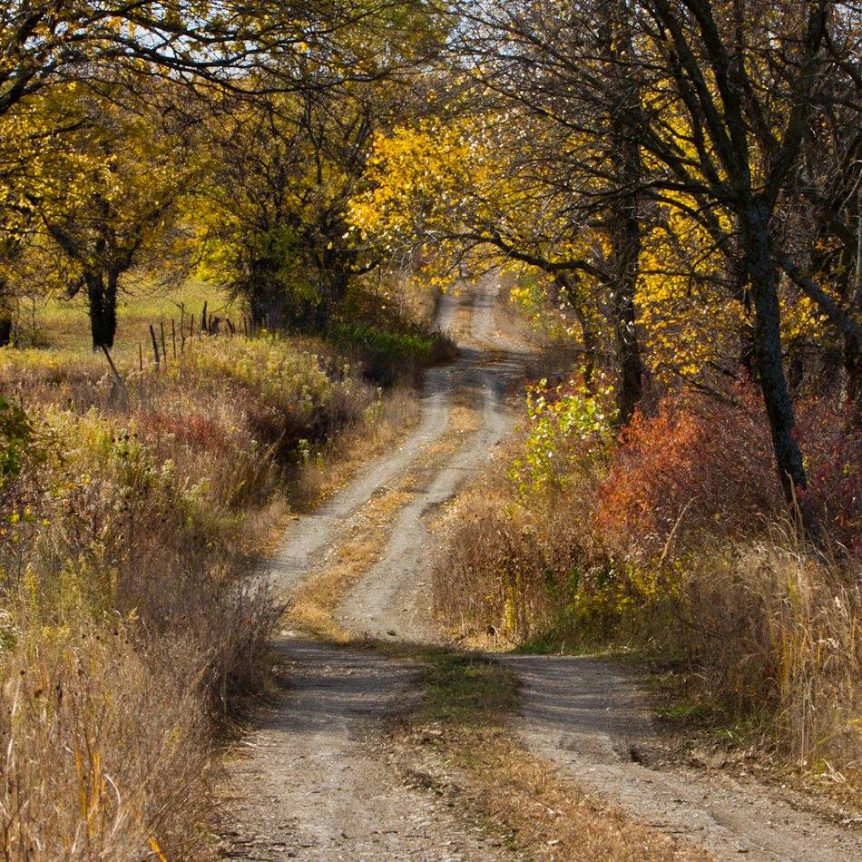
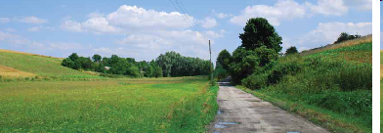
ROAD TRAVEL
The first roads were little more than primitive paths.
The arrival of settlers resulted in the need for better and larger roads.
The first public road ran from Morgan Morgan’s cabin to Winchester, VA.
Between 1790 and 1840, there was a surge in road construction.

Slide 16
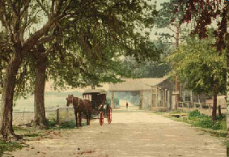
Turnpikes
The first roads were supposed to be kept up by property owners.
Since many property owners would not take responsibility for filling mud holes and doing other upkeep on the roads, the government intervened.
The government established a system of tolls to raise money for the upkeep of roads.
The roads with tolls became known as turnpikes because a barrier (called a pike) was placed across the road. When a toll was paid, the pike was lifted to allow access to the road.

Slide 17
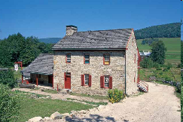
INNS and TAVERNS
Inns and taverns were built to provide rest stops for travelers. These facilities provided room and board as well as pasturage for animals.
Social class was not an issue in the inns and taverns. Everyone was treated the same on a “first come, first serve” basis. Perfect strangers sometimes had to share a room, or even a bed, depending on availability.
Early inns and taverns in western Virginia included the Red Horse Tavern on the Northwestern Turnpike.

Slide 18
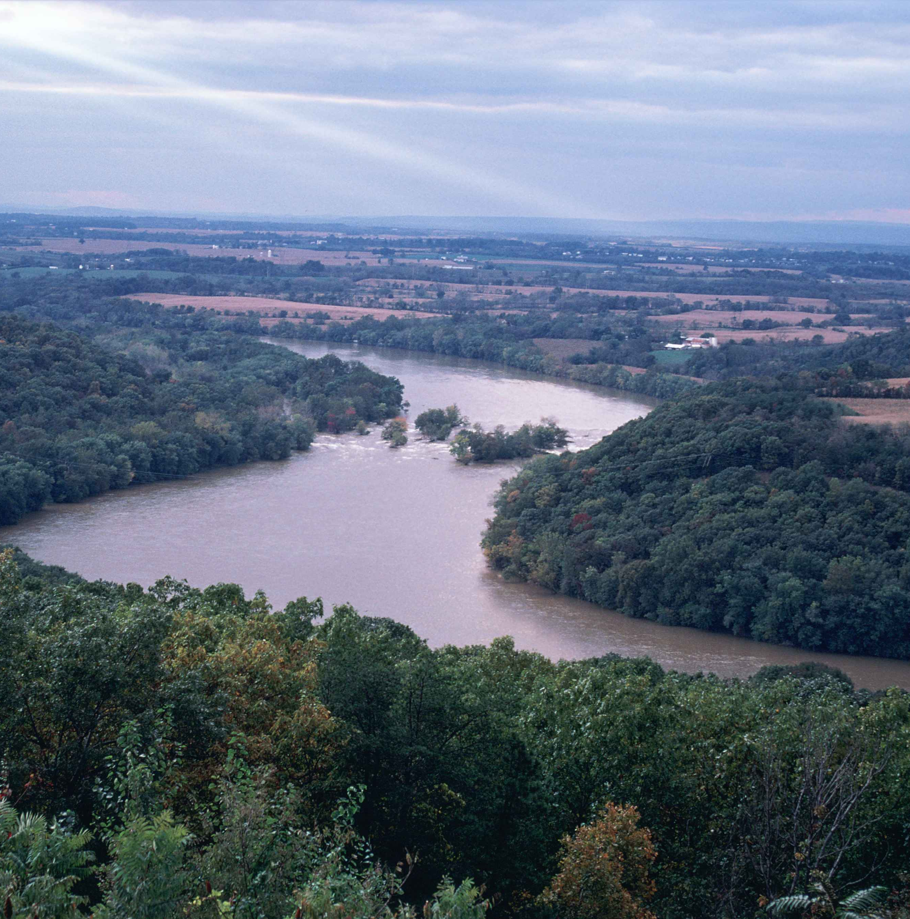
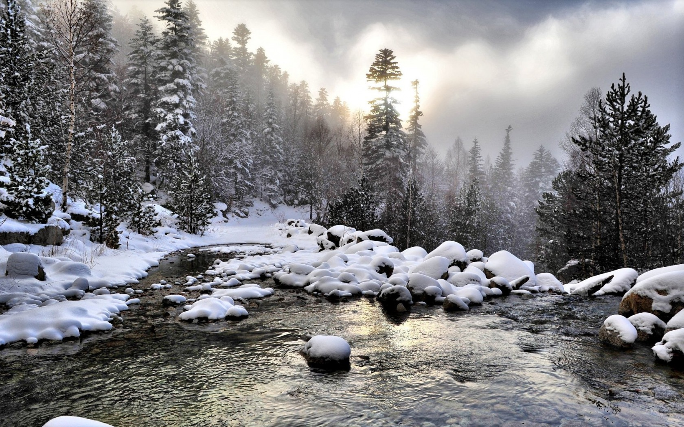
WATER TRAVEL
Water travelers faced a number of problems, including:
-inconsistent water levels on the rivers
-overflowing river banks
-low water levels in the summer
-rocks and rapids

Slide 19
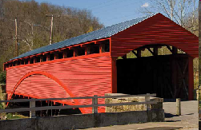
Land Travelers and Water Problems
Land travelers had a problem crossing rivers.
To address the problem, they established ferries…
Ferries presented their own problems. They could not operate when the water levels were extremely high or extremely low. Also they could not operate at night.
… and built bridges.
Bridges provided a better way to transport goods than ferries. In 1849 the Wheeling Suspension Bridge connected the city of Wheeling to Ohio. In the 1850s covered bridges became popular.

Slide 20
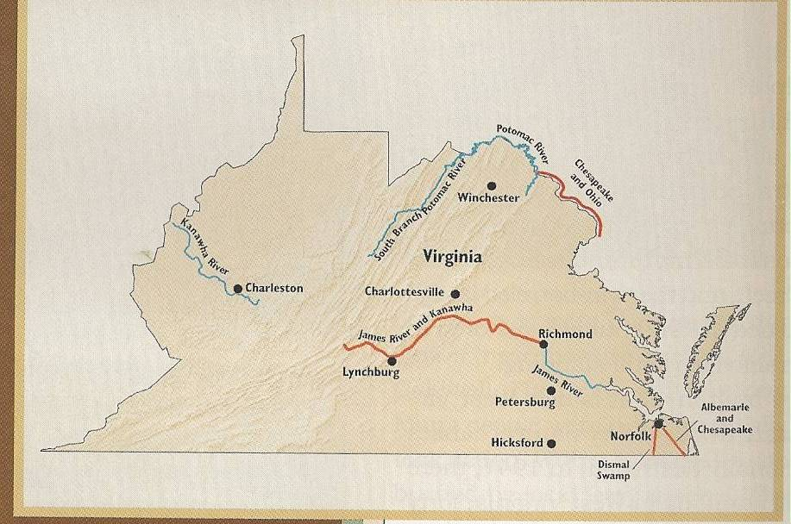
CANALS
Canals enjoyed a brief period of popularity as a means of transportation. They experienced limited use in winter because they would freeze over.
In western Virginia, the Chesapeake and Ohio Canal followed the route of the Potomac River between Cumberland, Maryland, and Washington, D.C.
Another project, which was not completed, would have connected the Potomac and Monongahela rivers.

Slide 21
FLATBOATS and KEELBOATS
Flatboats started as rafts that were guided with an oar. Later two sides were put on the raft. The sides kept the cargo safer.
Flatboats were moved by pushing poles into the river bottom.
Pushing the boats upstream was very difficult. Therefore, flatboats usually only traveled downstream. Sometimes, when a flatboat reached its destination, it was dismantled and had its logs and timber used to build a cabin.
Keelboats, which replaced flatboats, remained in operation until the 1900s.
Keelboats were moved by men with who walked along a running board, pushing long poles into the water.
Because of its design, keelboats could travel upstream as well as downstream.

Slide 22
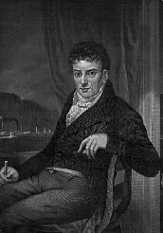
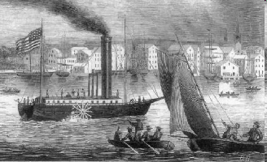
STEAMBOATS
Steamboats revolutionized river travel.
Two men, James Rumsey and Robert Fulton, adapted the steam engine to water transportation.
Rumsey launched a steam-powered boat on the Potomac River in 1787, but he died before he could perfect his invention.
Fulton demonstrated his boat, the Clermont, by traveling between New York and Albany in 1807.

Slide 23
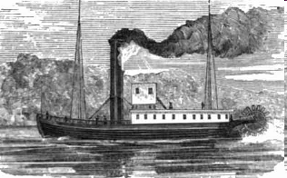
Steamboats Make Shipping Profitable
The New Orleans was the first steamboat to travel on major rivers, like the Ohio and Mississippi. The New Orleans proved that shipping goods by steamboat was profitable.
In 1815 the Enterprise, owned and operated by Captain Henry Shreve from Wheeling, made a trip from New Orleans to Louisville. The Enterprise could only make trips when the water level was high.
Henry Shreve also built the Washington. It was constructed from the timbers of Wheeling’s Fort Henry. This boat was the forerunner of the riverboats that promoted gambling and stage entertainment.

Slide 24
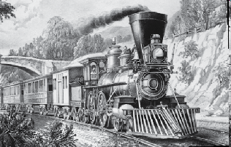
RAILROAD TRAVEL
Railroad travel, which included horse-drawn trains, did not become important until they became steam-powered.
Peter Cooper unveiled the first steam-powered engine, the Tom Thumb.
The Tom Thumb lost credibility when it lost a race against a horse-drawn rail car. The loss was the result of a broken belt.
Changing the position of the boilers on the steam engine provided the power the train engines needed to push across the Appalachian Mountains.
The Lafayette became the first horizontal boiler locomotive in America.

Slide 25
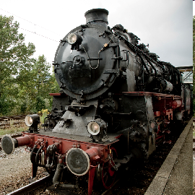
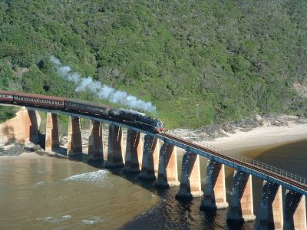
Locomotives became popular and successful because…
-railroads did not freeze in winter like canals
-the steam engine did not need daily care like horses

Slide 26
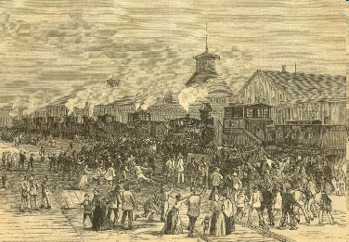
The Baltimore and Ohio Railroad
Construction of the B&O began in 1828 in Baltimore, Maryland.
Obstacles to building the B&O
mountains
rivalry between Maryland and its border states
It took fourteen years for the railroad to stretch from Baltimore to Cumberland, Maryland.
Construction stopped for five years when Virginia would not give Maryland permission to cross its border.
In 1848 construction began in western Virginia.
In 1852 the railroad was completed to Wheeling.

Slide 27
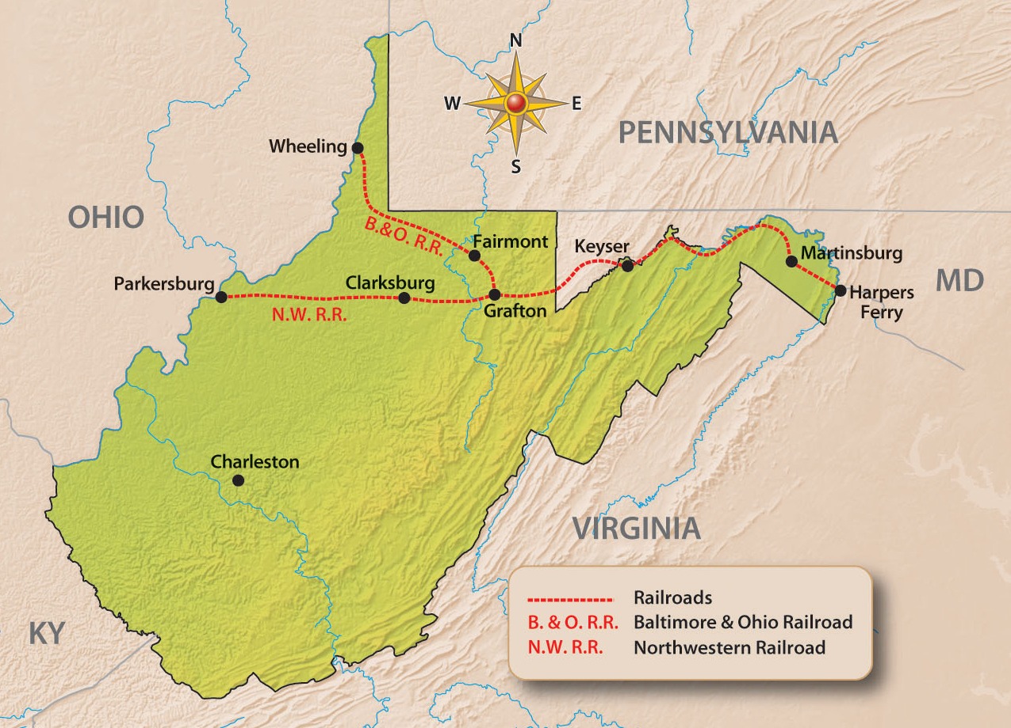
Railroads in Western Virginia
In 1853 the first B&O passenger and freight service opened in Wheeling.
At the time of the Civil War, the B&O and the Northwestern were the only railroads operating in western Virginia.
The Northwestern Virginia Railroad was charted by the B&O in 1851 to appease Parkersburg, which had lost its bid to become the Ohio River terminus on the B&O. This line was completed in 1857.

Slide 28
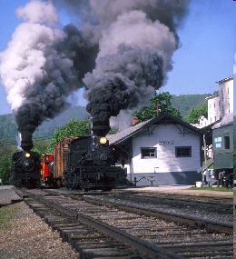
The Railroad Brings Change
The railroad
-helped create towns along its route
-added to the economic growth of the eastern panhandle
-provided a direct, easy route to the interior of the region
-created cultural change by bringing railroad construction workers of many nationalities into western Virginia.

Slide 29
End Chapter 10
Main Menu

