Slide 1
CHAPTER 11
OUT OF TURMOIL,
WEST VIRGINIA MOVES CLOSER TO STATEHOOD
Section 1 Slavery Promotes Conflict
Section 2 Moving Toward Secession

Slide 2
SECTION 1
Slavery Promotes Conflict
Main Menu

Slide 3
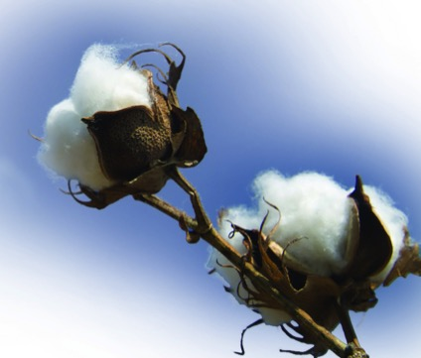
COTTON and SLAVERY
By 1860, cotton accounted for over 50% of the value of all United States exports.
Growing cotton required a great deal of manual labor, and slave labor kept the costs down, allowing the South to compete in the global marketplace.
Regardless of how Southerners felt about slavery personally, they needed it to survive economically.

Slide 4
POLITICAL IMPLICATIONS OF SLAVERY
In 1819, the United States had 22 states, eleven slave and eleven free.
The Slave States The Free States
were all in the South were all in the North
had 22 US Senators had 22 US Senators
had 81 Representatives had 104 Representatives
favored states’ rights favored a strong national government
Southerners feared the day when the growing North would gain control of both Houses of Congress. If this happened, slavery might be abolished.

Slide 5
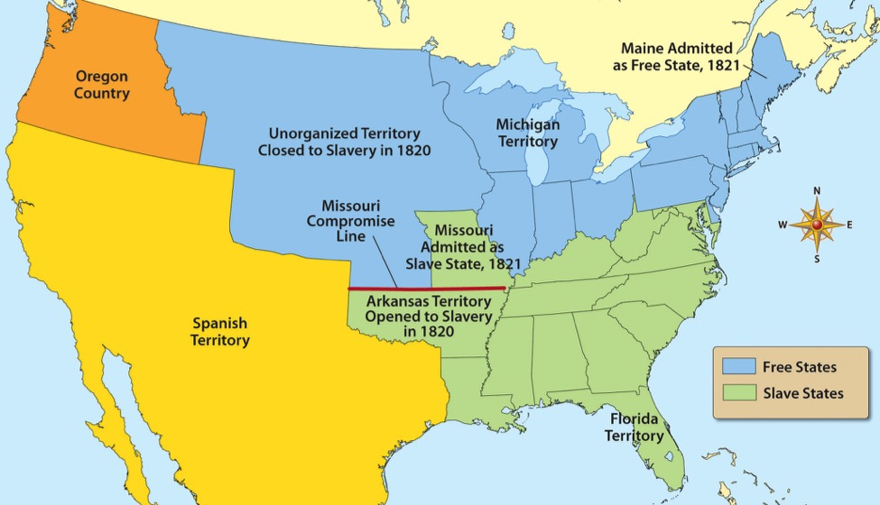
COMPROMISE MAINTAINS BALANCE OF POWER
In 1819, the balance of power between North and South was on the verge of toppling.
Missouri applied for admission to the United States as a slave state.
To keep the number of slave and free states equal, a compromise, in 1821, determined that Missouri would be added to the Union as a slave state, but Maine would be added as a free state.

Slide 6
OPPOSITION TO SLAVERY GROWS
Religious groups in the Northeast began to preach against slavery.
The American Antislavery Society was formed and called for an immediate end to slavery.
The Underground Railroad was formed.

Slide 7
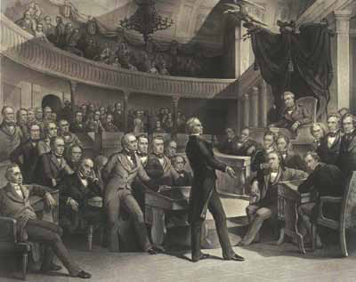
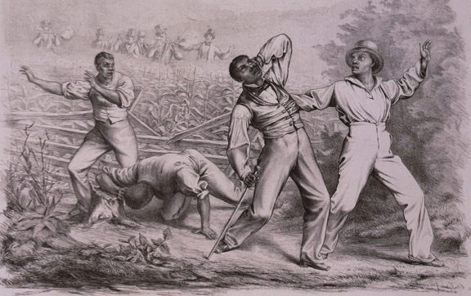
ANOTHER COMPROMISE AVOIDS WAR
In 1846, new lands acquired from the Mexican-American War reopened the issue of maintaining a balance between slave and free states.
The issue was resolved by the Compromise of 1850.
California was admitted to the Union as a free state.
Part of Texas was given to New Mexico.
Slavery was banned in the District of Columbia.
Slavery in New Mexico and Utah would be decided by popular sovereignty.
A stricter fugitive slave law was passed.

Slide 8
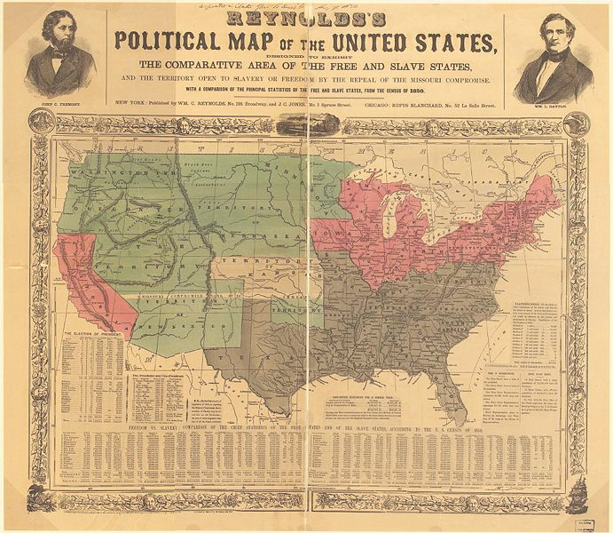
KANSAS-NEBRASKA ACT HEATS UP THE SLAVERY ISSUE
In 1854, Congress passed the Kansas-Nebraska Act, which allowed those territories to decide the issue of slavery by popular sovereignty.
Supporters and opponents of slavery flooded Kansas—each hoping to claim victory for their side.
The result was “Bleeding Kansas.”
The election to decide the issue of slavery was corrupted by illegal votes being cast.
Both sides claimed victory, and each established a government one free and one slave.
The situation escalated into violence.
This 1856 map shows slave states (gray), free states (pink) U.S. territories (green) with Kansas in center (white).

Slide 9
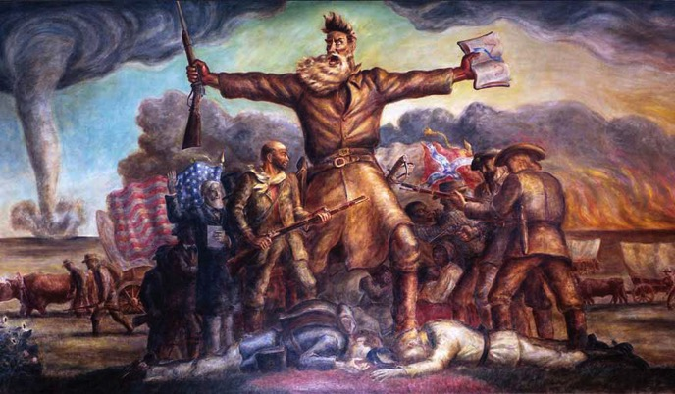
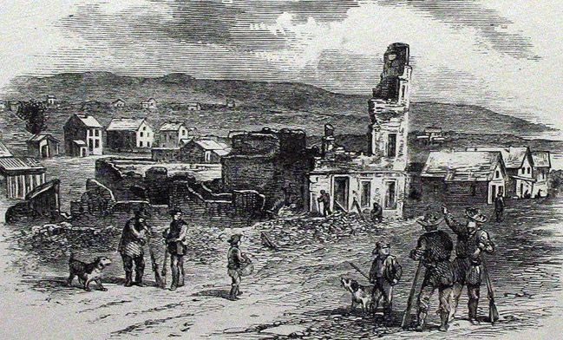
SPREAD OF VIOLENCE
John Brown, a leading abolitionist, went to Kansas after receiving a letter from one of his sons.
A slave-state government had been established in Kansas before Brown’s arrival.
After Brown’s arrival, another election was held and a convention was called in Topeka to establish a free-state government.
The pro-slavery supporters decided to destroy Lawrence, a center of the antislavery movement.
Lawrence fell to the border ruffians without a fight.
Ruins of Free State Hotel after Sacking of Lawrence

Slide 10
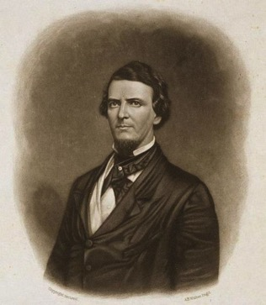
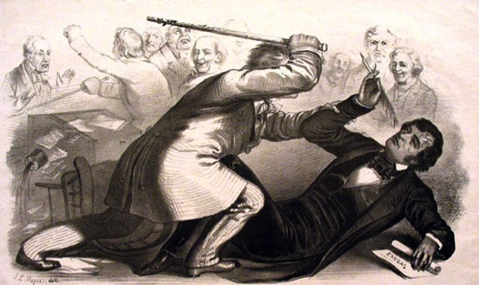
VIOLENCE IN KANSAS SPILLS INTO THE UNITED STATES CONGRESS
Massachusetts Senator Charles Sumner publicly criticized the Missouri border ruffians for their interference in Kansas. He also criticized South Carolina Senator Andrew Butler for his support of slavery.
Preston Brooks
Charles Sumner
Butler’s nephew, South Carolina Congressman Preston Brooks, in retaliation for Sumner’s actions, beat the Massachusetts Senator severely with his cane.
.

Slide 11
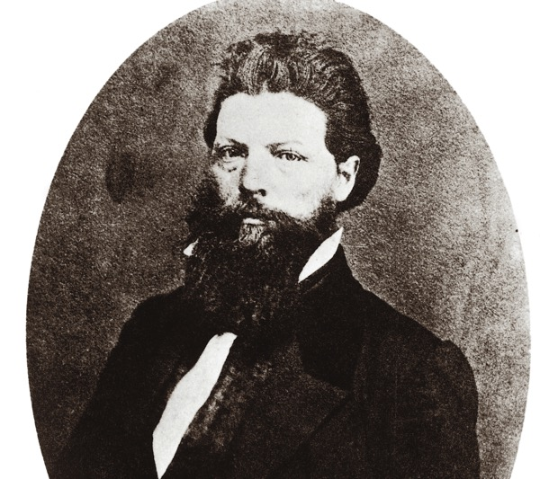
ATTACK ON POTTAWATOMIE
Three days after Butler’s attack on Charles Sumner, John Brown and seven followers led an attack on the proslavery settlement of Pottawatomie Creek.
They massacred five proslavery settlers.
Border ruffians sought retaliation and engaged in a skirmish with antislavery forces.
During the fighting, two of John Brown’s sons, including John Brown, Jr., were taken captive.
John Brown, Jr
After the massacre at Pottawatomie Creek, John Brown became a fugitive, fleeing from federal officials as well as border ruffians.

Slide 12
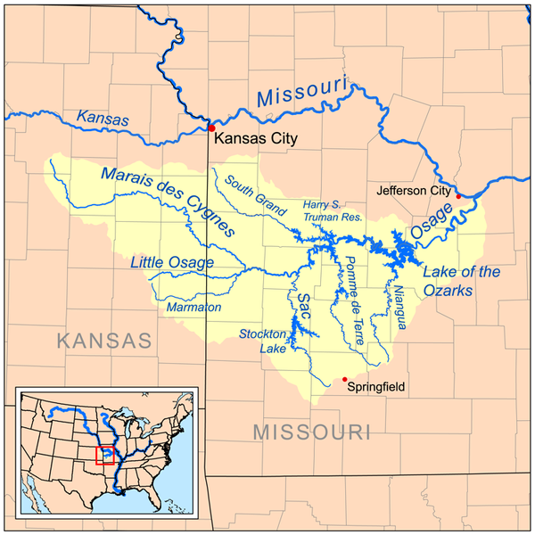
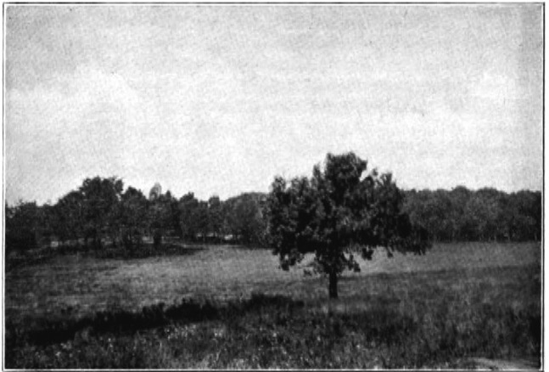
THE END OF BLEEDING KANSAS
The final battle to make Kansas free occurred near the Osage River.
The free-state supporters were outnumbered and had to retreat.
The pro-slavery supporters, rather than pursue them, headed to the antislavery settlement at Osawatomie. Once there, they burned homes and plundered the land.
The Osawatomie Battlefield
Looking toward the river
After the attack on Osawatomie, John Brown decided to leave Kansas and head back east.

Slide 13
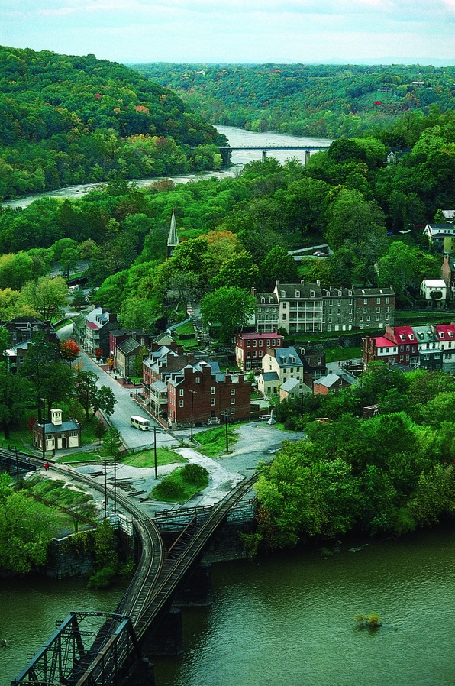
VIOLENCE SHIFTS TO HARPERS FERRY
John Brown arrived at Harpers Ferry on July 4, 1859.
His goal was to capture the federal arsenal, arm his followers, and set up a black state.
Brown lived in Maryland while developing a plan to accomplish his goals.
On October 16, he was ready to put his plan in action.

Slide 14
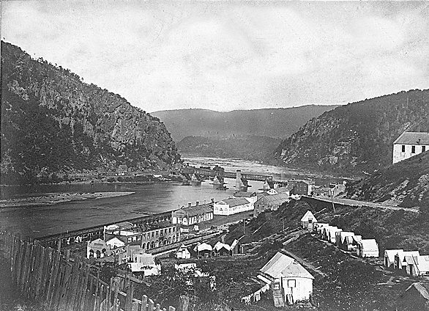
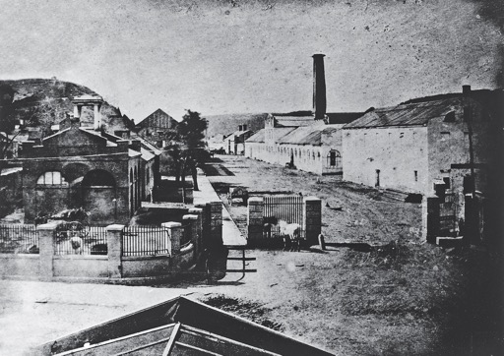
THE RAID AT HARPERS FERRY
John Brown and nineteen followers left Maryland and drove a wagon loaded with guns and ammunition to Harpers Ferry.
Brown’s group first met opposition on the covered bridge that connected Virginia and Maryland. When a watchman came to check the source of some noise he heard, he was taken prisoner by Brown’s men.
Brown’s men then continued their march toward the arsenal. They encountered another watchman at the gate to the armory located near the arsenal.
They captured that watchman and took up their prearranged stations.

Slide 15
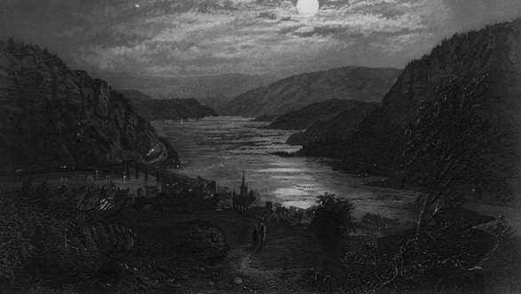
At 1:30 AM, when a mail train stopped in Harpers Ferry, Brown’s movements became known.
At the same time, Dr. John Starry, who was awakened by the earlier gunfire, became suspicious of what he thought was strange behavior.
When the mail train reached Baltimore, the conductor sent a telegram to government leaders to let them know what was happening in Harpers Ferry.
At first, President James Buchanan wanted the news from Harpers Ferry kept quiet because he was afraid it might spur other abolitionist uprisings.
Eventually, the President ordered Colonel Robert E. Lee to take control of the troops at Harpers Ferry and put down the insurrection.

Slide 16
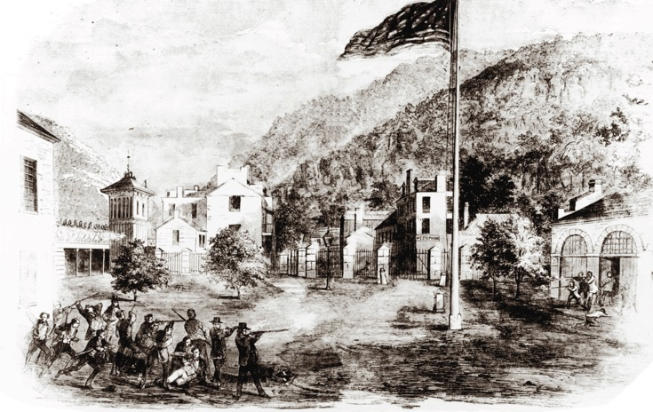
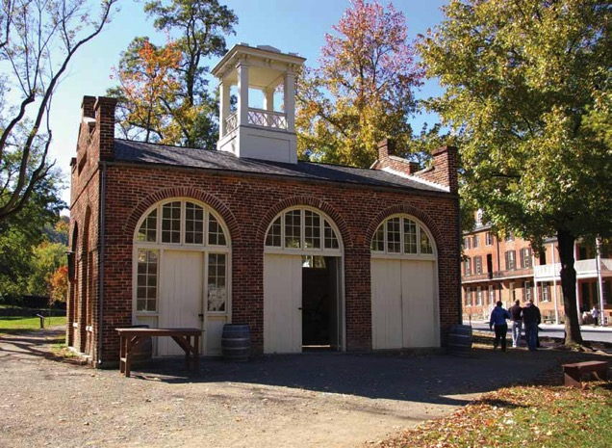
A FINAL STAND
Federal troops attacked Brown’s followers.
Brown was able to defend against the first attack.
It soon became evident, however, that Brown was no match against the federal troops. As the fighting heated up, he retreated to the engine house.

Slide 17
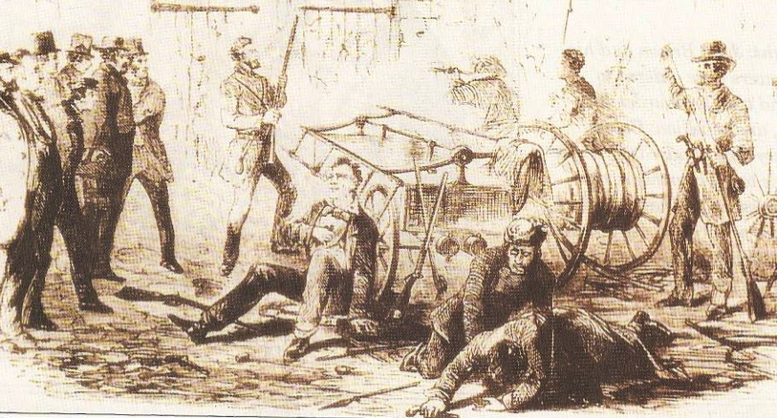
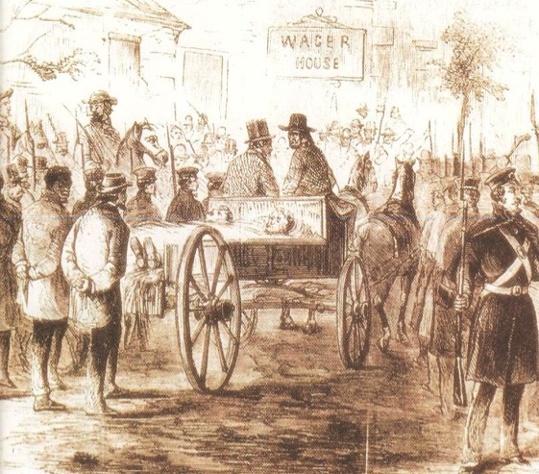
At the engine house, the federal troops asked Brown to surrender; but he refused.
Federal troops finally stormed the engine house and Brown was injured.
When the fighting ended, an injured Brown was arrested and taken to Charles Town.

Slide 18
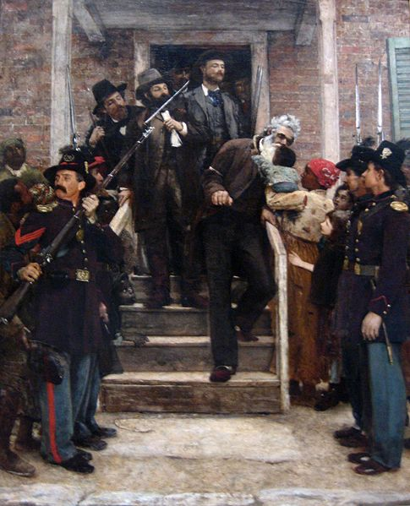
BROWN’S LAST DAYS
Some wanted Brown lynched for his crime.
Instead, he was tried at Charles Town for murder, insurrection, and treason.
Brown and six others were found guilty and sentenced to be hanged.
On December 2, 1859, John Brown was hanged.

Slide 19
SECTION 2
Moving Toward Secession
Main Menu

Slide 20
THE RIFT BETWEEN NORTH AND SOUTH GROWS
Two events caused the gap to widen between supporters and opponents of slavery in the 1850s.
The decision to allow the people in new states to decide the issue of slavery created opportunities for violence like “Bleeding Kansas.”
The rise of the Republican Party, which opposed slavery, made southerners doubtful about their place in the Union.

Slide 21
THE ELECTION OF 1860
There were four candidates for president in the Election of 1860.
Democrats could not agree on a candidate. They eventually split into two parties:
Southern Democrats named John Breckinridge as their candidate. Their platform supported the protection and expansion of slavery.
Northern Democrats named Stephen A. Douglas as their candidate. Their platform supported popular sovereignty as a way to decide the slavery issue.

Slide 22
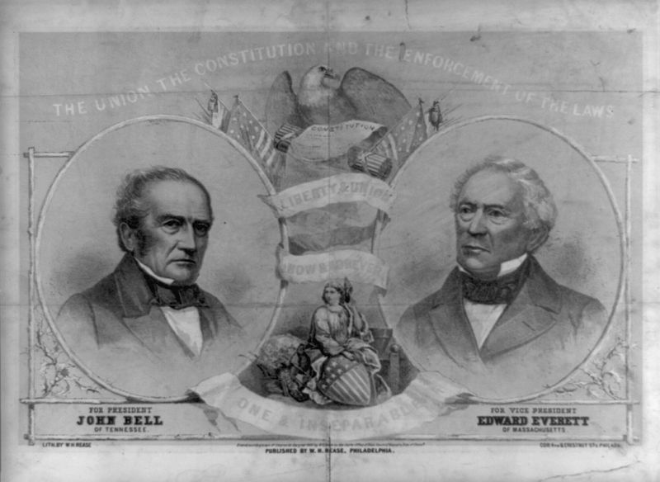
Republicans nominated Abraham Lincoln as a compromise candidate because he did not have any political enemies. Their platform supported making slavery illegal in the territories.
The Constitutional Union Party named John Bell as their candidate. Their platform took no position on slavery. They wanted to uphold the Constitution.

Slide 23
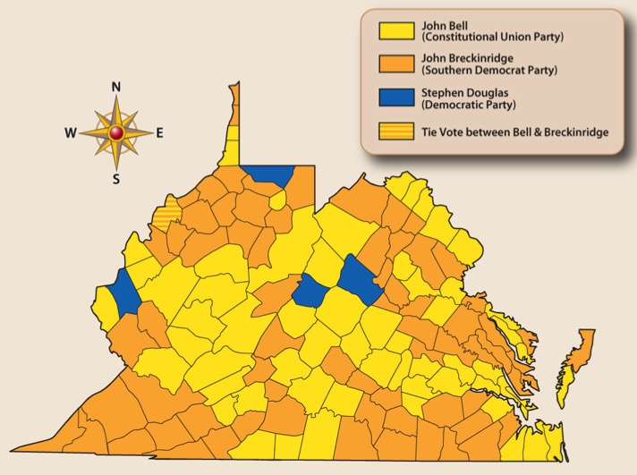
ELECTION OF 1860 IN VIRGINIA
Popular Vote in Virginia
Bell 74,322
Breckinridge 73,598
Douglas 16,155
Lincoln 1,887
Of Lincoln’s 1,887 votes, 1,764 came from western Virginia.

Slide 24
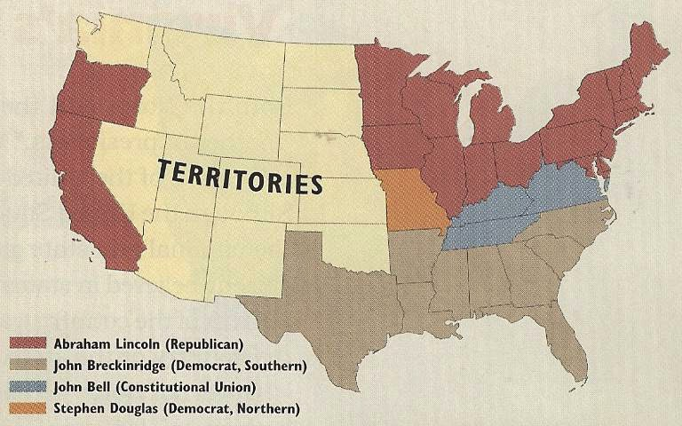
NATIONAL RESULTS of the ELECTION OF 1860
Lincoln won 40% of the popular vote, but had a clear majority of the electoral vote.
Lincoln carried all the northern states, except New Jersey.
Breckinridge carried 11 of the 15 southern states.
Bell carried three states, including Virginia.
Douglas carried one state, Missouri.
The election was determined largely by regional voting.

Slide 25
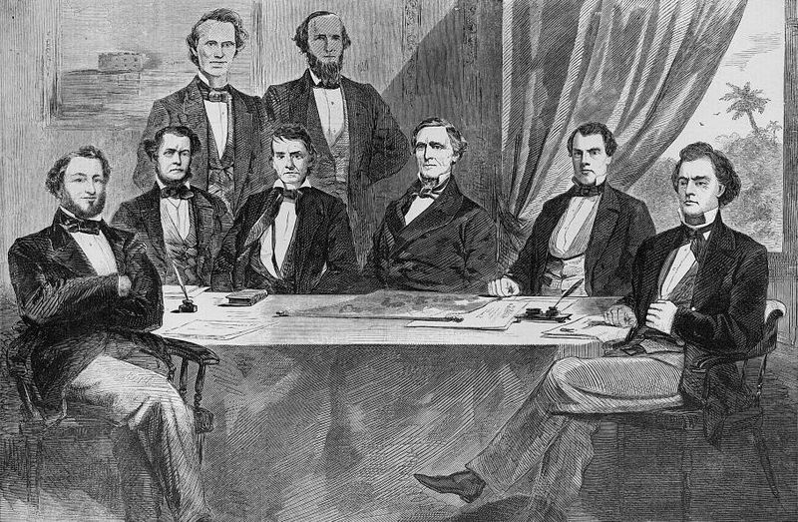
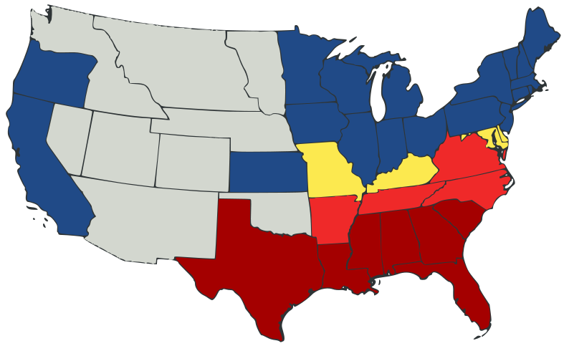
VIRGINIA MOVES TOWARD SECESSION
After Lincoln’s election, the south believed their only option was secession. To that end, South Carolina became the first state to secede (December 20, 1860).
South Carolina was followed by six others:
Georgia, Florida, Alabama, Mississippi, and Louisiana (January 1861)
Texas (February 1861)
Confederate Cabinet
These seven states met in Montgomery, Alabama, to form the Confederate States of America.

Slide 26
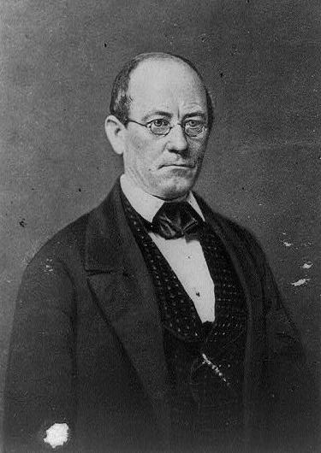
VIRGINIA’S DILEMMA
The North and the South both wanted the support of Virginia.
Virginia Governor John Letcher called the General Assembly into special session on January 7, 1861, to consider what the state should do.
The General Assembly decided to hold an election on February 4 to elect delegates to a convention to decide Virginia’s fate.
The convention delegates received pressure from both sides. Before they could make a decision, however, other events pushed Virginia out of the Union.

Slide 27
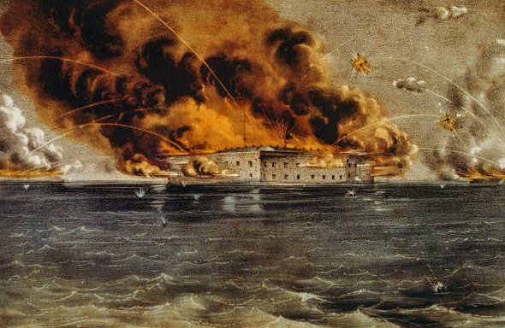
FIRING ON FORT SUMTER
When Abraham Lincoln became president on March 4, 1861, one of his immediate concerns was Fort Sumter which was located in South Carolina.
The South Carolina Confederate government wanted to take control of the fort. But, before Lincoln could send troops to reinforce the fort, South Carolina forced its surrender on April 12, 1861.

Slide 28
VIRGINIA SECEDES
Virginia’s delegates were still meeting when Fort Sumter fell to the Confederacy.
Then, President Lincoln called for each loyal state to supply 75,000 troops to put down the southern rebellion.
To comply with this request meant Virginia would have to deny the principle of states’ rights. The calling for these troops convinced many delegates that they could no longer remain in the Union.
On April 17, 1861, the Virginia convention passed an Ordinance of Secession. The ordinance would be presented to the people for ratification on May 23.

Slide 29
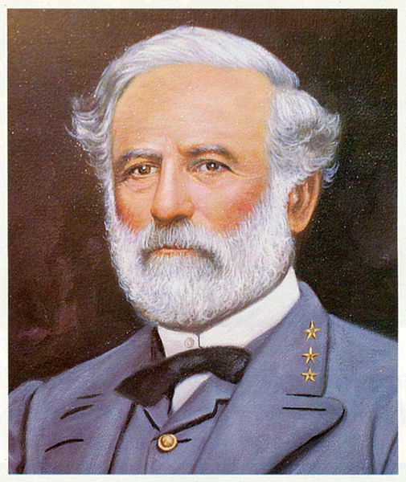
THE NEXT STEPS
After the passage of the Ordinance of Secession, eastern and western Virginia took very different paths.
Eastern Virginia prepared for war.
Governor Letcher named Robert E. Lee to lead the Virginia militia.
Western Virginia prepared a protest to secession. John C. Carlile led a protest meeting in Clarksburg on April 22.
The people who attended the Clarksburg meeting called for a convention to meet in Wheeling on May 13.

Slide 30
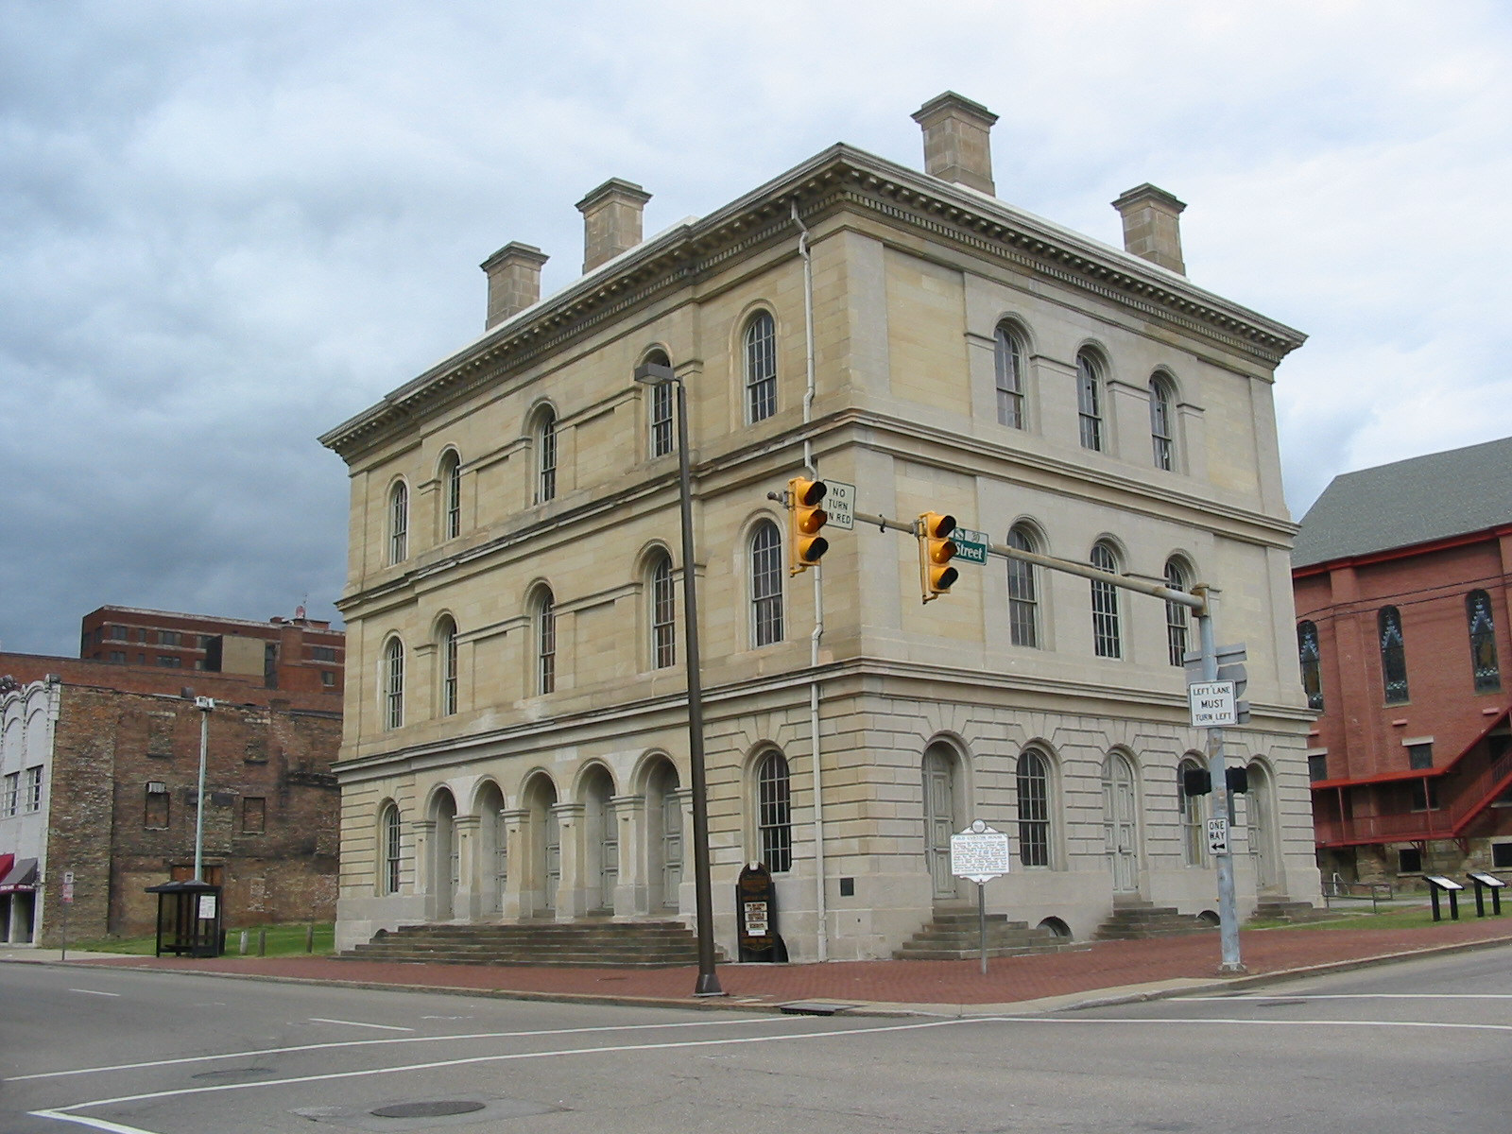
FIRST WHEELING CONVENTION RAISES LEGAL ISSUES
The calling of the First Wheeling Convention was regarded as a revolutionary act because it had not been authorized by Virginia’s government.
At the convention, John C. Carlile pushed for the creation of a new state, but some considered this proposal illegal because the U.S. Constitution forbade the formation of new state from another state without the permission of the older state.
The First Wheeling Convention voted that, if Virginia as a whole voted for secession, delegates would be elected to attend a second Wheeling Convention on June 11, 1861.

Slide 31
THE PEOPLE SPEAK
The results of the election on May 23 showed the people of Virginia favored secession. By a vote of 132,201 to 37,451, the people of Virginia supported the secession ordinance passed by the Convention a little more than a month earlier.
When news of the vote reached Washington, D.C., federal troops were immediately sent to protect the B&O Railroad.
The troops also assured the safety of the Second Wheeling Convention.

Slide 32
End Chapter 11
Main Menu

