Slide 1
CHAPTER 13
WEST VIRGINIA AND RECONSTRUCTION
Section 1 Social Changes
Section 2 Political Changes
Section 3 The Rise of Labor Unions
Section 4 A Famous Feud

Slide 2
SECTION 1
Social Changes
Main Menu

Slide 3
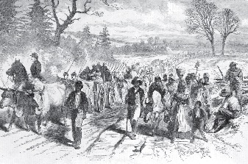
FREEDMEN
Problems for the newly freed slaves after the Civil War.
Where would they go?
What were they to do?
They had no special training or skills.
They had no money.
They had no education.
Many ended up in shanty towns.

Slide 4
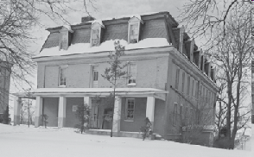
BUREAU of REFUGEES, FREEDMEN, and ABANDONED LANDS
This purpose of this organization, better known as the Freedmen’s Bureau, was to help both freedmen and poor whites cope with their everyday problems.
The organization…
-relieved hunger and distress
-tried to find work and land for blacks
-established schools
-furnished food and medical supplies
-protected the freedmen from corrupt labor contracts
-established military courts to administer justice

Slide 5
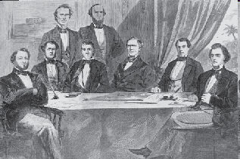
FORMER CONFEDERATES
After the Civil War, the property of former Confederates was taken from them.
They also had many of their rights taken away, including the right to…
-vote
-hold public office
-practice law
-serve as jurors
-sue in court
-defend themselves in
lawsuits brought by others

Slide 6
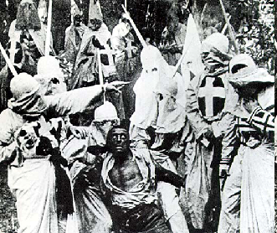
EFFORTS TO CONTROL BLACKS DURING RECONSTRUCTION
Former Confederates blamed blacks for the problems they experienced after the Civil War. As a result, they turned to drastic measures as a way to get revenge and bring about a return to their antebellum life.
Their tactics resulted in the emergence of the Ku Klux Klan.
The Klan began in Pulaski, Tennessee as a social club.
Its members dressed in robes with hoods.
The objective of the Klan was to terrorize and intimidate blacks.
They did this through beatings, whippings, and even murder.

Slide 7
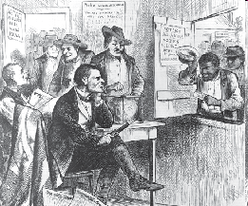
Former Confederates promoted Black Codes.
The Black Codes were designed to restrict the rights of the freedmen.
The Codes
-controlled the types of jobs freedmen could have.
-permitted whipping as a punishment.
-established work hours from sunrise to sunset, six days per week.
-permitted the imprisonment of unemployed blacks.
-took away the right of blacks to vote.
-did not permit blacks to serve on juries.
-did not permit blacks to testify against whites in courts.
-did not permit marriage between the races.
Congress reacted to the Black Codes by passing the Civil Rights Act of 1866 and the Fourteenth Amendment to the United States Constitution. Both of these acts gave blacks the rights of citizenship.

Slide 8
SECTION 2
Political Changes
Main Menu

Slide 9
PROBLEMS IN WEST VIRGINIA AFTER THE CIVIL WAR
Problems for West Virginia after the Civil War included
boundary disputes with neighboring states.
a debt to Virginia.
the location of the state capitol.
voting rights.

Slide 10
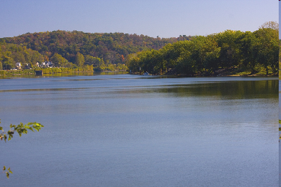
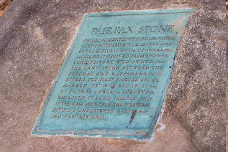
BOUNDARY DISPUTES WITH NEIGHBORING STATES
After the Civil War
Virginia sued to regain Jefferson and Berkeley counties. Virginia argued that West Virginia was an illegal state. The United States Congress denied Virginia’s claim. However, the matter was appealed to the United States Supreme Court. The Court ruled in favor of West Virginia.
West Virginia and Ohio disputed the boundary line between the two states in the Ohio River. The settlement set West Virginia’s border at the low-water mark on the north side of the Ohio River. This decision gave West Virginia all the islands in the Ohio River that border the two states.
The boundary dispute with Maryland was decided by the Supreme Court which ruled that the Fairfax Stone was the beginning point of the border between the two states.

Slide 11
THE VIRGINIA DEBT
During the Civil War, the federal government gave money intended for the State of Virginia to the Restored Government in Wheeling.
The Restored Government of Virginia in turn gave some of these monies to the new State of West Virginia.
West Virginia’s 1863 Constitution acknowledged an agreement made at the Second Wheeling Convention requiring West Virginia to pay a fair share of Virginia’s public debt as of January 1, 1863.
Since the two states could not agree on an amount, Virginia took matters into its hands and told West Virginia that the debt now totaled $34 million. That was considerably more than the $1 million that West Virginia believed it owed. West Virginia also contended that Virginia owed it $500,000.

Slide 12
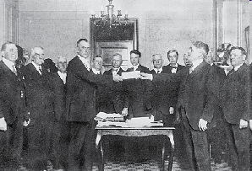
THE DEBT IS PAID
In 1906 Virginia finally sued West Virginia for the money.
The United States Supreme Court , which ruled in Virginia’s favor, set the amount at $7,182,500.
By 1919, because of nonpayment of the debt as well as interest and other charges, West Virginia owed Virginia $14,562,867.
In 1919, West Virginia made a cash payment of $1,062,867 and issued bonds for the amount of the rest of the debt.
The bonds were due in 1939 and the debt was finally paid on July 1, 1939—some eighty years after the debt was incurred.

Slide 13
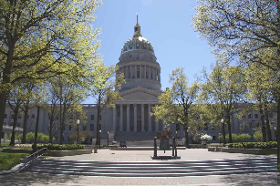
LOCATION OF THE STATE CAPITOL
West Virginia’s capitol was moved so often that it was sometimes called the “capitol on wheels.”
West Virginia’s first capital city was Wheeling.
In 1870, the capital was moved to Charleston.
In 1875, the capital was moved back to Wheeling.
On August 7, 1877, the citizens of the state were permitted to vote on a permanent location for the capital.
Charleston received 41,243 votes.
Clarksburg received 29,942 votes.
Martinsburg received 8,046 votes.
In 1885, Charleston became the capital city permanently.

Slide 14
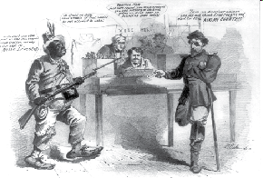
VOTING RIGHTS
The Fifteenth Amendment to the United States Constitution, passed on February 27, 1869, stated, “The rights of citizens of the United States to vote shall not be denied or abridged by the United States or by any State on account of race, color, or previous condition of servitude.”
In reaction to the Fifteenth Amendment, a number of states passed voting requirements that restricted who could vote. These requirements included a
Poll Tax. (A tax that had to be paid before a person could vote)
Literacy Test. (A test to determine if a person could read and write)
Grandfather Clause. (Any man that could vote on January 1, 1867, or who was the son or grandson of a man eligible to vote on that date, would be permitted to vote.)

Slide 15
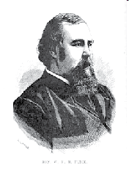
THE FLICK AMENDMENT
Returns Voting Rights to Former Confederates
As time went on, West Virginians became more lenient toward former Confederates.
The Democratic Party and liberal Republicans favored reforms to return some rights to former Confederates.
In 1870, John J. Jacob, a Democrat, was elected governor and the time seemed right to return the vote to former Confederates.
A state senator from Pendleton County, W. H. H. Flick, proposed an amendment to the West Virginia Constitution that would give the right to vote to all male citizens, except for minors and paupers, regardless of race.
The amendment was approved by the voters—23,546 to 6,323.

Slide 16
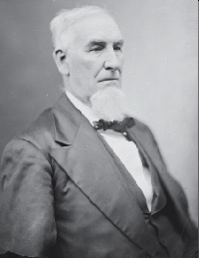
MOVE TO REVISE WEST VIRGINIA’S CONSTITUTION
Many believed West Virginia’s Constitution of 1863 was outdated and should be revised.
A convention was called to meet in Charleston on January 16, 1872, for that purpose. Seventy-eight delegates were selected to attend the meeting.
Samuel Price of Greenbrier County was chosen to preside over the meeting.

Slide 17
THE CONSTITUTION OF 1872
EXECUTIVE BRANCH
The governor would serve a four-year term and was given the right to veto legislation.
On the Board of Public Works, the secretary of state became an appointed position, while the superintendent of free schools was elected.
LEGISLATIVE BRANCH
State Senators would be elected to four-year terms.
Members in the House of Delegates would serve two-year terms.
Senatorial districts increased from eleven to twelve.
Regular sessions of the Legislature became biennial and lasted 45 days.
JUDICIAL BRANCH
Number of Supreme Court justices increased from 3 to 4.
Declared that the state could not be sued.

Slide 18
OTHER CONSTITUTIONAL CHANGES
LOCAL GOVERNMENT
Change from township to county system of government.
Reestablished justices of peace.
VOTING
All males over 21 were permitted to vote.
Voting would be open or by secret ballot.
State elections were scheduled at the same time as federal elections—in November.

Slide 19
SECTION 3
The Rise of Labor Unions
Main Menu

Slide 20
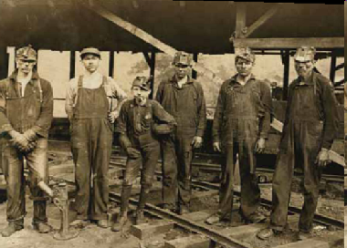
PURPOSE OF LABOR UNIONS
Labor unions were formed to improve wages and working conditions for workers. They also protected workers from discriminatory practices, which included
-yellow-dog contracts
-blacklists
-lockouts

Slide 21
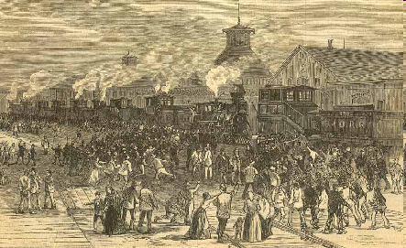
THE FIRST STRIKE
Workers used the strike as a way to get better working conditions and higher wages.
The first strike occurred in the railroad industry.
The B&O Railroad reduced workers’ wages four times in seven years. The workers became so angry that they decided to leave their trains and strike.
In response to the strike, the company hired new workers to replace the strikers.
Violence eventually erupted between the two sides.
To put down the violence, the state militia and, later, federal troops were called for assistance.
The workers accomplished nothing from the strike; in fact, their wages were further reduced when they returned to their jobs.

Slide 22
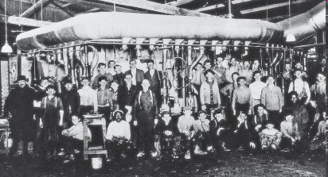
EARLY LABOR UNIONS
1869 Noble and Holy Order of the Knights of Labor was created.
Leader: Uriah S. Stephens
Goal: To unite all workers regardless of race, gender, or occupation
1879 Terrence Powderly became the head of the union.
1881 A federation of trade unions was established. The organization became known as The American Federation of Labor in 1886. This organization was a loose alliance of trade unions.
Leader: Samuel Gomphers
Goal: To give unions more bargaining power

Slide 23
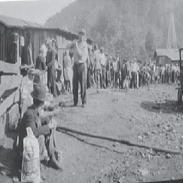
UNIONS COME TO WEST VIRGINIA
Much of the early labor issues in West Virginia began in the coal industry.
Strikes continued to be the main weapon of the unions, but companies used the “unholy four” to put down strikes.
The unholy four included:
-the use of the state militia, which often arrested law-abiding strikers.
-injunctions to stop or force a particular action.
-private armed guards to intimidate strikers.
-scabs to work in place of regular workers who went on strike.

Slide 24

GOVERNMENT INVOLVEMENT IN LABOR ISSUES
Many early West Virginia politicians had connections to mine owners or the railroads.
These politicians supported companies instead of unions because…
-they believed unions would harm the growth of business in the state
-wealthy businessmen donated money to their election campaigns
Because of this support, state government allowed mine owners to hire private armies to break strikes. Also, the governor at times sent the state militia to scare union members.

Slide 25
EARLY LABOR AGREEMENTS
In 1890, the United Mine Workers of America was organized.
In 1901, the United Mine Workers established District 17 at Wheeling to begin organizing miners.
Contracts which were negotiated between companies and unions were sometimes simple and other times quite complex. An example of a simple contract with the Harewood Mines in Fayette County called for:
2.25 cents for every bushel of 1 ½ inch of mined screen coal.
the return of union members to their old jobs.
no discrimination against employees for their connection to any organization.
prohibition of any interference in the mines by the Ku Klux Klan.
the hiring of check weighmen to verify the accuracy of the weight of the coal mined by each miner.

Slide 26
SECTION 4
A Famous Feud
Main Menu

Slide 27
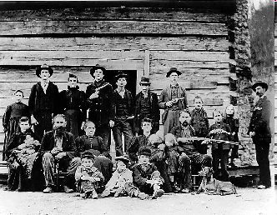
THE BEGINNING OF THE FEUD
There are several versions of what caused the feud between the Hatfields and the McCoys.
One of the earliest versions was that the feud had its beginnings during the Civil War when the Hatfields supported the Confederacy and the McCoys supported the Union.
After the Civil War, another reason for the feud focused on wild pigs that roamed the countryside, tended by both Floyd Hatfield and Randolph McCoy.
Because Floyd Hatfield took some of the pigs to his house, he was accused by Randolph McCoy of stealing.
After a trial, Hatfield was found not guilty. The McCoys believed their family had been wronged and vowed to get revenge.

Slide 28
TWO WRONGS DON’T MAKE A RIGHT
The McCoys singled out Bill Stanton as the target for their revenge. They beat him because of his testimony during the trial.
To revenge Stanton’s beating, members of the Hatfield family attacked members of the McCoy family. Stanton once fired on Sam and Paris McCoy, wounding Paris.
Sam McCoy then attacked Stanton. During the fight a gun went off, killing Bill Stanton.
Sam McCoy was arrested and charged with murder. A jury, however, acquitted him, calling the shooting self-defense.
This time, it was the Hatfields who wanted revenge for what they perceived to be an injustice.

Slide 29
A ROMANCE FURTHER SEPARATES THE TWO FAMILIES
Although they feuded, the Hatfields and McCoys occasionally attended the same social events.
On Election Day, 1880, both families attended a picnic while voting for their favorite candidates.
At the picnic, Roseanna McCoy (daughter of Randolph McCoy) and Johnse Hatfield (son of Devil Anse Hatfield) met and fell in love.
Roseanna eventually moved in with the Hatfields and became pregnant with Johnse’s child.
Their families would not let them marry.
They continued to see one another. After one of Johnse’s visits, he was captured by Roseanna’s brothers who wanted to take him to Kentucky. Roseanna foiled their plan by telling Devil Anse who rescued his son.
Johnse never visited Roseanna after this incident.

Slide 30
ELECTION DAY 1882
The Official Beginning of the Feud
Ellison Hatfield and Tolbert McCoy got into a fight.
Two other McCoys joined the fight and Ellison Hatfield was wounded.
The McCoys were arrested, but the Hatfields captured and held them prisoner until they knew whether Ellison would live or die.
Ellison Hatfield
When Ellison died, the three McCoy boys were shot and killed.
Warrants were issued for the Hatfields believed to have shot the McCoys, but no arrests were ever made.

Slide 31
THE FEUD CONTINUES
In 1888, the Hatfields made a major raid into Kentucky. Their objective was to kill Randolph McCoy.
During the raid
-Randolph’s house was burned
-Randolph’s daughter, Allifair, was fatally wounded
-Randolph’s son, Calvin, was killed
-Randolph’s wife, Sarah, was beaten unconscious
-Randolph McCoy escaped to Pikeville, Kentucky

Slide 32
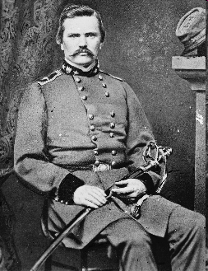
ONE LAST RAID
Kentucky Governor Simon Bolivar Buckner sent deputies to West Virginia to arrest the Hatfields. They were brought to Kentucky and housed in the jail at Pikeville.
West Virginia Governor E. Willis Wilson questioned whether it was legal for Kentucky law officials to cross the Tug Fork River and seize West Virginia citizens.
The United States Supreme Court ruled that it was legal for Kentucky officers to enter West Virginia in pursuit of criminals.
Most of the Hatfields held in Pikeville were eventually sentenced to prison, but none were hanged.

Slide 33
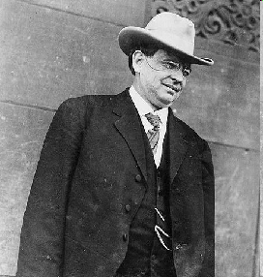
THE END OF THE FEUD
The feud died on its own after legal authorities became involved. The two families seem to lose interest in the fighting.
One member of the Hatfield family, Henry D. Hatfield, became a governor of West Virginia. He was also elected to the United States Senate.
A ceremonial end to the feud occurred on May 1, 1976, at a dedication ceremony of a McCoy family monument above Hardy, Kentucky.
Willis Hatfield, the last surviving son of Devil Anse Hatfield, shook hands with Jim McCoy.
This event symbolically buried the hatched, bringing the feud to an end.

Slide 34
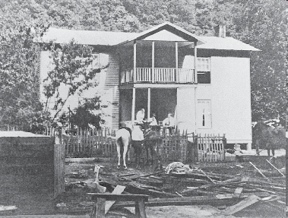
The Hatfield home was located in Logan County.
The Feud On YouTube

Slide 35
End Chapter 13
Main Menu

