Slide 1
CHAPTER 2
STATE AND LOCAL GOVERNMENT IN WEST VIRGINIA
Section 1 A History of West Virginia Government
Section 2 The Three Branches of State Government
Section 3 County and Municipal Government

Slide 2
Section 1
A History of West Virginia Government
Main Menu

Slide 3
West Virginia’s government is based on the same five principles as the federal government.
Sovereignty
Limited Government
Separation of Powers
Checks and Balances
Federalism

Slide 4
West Virginia has had two constitutions in its nearly 150 years of statehood. The present constitution, which was written in 1872, begins with a preamble, which states its purpose.
Preamble to the West Virginia Constitution
Since through Divine Providence we enjoy the blessings of civil, political and religious liberty, we, the people of West Virginia, in and through the provisions of this Constitution, reaffirm our faith in and constant reliance upon God and seek diligently to promote, preserve and perpetuate good government in the State of West Virginia for the common welfare, freedom and security of ourselves and our posterity.

Slide 5
Since the people who wrote the West Virginia Constitution in 1872 could not anticipate what life would be like in the future, the amendment process provides the flexibility to make needed changes.
West Virginia Constitution
Amendment Process
Proposed by two-thirds of members of both houses of the Legislature and approved by a majority of the voters in the state
Proposed by constitutional convention and approved by a majority of both houses of the Legislature and a majority of the voters
Or

Slide 6


Amendments include
Adding a preamble
Establishing a family court system
Allowing the governor to serve two consecutive terms
Providing better highways
Providing bonuses for veterans

Slide 7
SECTION 2
The Three Branches of State Government
Main Menu

Slide 8
THREE BRANCHES OF STATE GOVERNMENT
LEGISLATIVE
EXECUTIVE
JUDICIAL

Slide 9
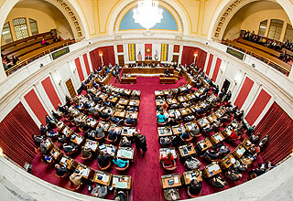
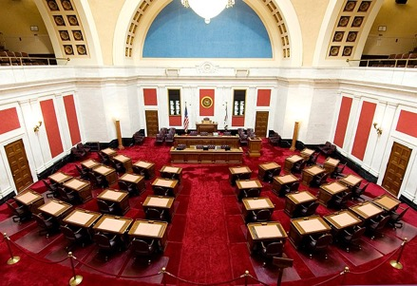
LEGISLATIVE BRANCH
HOUSE OF DELEGATES
100 members; 58 districts
Serve two-year terms; unlimited number of terms
Speaker of the House is the presiding official
SENATE
34 members; 17 districts
Serve 4-year terms; unlimited number of terms
President/Lieutenant Governor is the presiding official

Slide 10
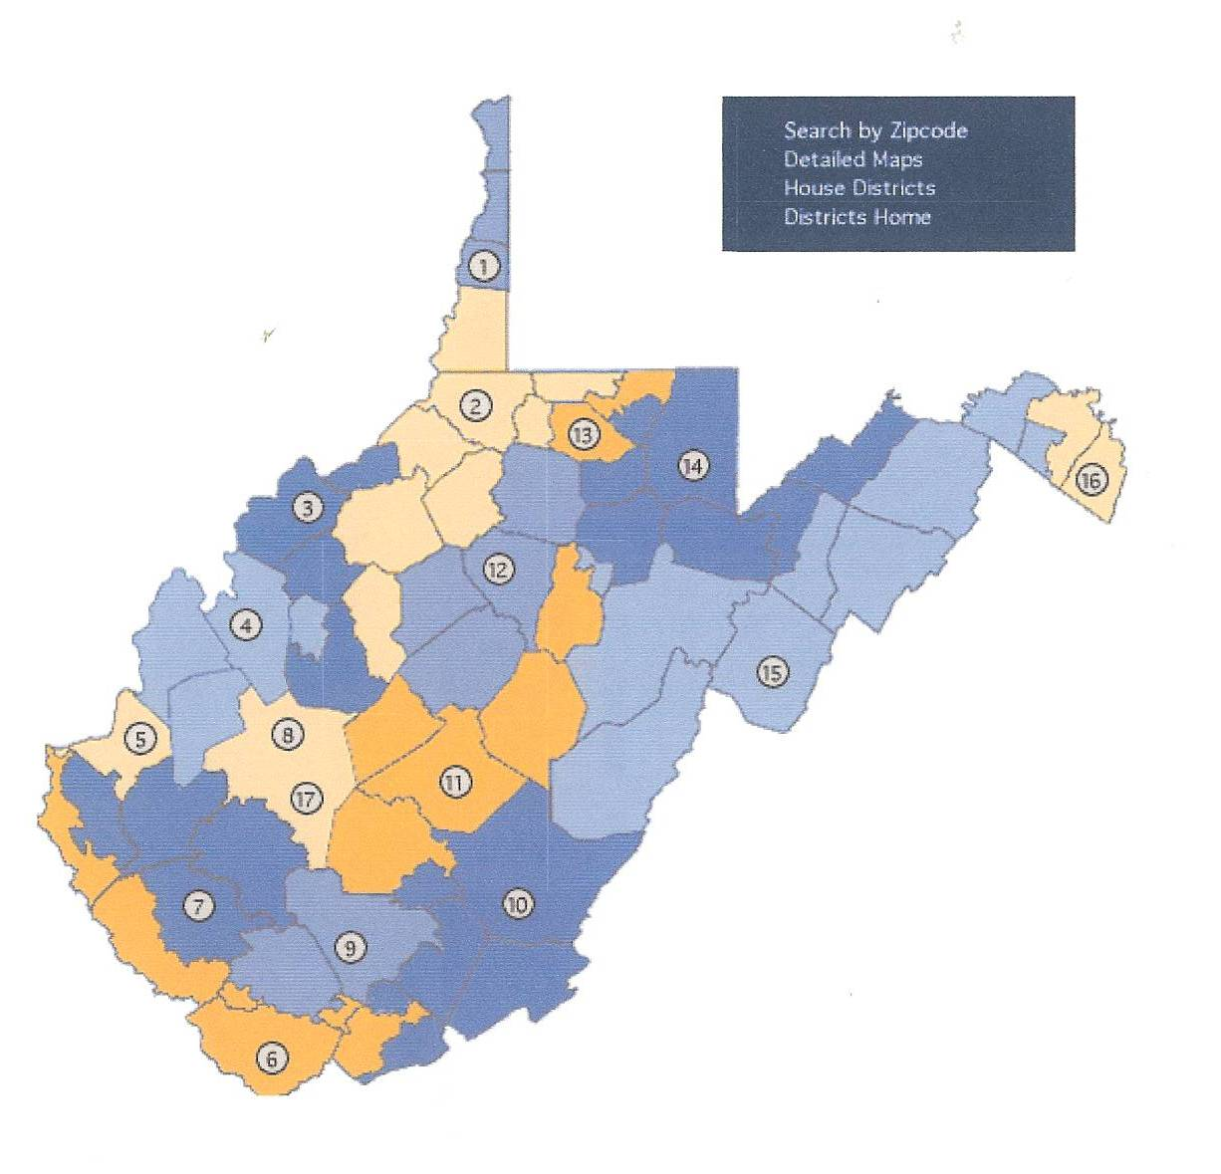
State Senate Districts

Slide 11
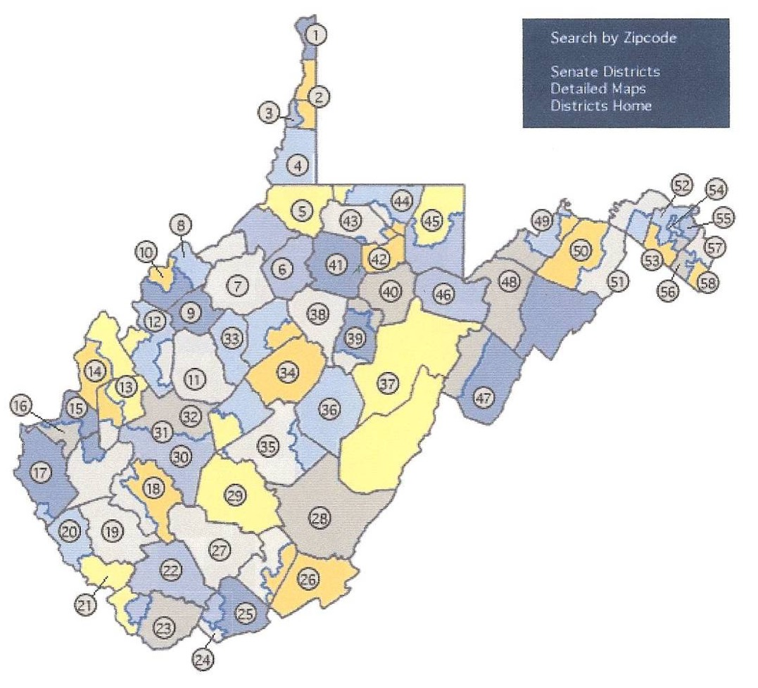
House of Delegates Districts

Slide 12
REQUIREMENTS TO SERVE IN THE LEGISLATURE
House of Delegates | Senate
Eligible to vote Resident of state for one year Resident of district in which they are running At least 18 years of age | Eligible to vote Resident of state for one year Resident of district in which they are running At least 25 years of age

Slide 13
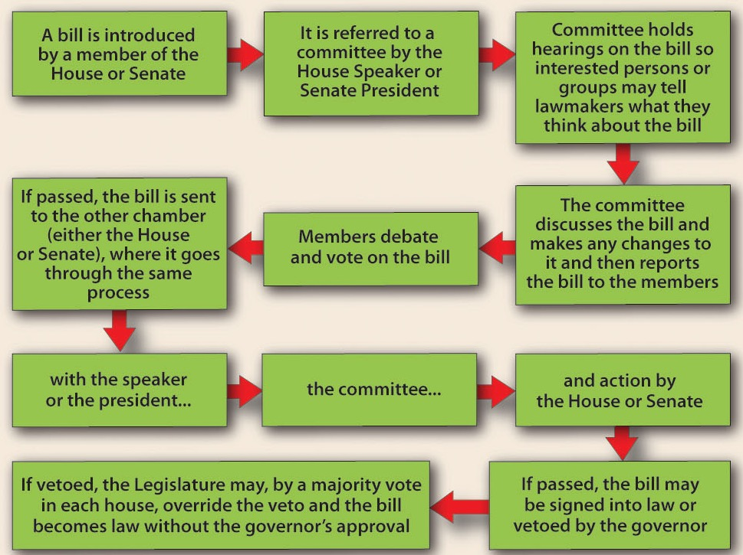
LAW MAKING PROCESS
To become a law, a bill goes through a process similar to that at the national level.

Slide 14
EXECUTIVE BRANCH
GOVERNOR
BOARD of PUBLIC WORKS
CABINET
VARIOUS AGENCIES AND OFFICES

Slide 15
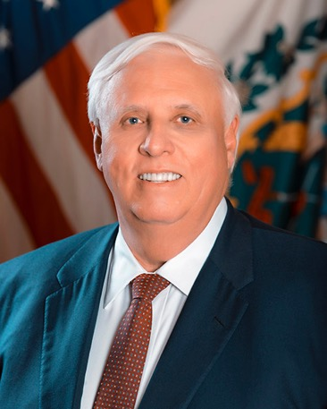
GOVERNOR
Jim Justice became the 36th governor in 2017. To be governor, a person must be at least 30 years of age and have lived in the state for five years prior to the election.
DUTIES
Enforces state laws
Prepares annual budget
Commander-in-chief of state’s military
Pardons people accused of crimes
Appoints heads of various agencies
Serves on state boards and commissions
Holds press conferences to keep people informed

Slide 16
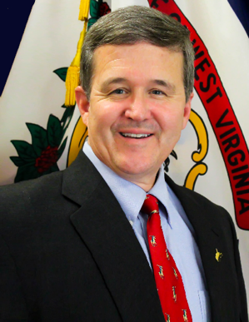
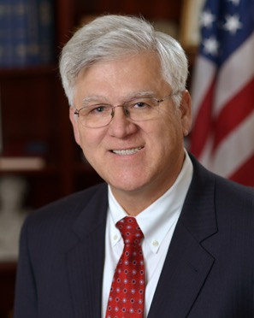
BOARD OF PUBLIC WORKS
Secretary of State
Keeper of Great and Less Seal of State
Chief state election officer
Maintains all official state papers
State Treasurer
Receives state revenues
Pays the state’s bills
Mac Warner
John Perdue

Slide 17
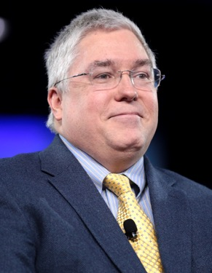
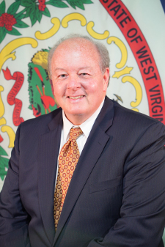
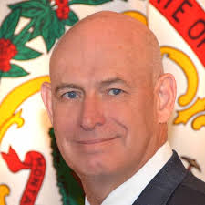
Attorney General
Heads state legal department
Serves as the state’s lawyer
State Auditor
State’s official bookkeeper
Commissioner of Agriculture
Sets standards
Grades all farm products
Identifies markets for farm products
State Superintendent of Schools
Oversees state’s public school system, including teacher certification, curriculum, and textbook adoptions
Patrick Morrisey
John McCuskey
Kent Leonhardt
Steven Paine

Slide 18
Other Executive Departments
Department of Administration
Department of Commerce
Department of Arts, Culture and History
Department of Environmental Protection
Department of Health and Human Resources
Department of Military Affairs and Public Safety
Department of Revenue
Department of Transportation
Department of Veterans’ Assistance
Each of these departments is headed by a secretary.

Slide 19
This chart provides a look at the organization of the executive branch of West Virginia’s government.

Slide 20
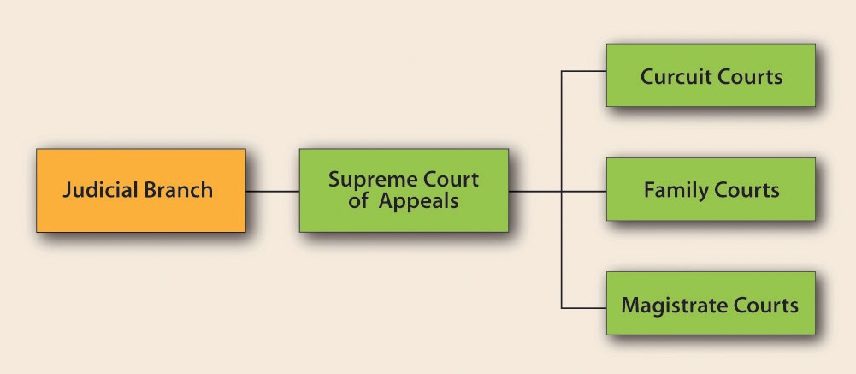
JUDICIAL BRANCH

Slide 21
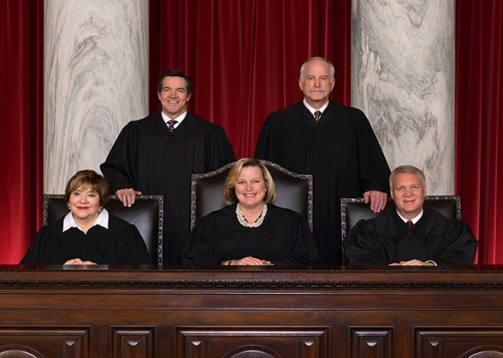
WEST VIRGINIA SUPREME COURT
The Court has five justices, one of whom serves as the chief justice.
A chief justice may serve from one to four years.
Justices are elected for twelve-year terms.
The Court has two terms each year: January to July and September into December.

Slide 22
The Supreme Court
has appellate and original jurisdiction. Most of the court’s cases are appealed from circuit or magistrate courts.
has no witnesses, testimony, or juries. The justices hear oral arguments and review printed materials.
has the power of judicial review.
Most of the decisions of the Supreme Court are final.

Slide 23
OTHER STATE COURTS
CIRCUIT COURTS
Trial Court
31 circuits; 74 judges
Judges elected to eight-year terms
Hear all felony and some misdemeanor cases
MAGISTRATE COURTS
158 magistrates
At least 2 in every county
Magistrates elected to four-year terms

Slide 24
SECTION 3
County and Municipal Government
Main Menu

Slide 25
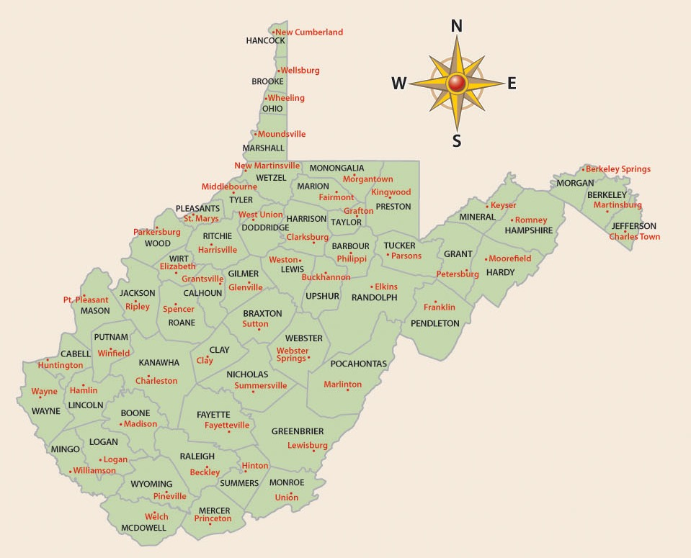
West Virginia’s Constitution provides for the establishment of governments for counties, municipalities, and boards of education.
There are over 3,000 counties in the United States; 55 of those counties are located in West Virginia.

Slide 26
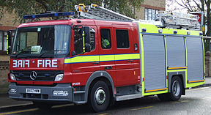
Services Provided by County Governments
Building and maintaining water and sewage systems
Fire Protection
Building and maintaining libraries
Providing emergency services, e.g., law enforcement, fire protection, medical emergencies
Providing recreational opportunities, e.g., swimming pools, parks

Slide 27
A County Commission presides over county government.
Each county commission must have at least three members.
Commissioners are elected to six-year terms.
Commissioners must meet at least four times per year.
Other Elected County Officials
County Clerk keeps official records of county
Circuit Clerk keeps records of circuit court
Sheriff enforces the law and collects taxes
Assessor determines value of property for tax purposes
Prosecuting Attorney represents county in court; pursues wrongdoers

Slide 28
Counties have executive, legislative, and judicial duties.
EXECUTIVE
Collect taxes
Enforce county ordinances
Conduct elections
Keep records
LEGISLATIVE
Regulate the use of property
Levy taxes
Issue bonds
Set requirements for business licenses
Spend money for county purposes
JUDICIAL
Hear appeals on tax assessments, employee complaints, and zoning decisions
Prosecute cases in circuit courts

Slide 29
MUNICIPAL GOVERNMENT
Depending on its size, a municipality may be classified as a city, town or village.
CLASS I CITIES have a population of at least 50,000
CLASS II CITIES have a population between 10,000 and 50,000
CLASS III CITIES have a population between 2,000 and 10,000
Municipalities of less than 2,000 are classified as towns or villages.

Slide 30
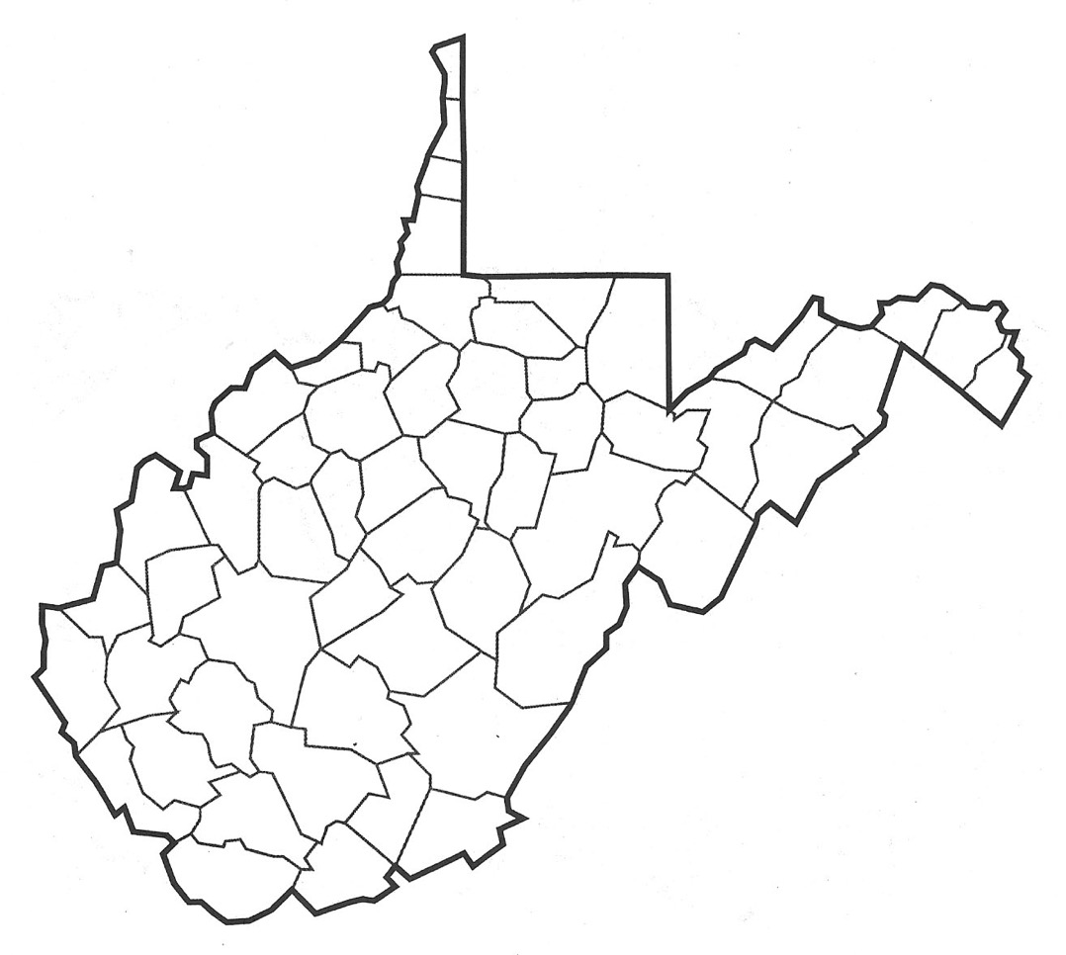
WEST VIRGINIA’S LARGEST CITIES BY POPULATION
Weirton
Wheeling
Morgantown
Martinsburg
Fairmont
Parkersburg
Charleston
Clarksburg
Huntington
Beckley

Slide 31
Municipalities may choose from one of three types of government:
Mayor-Council Form
Commission Form
The people elect both the mayor and the council members.
Voters elect individuals to specific
administrative positions. In West
Virginia, there must be either three or
five commissioners.
Council-Manager Form
Elected city council members set policy and pass ordinances. There is a mayor who presides at council meetings. The mayor is either elected to the office or designated by a vote of the council members.
Municipalities of fewer than 2,000 residents, however, must use the Mayor-Council form of government.

Slide 32
BOARDS of EDUCATION
The third example of local government is the board of education.
Each county has a Board of Education consisting of five members.
Board members are chosen in nonpartisan elections.
Board members set education policy, approve a budget, approve curriculum, and hire employees.
Board members hire the county superintendent to carry out the system’s goals.
County boards of education receive direction from the West Virginia Department of Education.
County boards of education receive funding from county property taxes, state funds, federal funds, and sometimes from special assessments.

Slide 33
End Chapter 2
Main Menu

