Slide 1
Chapter 5
The Geography of West Virginia
Section 1 Location
Section 2 Place
Section 3 Human/Environmental
Section 4 Movement
Interaction

Slide 2
Section 1
Location

Slide 3
A very basic geographical skill is to describe where a place is located.
Location can be shown in a number of ways.
From general relative location . . .

Slide 4
Relative to the solar system,
West Virginia is on the Earth.

Slide 5
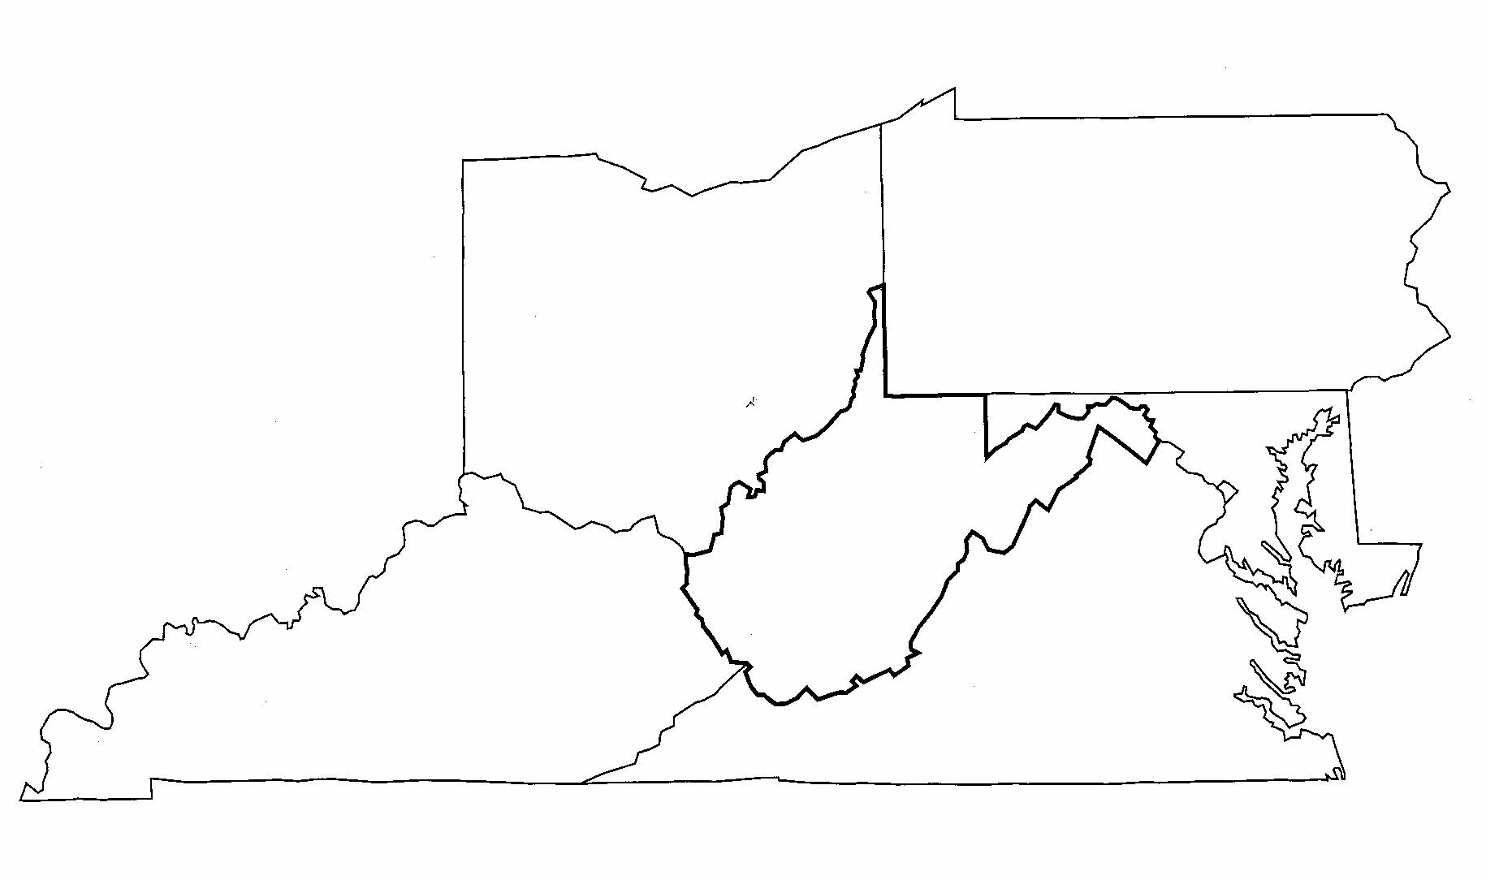
Relative to its location in the United States, West Virginia is surrounded by
Pennsylvania
Ohio
Maryland
West
Virginia
Kentucky
Virginia

Slide 6
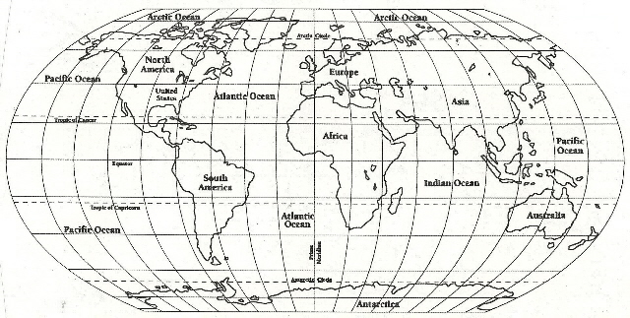
Mapping the earth requires putting a graph on the earth
Map
To do this we use terms like:
W Longitude
E Longitude
Prime Meridian O
180’ 160’ 140’ 120’ 100’ 80’ 60’ 40’ 20’
20’ 40’ 60’ 80’ 100’’ 120’ 140’ 160’ 180’
72’
90’
N Latitude
72’
54’
36’
18’
Equator
0’
18’
36’
S Latitude
54’
72’
90’

Slide 7
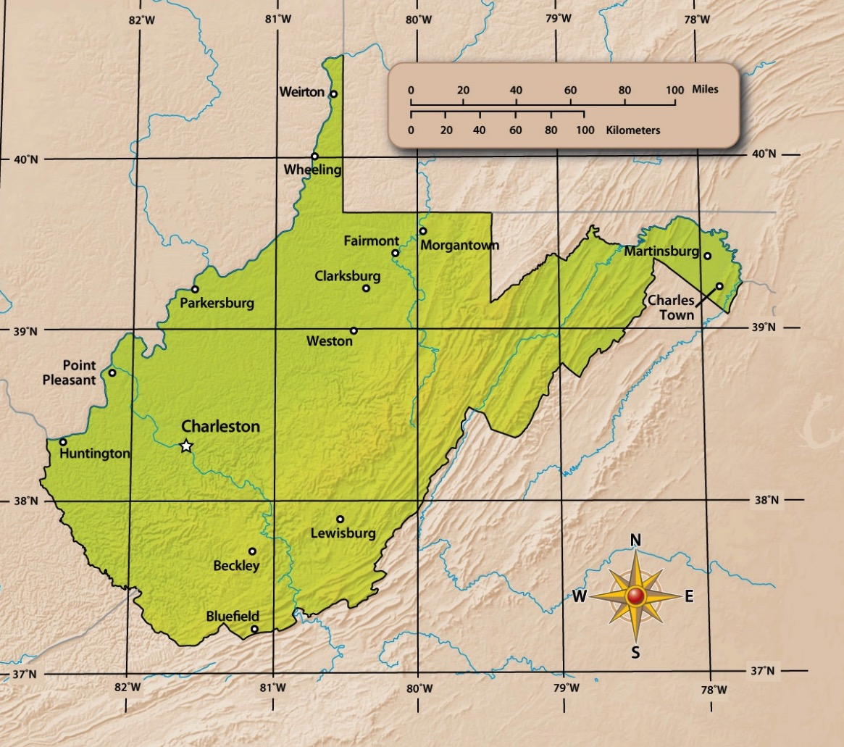
40° 38' N
Absolute Location
´
77° 38´ W
82° 55' W
37° 12' N
West Virginia lies between
longitude
and
latitude.

Slide 8
Section 2
Place
Main Menu

Slide 9
Describing what a place is like includes a description of its
Climate
Natural Wonders
Waterways

Slide 10
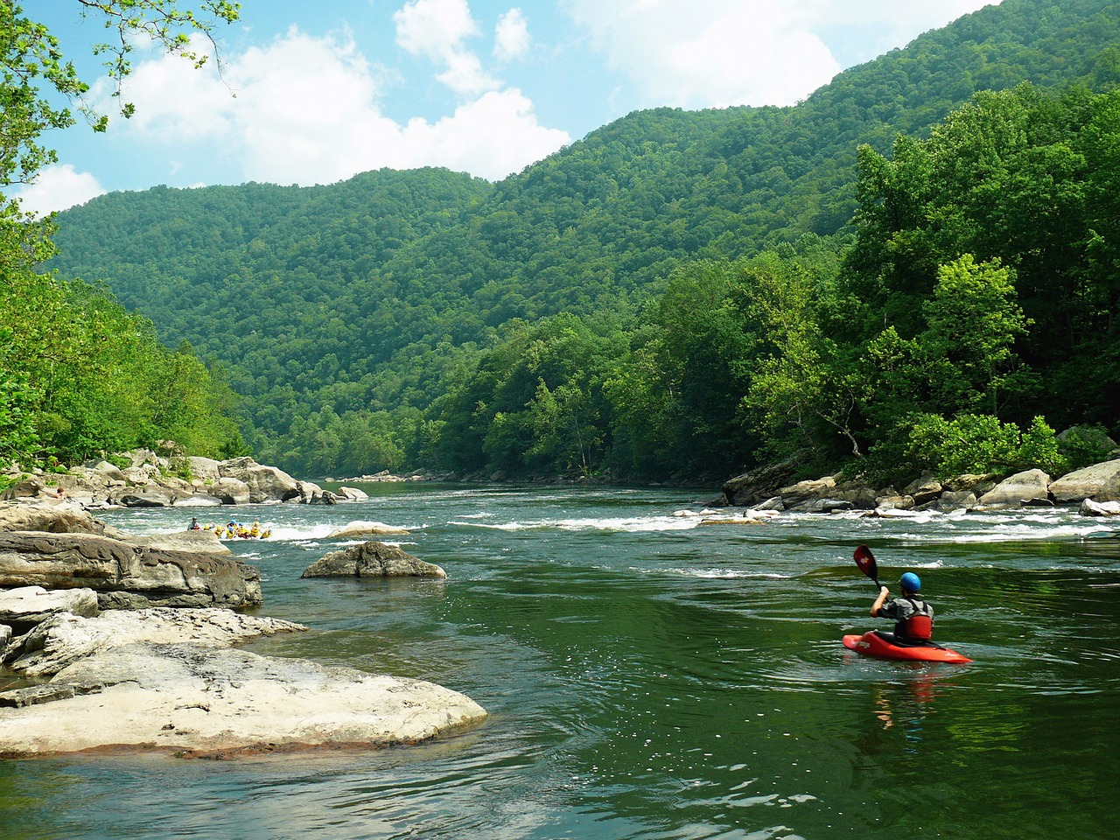
West Virginia has a Humid Continental climate which means it has four seasons
Spring

Slide 11
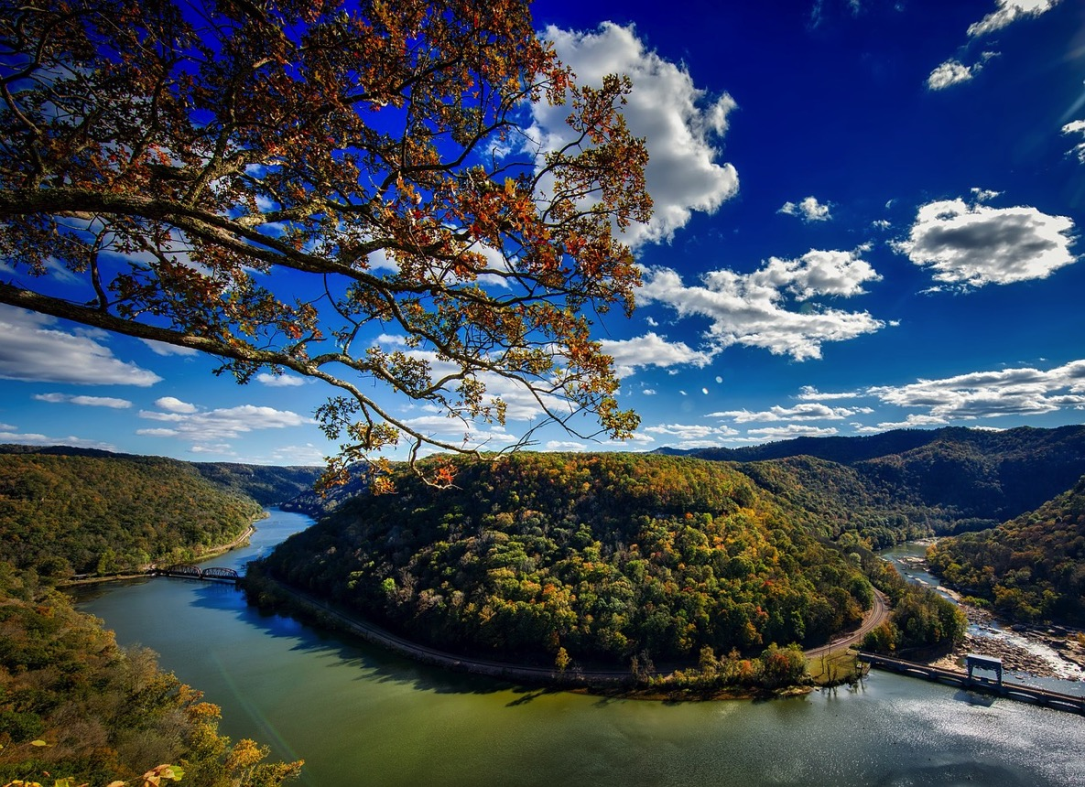
Summer

Slide 12
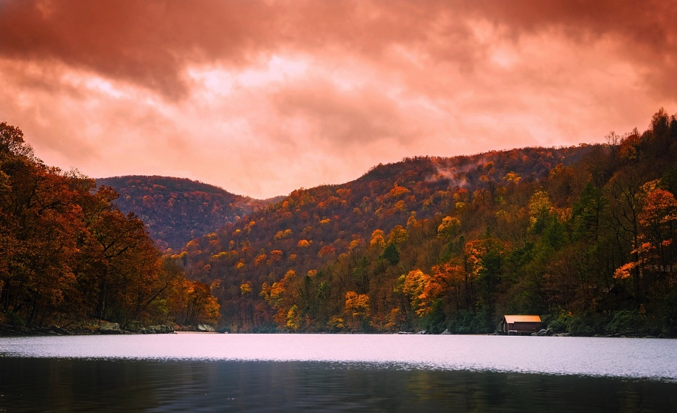
Fall

Slide 13
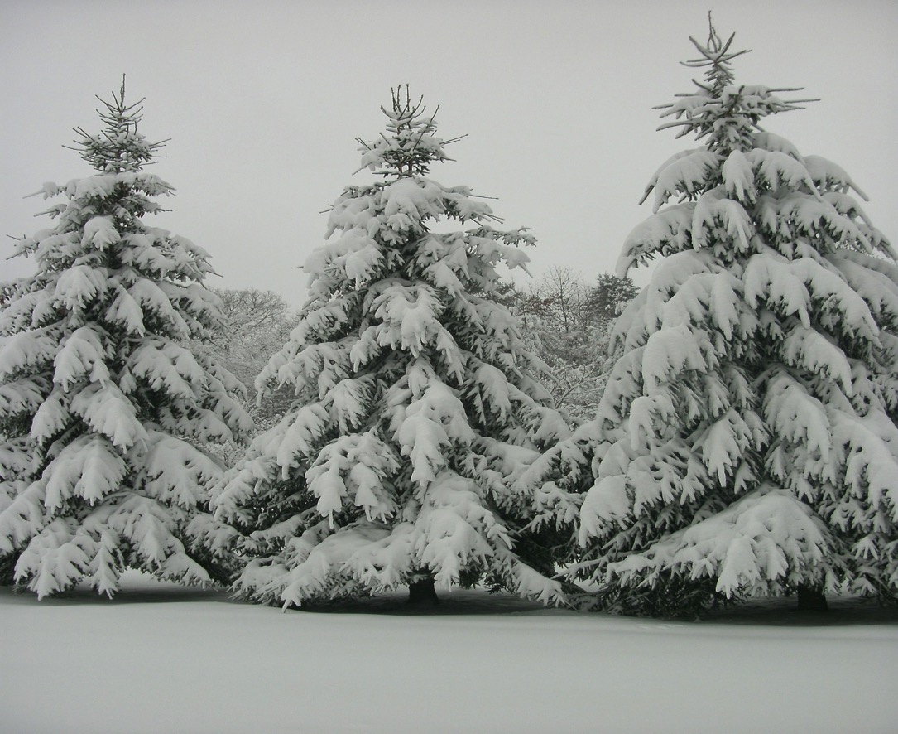
Winter

Slide 14
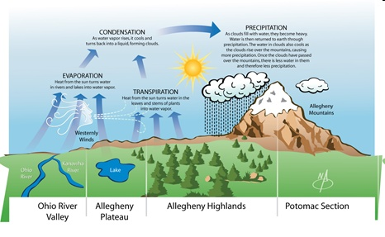
West Virginia’s mountains also play a role in the state’s weather
Place

Slide 15
Besides climate, a place is defined by its natural wonders, which include
Valleys
Waterfalls
Caves
Rock Formations
Waterways
Place

Slide 16
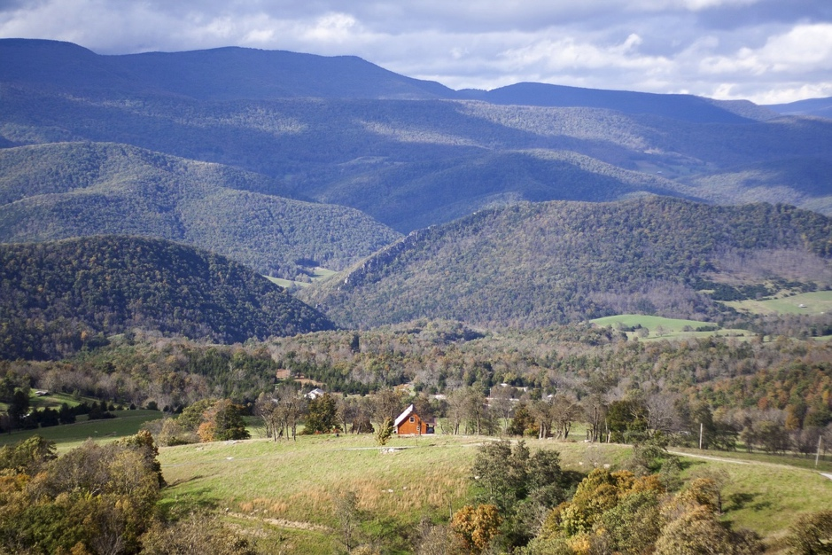
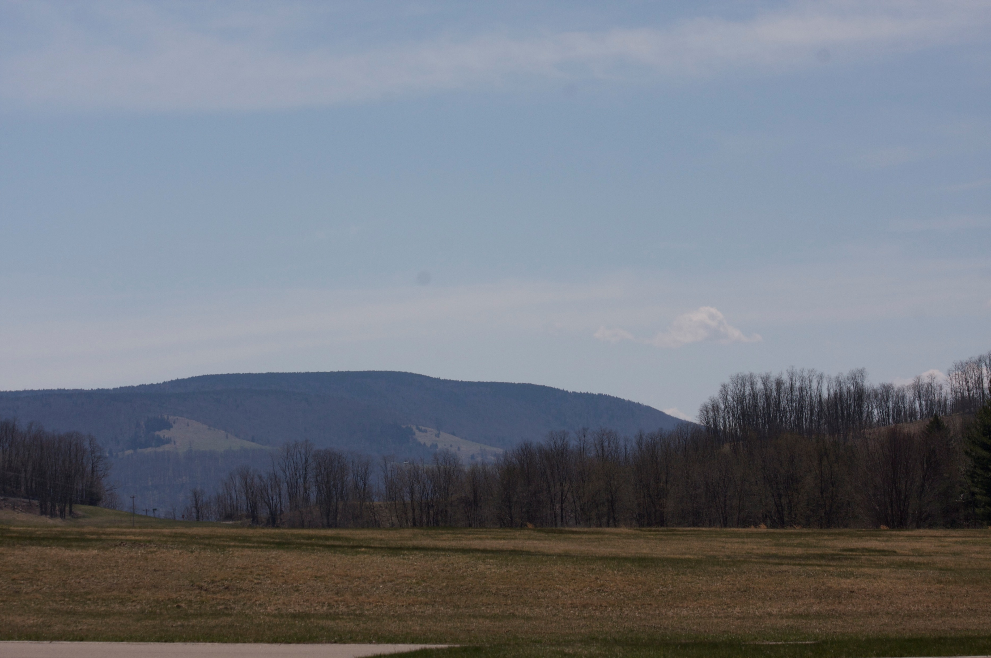

Valleys, like Canaan, provide a striking contrast to the state’s mountains.

Slide 17
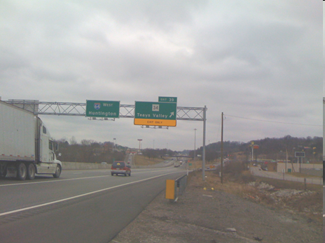
Teays Valley was once covered by an ancient river.
Natural Wonders

Slide 18
Waterfalls add beauty to West Virginia’s natural environment.
Sandstone Falls
Brush Creek Falls

Slide 19
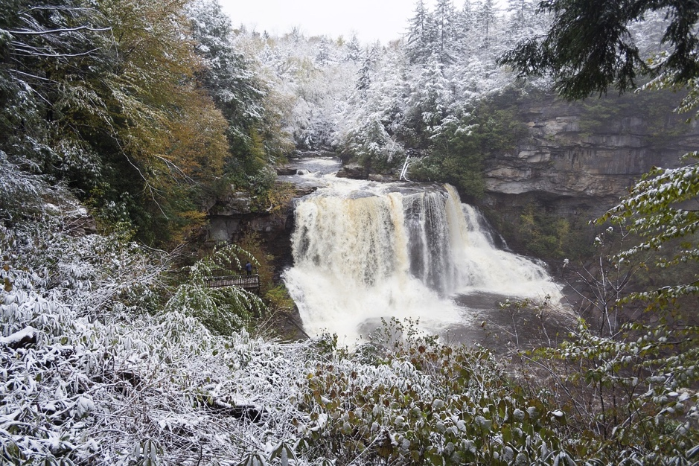
Blackwater Falls, in Tucker County, is one of the most photographed scenes in the state.

Slide 20
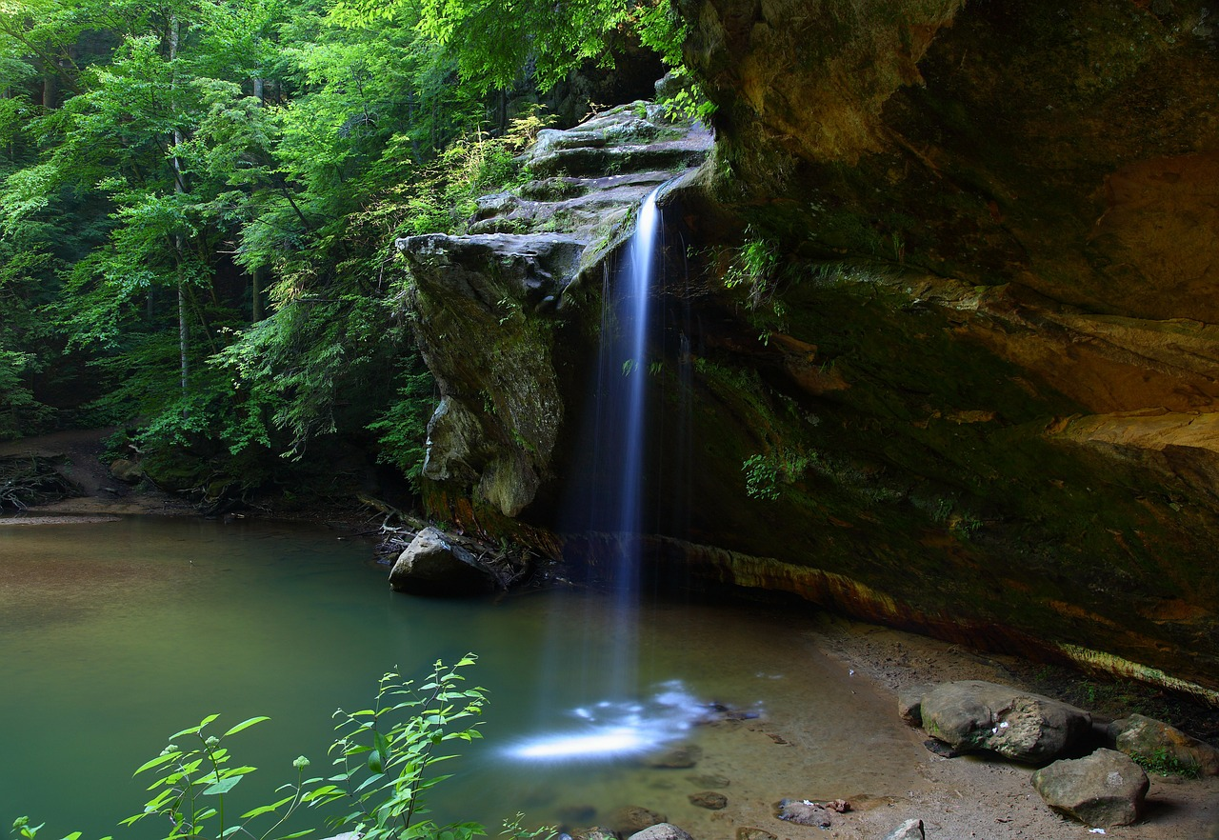
Hills Creek Falls

Slide 21
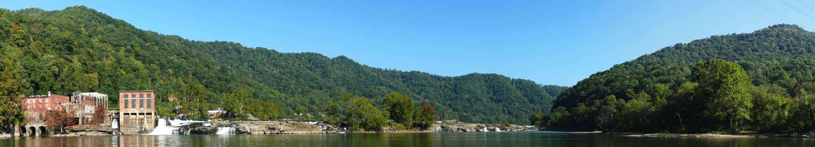
Kanawha Falls, in Fayette County, is located on the Kanawha River.
Natural Wonders

Slide 22
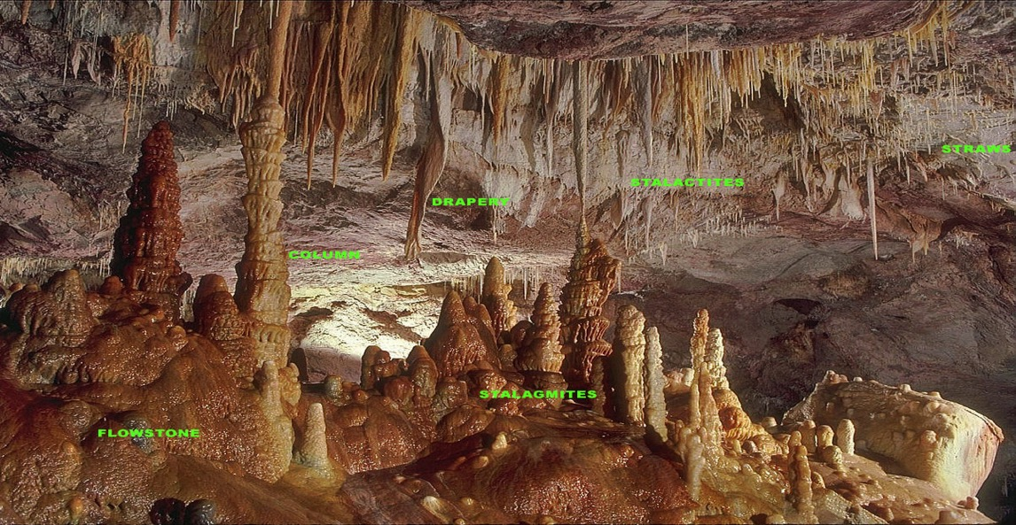
Caves are a haven for spelunkers. In caves you find stalactites and stalagmites.
Stalactites
Calcium carbonate deposits which hang from the roof of the cave
Stalagmites
Calcium carbonate deposits which build up from the floor of the cave

Slide 23
Caves include
Seneca Caverns
Organ Cave
Scott Hollow Cave

Slide 24
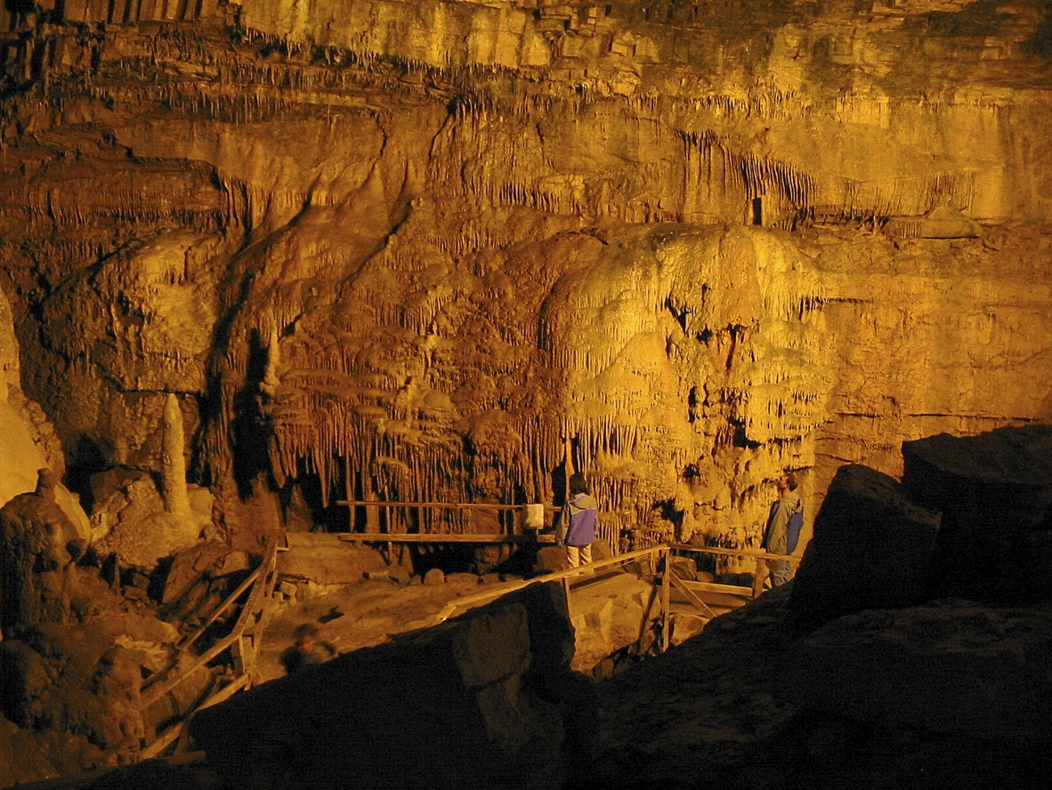
Lost World Caverns

Slide 25
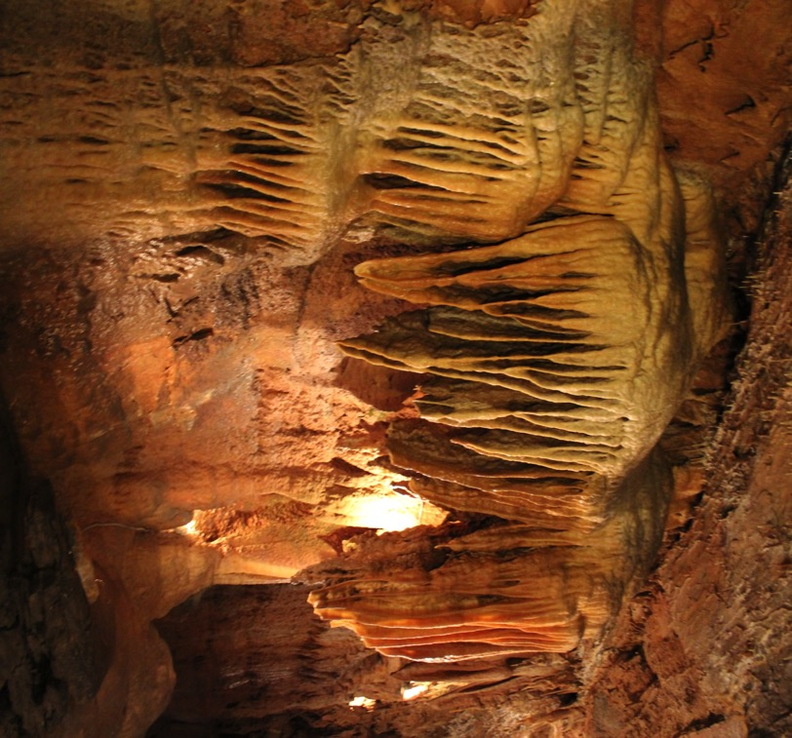
Smokehole Caverns
Natural Wonders

Slide 26
Rock formations are another natural wonder.
Bear Rock Preserve
Caudy’s Castle
Hanging Rocks

Slide 27
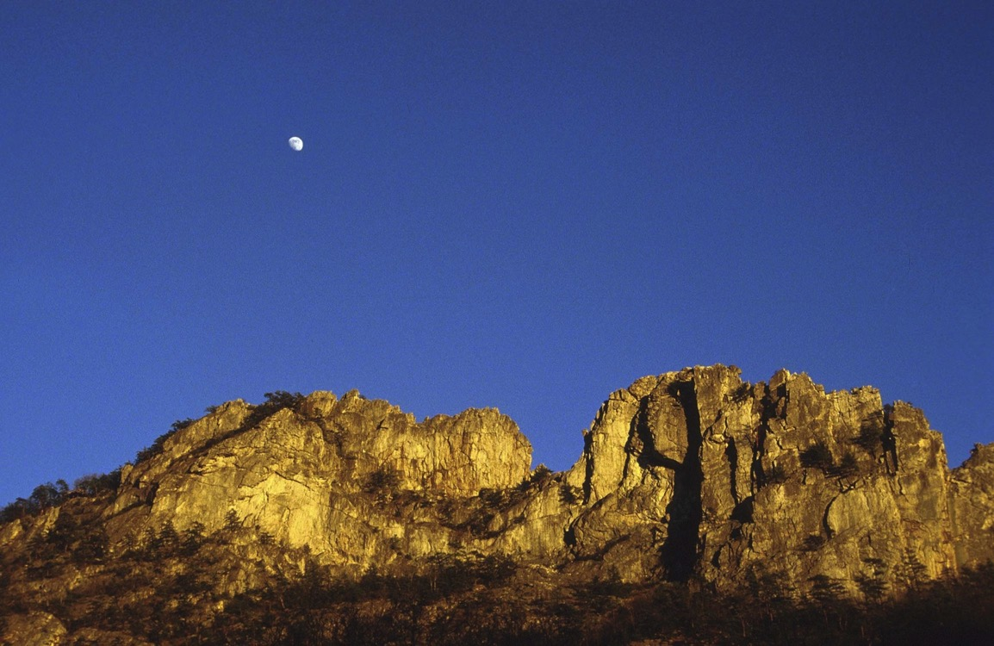
Seneca Rocks

Slide 28
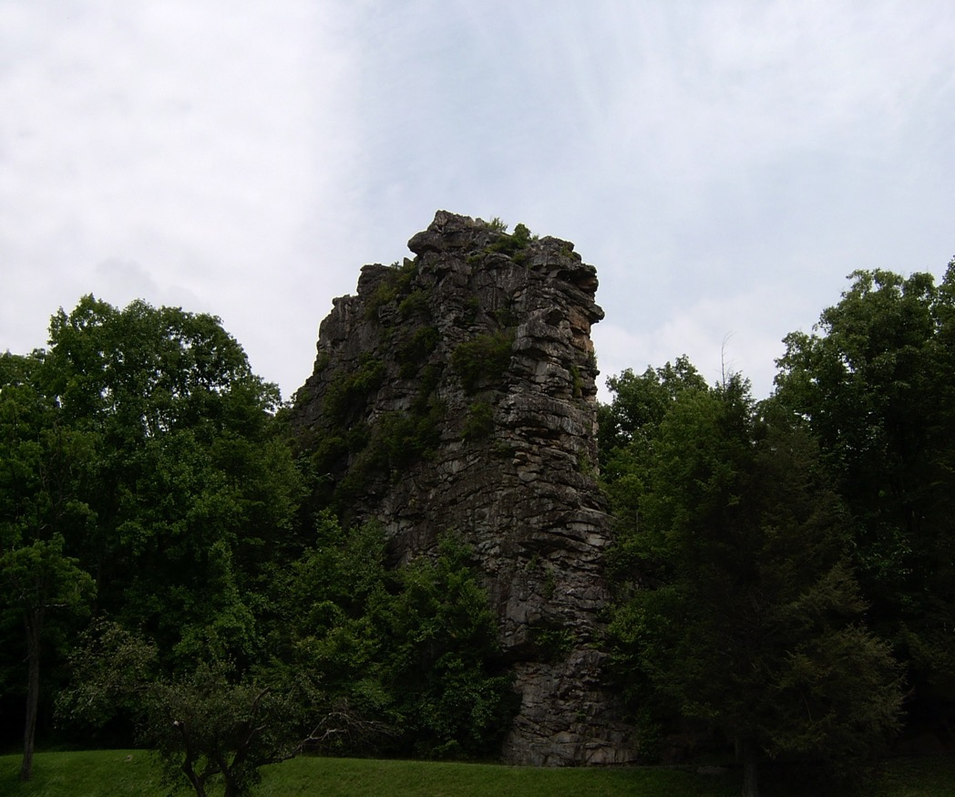
Pinnacle Rock
Natural Wonders

Slide 29
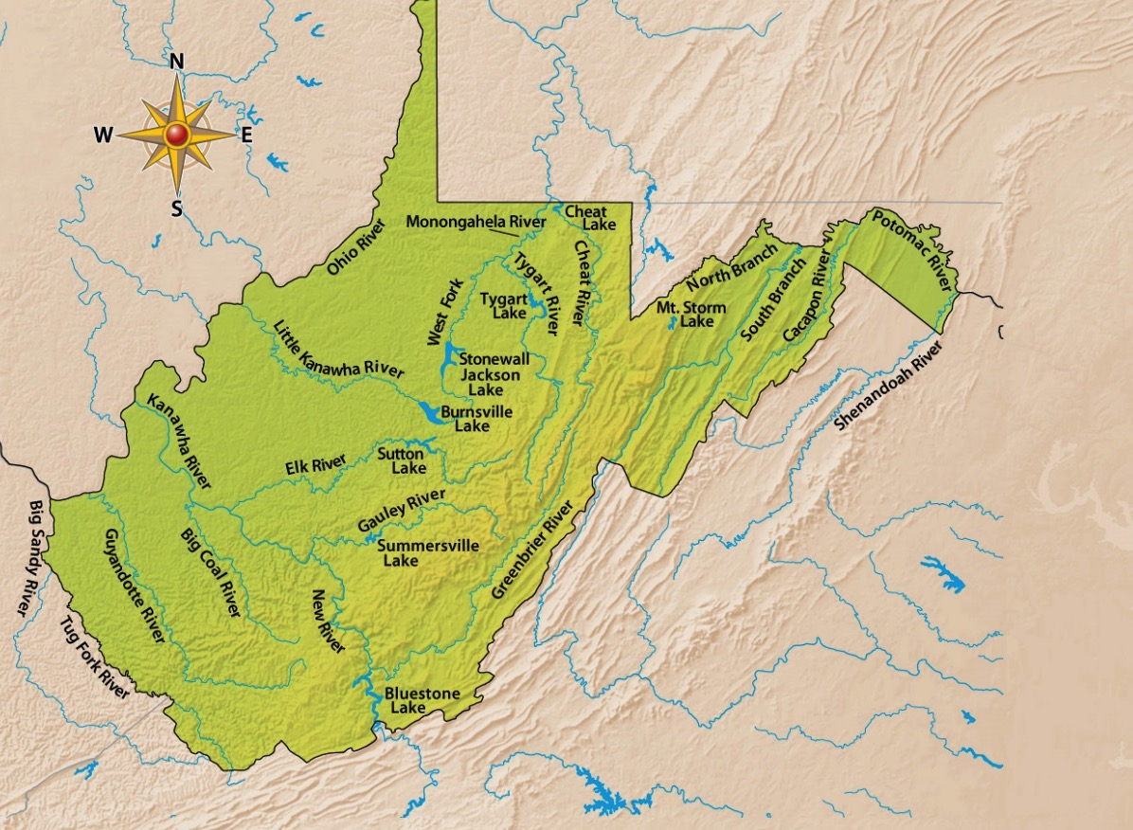
West Virginia Lakes and Rivers
West Virginia has a number of waterways, including rivers and lakes.

Slide 30
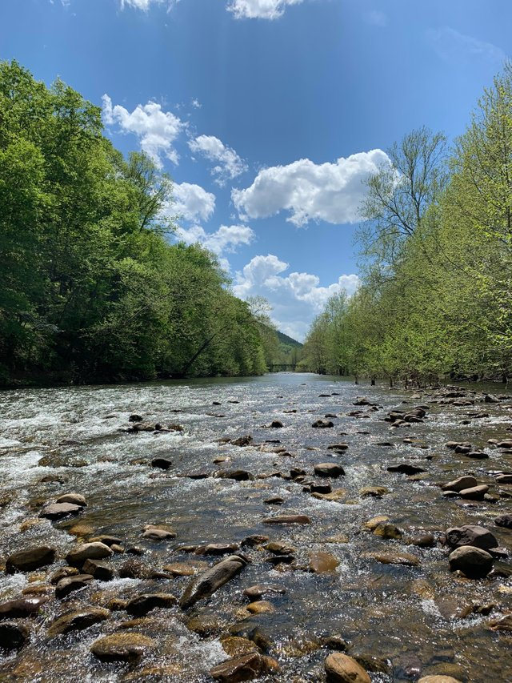
North Branch of the South Fork of the Potomac River

Slide 31
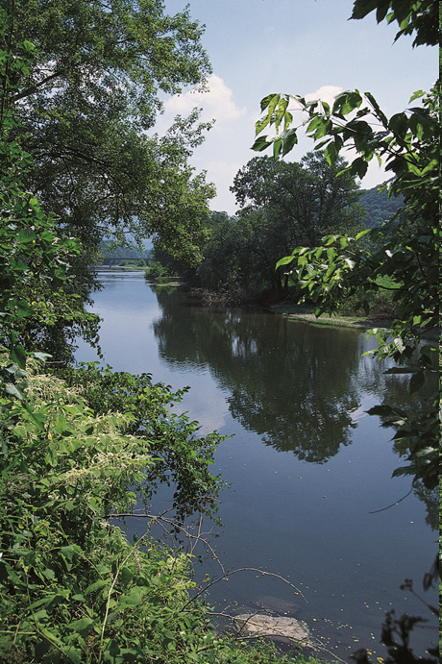
Greenbrier River

Slide 32
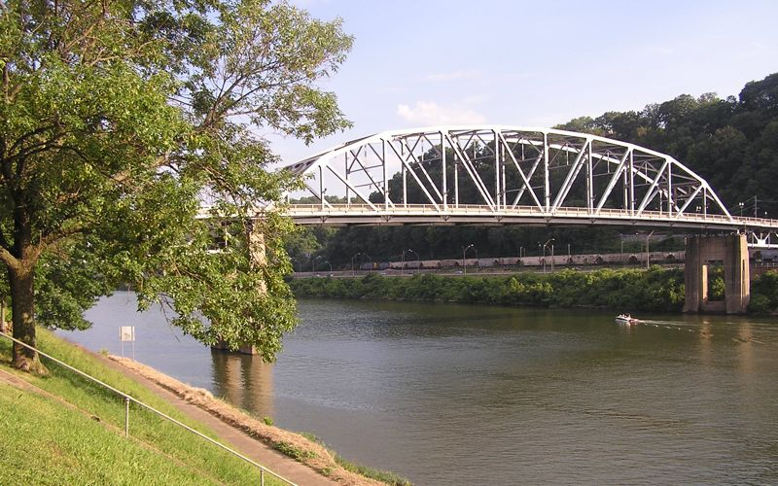
Kanawha River

Slide 33
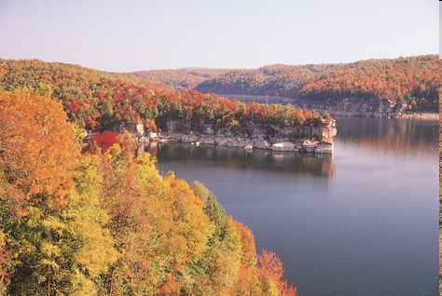
Summersville Lake
Natural Wonders

Slide 34
Section 3
Human/Environmental Interaction
Main Menu

Slide 35
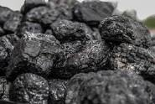
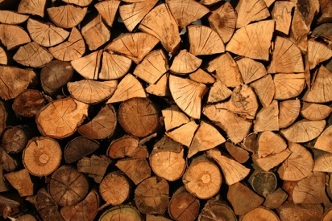
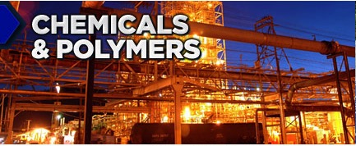
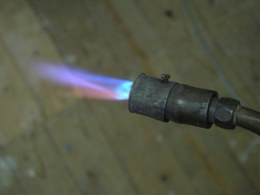
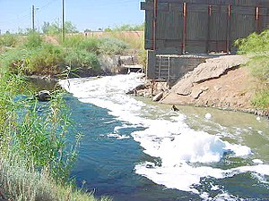
The Environment and Industrial Growth
West Virginia’s natural resources helped industries to grow.
However, the growth of some of those industries have impacted the state’s environment negatively.

Slide 36
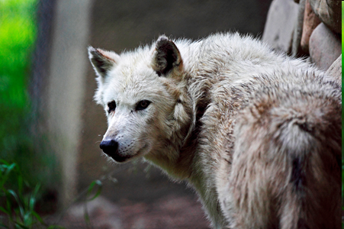
The geographic theme of Human/Environmental Interaction describes how humans use, affect, and are affected by their environment.
Animals like the wolf once thrived, but hunters and government bounties made them extinct in West Virginia.
Photo by Todd Ryburn

Slide 37
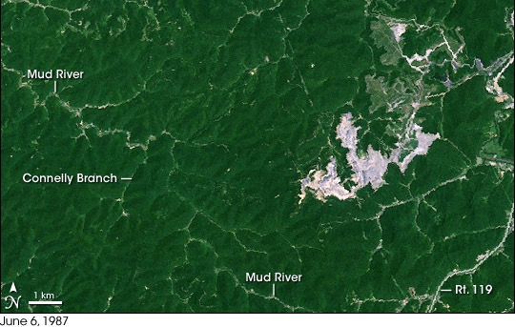
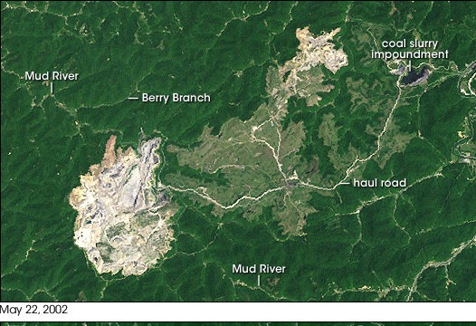
As mining became more profitable, companies began to look for an easier way to extract coal. The result was surface mining (strip mining) which has changed the look of the state
Hobet 21
Satellite picture 1987
Satellite picture 2002
To see how strip mining changes the landscape around the Hobet mine over time, go to https://www.wvpublic.org/post/watch-30-years-mountaintop-removal-spread-across-appalachia#stream/0

Slide 38
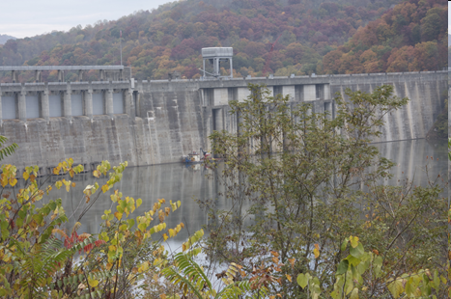
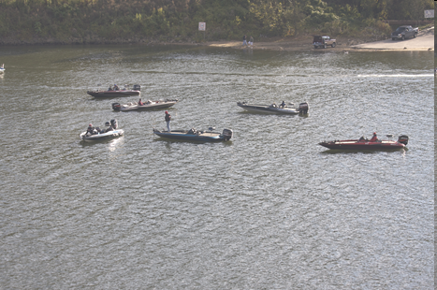
Building dams on rivers to prevent flooding has created man-made lakes.
These lakes provide recreational activities.
Main Menu

Slide 39
Section 4
Movement

Slide 40
The geographic theme of movement focuses on the ways people are linked—by regions, cultures, and other people—beyond their environment.

Slide 41
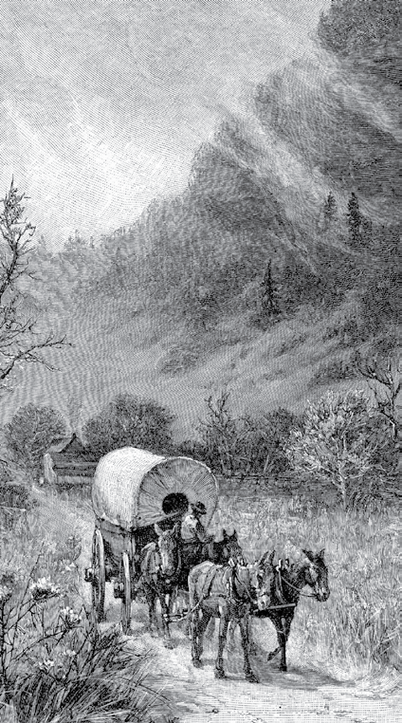
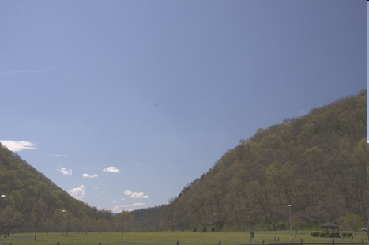
The earliest routes for settlers to western Virginia were through gaps in mountains and trails through level valleys.

Slide 42
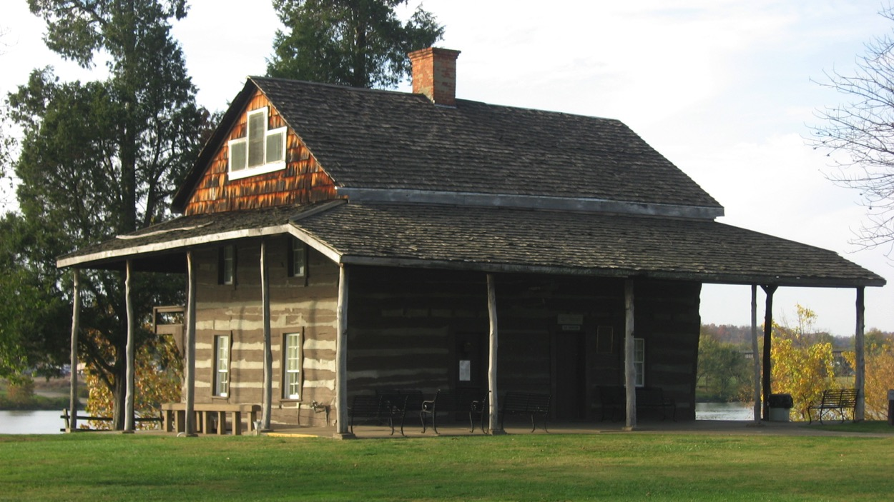
For this reason, the earliest settlements were made in the eastern panhandle.

Slide 43
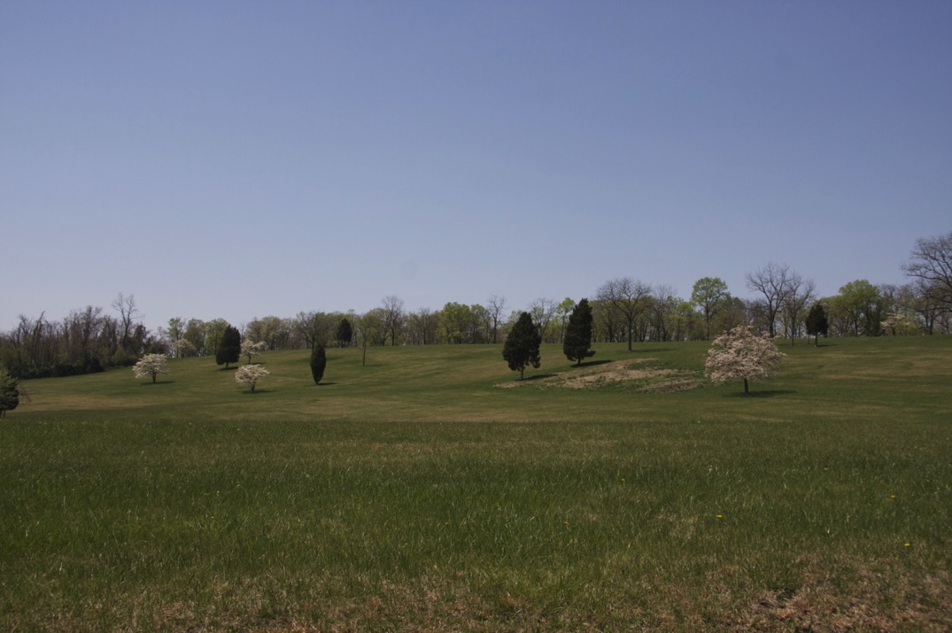
As more people settled in a specific area, the area became crowded. This forced people to move to less settled areas.

Slide 44
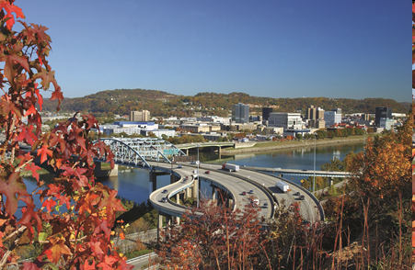
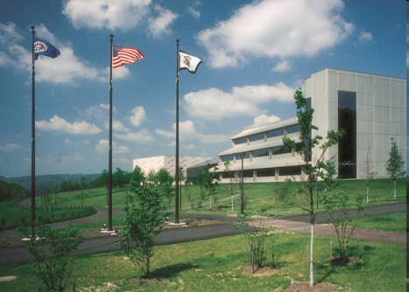
In more recent times, people move to find jobs.

Slide 45
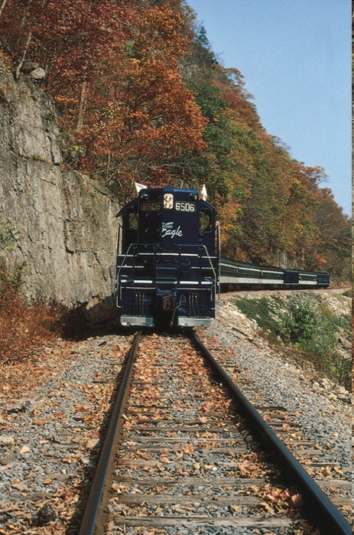
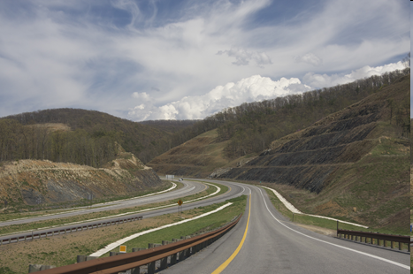
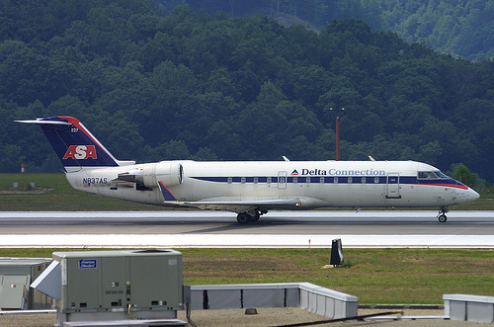
More modern methods of transportation have made movement easier.
Amtrack
Photo by
Tom Turner

Slide 46
End Chapter 5
Main Menu

