Slide 1
CHAPTER 8
EXPLORING AND SETTLING WESTERN VIRGINIA
Section 1 Early Explorers in Western Virginia
Section 2 Early Settlers in Western Virginia

Slide 2
SECTION 1
Early Explorers in Western Virginia
Main Menu

Slide 3
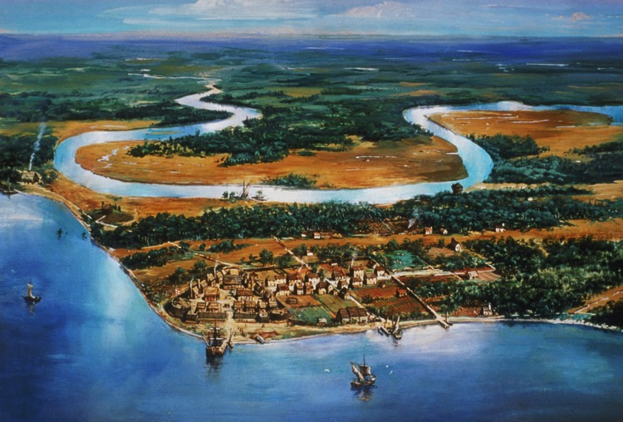
The exploration of Virginia, and more specifically western Virginia, occurred a little more than 100 years after the voyages of Christopher Columbus.
The first settlement in Virginia was made in Jamestown in 1607. This site was chosen because the settlement could be easily defended and the land was not occupied by Native Americans.

Slide 4
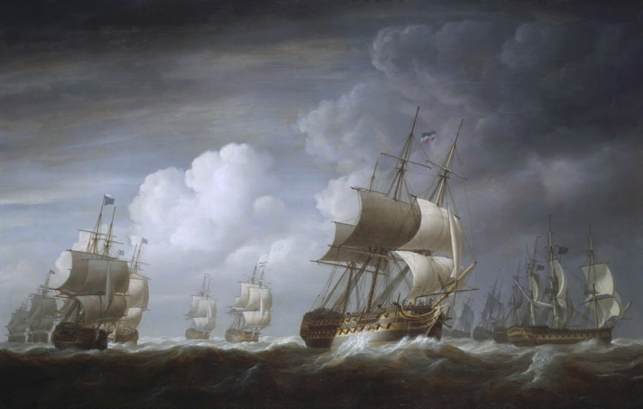
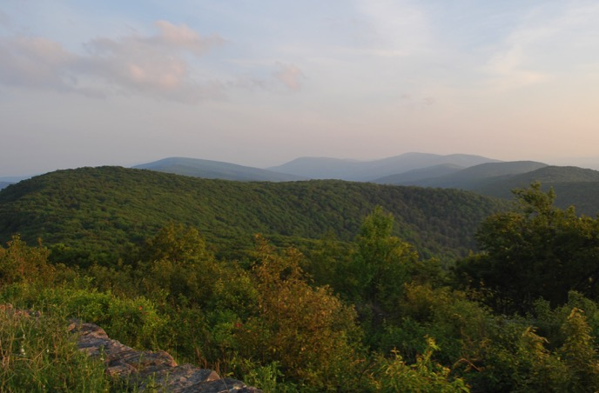
A year after sailing to the new world, Captain Christopher Newport led an expedition from Jamestown, to explore the western lands of Virginia.
The mountains of western Virginia were a tremendous barrier to exploration. Therefore, the Europeans investigated routes that would take them through gaps in the mountains or along river valleys.

Slide 5
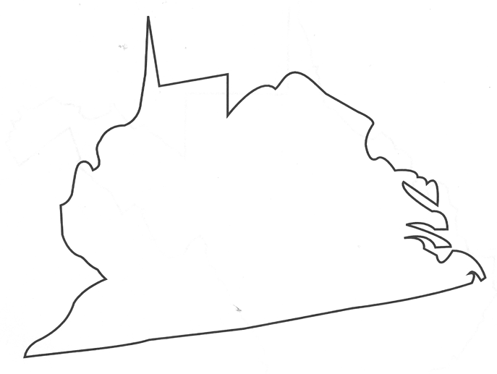
Early explorers of western Virginia included
Abraham Wood
a fur trader who commanded Fort Henry near present-day Petersburg, Virginia
Wood personally led an expedition into western lands in 1650.
The group traveled from Fort Henry to the headwaters of the Roanoke River.
The voyage was documented in a pamphlet called “The Discovery of New Brittaine.”
Fort Henry

Slide 6
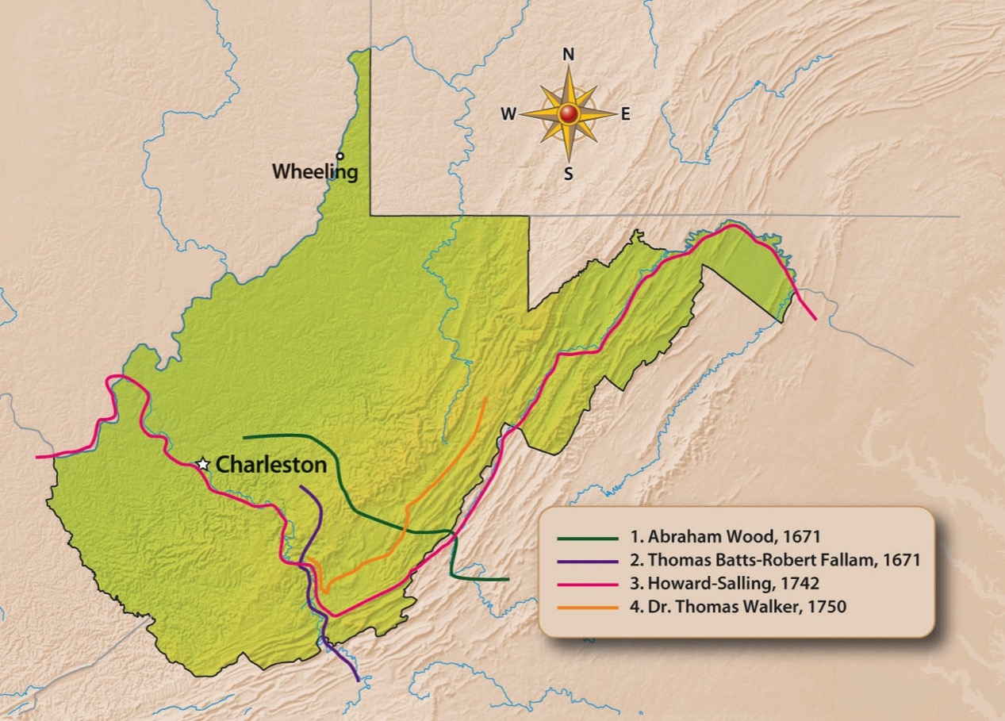
Later, others crossed western Virginia while exploring new lands. These explorers included
1669-1671 John Lederer
1671 Abraham Wood
1671 Thomas Batts and Robert Fallam
1742 Howard and Salling
1750 Thomas Walker

Slide 7
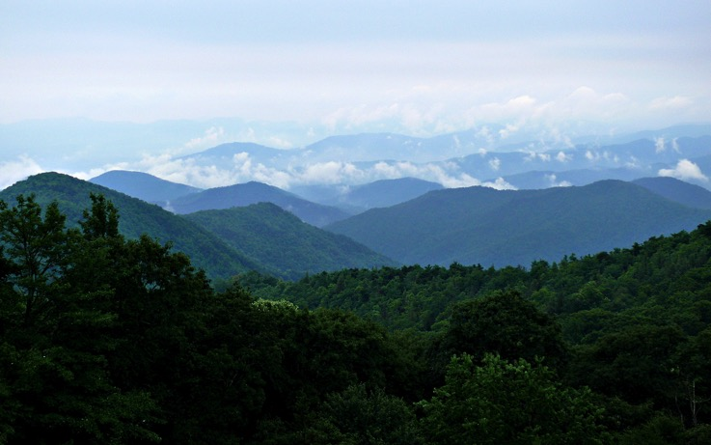
John Lederer
First person to enter present-day West Virginia
His expedition is sometimes discredited because
    some believe he sometimes recorded hearsay.
    his journal account contained references that some think are imaginary.
His journal referred to the “Atlantick” Ocean, which some think actually might have been fog over the Blue Ridge Mountains.

Slide 8
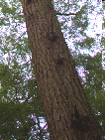


Thomas Batts and Robert Fallam
Members of the expedition
Found interesting tree markings, M.A.N.I. and MA.NI, which probably meant others had been there before them
Thomas Batts (the leader of the voyage)
Robert Fallam (kept a journal)
Thomas Wood (may have been a relative of Abraham Wood)
Penecute (an Appomattox Indian who guided the group)
Jack Weason (perhaps an indentured servant of Abraham Wood)
M.A.N.I.
MA.NI.
In Monroe County they marked trees with a hot iron to claim their territory
Marking included:
CR for the English King Charles II
WB for Virginia governor William Berkeley
AW for Abraham Wood
TB:RF:P for Thomas Batts, Robert Fallam, and Penecute
TB:RF:P

Slide 9
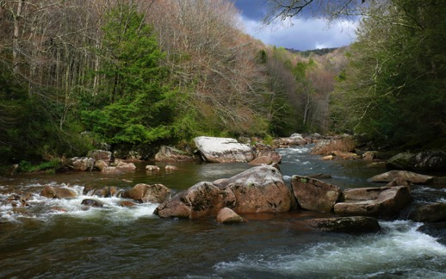
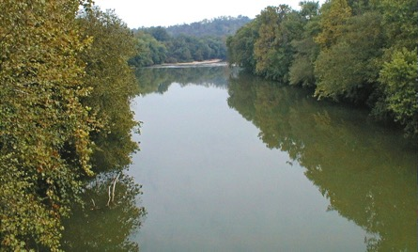
James Needham and Gabriel Arthur
Traveled from Fort Henry to Tennessee to make an agreement with the Cherokee to end the trade monopoly of the Occaneechi.
After making a treaty with the Cherokee, Needham returned to Fort Henry while Arthur stayed in Tennessee.
Later, when Needham set out to return to Tennessee, he was killed.
Sometime later, Arthur went with the Cherokee to Spanish West Florida on a trading mission. On the return voyage, the group passed through Tennessee and western Virginia. They eventually followed the Coal River to a Moneton Indian village near St. Albans.
Arthur is believed to be the first European to see the Kanawha River.
The importance of the exploration of Needham and Arthur was that it ended the trading superiority of the Occaneechi and Spaniards.

Slide 10
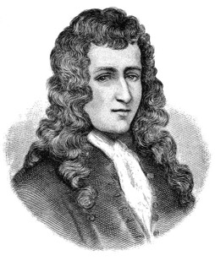
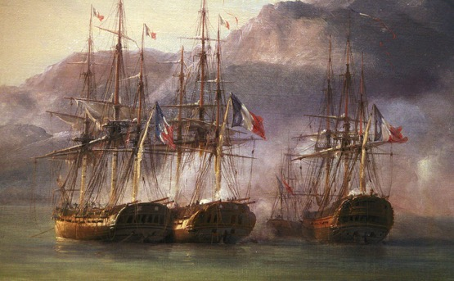
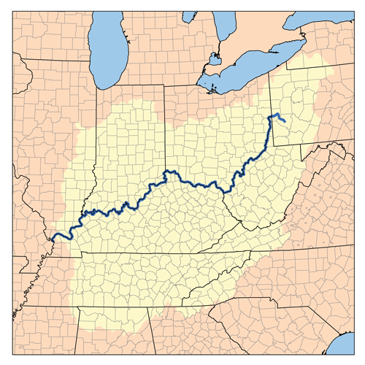
FRENCH EXPLORATION
At the same time the English were exploring western Virginia from the east, the French decided to explore the land from the north.
Robert Cavelier Sieur de La Salle sailed from the Great Lakes and reached the Falls of the Ohio River, near present-day Louisville, KY.
La Salle’s expedition gave France a claim to the Ohio Valley
Since the English also had a claim to the same area, this would later lead to confrontation and war between the two European powers.

Slide 11
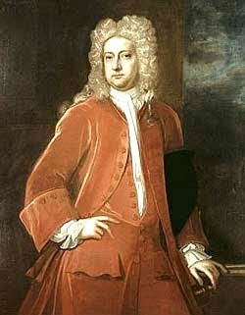
As the French increased their exploration activities in North America, the British temporarily ceased theirs.
The English suspended their explorations for a number of reasons, including:
Virginia lost its main promoter of exploration when Abraham Wood died.
Governor William Berkeley angered the colonists when he refused to send troops to protect them from Indian attacks.
Bacon’s Rebellion resulted in the withdrawal of monetary support from wealthy supporters of the western fur trade in England.

Slide 12
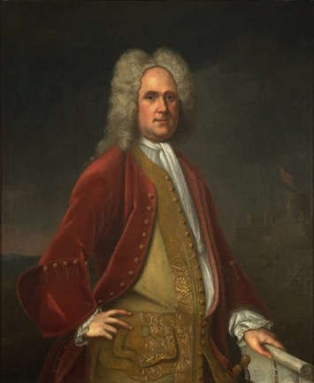
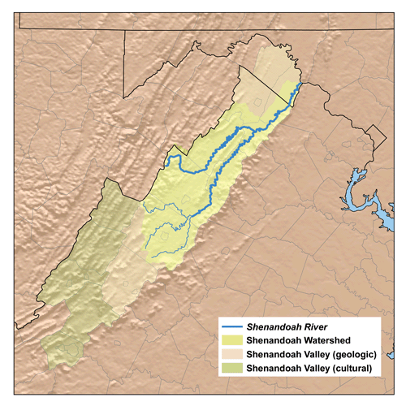
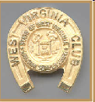
Returned British Interest in Western Exploration
In 1716, Alexander Spotswood, lieutenant governor of Virginia, personally led an expedition of thirty aristocrats from Williamsburg, Virginia, across the Appalachian Mountains into the Shenandoah Valley.
Along the way, they killed bears, told stories around campfires, and swam in the Shenandoah River.
Shenandoah Valley
Spotswood described the land they discovered as an agricultural paradise in order to encourage settlement.
Williamsburg
Spotswood gave each member of his expedition a miniature golden horseshoe. Today a replica of this gift is given to eighth-grade students across West Virginia in honor of their excellence in pursuit of the study of West Virginia History.

Slide 13
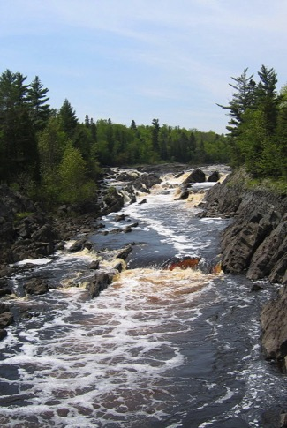
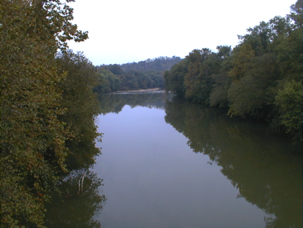
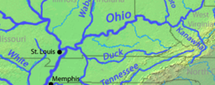
The Conflict between the English and the French Intensifies.
To gain a stronger claim to the western lands, Virginia Governor William Gooch sent John Howard and John Peter Salling on an expedition through the western lands to the Mississippi River.
They crossed the Allegheny Mountains and traveled for a time along the New River.
They left the New River and traveled by foot until they came to a smaller, calmer river. As they traveled along that river, they became the first explorers to see coal at Peytona. They named the small, calm river the Coal.
They finished their voyage by traveling from the Coal to the Kanawha River and then following the Kanawha to Point Pleasant where they entered the Ohio River. Finally, they traveled on the Ohio River to the Mississippi.

Slide 14
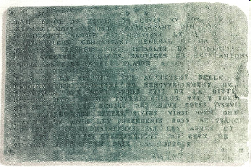
To give the French a stronger claim to western lands, the governor of Canada ordered an expedition to place leaden plates along the Ohio River as proof of their ownership of the land in the area.
A plate that was buried at the mouth of the Kanawha River was found by a young boy in 1846.
Celoron de Blainville led some 250 men, including a number of Indians, on the expedition.

Slide 15
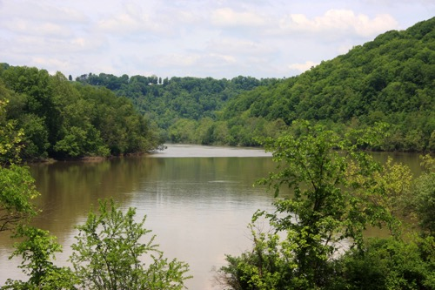
A New Reason for Exploring
By the middle of the 18th century, privately owned land companies began exploring to find land for profit.
Two of the most important land companies were
The Loyal Land Company
The Ohio Land Company
employed Dr. Thomas Walker to explore land that included part of present-day southern West Virginia
employed Christopher Gist, who on a second trip, explored an area bordered by the Monongahela, Ohio and Kanawha rivers.

Slide 16
SECTION 2
Early Settlers in Western Virginia
Main Menu

Slide 17
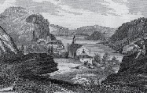
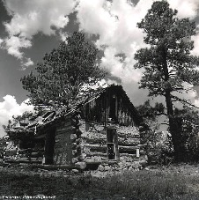
After 1730, settlements in the western land increased substantially.
Reasons for this increase included
Increased interest in the area after hearing reports from other settlers
The desire for “breathing room” by those who wanted to escape the crowded conditions in the middle colonies
The desire of the British to discourage further French expansion
A need for additional settlements as protection against land claims by Maryland and Pennsylvania

Slide 18
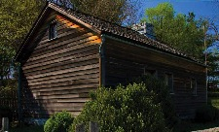
Morgan Morgan
-is believed to be western Virginia’s first
permanent European settler.
-came from Delaware, crossing the mountains in a horse-drawn wagon, to settle near Martinsburg, in West Virginia’s Eastern Panhandle.
-built a crude cabin and then spent three years building a more substantial one.
(Visitors to the region may visit the Morgan cabin today.)
-founded a militia in which he served as a captain.
-established an inn and became the first hotel proprietor in western Virginia.
-organized the building of a road from his home to Winchester, Virginia.

Slide 19
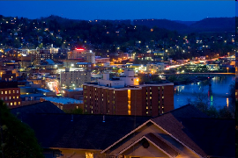
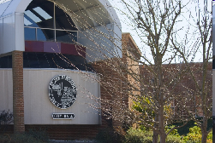
Members of Morgan’s family settled other areas in western Virginia.
Zackquill Morgan established Morgan’s Fort (Morgantown)
Levi, Mod, and James Morgan established a fort at New Martinsville.

Slide 20
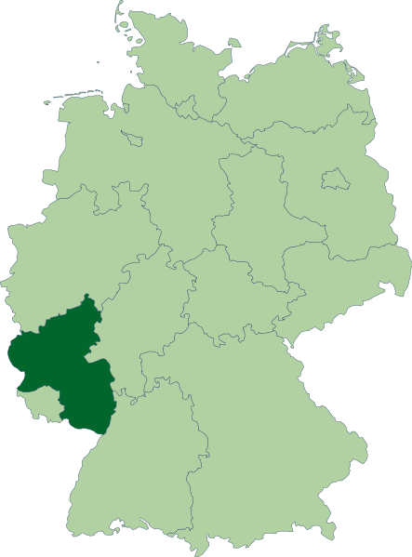
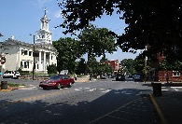
Who Settled Western Virginia?
GERMANS
They came from the Rhine River Valley (Palatinate) of Germany.
They left Germany because of extended periods of warfare and religious persecution.
Germany
They first settled in Pennsylvania and New Jersey and later moved into western Virginia.
In western Virginia, they first settled in the Eastern Panhandle. One of the settlers, Thomas Shepherd, acquired land that ultimately became Shepherdstown.

Slide 21
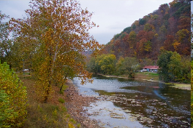
SCOTS-IRISH were actually Scots who had been settled in northern Ireland by English King James I.
The Scots-Irish were unhappy in northern Ireland because they
-were restricted in their farming methods.
-were discriminated against in their religion.
-could not hold political office.
The Scots-Irish had a love of freedom and democracy because they had suffered economically, religiously, and politically.
When they emigrated to America, the Scots-Irish first settled in Pennsylvania and later moved into Virginia. They eventually made their way into western Virginia, settling in the Greenbrier Valley.
They became some of the best fighters on the frontier.

Slide 22
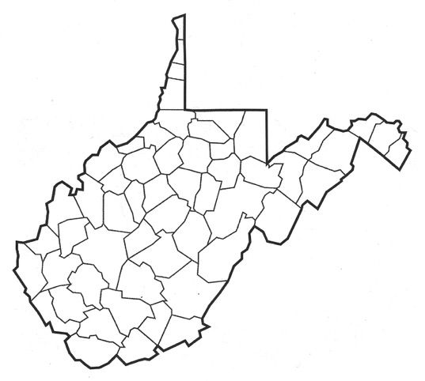
Later settlers included
Andrew Lewis
Jacob Marlin and Stephen Sewell
A Scots-Irish emigrant who came with his parents to Augusta County, Virginia (now Greenbrier County). Because of his skill and hard work, he quickly moved up the ranks of the military.
Friends who settled in the Greenbrier Valley. Their friendship broke up because of religious differences. These settlers gave their names to Sewell Mountain and the town of Marlinton.
David Tygart and Robert Files
Settled near the town of Beverly. Tygart Valley and Files Creek bear their names today.

Slide 23
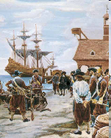
Some settlers of western Virginia came to America as Indentured Servants.
Indentured servants agreed to work as servants for a period of time in exchange for passage to America.
A ship’s captain agreed to bring a boatload of passengers to the New World free of charge. When they arrived, the captain would sell his passengers as indentured servants.
Most indentured servants received their freedom after their term of indenture ended. However, most indentured servants from Africa never received their freedom.

Slide 24
End Chapter 8
Main Menu

