Slide 1
SMART SKILLS
Map 1: Counties of West Virginia
© 2018 Clairmont Press

Slide 2
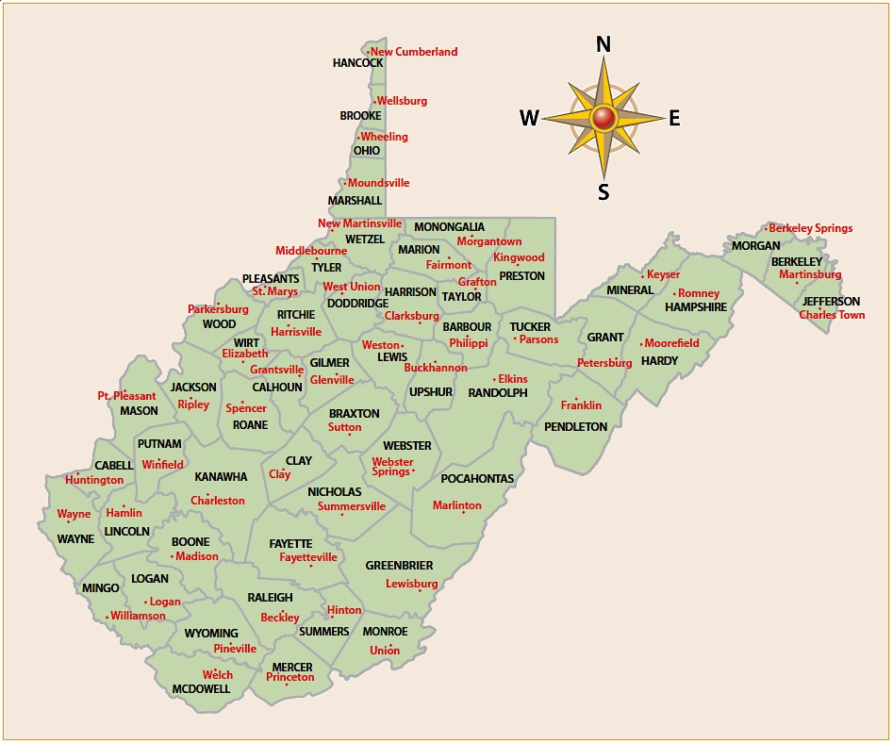
Question 1:
West Virginia’s Counties and County Seats
✪
What does this map depict?
Notes:
The counties of West Virginia as well as the county seats.

Slide 3
Question 2:
West Virginia’s Counties and County Seats
West Virginia’s Counties and County Seats
✪
In which county is the state capital?
Notes:
Kanawha County

Slide 4
Question 3:
West Virginia’s Counties and County Seats
✪
What county do you live in? What counties of West Virginia border your county?
Notes:
Answers may vary; answers may vary.

Slide 5
Question 4:
West Virginia’s Counties and County Seats
✪
Which counties appear to be the three largest in the state? Which appear to be the three smallest?
Notes:
Randolph, Greenbrier, and Pocahontas Counties; Hancock, Brooke, and Ohio Counties

Slide 6
Question 5:
West Virginia’s Counties and County Seats
✪
List three types of information that a person could gather from this map.
Notes:
Answers will vary; county locations, county seat locations, relative locations of counties to one another, using the compass rose to locate counties in a specific direction

Slide 7
Image Credits
Title Slide: General “Stonewall” Jackson, by Snoopywv, Uploaded 20 June 2009, Wikimedia Commons;
End Slide: Glade Creek Grist Mill, by Gabor Eszes, Uploaded 29 April 2006, Wikimedia Commons
Glade Creek Grist Mill
Return to Main Menu

