Slide 1
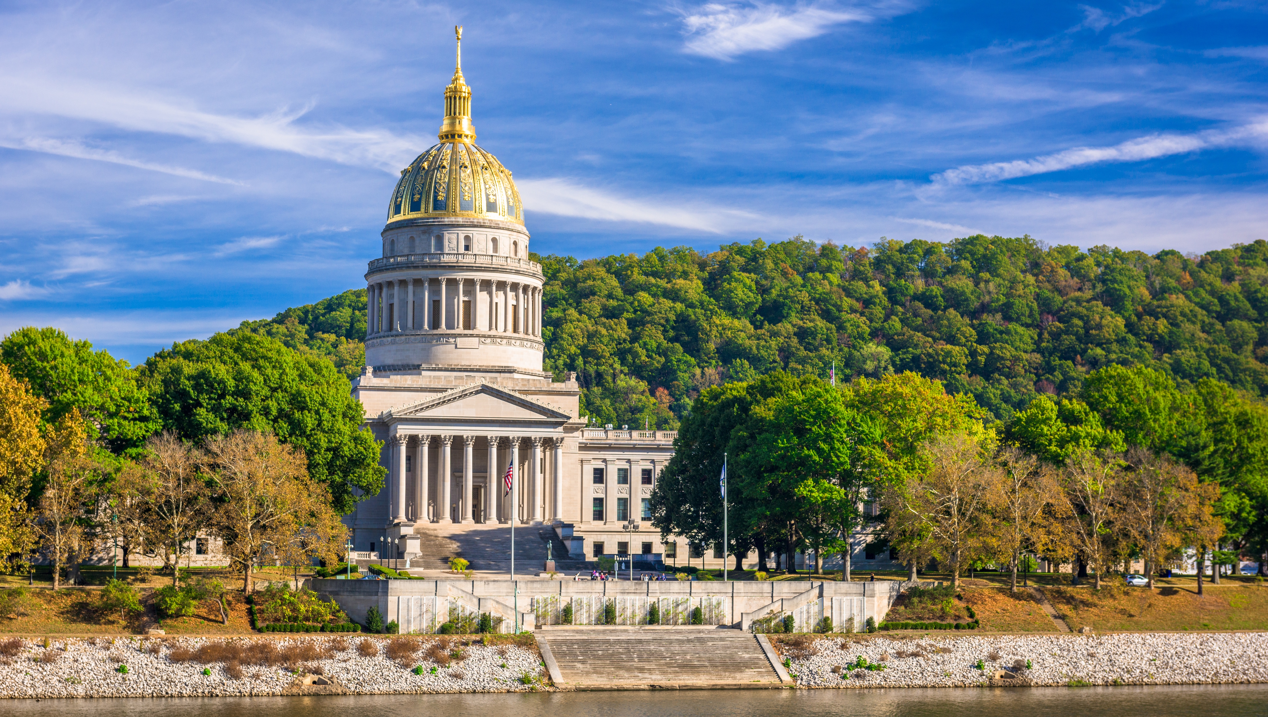

Smart Skills
Week 10
Political Cartoon 2: King George III and Family
Notes:
See the Smart Skills directions on the Teacher Tech Website for West Virginia: Our Beautiful Home for teaching suggestions.
Teacher notes and answers will display in this space.

Slide 2

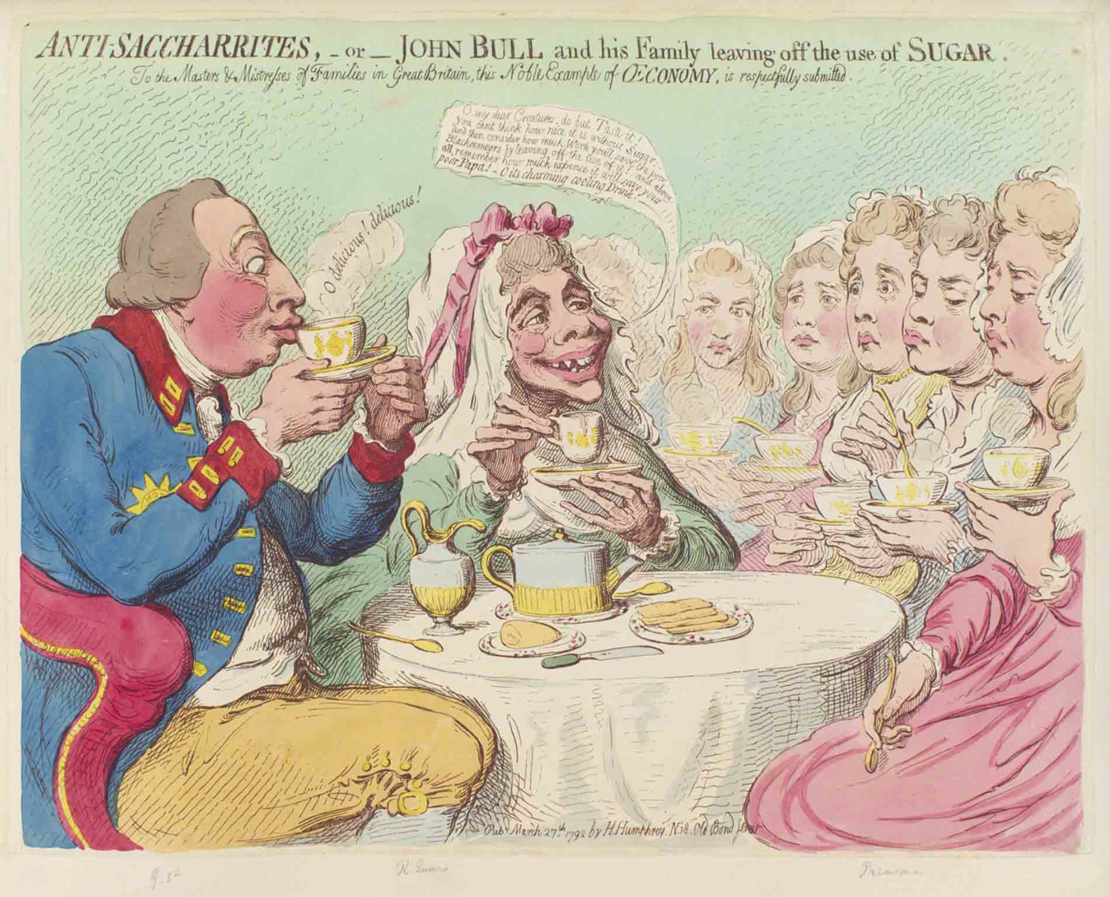
Monday
Study the image. Make a jot list of your observations.
Notes:
Answers will vary. Discuss observations only.
This opener lets students view the image without a specific question to answer. A one- or two-minute silent study helps students notice details they might miss otherwise. Discuss responses as a group, and let students physically point out their findings on the projection to ensure all students see the details being discussed.

Slide 3
TUESDAY
A caricature is an image of a person that exaggerates their features, often in a mockingly humorous manner.
What features of these people are evident in the caricatures?
Notes:
Answers will vary.

Slide 4
WEDNESDAY
The caricatures depict Britain’s King George III (left), Queen Charlotte (center), and six of their daughters.
Is the cartoonist a supporter of the king or not?
What evidence is there in the image to support your thinking?
Notes:
The unflattering image suggests that the cartoonist does not support the king.
The king appears obese, with bulging lips and protruding eyes. Queen Charlotte looks skeletal.

Slide 5
THURSDAY
The 1792 political issue relates to sugar. The queen attempts to persuade the princesses to enjoy afternoon tea without sugar. The king was notoriously thrifty, so she says that skipping sugar helps their “poor papa.”
Opponents of the slave trade wanted to boycott sugar, which depended on the labor of enslaved people.
How effective was this image in getting the public to debate the issue?
Notes:
Answers will vary. It does not appear that the princesses are enjoying their tea without sugar.
TEACHER NOTE: The debate over the slave trade persisted for many years. It was banned in Britain in 1807.

Slide 6
FRIDAY
What famous people are in today’s political cartoons?
What features about them are a part of their caricatures?
Notes:
Answers will vary.
TEACHER NOTE: It may be necessary to show a few present-day political cartoons to see current examples of caricatures.

Slide 7
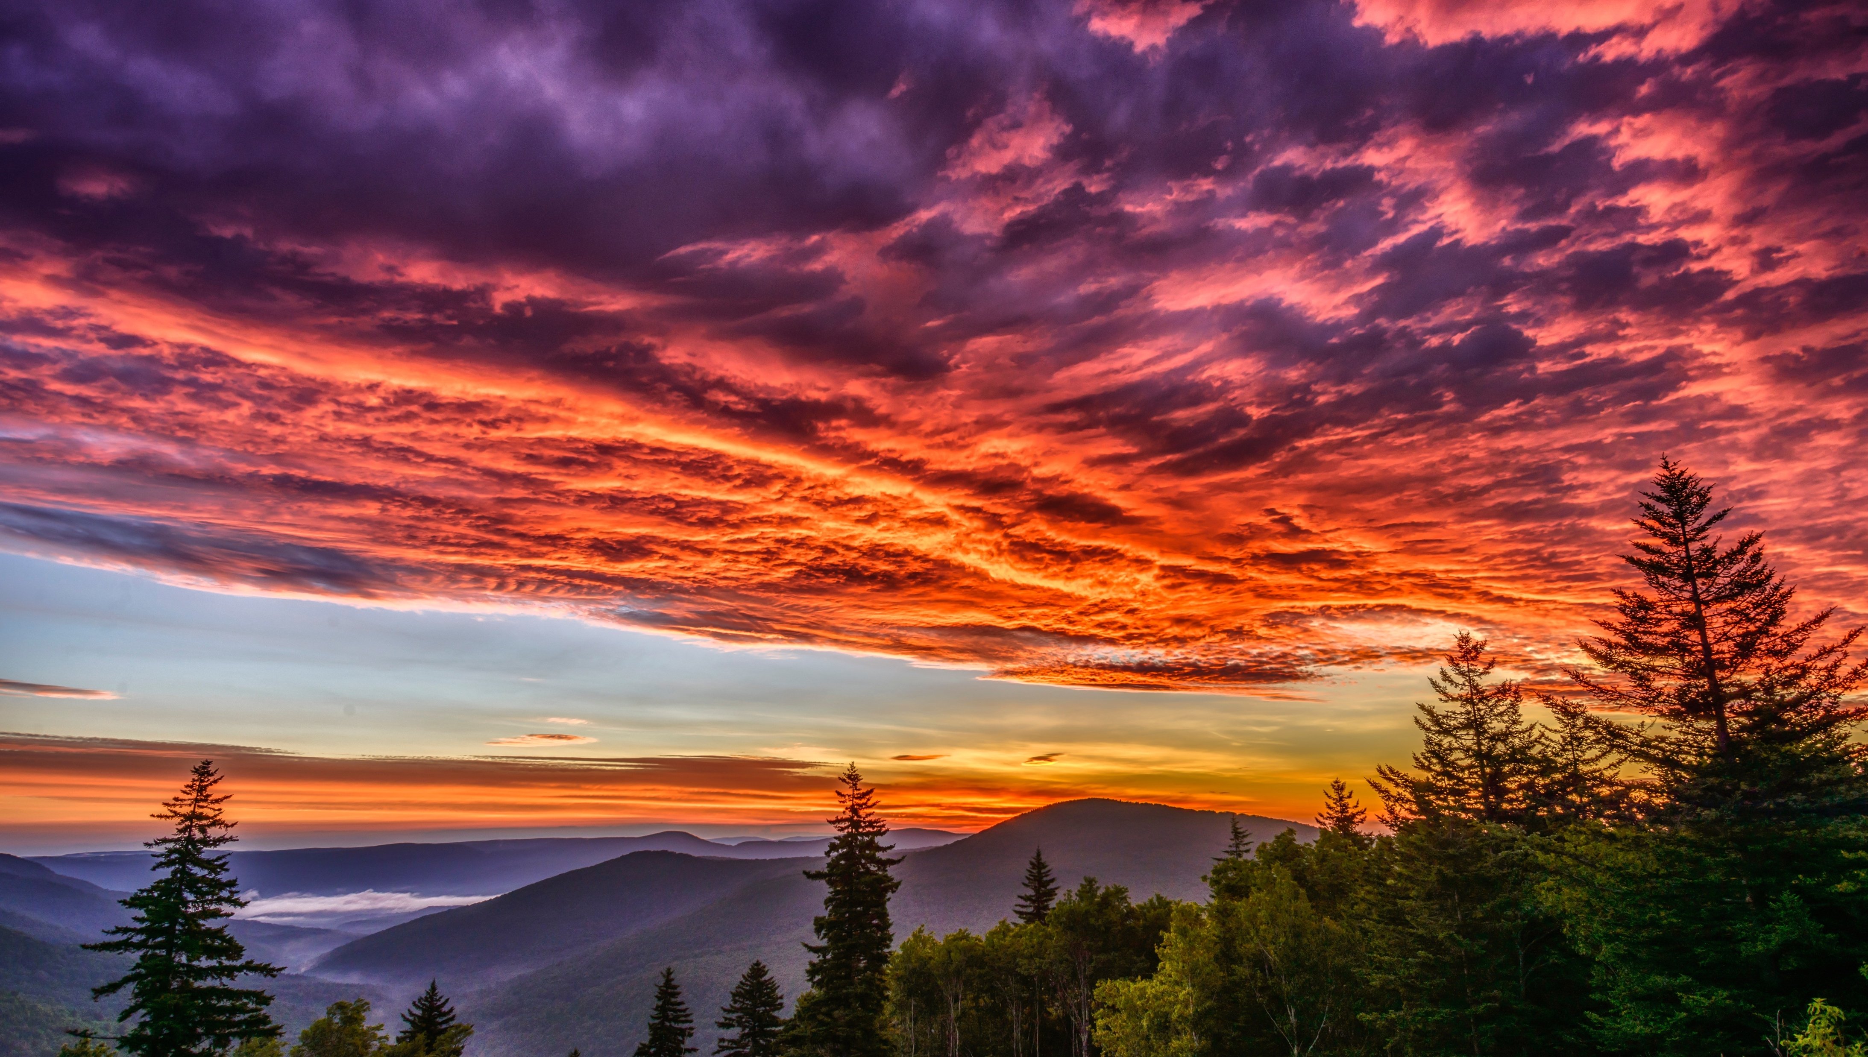
Image credits: Title slide, West Virginia State Capitol, Charleston, WV, ©Shutterstock; End slide, Williams River Valley Overlook, Black Mountain, Monongahela National Forest, West Virginia, ©Shutterstock.

