Slide 1


Smart Skills
Week 11
Map 3: New France
Notes:
See the Smart Skills directions on the Teacher Tech Website for West Virginia: Our Beautiful Home for teaching suggestions.
Teacher notes and answers will display in this space.

Slide 2

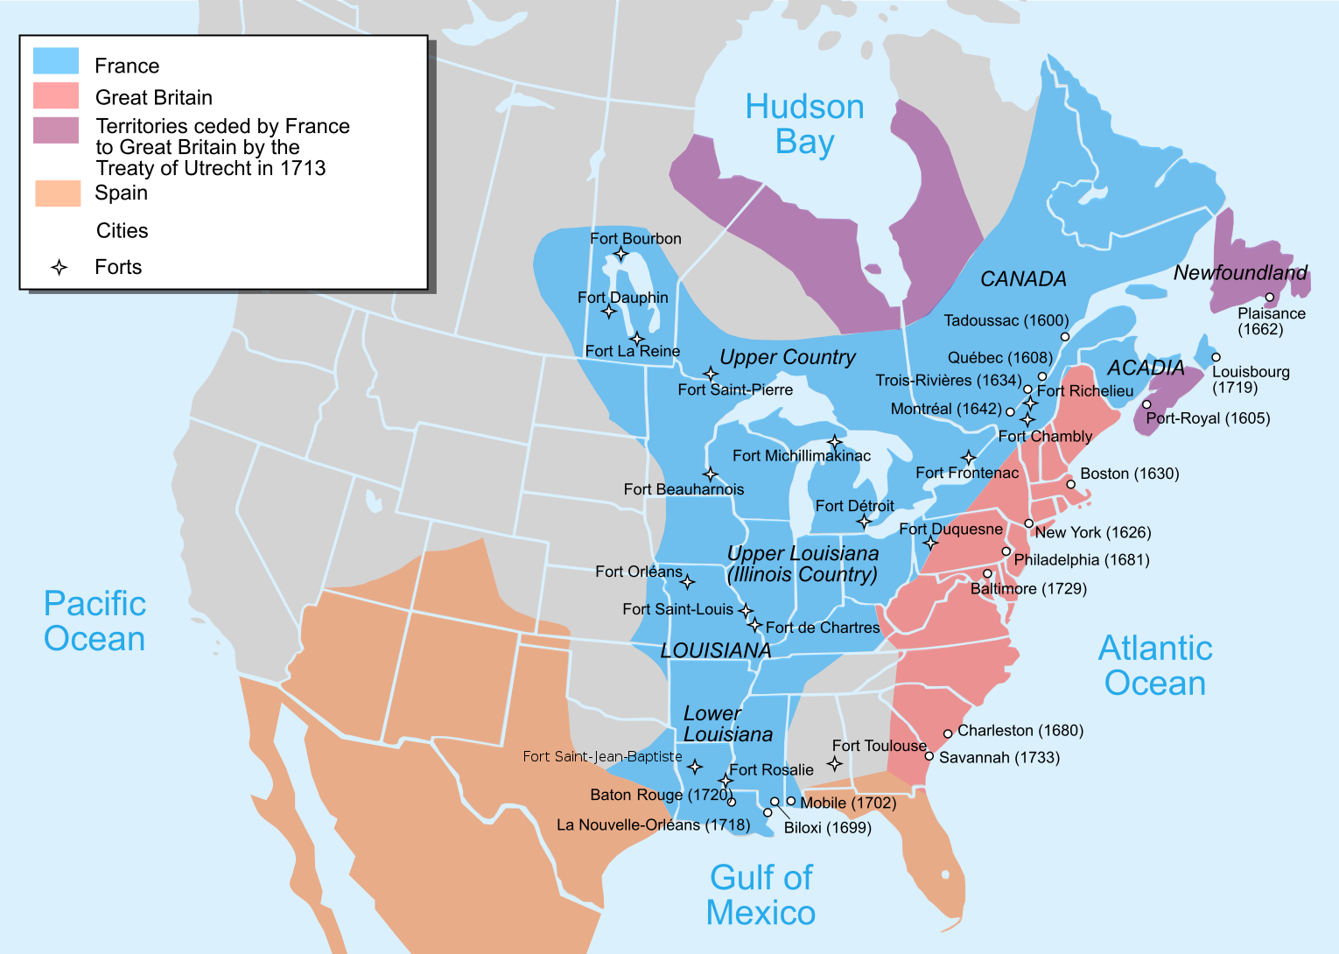
Monday
Map of New France,1750
Study the map. What do you notice about it? In the time given by your teacher, jot down the things that you notice about the map.
Notes:
This opener allows students to view the map with no specific question to answer. Often, it is beneficial to study a map and its components before searching for a specific answer.
Allow at least one minute for students to silently study the map and create a jot list before discussing responses as a group.
Students may notice that this is a map of New France in 1750. There is a key to explain the colors and the symbols.
Remember, this is a time for students to discuss what they notice on the map. There will be time later to discuss other things.

Slide 3
Map of New France,1750
TUESDAY
The white lines show present-day boundaries. What does the blue land area indicate?
Which country had the largest land claims on the map?
Which country claimed the land labeled as Louisiana?
The map shows land claims in this part of North America for what year?
Notes:
Land claimed by France
France
France
1750

Slide 4
Map of New France,1750
WEDNESDAY
When was La Nouvelle-Orléans (New Orleans) founded?
What French fort was closest to present-day West Virginia?
What name was given to the Upper Louisiana area?
Which countries claimed the land of present-day West Virginia?
Notes:
1718
Fort Duquesne
Illinois Country
France and Great Britain

Slide 5
Map of New France,1750
THURSDAY
What is the oldest settlement labeled on the map?
When was it settled?
Which French fort was furthest west?
Which French fort was furthest north?
A traveler going from Fort Détroit to Québec would be going in which general direction?
Notes:
Tadoussac
1600
Fort Dauphin
Fort Bourbon
northeast

Slide 6
Map of New France,1750
FRIDAY
Write a question that could be answered using information on the map. Share your question with another student and agree on the correct answer. Be prepared to share your question.
Notes:
Answers will vary.
Management tip: Let students know they will be working with an elbow partner, and each person must write a question and answer their partner’s question.
Allow some students to share their questions and point to the information on the map that supports their answers.

Slide 7

Image credits: Title slide, West Virginia State Capitol, Charleston, WV, ©Shutterstock; End slide, Williams River Valley Overlook, Black Mountain, Monongahela National Forest, West Virginia, ©Shutterstock.

