Slide 1


Smart Skills
Week 12
Charts & Graphs 3:
Colonial Occupations
Notes:
See the Smart Skills directions on the Teacher Tech Website for West Virginia: Our Beautiful Home for teaching suggestions.
Teacher notes and answers will display in this space.

Slide 2

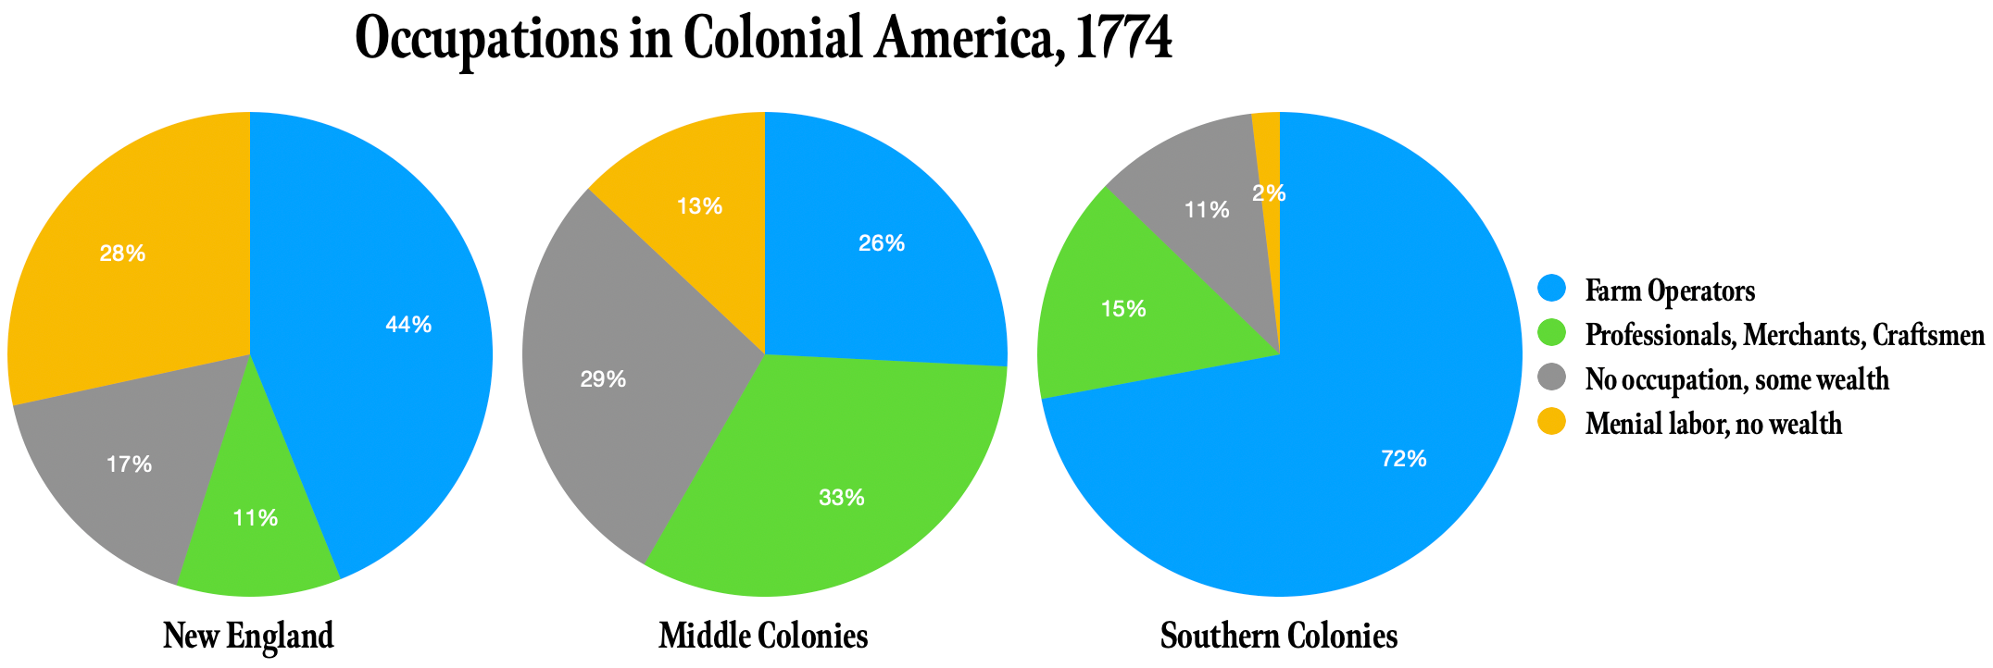
Monday
Study the data presentations. What do you notice?
Notes:
Answers may vary. Students should notice that the three circle graphs, or pie charts, show data from the same year for different regions. There are four colors used. Data are presented as percentages.

Slide 3
TUESDAY
What do the numbers on the charts represent?
How do the colors aid the reader in understanding the information?
Notes:
The colors correspond to the different job categories.
Using the colors makes it easier to compare the three pie charts.

Slide 4
WEDNESDAY
What job category is most common among the people in each region?
Notes:
In New England and the Southern Colonies, farming is the most common. In the middle colonies, there was a higher percentage of professionals, merchants, and craftsmen.

Slide 5
THURSDAY
A student claims that there were more farmers in the southern colonies than either of the other two regions. Agree or disagree with the claim and explain your thinking.
Notes:
The claim cannot be supported using the information in this case since the data are given in percentages. The students would need to know how many people were in each region before the claim could be supported.
TEACHER NOTE: This is an opportunity to reinforce the distinction between data presented as percentages and a count of data.

Slide 6
FRIDAY
What question could be answered using the charts? Explain your answer.
Notes:
Answers will vary. Students could be allowed to share their questions and check that others have determined the correct answer.

Slide 7

Image credits: Title slide, West Virginia State Capitol, Charleston, WV, ©Shutterstock; End slide, Williams River Valley Overlook, Black Mountain, Monongahela National Forest, West Virginia, ©Shutterstock.

