Slide 1
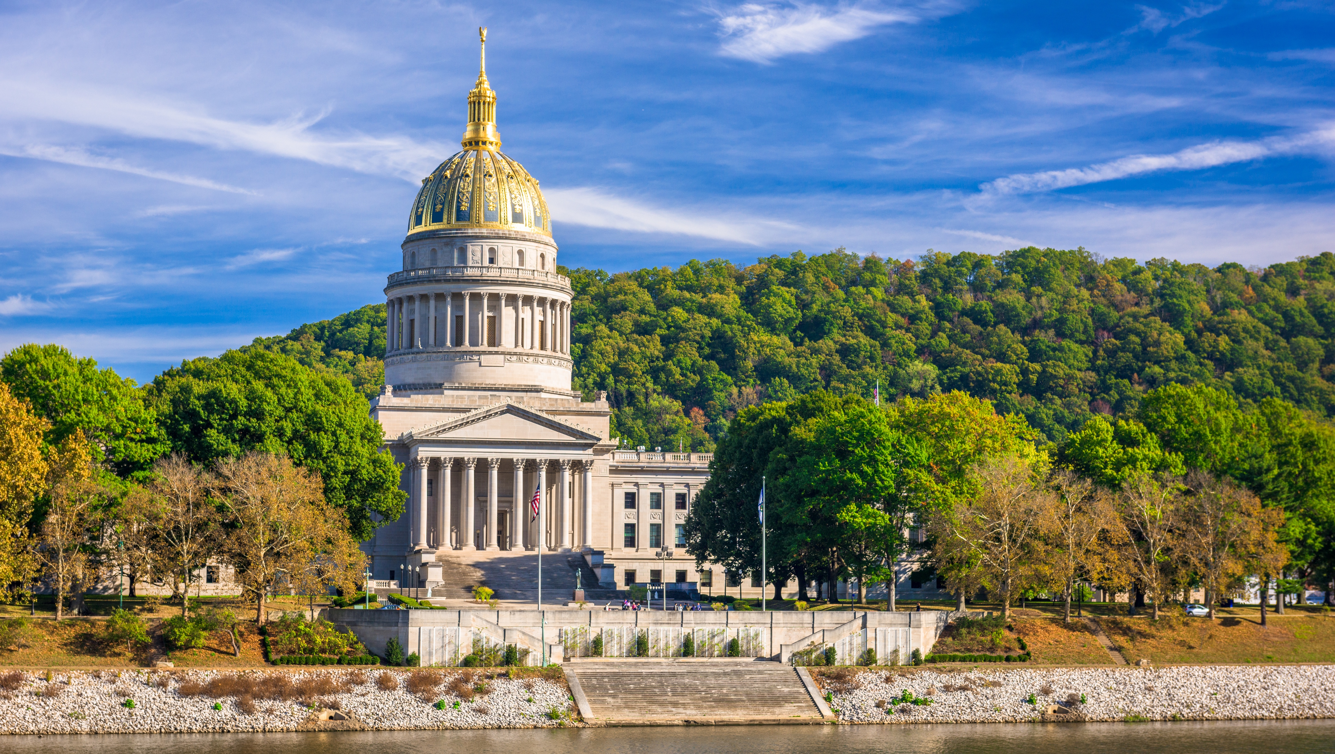
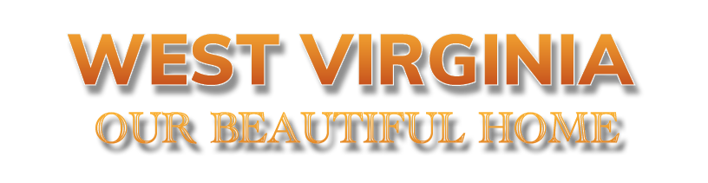
Smart Skills
Week 13
Art & Artifacts 3: Colonial Engraving
Notes:
See the Smart Skills directions on the Teacher Tech Website for West Virginia: Our Beautiful Home for teaching suggestions.
Teacher notes and answers will display in this space.

Slide 2

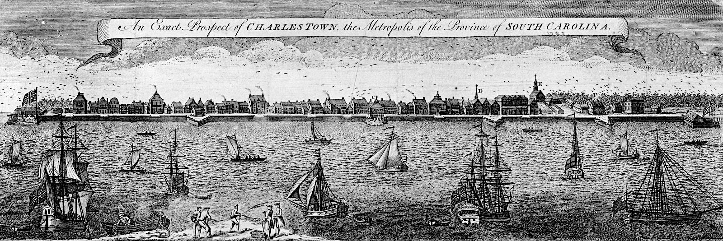
Monday
Study the picture. Make a list of as many observations as you can.
Notes:
Answers will vary.
This opener lets students view the image without a specific question to answer. A one- or two-minute silent study helps students notice details they might miss otherwise.
Discuss responses as a group, and let students physically point out their findings on the projection to ensure all students see the details being discussed.

Slide 3
TUESDAY
What is shown in the illustration, and in what year is the scene?
Notes:
The illustration shows Charleston, South Carolina, in 1762.
Ask students to explain where they found this answer. Some students tend to skip reading the titles.
You may want to take a moment to explain the language used in the title. For example, a common definition of “prospect” is the idea of something that might happen in the future. A less common definition is a good view of a large land area or a city. A metropolis is a large city or an important one for an area. South Carolina is described as a province because it was a colony.
The date appears to be penciled in and not a part of the artist's original drawing.

Slide 4
WEDNESDAY
What evidence is there of human activity?
Notes:
Examples: People are shown with a fishing net. The ships and boats would have people on them. People built the wall, fort, and buildings in the town. Smoke from the chimneys indicates someone built a fire in a fireplace.

Slide 5
THURSDAY
Why did the artist create this image? Who might have valued it?
Notes:
Answers will vary.
These questions call on students to speculate on why the artist created the image. Was this something that a person in the area would want in their home? Could it be used to advertise the colony to potential colonists?

Slide 6
FRIDAY
How might things be different if you visited Charleston, South Carolina, today? How might they be the same?
Notes:
Answers will vary. Guide students to explain their thinking, contrasting modern-day Charleston with the 18th-century image.

Slide 7
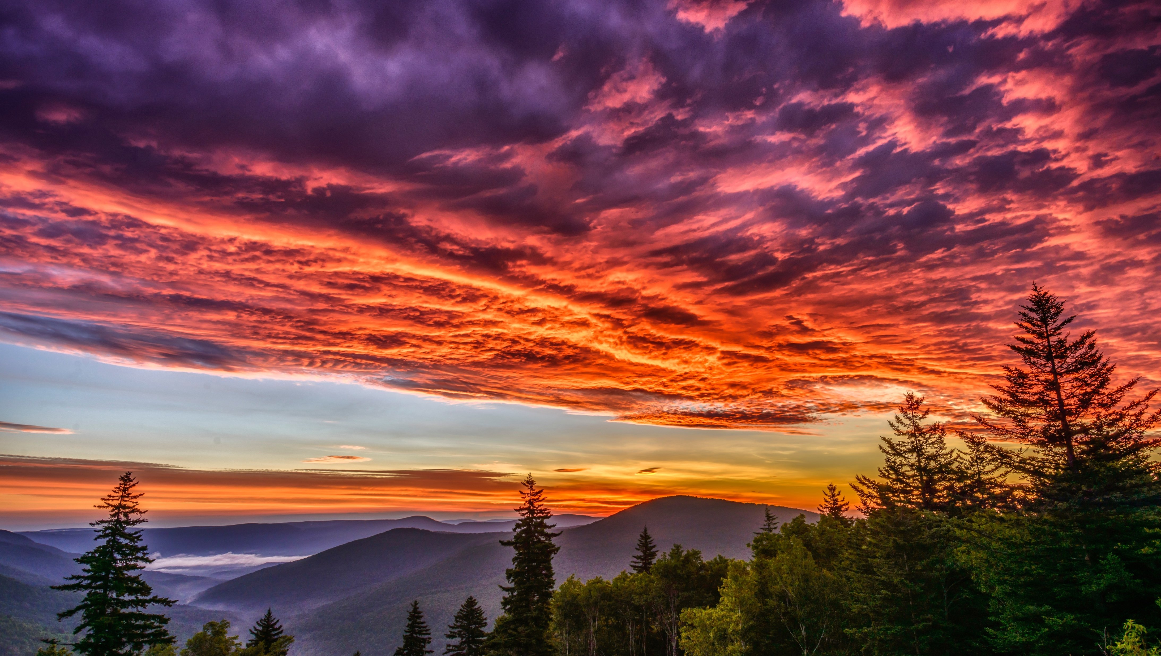
Image credits: Title slide, West Virginia State Capitol, Charleston, WV, ©Shutterstock; End slide, Williams River Valley Overlook, Black Mountain, Monongahela National Forest, West Virginia, ©Shutterstock.

