Slide 1
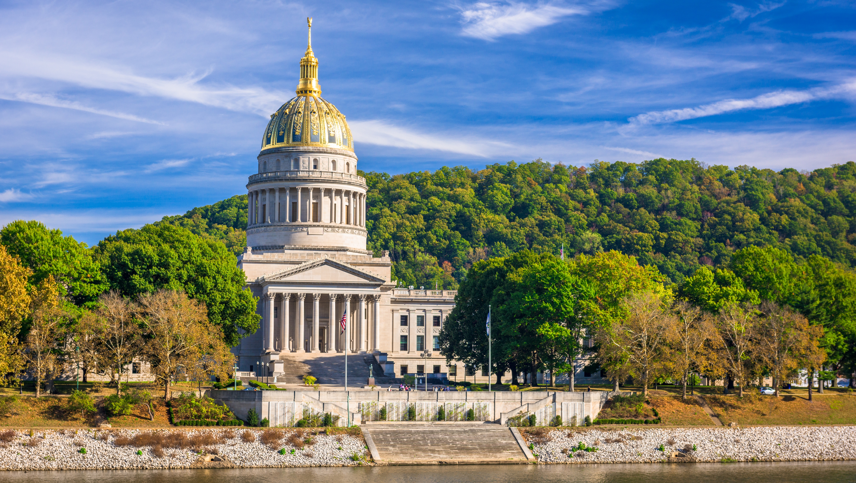

Smart Skills
Week 16
Map 4: Immigrant Home Countries
Notes:
See the Smart Skills directions on the Teacher Tech Website for West Virginia: Our Beautiful Home for teaching suggestions.
Teacher notes and answers will display in this space.

Slide 2

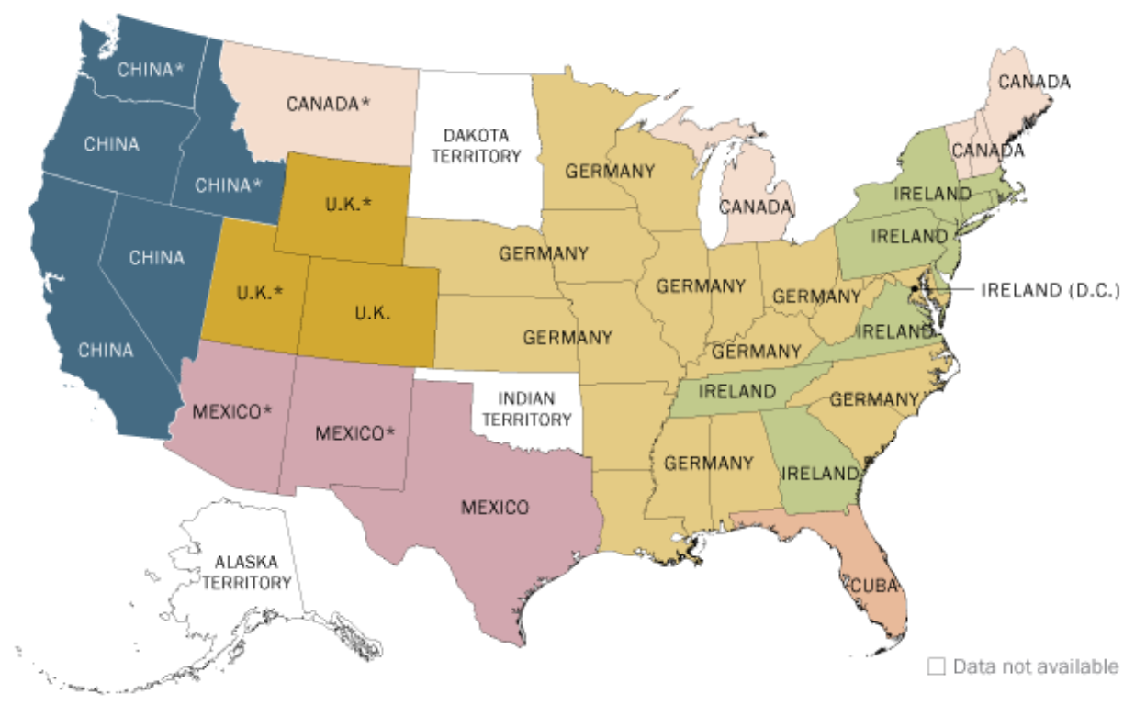
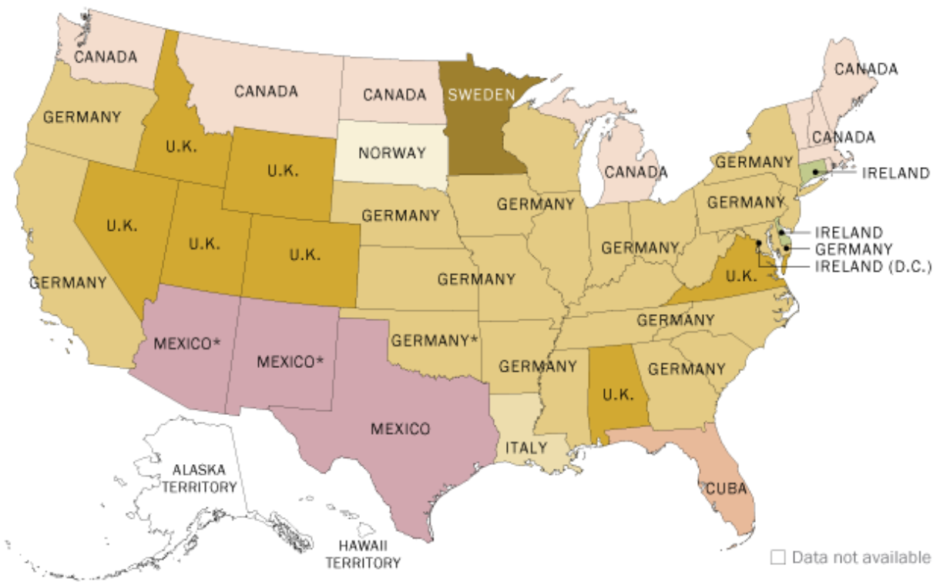
Monday
Most Common Source of Immigrants
1880
1900
Study the maps. Record your observations.
Notes:
Allow 1-2 minutes for students to record their observations on the map. Limit discussion to observations. Examples: the maps are from two different times, different colors are associated with different countries, some areas have no data, data are from different years, etc.
NOTE: The asterisk on some locations indicates the area was a territory but not a state in the Union.

Slide 3
TUESDAY
Most Common Source of Immigrants
1880
1900
What is the purpose of the maps? What is the time difference between the two maps?
Notes:
The purpose of the maps is to show the most common source country of immigrants to each state in 1880 and 1900. There is a twenty-year difference.

Slide 4
WEDNESDAY
Most Common Source of Immigrants
1880
1900
What changes occurred in the source of immigrants to West Virginia between 1880 and 1900?
How did West Virginia compare to the state of California?
Where did most of Texas’ immigrants come from in 1880? in 1900?
Notes:
The greatest number of immigrants to West Virginia were from Germany each time.
California had more Chinese immigrants in 1880, but in 1900, Germany was the source of most immigrants.
Mexico; Mexico

Slide 5
THURSDAY
Most Common Source of Immigrants
1880
1900
What countries are listed on both maps as source countries?
What countries are only on one of the maps?
Why do you think there was a change?
Notes:
Canada, U.K., Mexico, Germany, Ireland, Cuba
China, Sweden, Norway, Italy
Answers will vary.
Be sure to point out that the U.K. refers to the United Kingdom. Sometimes students are confused by the use of England, Great Britain, and the United Kingdom. The words are sometimes used interchangeably, although that is incorrect.

Slide 6
FRIDAY
Most Common Source of Immigrants
1880
1900
Write a question that could be answered using the maps. Have another student answer it and check their answer. Use evidence from the maps to agree upon the correct answer.
Notes:
Answers will vary.
If time allows, have students speculate on how a map from today might look different than these and explain their thinking.

Slide 7
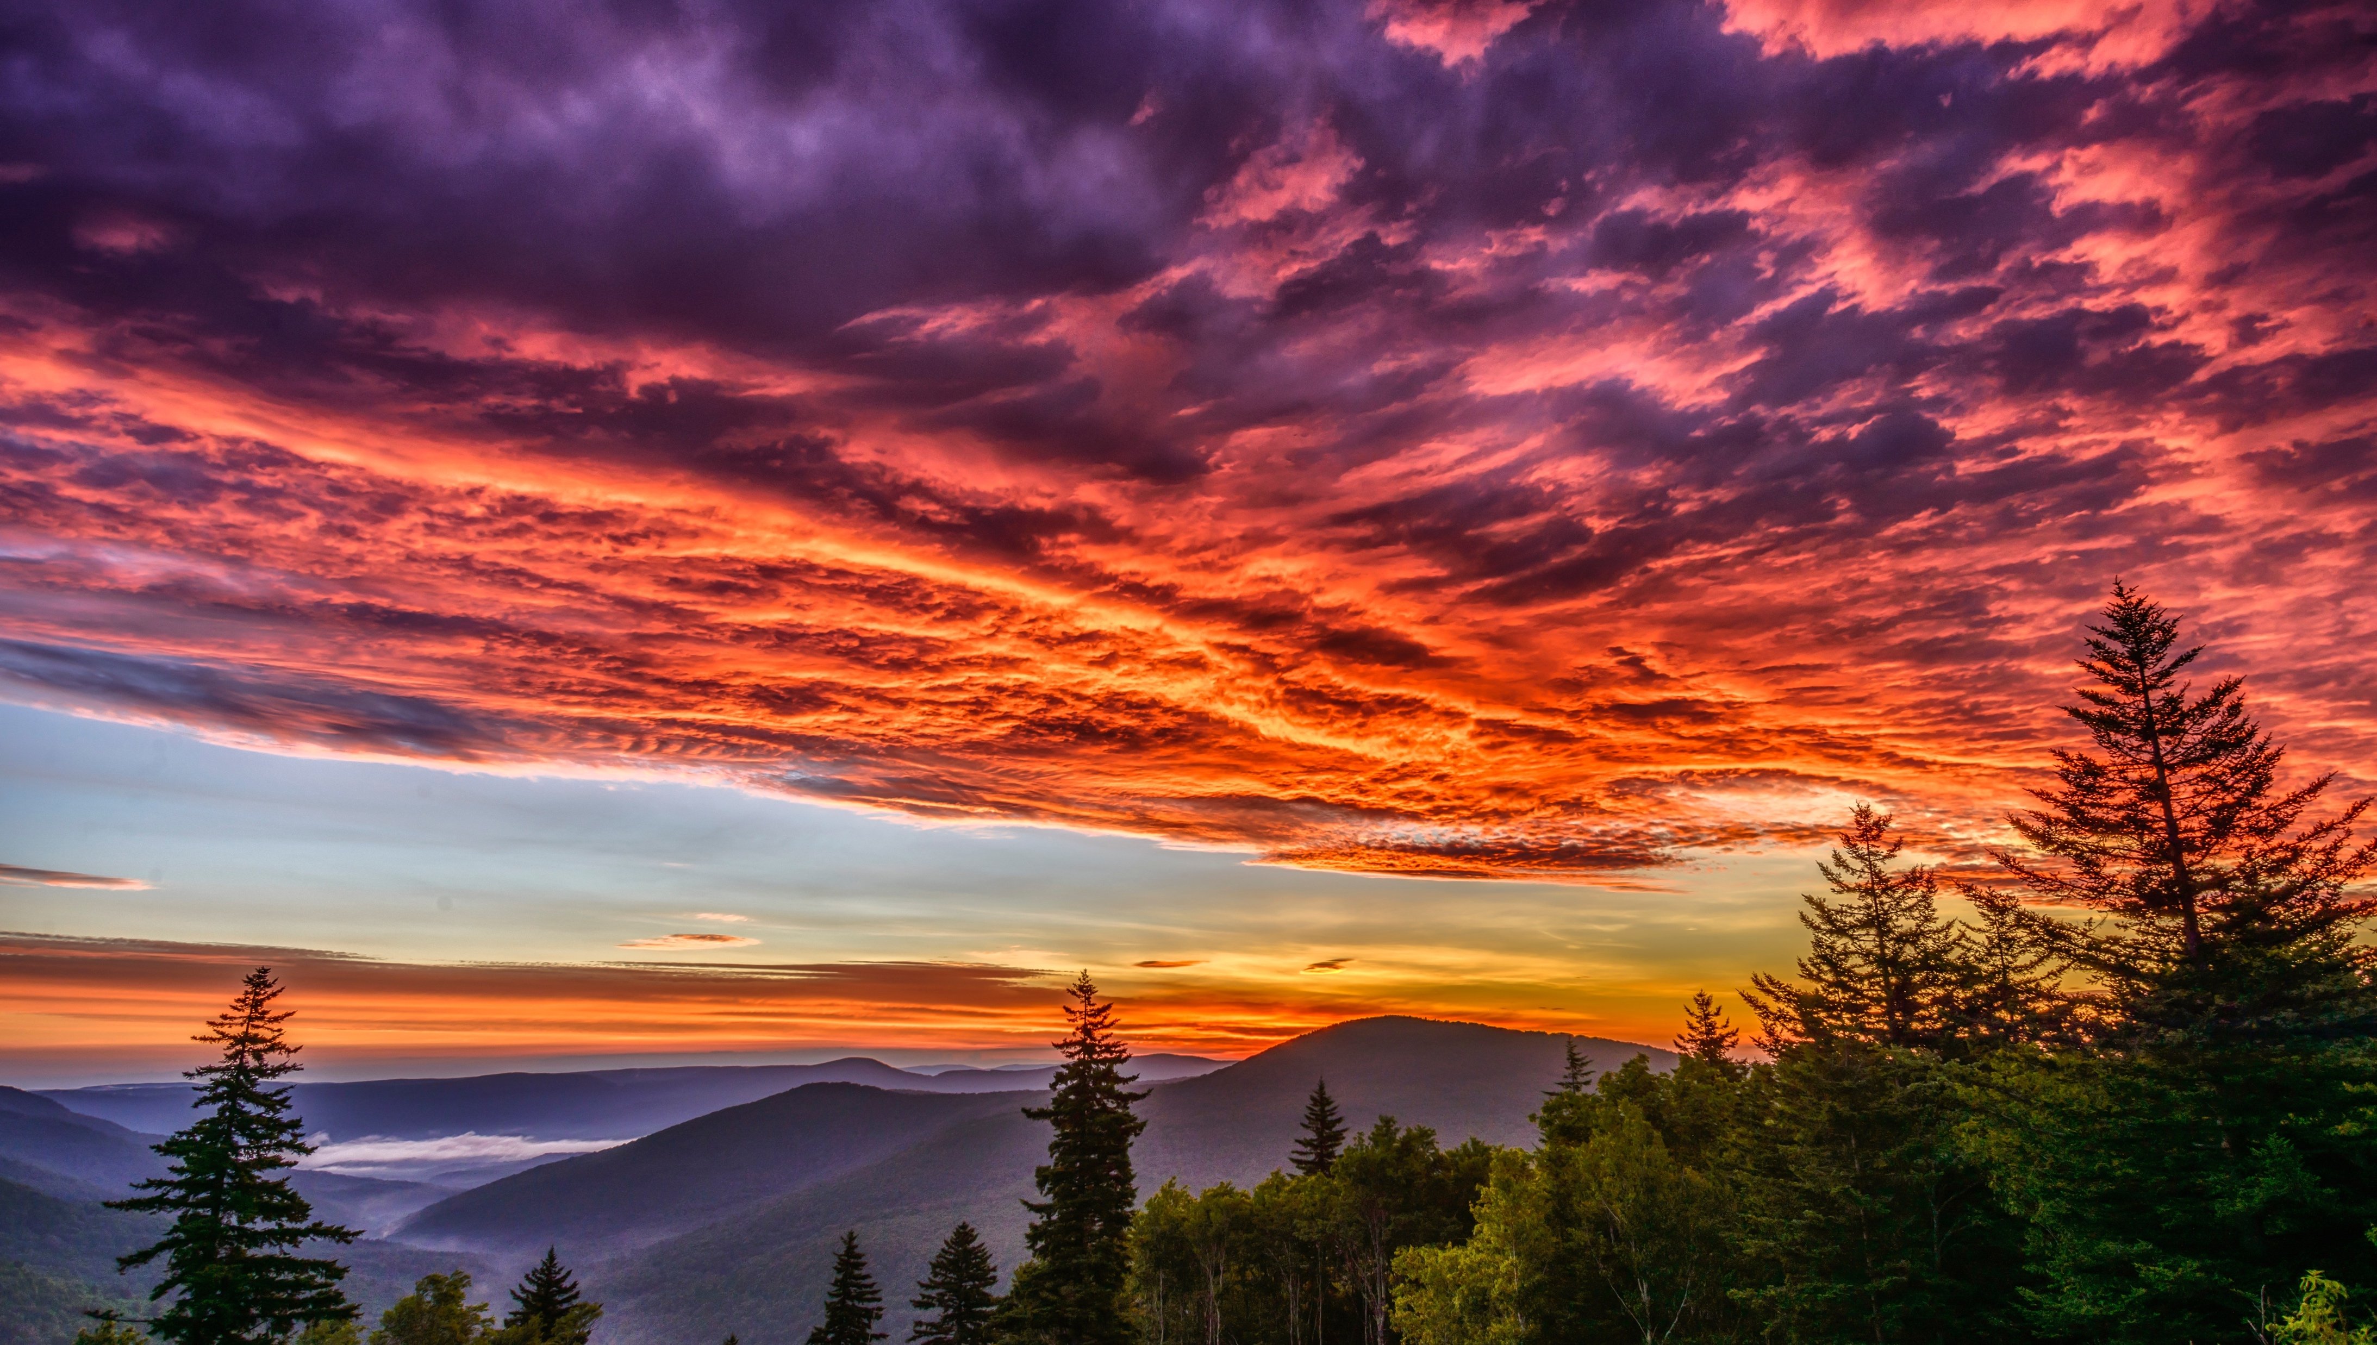
Image credits: Title slide, West Virginia State Capitol, Charleston, WV, ©Shutterstock; End slide, Williams River Valley Overlook, Black Mountain, Monongahela National Forest, West Virginia, ©Shutterstock.

