Slide 1


Smart Skills
Week 17
Charts & Graphs 4: Miles of Railroad (1850-1920)
Notes:
See the Smart Skills directions on the Teacher Tech Website for West Virginia: Our Beautiful Home for teaching suggestions.
Teacher notes and answers will display in this space.

Slide 2

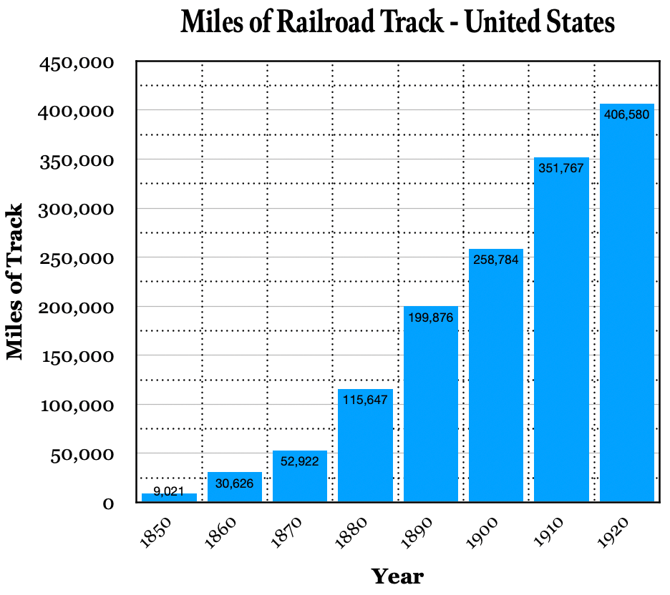
Monday
Study the graph. What do you notice?
What information is contained on the x-axis and y-axis?
Notes:
Answers will vary.
The x-axis represents years; the y-axis shows miles of railroad track.
TEACHER NOTE: Some students may need a review lesson on what the x-axis and y-axis refer to.

Slide 3
TUESDAY
Based on the graph, how many miles of railroad were in the United States in 1850?
How much had it grown by the turn of the century?
Notes:
9,021
The amount of track grew from 9,021 to 258,784, an increase of 249,763 miles of track.
TEACHER NOTE: If necessary, explain the phrase “turn of the century” here and point students to observe data from 1900.

Slide 4
WEDNESDAY
Focus on the axes.
How many years are there between each entry on the x-axis?
What value is represented by the distance between the solid lines on the y-axis?
What value is represented by the first row of dotted lines on the y-axis?
Notes:
Ten years
50,000 miles of track
25,000 miles of track

Slide 5
THURSDAY
What is the overall trend shown on the graph?
What might a person predict as the number of miles of track in 1930?
What about 1940? Explain your thinking.
Notes:
The overall trend was a large increase in miles of track each year.
A person might predict that, since this trend has persisted for 70 years, it will likely continue.
Students may predict that railroad mileage will decrease as other forms of transportation (e.g., automobiles, airplanes) rise in importance.

Slide 6
FRIDAY
Write a question that can be answered using this chart. Have another student answer it and check their work. Agree on the correct answer.
Notes:
Answers will vary.
You may want to allow some students to share their questions and answers if time allows. Allow students to explicitly identify the data on the graph that supports their answers to the questions.

Slide 7
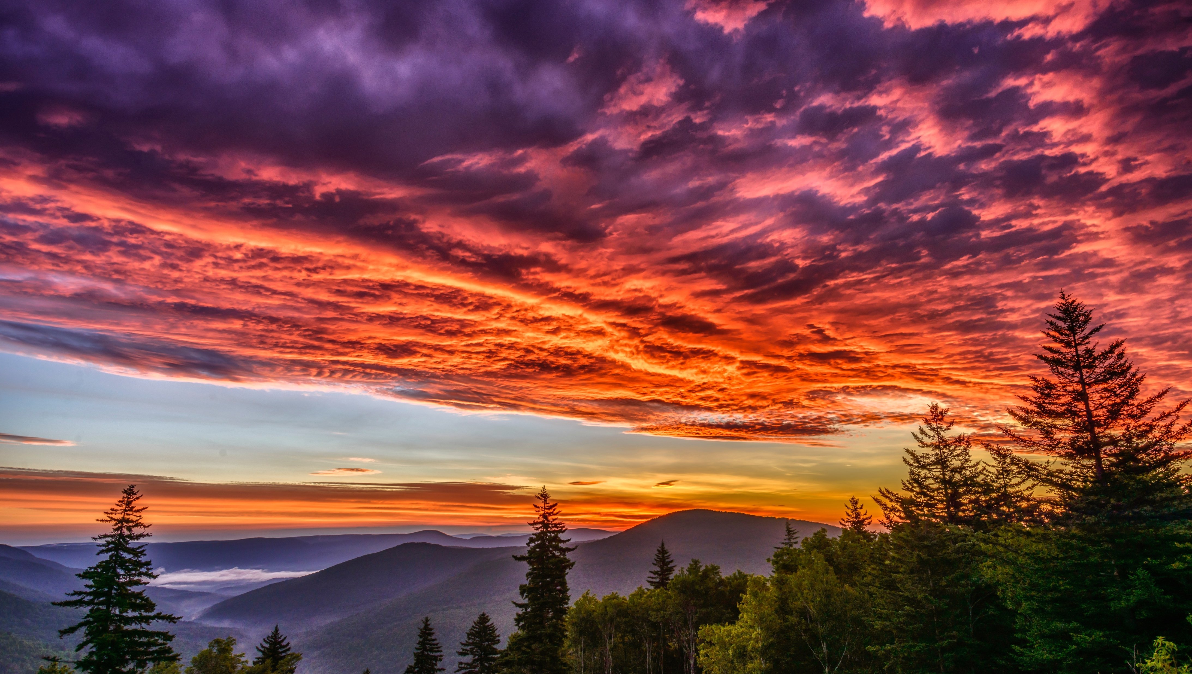
Image credits: Title slide, West Virginia State Capitol, Charleston, WV, ©Shutterstock; End slide, Williams River Valley Overlook, Black Mountain, Monongahela National Forest, West Virginia, ©Shutterstock.

