Slide 1


Smart Skills
Week 19
Timeline 4: 19th Century Inventions
Notes:
See the Smart Skills directions on the Teacher Tech Website for West Virginia: Our Beautiful Home for teaching suggestions.
Teacher notes and answers will display in this space.

Slide 2

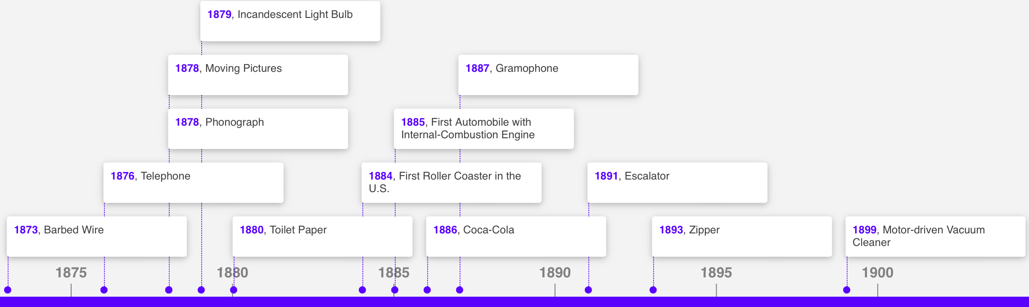
Monday
Study the graphic. Make a jot list of your observations.
Notes:
Answers will vary.
This opener lets students view the image without a specific question to answer. A one- or two-minute silent study helps students notice details they might miss otherwise. Discuss responses as a group, and let students physically point out their findings on the projection to ensure all students see the details being discussed.

Slide 3
TUESDAY
What is the range of years on the timeline?
What is its topic?
What would you describe as its purpose?
Notes:
1873-1899 (or 1875-1900)
The topic is inventions.
The purpose is to showcase important inventions from 1870 to 1900.

Slide 4
WEDNESDAY
When was the incandescent light bulb invented?
How many years passed between the invention of the phonograph and the very similar gramophone?
Is it possible for the inventor of the zipper to telephone a friend about the invention? Explain your thinking.
Notes:
1879
8 years
Yes. The zipper was invented 17 years after the telephone was invented.

Slide 5
THURSDAY
Write a question that could be answered using the timeline. Ask another student to answer it and check their response against your own. Agree upon the correct answer.
Notes:
Students can share their questions and answers. Allow time for some to share as a group.

Slide 6
FRIDAY
How would you modify this timeline to make it more effective or informative?
Notes:
Answers will vary.
Students may indicate that adding pictures or adding maps would be helpful. Additionally, they may suggest a title, larger text, or a longer timeline with the inclusion of key events.

Slide 7
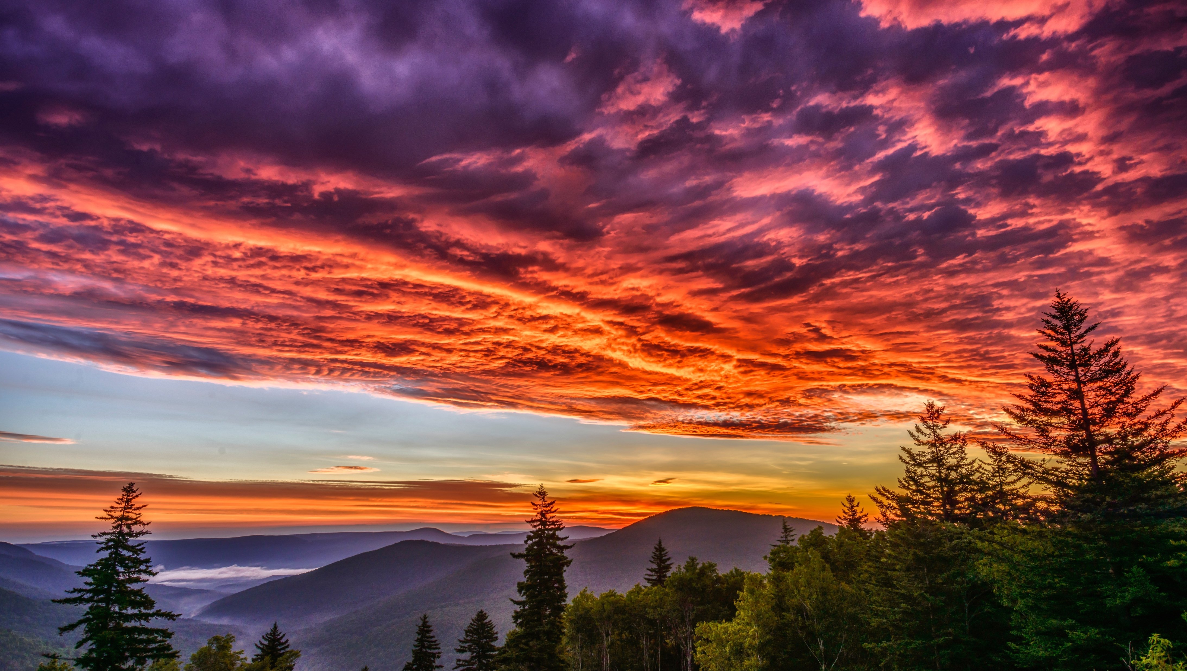
Image credits: Title slide, West Virginia State Capitol, Charleston, WV, ©Shutterstock; End slide, Williams River Valley Overlook, Black Mountain, Monongahela National Forest, West Virginia, ©Shutterstock.

