Slide 1


Smart Skills
Week 20
Political Cartoon 4: Guilting a Young Man to Enlist
Notes:
See the Smart Skills directions on the Teacher Tech Website for West Virginia: Our Beautiful Home for teaching suggestions.
Teacher notes and answers will display in this space.

Slide 2

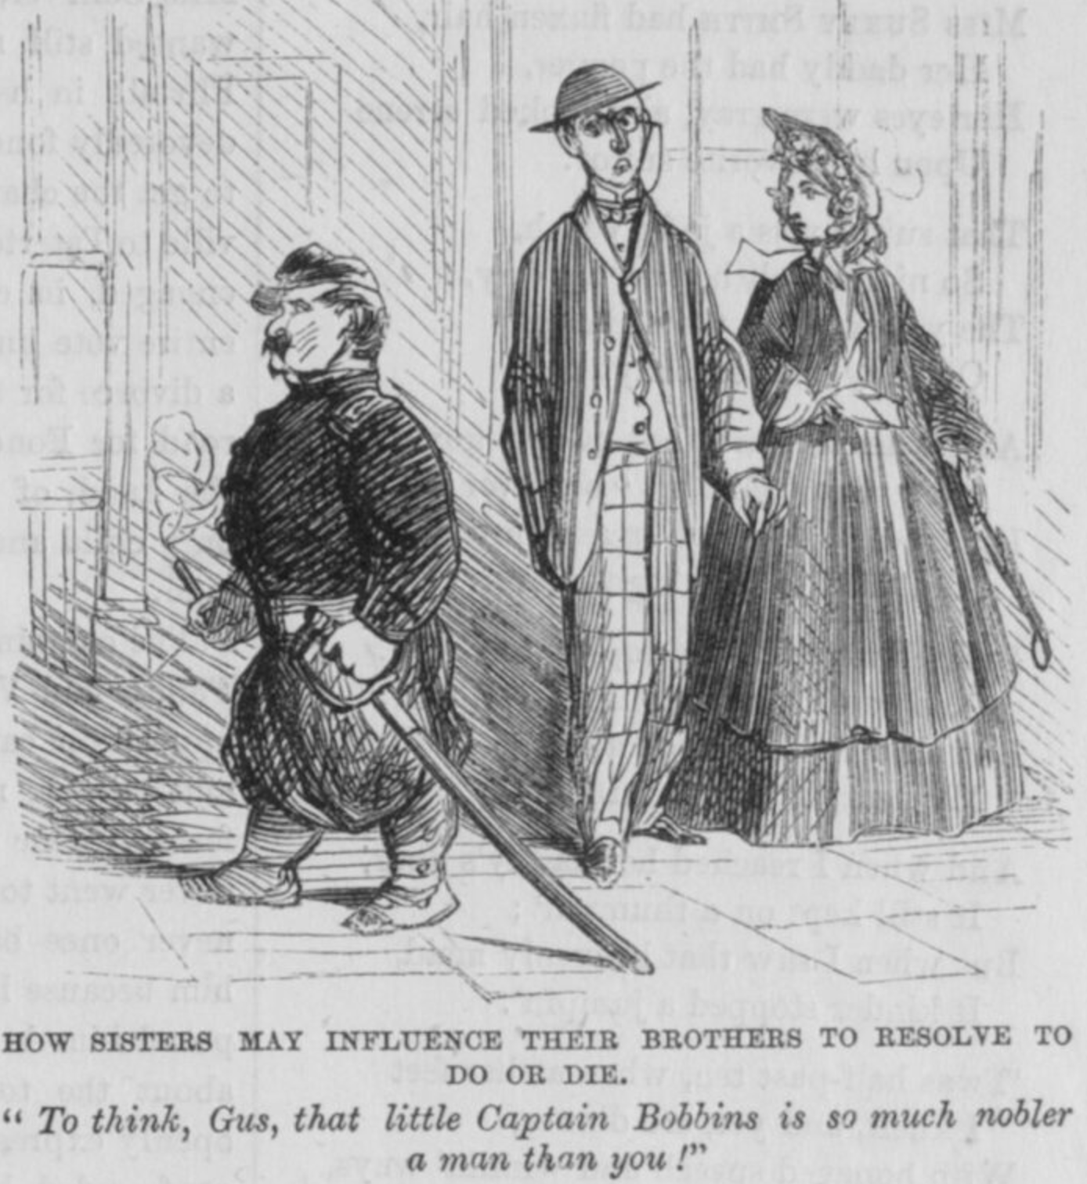
Monday
Study the image. Make a jot list of what you notice.
Notes:
Answers will vary. Discuss observations only.
This opener lets students view the image without a specific question to answer. A one- or two-minute silent study helps students notice details they might miss otherwise. Discuss responses as a group, and let students physically point out their findings on the projection to ensure all students see the details being discussed.

Slide 3
TUESDAY
What symbols did the cartoonist use, and what do they stand for?
Notes:
The sword and uniform on the shorter man symbolize the Union Army. Students may conclude that the monocle is symbolic of a man who is bookish rather than a fighter.

Slide 4
WEDNESDAY
How do the words used help the artist convey his message?
Notes:
The words are necessary to convey the woman's point of view. She is trying to persuade her brother to join the Union Army by embarrassing him. The smaller, plump man is more noble in her eyes than her brother.

Slide 5
THURSDAY
What is the location or setting of the cartoon?
Is it important to the message?
Notes:
There is no indication of the location or setting. There are buildings in the background, and the people walk on pavement or tile. This suggests an urban setting.
The location does not appear to be significant.

Slide 6
FRIDAY
Who is the artist supporting with his message?
What evidence do you see to defend your thinking?
Notes:
Answers will vary. The artist supports men enlisting in the Union Army. The purpose of the cartoon is to encourage women in the Union to pressure their brothers to enlist. The tone of the woman’s comment suggests that she believes her brother lacks the honor that ”Captain Bobbins” has. Captain Bobbins is depicted as a smaller, slightly overweight, and smoking individual. He is so short that his sword drags the ground. Yet, the young woman is complimentary of him because he is in the military.

Slide 7

Image credits: Title slide, West Virginia State Capitol, Charleston, WV, ©Shutterstock; End slide, Williams River Valley Overlook, Black Mountain, Monongahela National Forest, West Virginia, ©Shutterstock.

