Slide 1
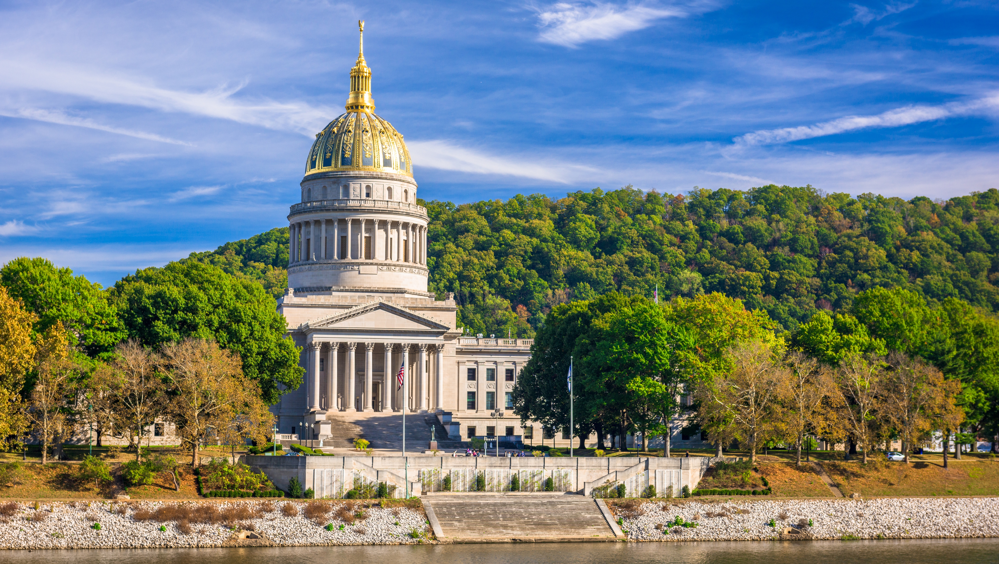

Smart Skills
Week 21
Map 5: Percent Change in U.S. Population
Notes:
See the Smart Skills directions on the Teacher Tech Website for West Virginia: Our Beautiful Home for teaching suggestions.
Teacher notes and answers will display in this space.

Slide 2

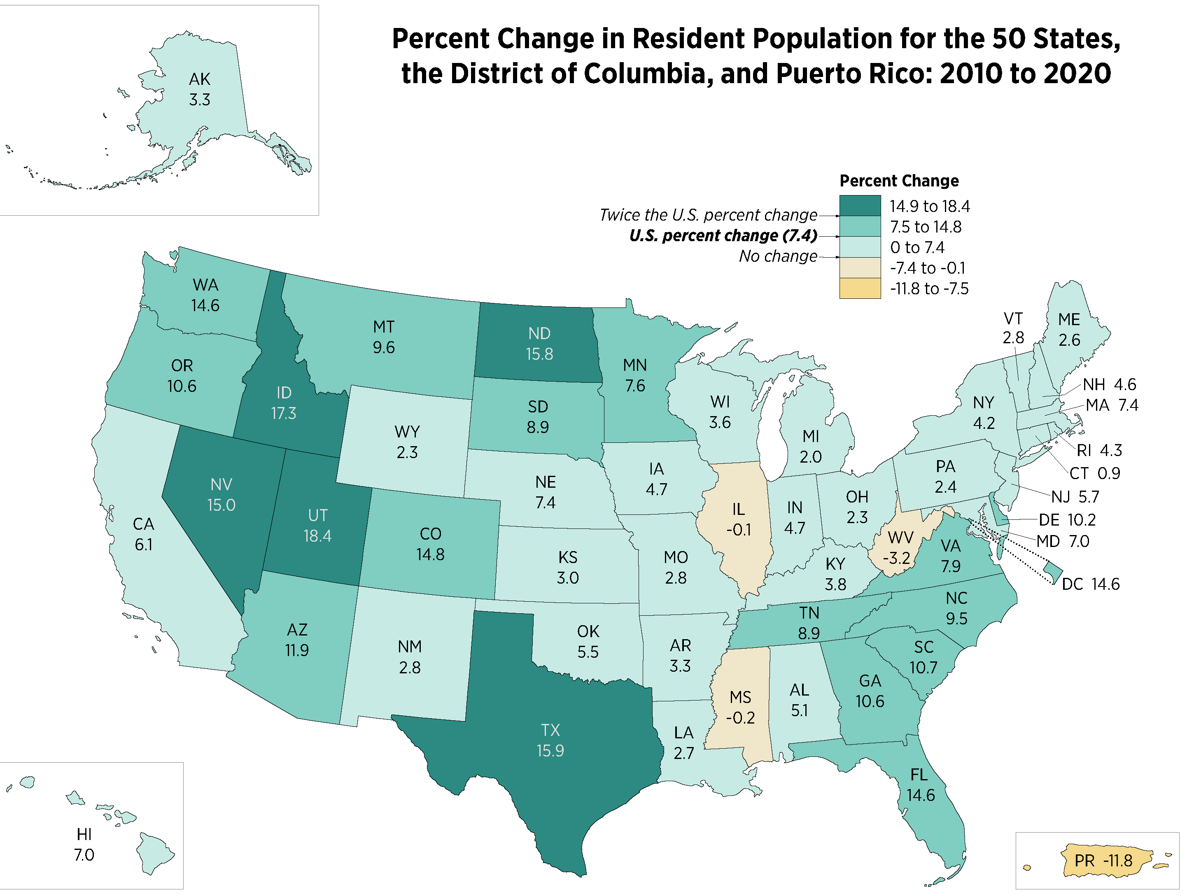
Monday
Study the map. Record what you notice about the map.
Notes:
Allow 1-2 minutes for students to record what they notice on the map.
Limit the discussion to what students see on the map.

Slide 3
TUESDAY
What do the different colors of the states on the map represent?
Notes:
The different colors indicate the percentage change in population, as indicated by the legend at the top right.

Slide 4
WEDNESDAY
What was the average percent change in population for the United States between 2010 and 2020?
Where did you find this information?
Notes:
7.4% increase
This information is in the legend.

Slide 5
THURSDAY
Which states had a growth rate at least double the rate of the United States average?
Why might those states have grown by so much?
Notes:
Idaho, Nevada, Utah, North Dakota, Texas
Answers will vary.

Slide 6
FRIDAY
Which states and territories had negative growth during the period?
Why might these areas have had a decrease in population?
Notes:
Illinois, West Virginia, Mississippi, Puerto Rico
Answers will vary.

Slide 7
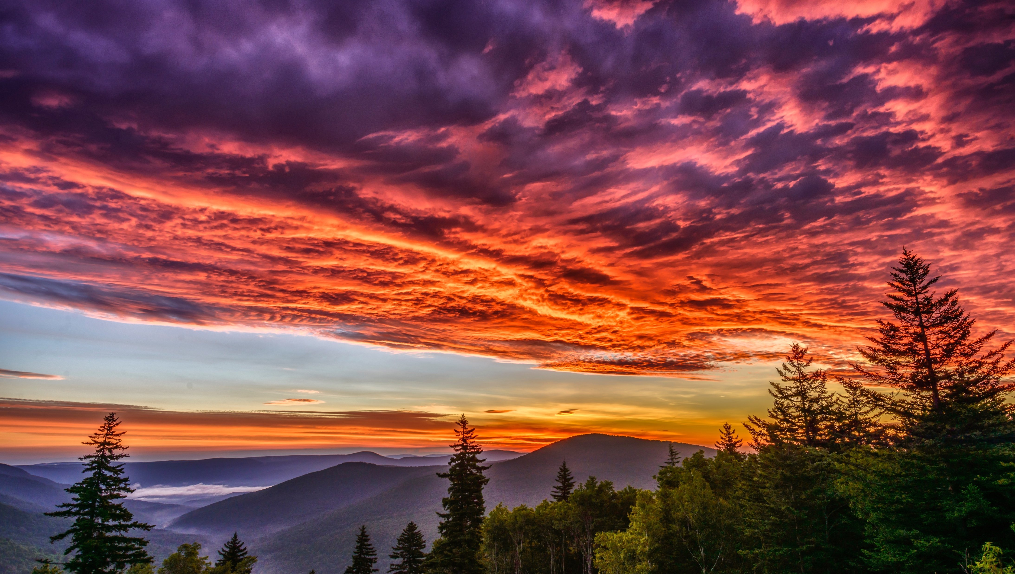
Image credits: Title slide, West Virginia State Capitol, Charleston, WV, ©Shutterstock; End slide, Williams River Valley Overlook, Black Mountain, Monongahela National Forest, West Virginia, ©Shutterstock.

