Slide 1


Smart Skills
Week 23
Art & Artifacts 5: 19th Century Artifact
Notes:
See the Smart Skills directions on the Teacher Tech Website for West Virginia: Our Beautiful Home for teaching suggestions.
Teacher notes and answers will display in this space.

Slide 2

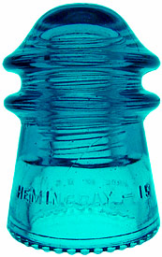
Monday
Study the picture. Make a list of as many observations of the artifact as you can.
Notes:
Answers will vary. Examples include: made of glass, blue color, ridges inside, hollow, bumps on bottom, letters on side, etc.
Allow students a brief time such as 1-2 minutes. Discuss only OBSERVATIONS.

Slide 3
TUESDAY
What might be the purpose of the artifact? Explain your thinking.
Notes:
Answers may vary.

Slide 4
WEDNESDAY
What has been added to the image? How does this information help you understand the artifact?
4 ¼ Inches
Notes:
An approximate measurement has been added. This helps explain the size of the object, for example, it’s something that could be held in a person’s hand.

Slide 5
THURSDAY
This object was made in the late 1870s. How does knowing the date help you consider why it was made?
Notes:
Answers will vary, but some students may have an idea of the object’s purpose based on their prior knowledge. The date provides a clue that it could be a part of some ‘new’ technology.

Slide 6
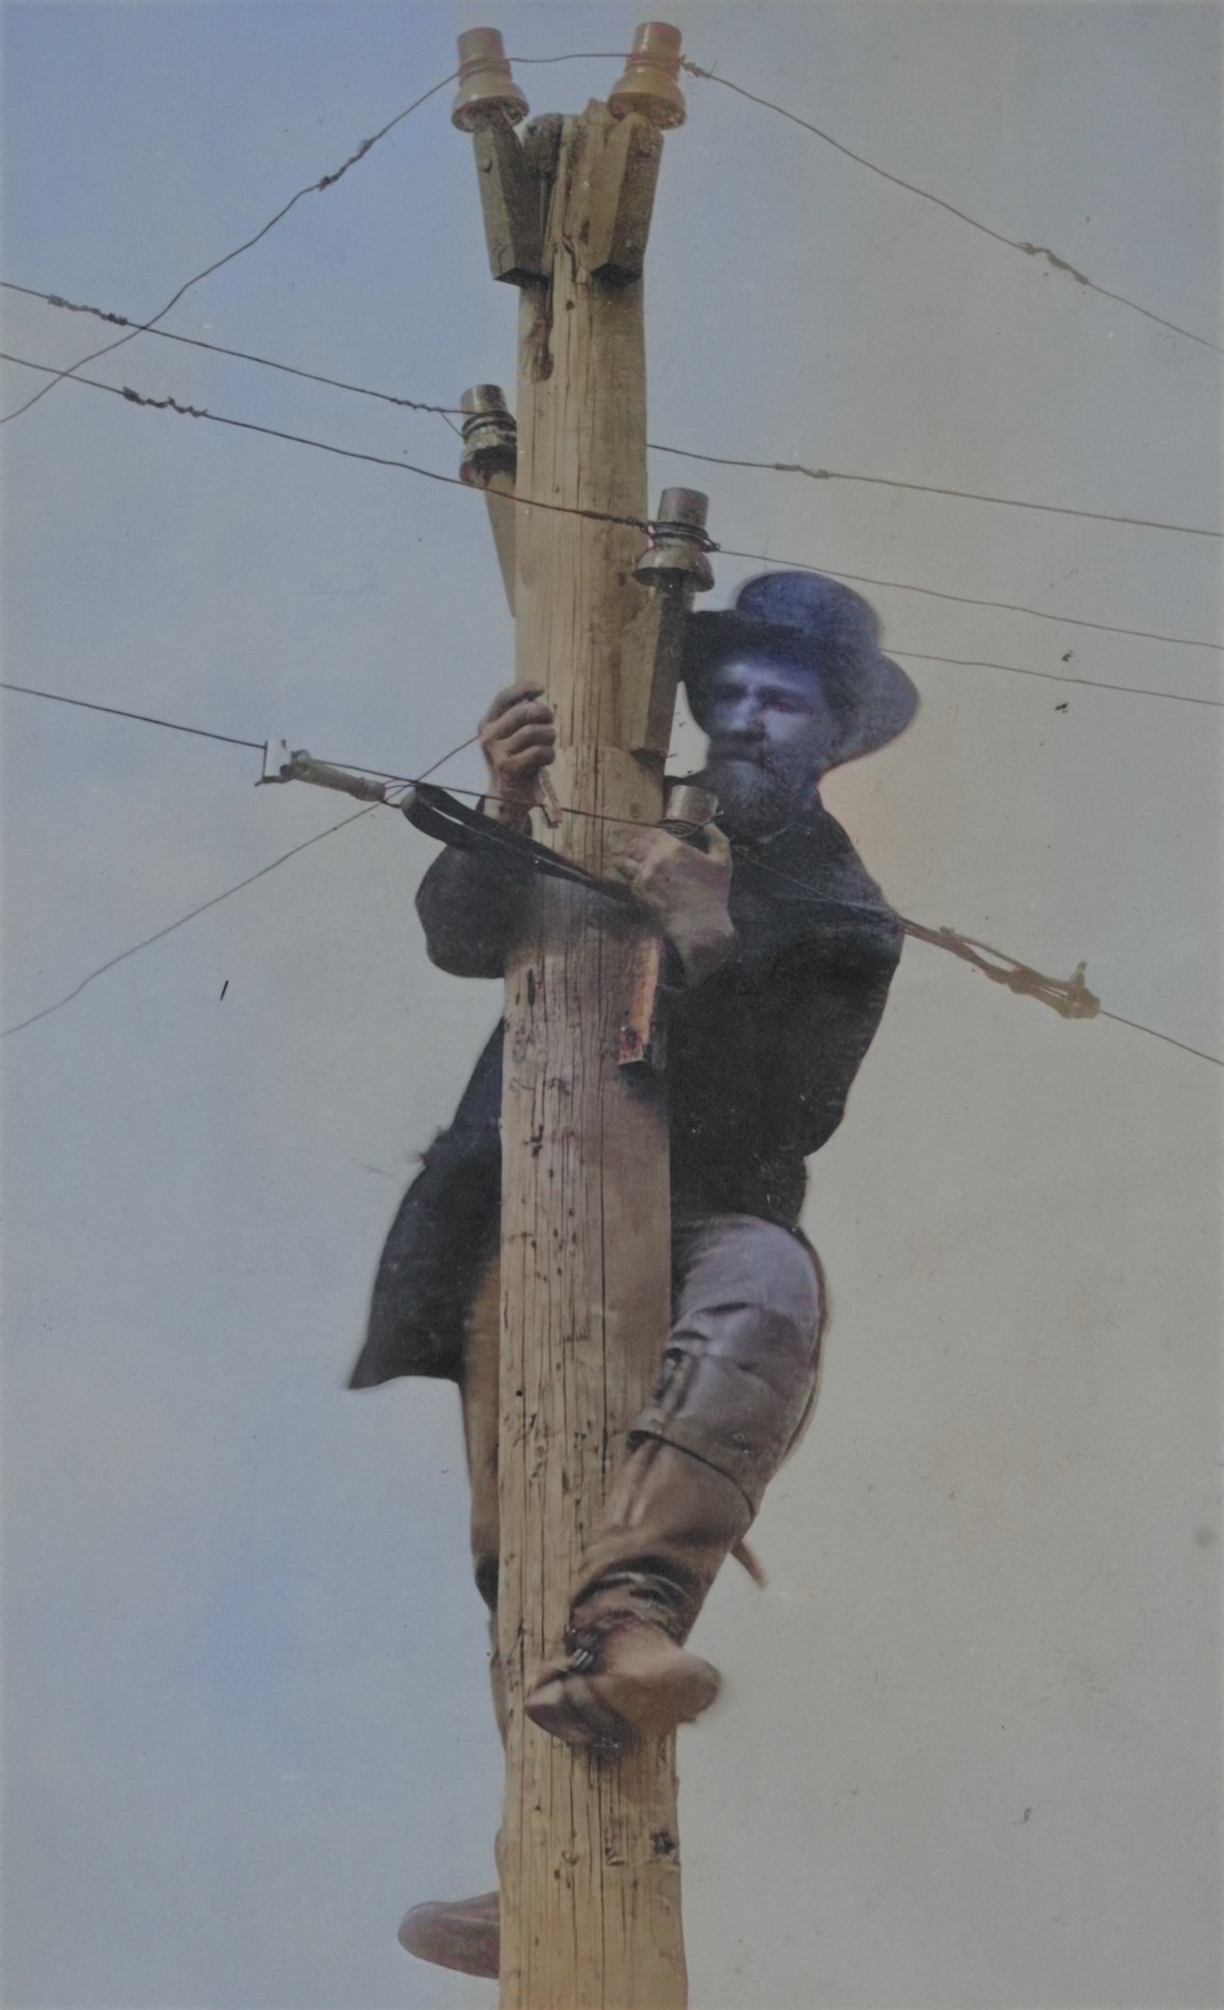
FRIDAY
The photo is from about 1870 and shows a man repairing a telegraph line. Notice the object in his hand and those on the pole. They are like this week’s artifact – a telegraph line insulator. What might be their purpose? Are similar objects used today? Explain your thinking.
Notes:
Answers will vary.
TEACHER’S NOTE: The object is an insulator for a telegraph line. Insulators are non-electrical conducting objects intended to insulate the current running in a wire from grounding out, especially in fog or rain. In the late 19th and early 20th century, such insulators were made of glass.

Slide 7
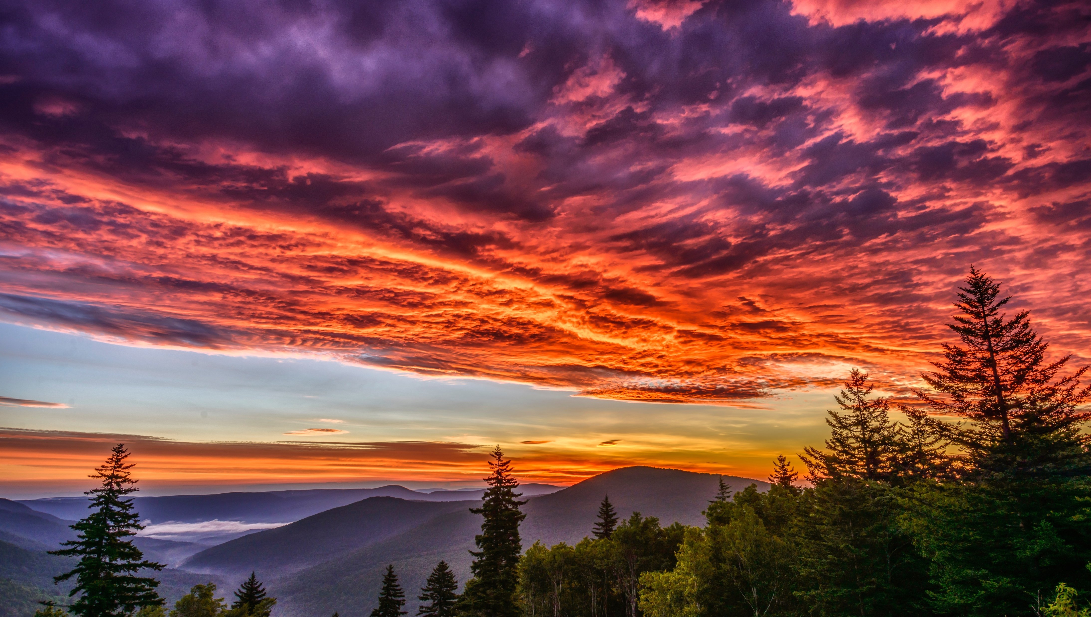
Image credits: Title slide, West Virginia State Capitol, Charleston, WV, ©Shutterstock; End slide, Williams River Valley Overlook, Black Mountain, Monongahela National Forest, West Virginia, ©Shutterstock.

