Slide 1
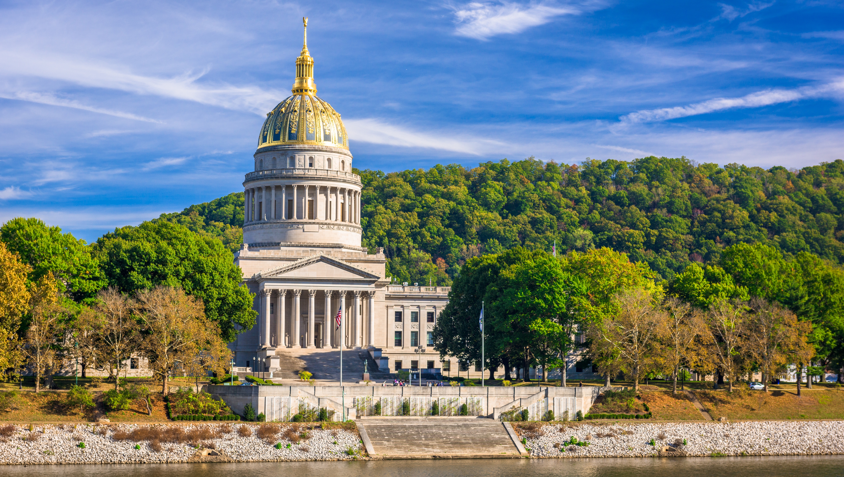

Smart Skills
Week 25
Political Cartoon 5:
Anti-Chinese Immigration
Notes:
See the Smart Skills directions on the Teacher Tech Website for West Virginia: Our Beautiful Home for teaching suggestions.
Teacher notes and answers will display in this space.

Slide 2

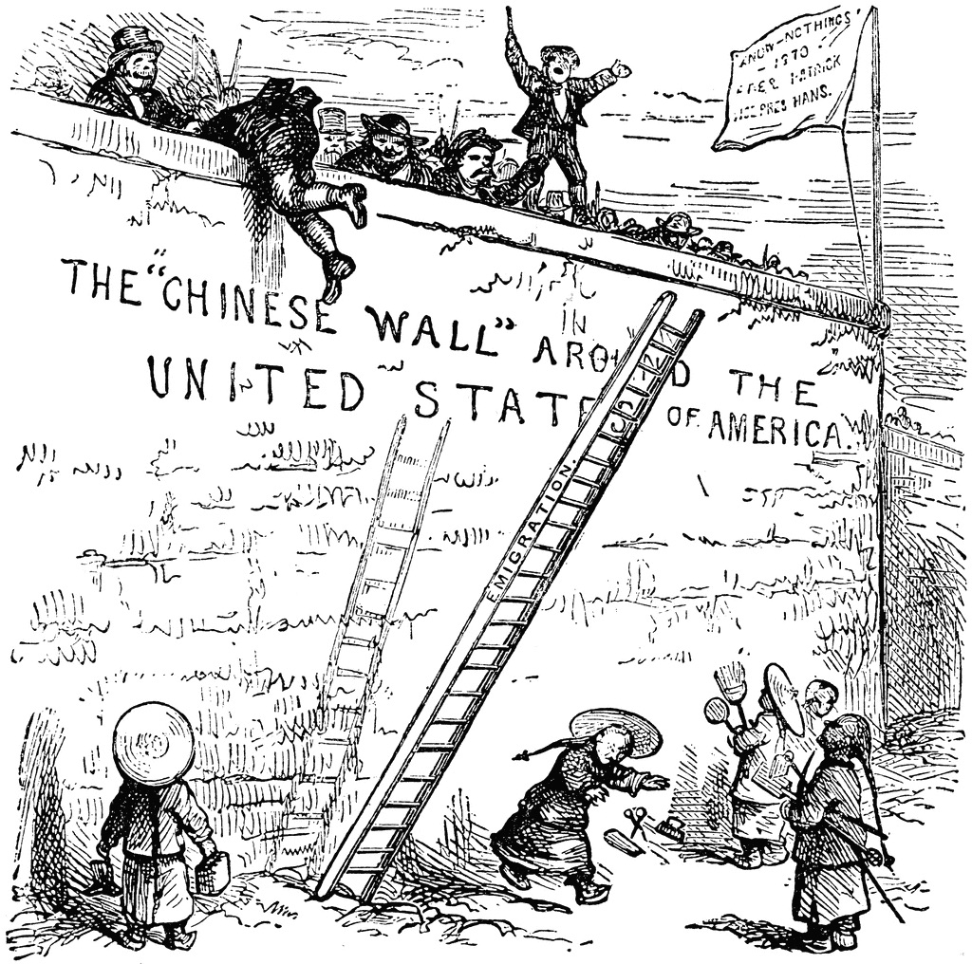
Monday
Study the political cartoon from 1870. Record your observations.
Notes:
Answers will vary. Focus the class discussion on observations only.
This opener lets students view the image without a specific question to answer. A one- or two-minute silent study helps students notice details they might miss otherwise. Discuss responses as a group, and let students physically point out their findings on the projection to ensure all students see the details being discussed.

Slide 3
TUESDAY
What symbols did the artist use, and what do they stand for?
Notes:
The people at the bottom of the wall are in traditional Chinese dress, symbolizing immigrants. The ladder symbolizes the path of immigrants to the United States. The flag is of the Know-Nothing party, which was known to favor policies against immigrants. The wall refers to the Great Wall of China, a symbol of that country. The immigrants are carrying the tools of laborers, symbolizing their willingness to work.

Slide 4
WEDNESDAY
How do the words used help the cartoonist convey his message?
Notes:
The words are needed to label the flag, the wall, and the ladder to help explain the cartoon's meaning. Note the “e” on “Emigration.” That shows that the ladder was for the Chinese on the ground level to climb into the United States.

Slide 5
THURSDAY
What is the location or setting of the cartoon?
Is it important to the message?
Notes:
The location is the border of the United States, but the reference is to the Great Wall of China, a geographic landmark of that country.
The wall’s location is essential to the message. The Great Wall was built to protect the Chinese from invaders. This cartoon implies that the Chinese are the invaders coming to the United States and must be pushed back.

Slide 6
FRIDAY
Who is the artist supporting with his message?
What evidence do you see to defend your thinking?
Notes:
Answers will differ. The artist supports Chinese immigrants. By showing men on the wall alongside the Know-Nothings, he suggests that the people on the wall believe they embody "true" American values and oppose immigrants, even though they or their ancestors were immigrants. The Chinese immigrants are depicted as eager to work.

Slide 7

Image credits: Title slide, West Virginia State Capitol, Charleston, WV, ©Shutterstock; End slide, Williams River Valley Overlook, Black Mountain, Monongahela National Forest, West Virginia, ©Shutterstock.

