Slide 1


Smart Skills
Week 26 Map 6: United States Map
Notes:
See the Smart Skills directions on the Teacher Tech Website for West Virginia: Our Beautiful Home for teaching suggestions.
Teacher notes and answers will display in this space.

Slide 2

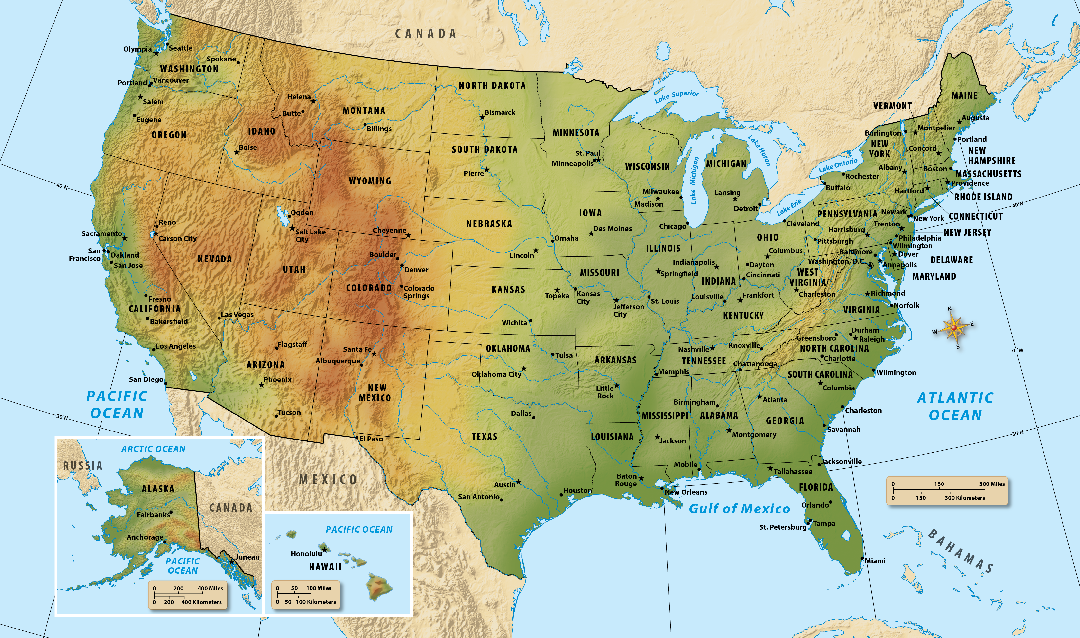
Monday
Study the map. What do you notice about it? In the time given by your teacher, jot down the things that you notice about the map.
Notes:
This opener allows students to view the map with no specific question to answer. Often, it is beneficial to study a map and its components before searching for a specific answer.
Allow at least one minute for students to silently study the map and create a jot list before discussing responses as a group.
Students may notice that this is a map of the United States, with states and their capitals identified. There is a compass rose. Students may notice that there are no physical features labeled, even though they are shown. There are lines of latitude and longitude.

Slide 3
TUESDAY
What do the dots and stars on the map represent?
Which of these symbols is used in West Virginia on the map?
What does it represent?
Notes:
Dots mark large cities; stars mark state capitals. The circled star marks the national capital, Washington, D.C.
star
The state capital, Charleston

Slide 4
WEDNESDAY
What states border West Virginia?
Which of the Great Lakes is closest to West Virginia?
Which of the Great Lakes is furthest from West Virginia?
Which ocean is closest to West Virginia?
Notes:
Ohio, Pennsylvania, Maryland, Virginia, Kentucky
Lake Erie
Lake Superior
Atlantic Ocean
Have students point out these locations on the map for the group as part of the discussion.

Slide 5
THURSDAY
Besides the United States, what countries are shown?
What is the purpose of the small (inset) maps in the bottom-left corner?
Notes:
Canada, Mexico, Russia, and the Bahamas. Note that Cuba is shown in the southeast corner of the map but is not labeled.
To show Alaska and Hawaii, which are states but are not contiguous with the other states.
Have different students point out the location of the countries.
Discuss the need for the inset maps in order to show Alaska and Hawaii. Ask why these states might have been shown in inset maps. Both states are non-contiguous, that is, they are not connected to the continuous landmass of the other 48 states and the District of Columbia.
It is difficult to show these two states on a map at the same scale as the contiguous states. The total landmass of Hawaii is slightly larger than that of Connecticut. However, if you overlaid maps of the same scale, the Hawaiian Islands would stretch from Houston, Texas, to San Francisco, California. The total landmass of Alaska is almost 2.5 times the size of Texas. An overlay of the maps would show Alaska and its islands stretching from about Savannah, Georgia to Los Angeles, California, and north to the Canadian border.

Slide 6
FRIDAY
If a person were to fly due south from Charleston, WV, to Cuba, what states would they fly over?
In which general direction is El Paso, TX, from Charleston, WV?
Notes:
West Virginia, Virginia, North Carolina, South Carolina, Georgia, Florida
southwest
If there is time, have students write a question that could be answered using information on the map. Have them share the question with an elbow partner and see if they agree on the answer. Allow time for students to share their questions with the larger group.

Slide 7

Image credits: Title slide, West Virginia State Capitol, Charleston, WV, ©Shutterstock; End slide, Williams River Valley Overlook, Black Mountain, Monongahela National Forest, West Virginia, ©Shutterstock.

