Slide 1
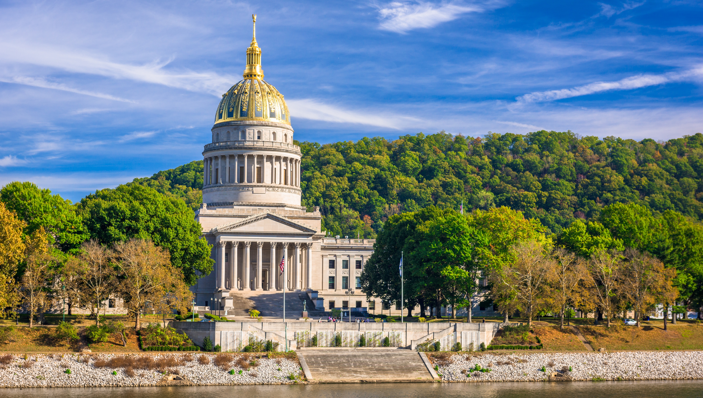

Smart Skills
Week 28
Art & Artifacts 6:
1908 Photograph
Notes:
See the Smart Skills directions on the Teacher Tech Website for West Virginia: Our Beautiful Home for teaching suggestions.
Teacher notes and answers will display in this space.

Slide 2

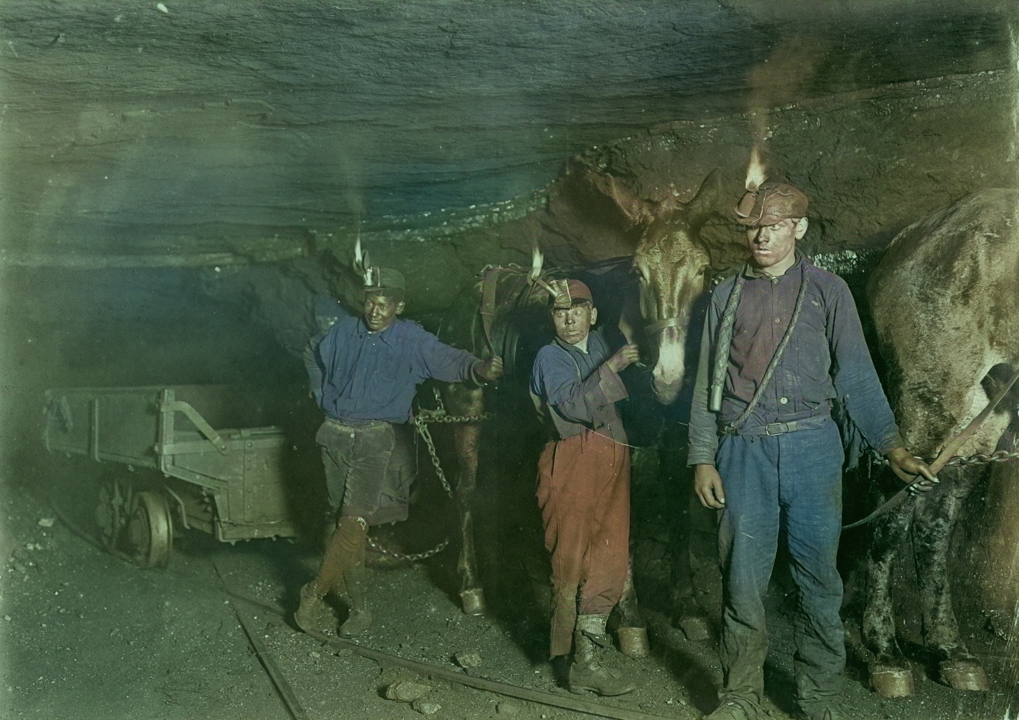
Monday
Study the picture. What do you notice? Record observations only.
Notes:
Answers will vary. Discuss only observations.
TEACHER’S NOTE: This photograph is from 1908 and has been colorized. The three boys worked in a coal mine in Gary, West Virginia.

Slide 3
TUESDAY
What objects do you notice?
What might be their purpose?
Notes:
Answers will vary.
During the class discussion, encourage students to explain their thinking regarding an object’s purpose.

Slide 4
WEDNESDAY
Where do you think this photograph was taken?
What evidence do you have to support your thinking?
Notes:
Answers will vary. The location is a coal mine in West Virginia. Students should use evidence from the image to support their thinking, even if their current guess about the location is incorrect.

Slide 5
THURSDAY
Why do you think these boys are in this location? Explain your thinking.
Notes:
Answers will vary, but some students may have an idea that the boys are a part of the labor force for the mine.

Slide 6
FRIDAY
The photographer, Lewis Wickes Hine, took this photo in 1908.
What might have drawn him to these boys in this place?
Notes:
Answers will vary. It is possible that Hines sought to draw attention to the issue of child labor in the early 20th century.

Slide 7
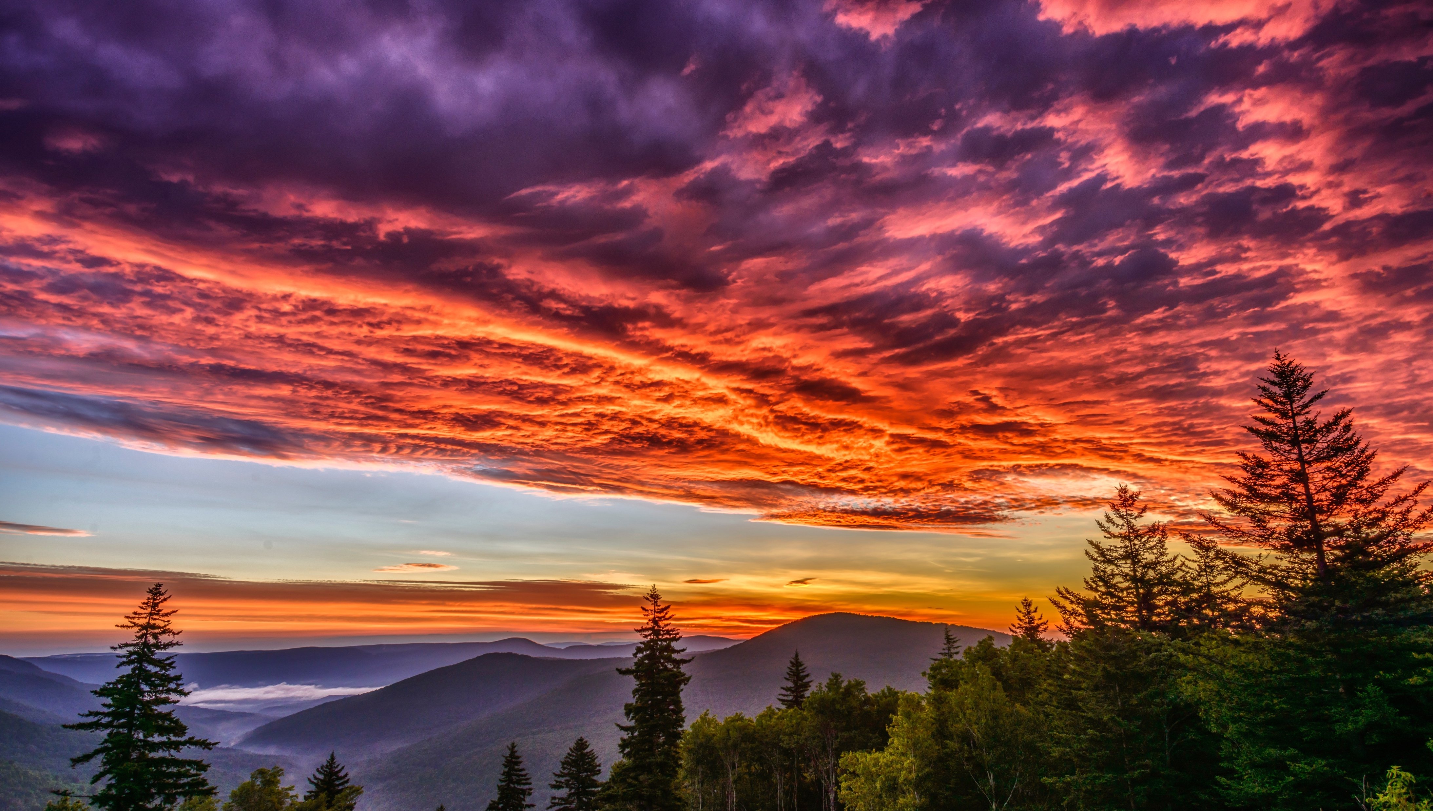
Image credits: Title slide, West Virginia State Capitol, Charleston, WV, ©Shutterstock; End slide, Williams River Valley Overlook, Black Mountain, Monongahela National Forest, West Virginia, ©Shutterstock.

