Slide 1


Smart Skills
Week 29
Timeline 6:
Conflicts in Southwest Asia
(Middle East)
Notes:
See the Smart Skills directions on the Teacher Tech Website for West Virginia: Our Beautiful Home for teaching suggestions.
Teacher notes and answers will display in this space.

Slide 2

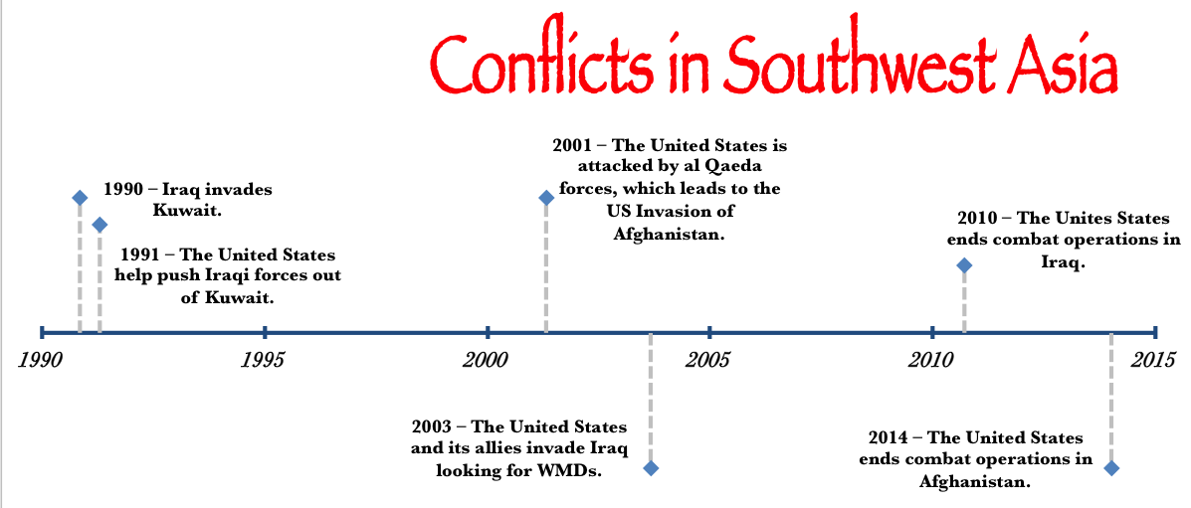
Monday
Study the graphic. Create a jot list of your observations.
Notes:
Allow students 1-2 minutes to record observations. Discuss only what students have noticed from the timeline.

Slide 3
TUESDAY
What is the first event in the timeline?
How long after Iraq invaded Kuwait did the U.S. help push the Iraqis out?
How long after Iraqis were pushed out of Kuwait was it until al Qaeda attacked the U.S. on September 11, 2001?
Notes:
Iraq invades Kuwait (1990)
one year
ten years

Slide 4
WEDNESDAY
According to the timeline, what were the reasons given for U.S. military actions?
Notes:
Iraq invaded Kuwait; invaded Iraq looking for weapons of mass destruction (WMDs); the U.S. was attacked on 9/11/2001 which led to the invasion of Afghanistan

Slide 5
THURSDAY
According to the timeline, which military action lasted the longest?
Notes:
The United States’ Invasion of Afghanistan was the longest.

Slide 6
FRIDAY
What is a question that could be answered using the timeline? Share your question with another student. Agree upon the correct answer.
Notes:
Answers will vary; you may want to use some of the questions and answers for class discussion.

Slide 7

Image credits: Title slide, West Virginia State Capitol, Charleston, WV, ©Shutterstock; End slide, Williams River Valley Overlook, Black Mountain, Monongahela National Forest, West Virginia, ©Shutterstock.

