Slide 1
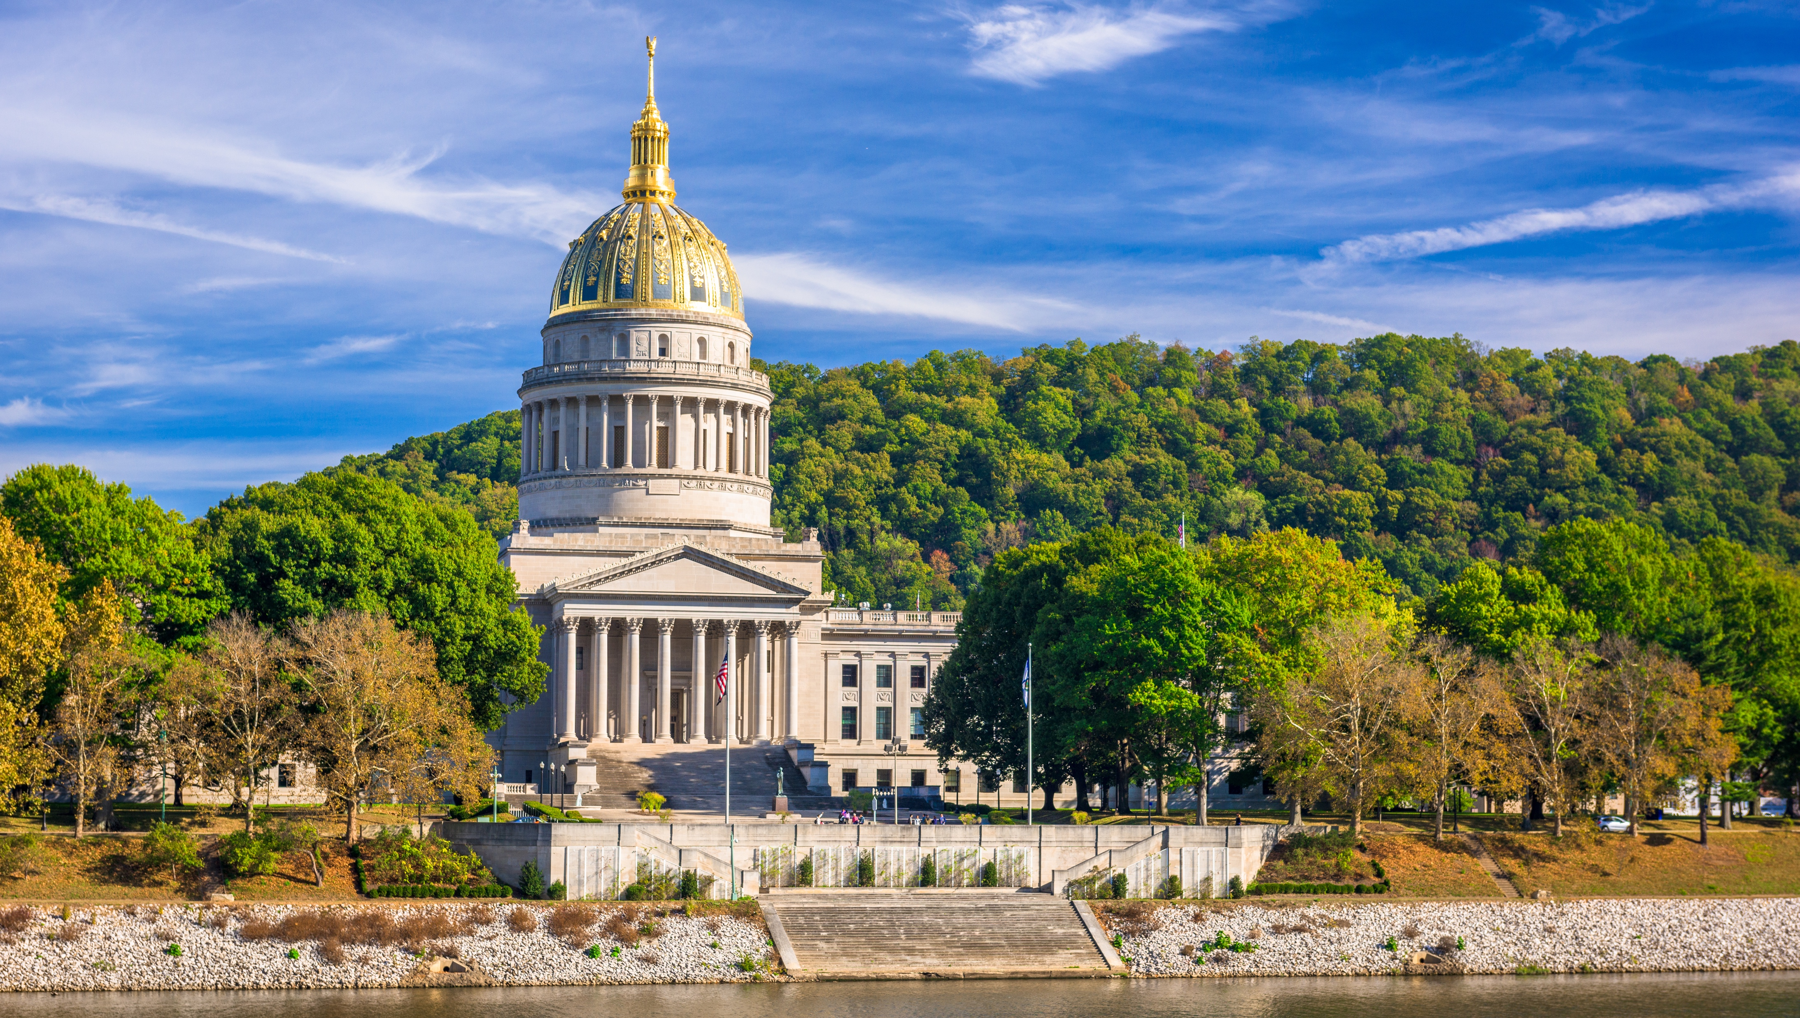

Smart Skills
Week 30
Political Cartoon 6: School Desegregation
Notes:
See the Smart Skills directions on the Teacher Tech Website for West Virginia: Our Beautiful Home for teaching suggestions.
Teacher notes and answers will display in this space.

Slide 2

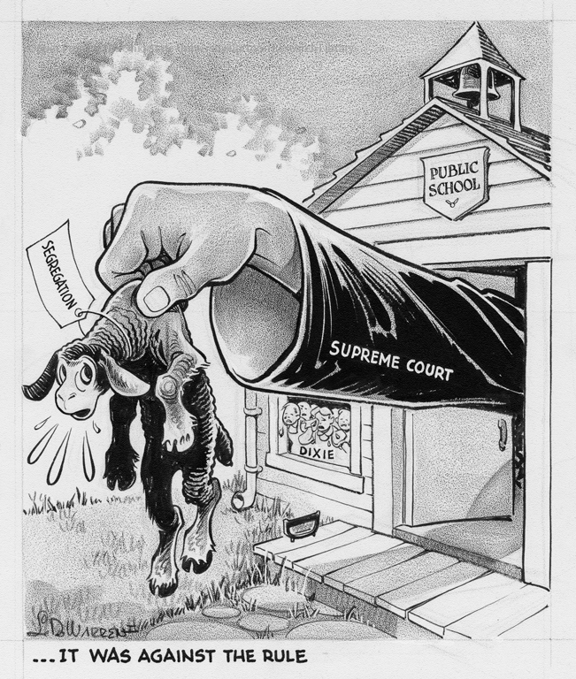
Monday
Study the political cartoon from 1954.
Record your observations.
Source: http://cartoons.osu.edu/
Notes:
Answers will vary. Discuss observations as a class.
TEACHER NOTE: This opener lets students view the image without a specific question to answer. A one- or two-minute silent study helps students notice details they might miss otherwise. Discuss responses as a group, and let students physically point out their findings on the projection to ensure all students see the details being discussed.

Slide 3
TUESDAY
What symbols did the cartoonist use, and what do they stand for?
Source: http://cartoons.osu.edu/
Notes:
Answers will vary.

Slide 4
WEDNESDAY
What is the meaning of the quote at the bottom of the image?
How does it relate to the other words in the image?
Source: http://cartoons.osu.edu/
Notes:
The three dots show that the words are a part of a longer sentence. In this case, the nursery rhyme “Mary Had a Little Lamb.” The lamb is named ”Segregation” and the Supreme Court is removing it from the Public School. The Dixie children are shown as unhappy to see it leave.
TEACHER NOTE: The first stanza of the 1830 nursery rhyme contains the lines, “He (Mary’s lamb) followed her to school one day, That was against the rule.”
Some students may not be familiar with the nursery rhyme. This presents one of the challenges for political cartoonists, because their representations rely on background knowledge that the viewer might not have. Here is the first stanza of the nursery rhyme.
MARY’S LAMB Mary had a little lamb, Its fleece was white as snow. And everywhere that Mary went, The lamb was sure to go. He followed her to school one day, That was against the rule. It made the children laugh and play To see a lamb at school.

Slide 5
THURSDAY
What is the location, or setting, of the cartoon?
Is it important to the message?
Source: http://cartoons.osu.edu/
Notes:
The setting is a small, one-room schoolhouse.
It is important to the cartoon since the Supreme Court’s Brown v. Board of Education ruling related to schools.

Slide 6
FRIDAY
Does the artist support the court’s decision?
What evidence do you see to defend your thinking?
Source: http://cartoons.osu.edu/
Notes:
Answers will vary.
The Dixie children are visibly upset, and the lamb looks surprised. But the strong arm of the Supreme Court is prevailing. There is nothing in the drawing to suggest the Court is the bad guy. The court is seen as setting things right. Dixie is depicted as an immature child.

Slide 7
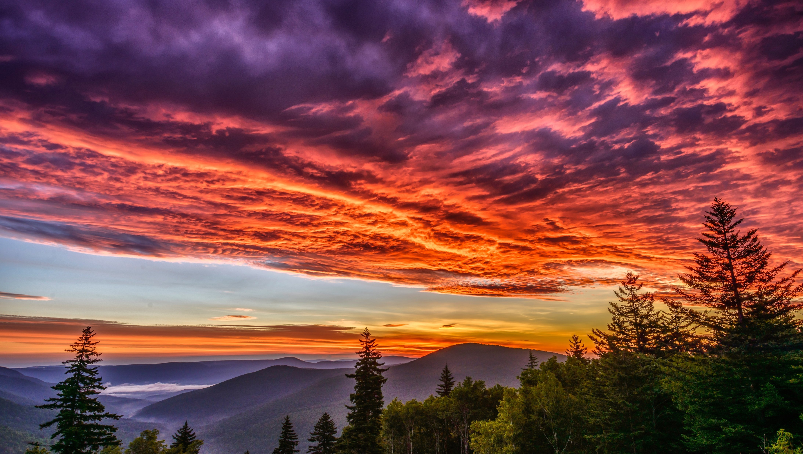
Image credits: Title slide, West Virginia State Capitol, Charleston, WV, ©Shutterstock; End slide, Williams River Valley Overlook, Black Mountain, Monongahela National Forest, West Virginia, ©Shutterstock.

