Slide 1


Smart Skills
Week 35
Political Cartoon 7: Draft Dodgers
Notes:
See the Smart Skills directions on the Teacher Tech Website for West Virginia: Our Beautiful Home for teaching suggestions.
Teacher notes and answers will display in this space.

Slide 2

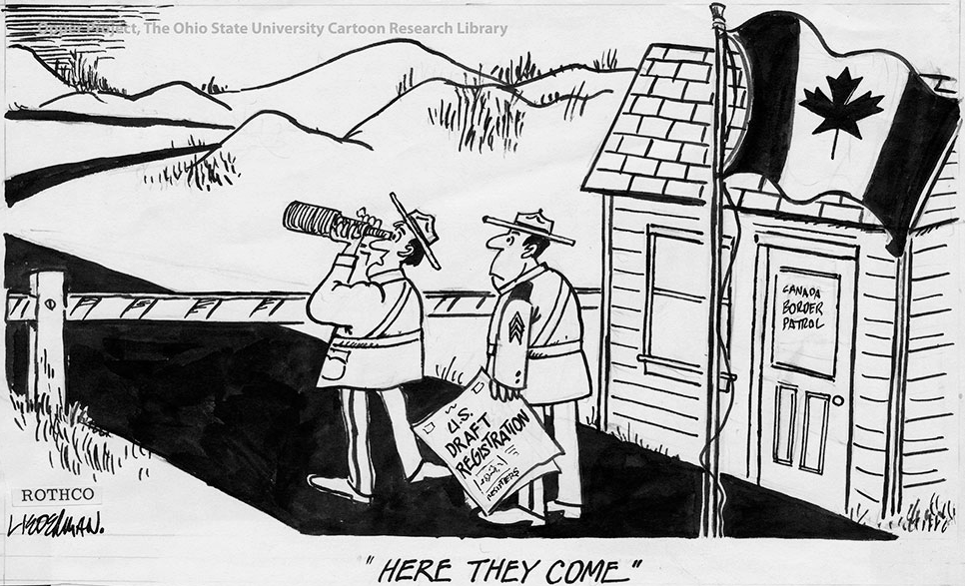
Monday
Study the political cartoon from the 1960s. Record your observations.
Source: http://cartoons.osu.edu/
Notes:
Answers will vary. Discuss observations as a group.
TEACHER NOTE: This opener lets students view the image without a specific question to answer. A one- or two-minute silent study helps students notice details they might miss otherwise. Discuss responses as a group, and let students physically point out their findings on the projection to ensure all students see the details being discussed.

Slide 3
TUESDAY
What symbols did the cartoonist use, and what do they stand for?
Source: http://cartoons.osu.edu/
Notes:
Examples: The flag of Canada symbolizes that country. The small building and gate symbolize the border between Canada and the United States. The telescope symbolizes seeing something in the distance.

Slide 4
WEDNESDAY
How do the words used help the cartoonist convey his message?
Source: http://cartoons.osu.edu/
Notes:
Sample ideas: The newspaper headline highlights the topic of activating the Selective Service (draft) system for the Vietnam War. The words on the door of the building help to provide a location. The quote refers to men who attempted to evade conscription by fleeing to Canada from the United States.

Slide 5
THURSDAY
What is the location, or setting, of the cartoon?
Is it important to the message?
Source: http://cartoons.osu.edu/
Notes:
The flag and border patrol office symbolize the Canadian side of the border.
Since people opposing the draft crossed the border into Canada, the location of the cartoon is important to the cartoon’s message.

Slide 6
FRIDAY
Who is the artist supporting with his message?
What evidence do you see to defend your thinking?
Source: http://cartoons.osu.edu/
Notes:
Answers will vary.
The cartoonist doesn’t seem to convey a particular viewpoint on the “draft dodgers” or the war. He predicts that, due to the draft, people will attempt to leave the United States. It also seems that there is no strong barrier to keep the draft dodgers out of Canada, so they’ll be able to enter easily.

Slide 7

Image credits: Title slide, West Virginia State Capitol, Charleston, WV, ©Shutterstock; End slide, Williams River Valley Overlook, Black Mountain, Monongahela National Forest, West Virginia, ©Shutterstock.

