Slide 1


Smart Skills
Week 4
Timeline 1: Colonial Era 1625-1750
Notes:
See the Smart Skills directions on the Teacher Tech Website for West Virginia: Our Beautiful Home for teaching suggestions.
Teacher notes and answers will display in this space.

Slide 2

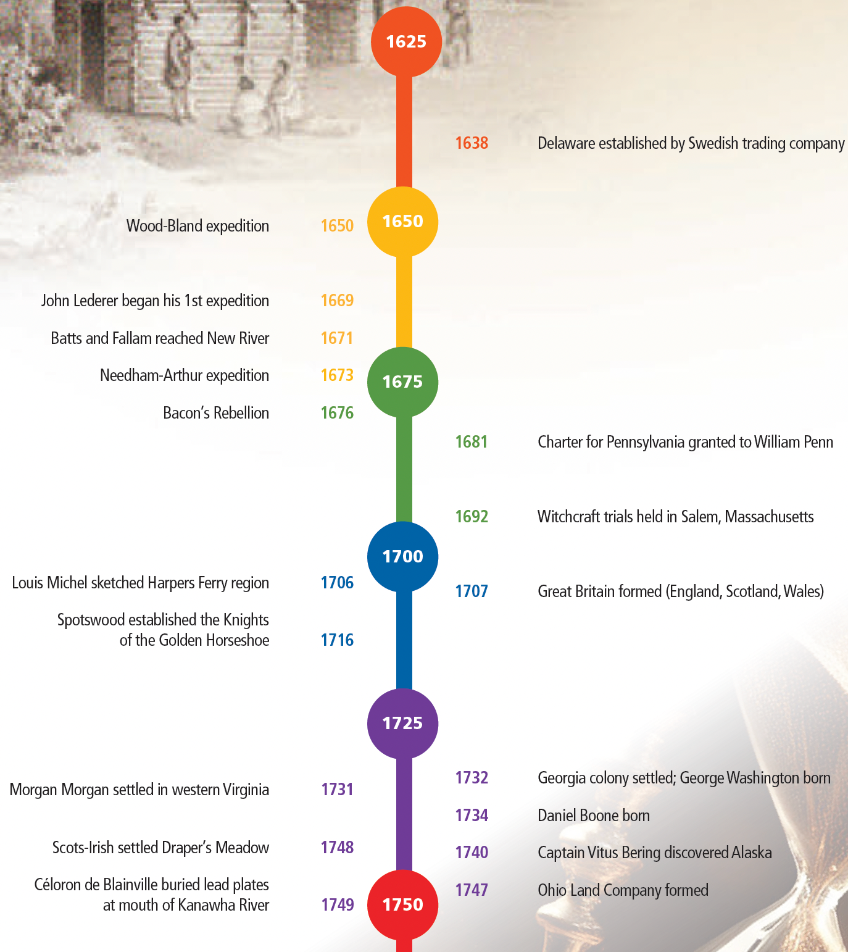
Monday
Study the timeline. Create a jot list of things that you observe.
Notes:
Answers will vary.
TEACHER NOTE: This opener lets students view the image without a specific question to answer. A one- or two-minute silent study helps students notice details they might miss otherwise. Discuss responses as a group, and let students physically point out their findings on the projection to ensure all students see the details being discussed. The timeline is from their textbook, page 301.

Slide 3
TUESDAY
What years are included?
What is the basic purpose of the timeline?
What would need to be added to include “Founding of Virginia” in 1607?
Notes:
The date range is 1625 to 1750.
To show events in colonial history from 1625 to 1750.
The timeline would have to have more space at the top and add a 1600 “bubble.” An event near the top would be needed for Founding of Virginia in 1607.

Slide 4
WEDNESDAY
How many years passed between the founding of Delaware and the founding of Georgia?
A student claims that George Washington was present at the founding of the Pennsylvania colony. What evidence is there to support or dispute the claim?
How many years passed after Batts and Fallam reached New River, did Morgan Morgan settle in western Virginia?
Notes:
94 years
George Washington was born in 1732, which is 51 years after the charter was granted for Pennsylvania.
60 years

Slide 5
THURSDAY
Write a question that could be answered using the timeline. Have another student answer the question, then check their answer. Agree on the correct answer.
Notes:
Answers will vary. Use some students’ responses for class discussion.

Slide 6
FRIDAY
How would you change this timeline to make it more effective or informative?
Notes:
Answers will vary. Students may suggest a longer timeline, incorporating key events. They may indicate that different colors would be more effective. A descriptive title might help users, etc.

Slide 7
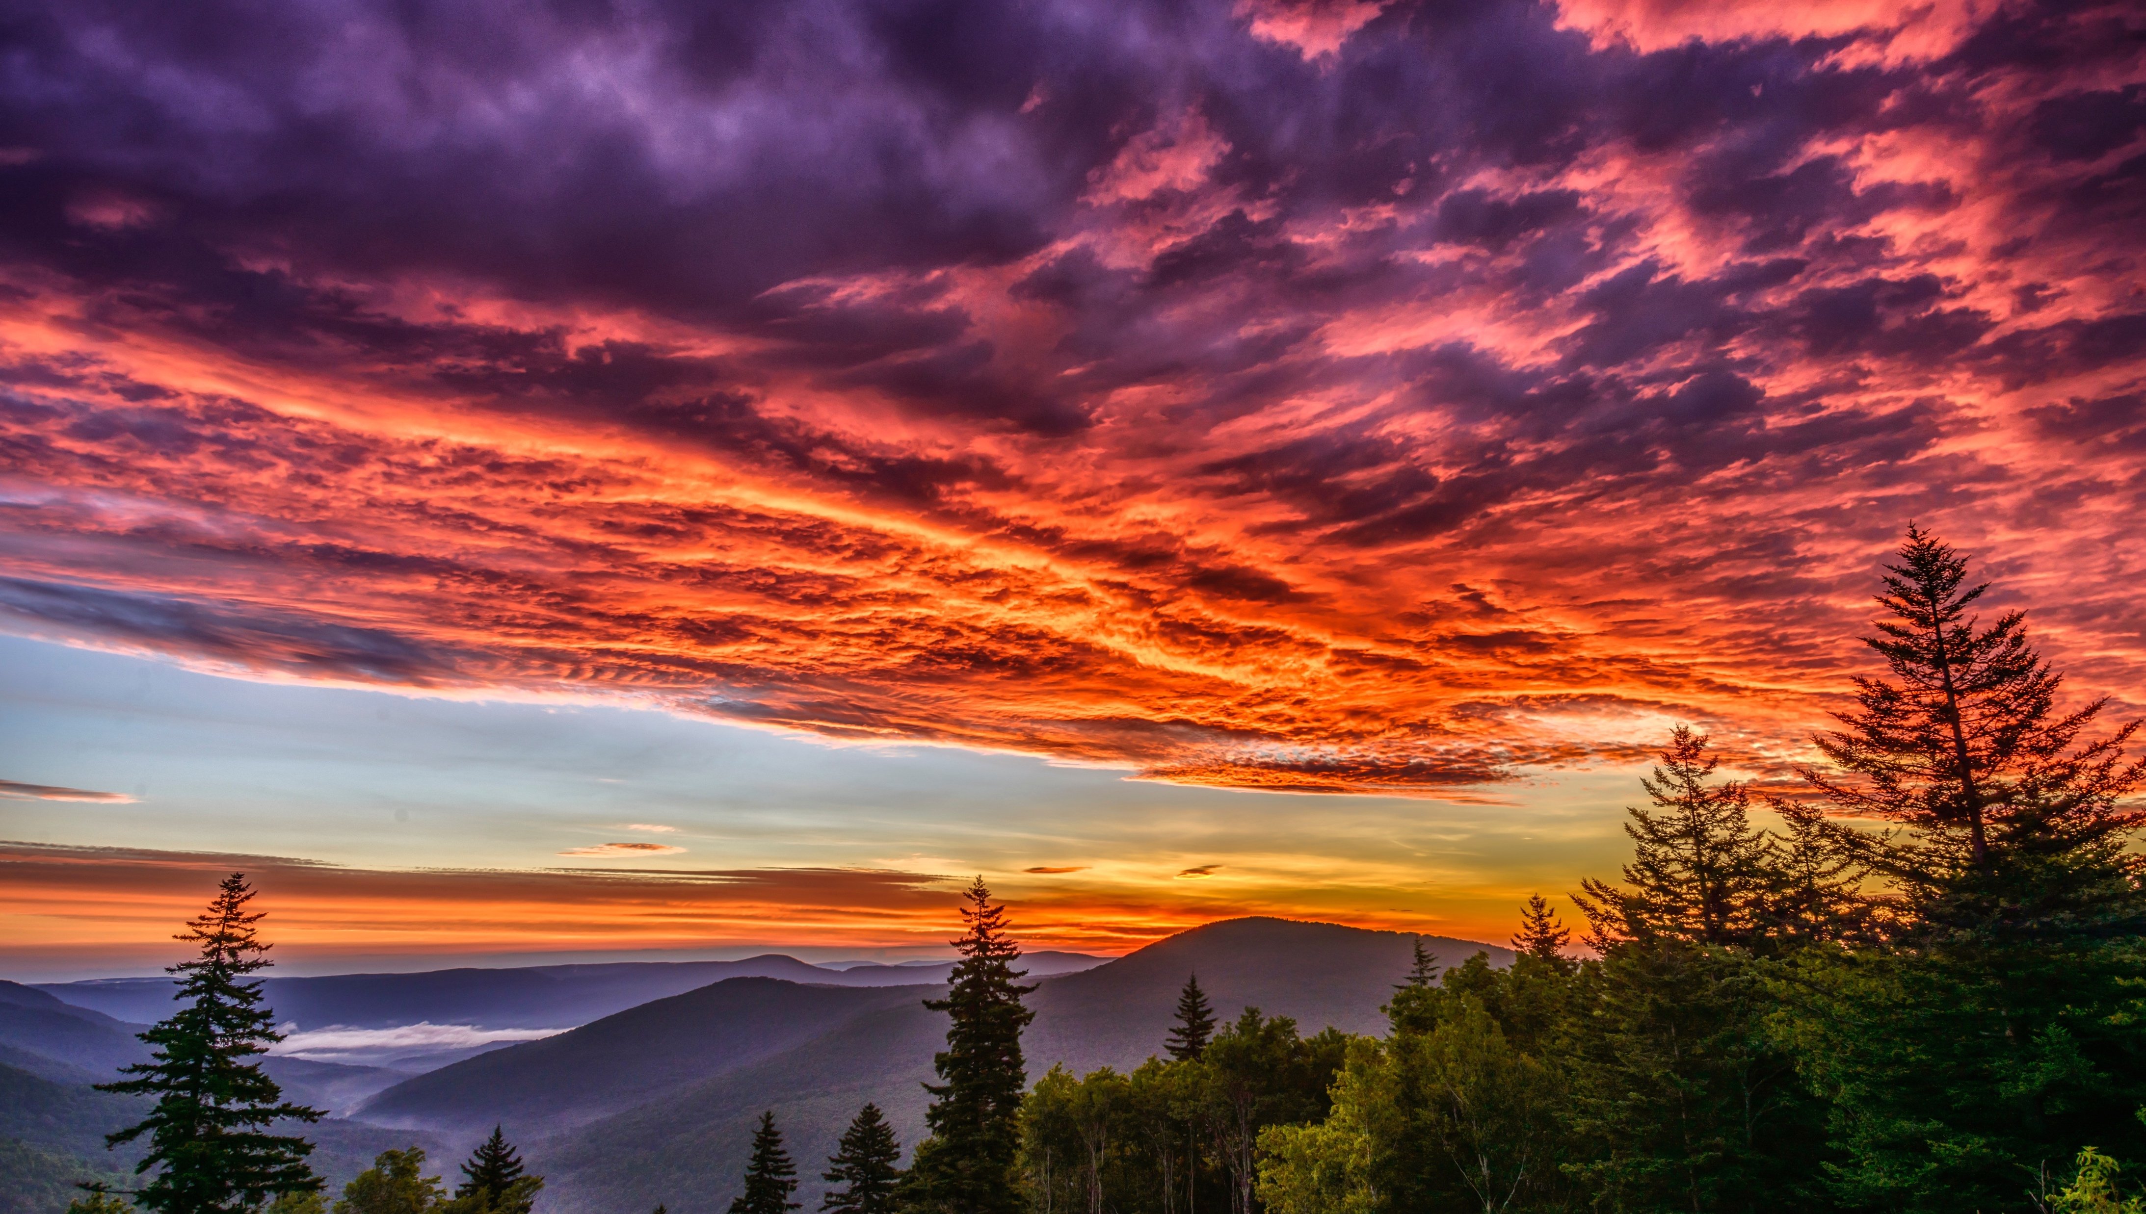
Image credits: Title slide, West Virginia State Capitol, Charleston, WV, ©Shutterstock; End slide, Williams River Valley Overlook, Black Mountain, Monongahela National Forest, West Virginia, ©Shutterstock.

